Slide 1
Chapter 8:
Strings
Problem Solving & Program Design in C
Seventh Edition
By Jeri R. Hanly &
Elliot B. Koffman

Slide 2
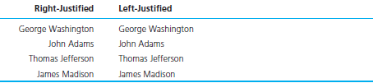
Figure 8.1 Right and Left Justification of Strings
1-<number>

Slide 3
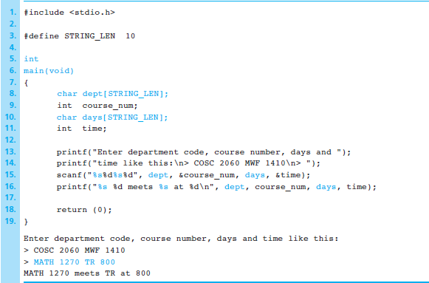
Figure 8.2 String Input/Output with scanf and printf
1-<number>

Slide 4
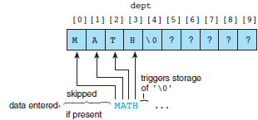
Figure 8.3 Execution of scanf (“%s”, dept);
1-<number>

Slide 5

Figure 8.4 Execution of scanf (“%s%d%s%d”, dept, &course_num, days, &time); on Entry of Invalid Data
1-<number>

Slide 6
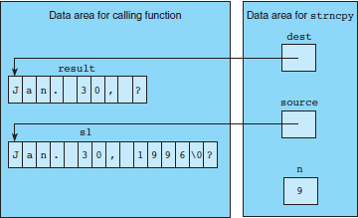
Figure 8.5 Execution of strncpy (result, s1, 9)
1-<number>

Slide 7
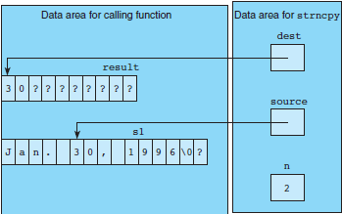
Figure 8.6 Execution of strncpy (result, &s1[5], 2)
1-<number>

Slide 8
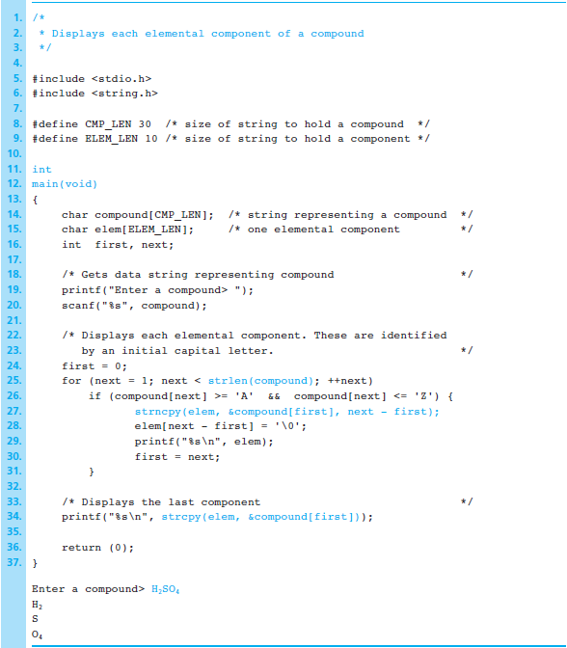
Figure 8.7
Program Using strncpy and strcpy
Functions to Separate Compounds into
Elemental Components
1-<number>

Slide 9
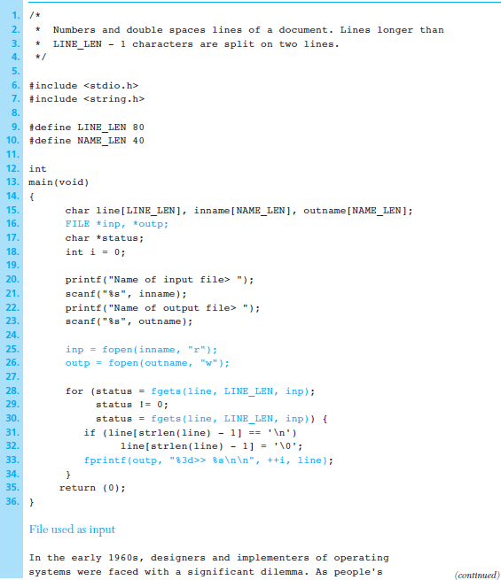
Figure 8.8
Demonstration of Whole-Line
Input
1-<number>

Slide 10
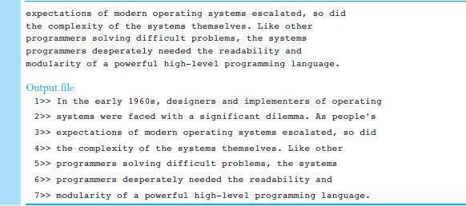
Figure 8.8 Demonstration of Whole-Line Input (cont'd)
1-<number>

Slide 11
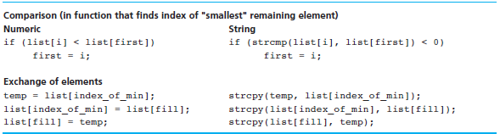
Figure 8.9 Numeric and String Versions of Portions of Selection Sort That Compare and Exchange Elements
1-<number>

Slide 12
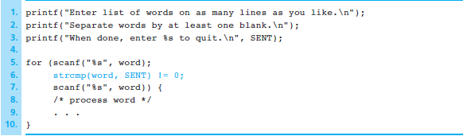
Figure 8.10 Sentinel-Controlled Loop for String Input
1-<number>

Slide 13

Figure 8.11 Exchange String Elements of an Array
1-<number>

Slide 14
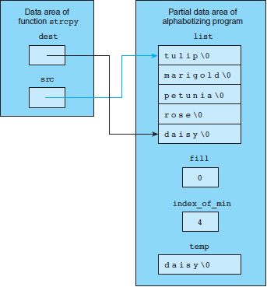
Figure 8.12
Executing strcpy (list
[index_of_min], list[fill]);
1-<number>

Slide 15
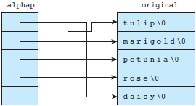
Figure 8.13 An Array of Pointers
1-<number>

Slide 16
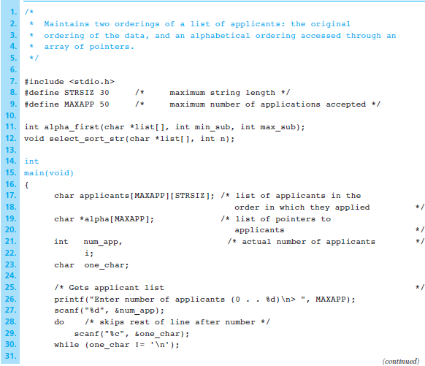
Figure 8.14
Two Orderings of One List
Using an Array of Pointers
1-<number>

Slide 17
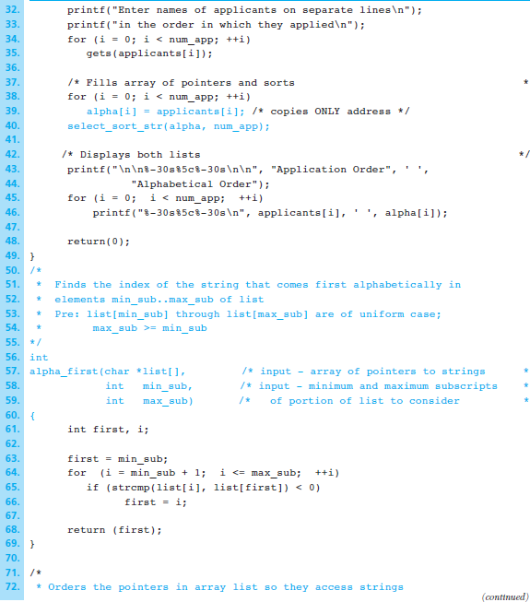
Figure 8.14
Two Orderings of One List
Using an Array of Pointers
(cont’d)
1-<number>

Slide 18
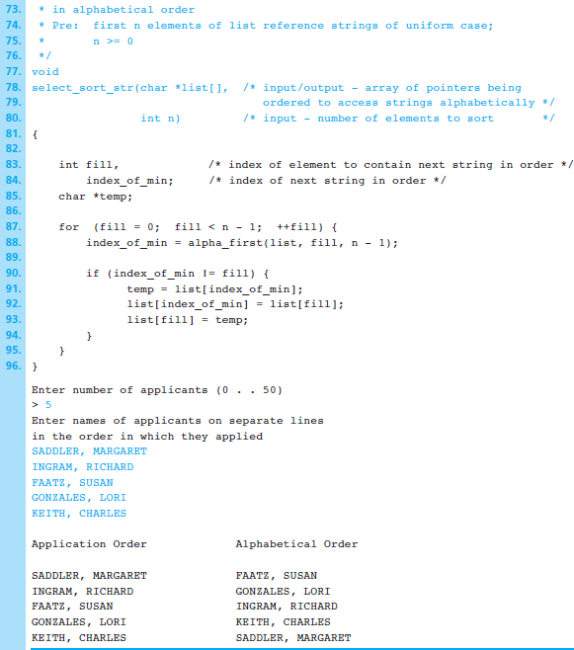
Figure 8.14
Two Orderings of One List
Using an Array of Pointers
(cont’d)
1-<number>

Slide 19
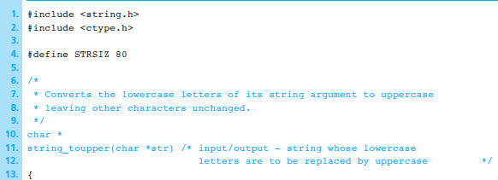
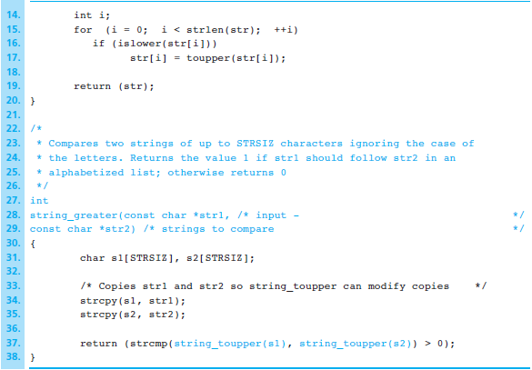
Figure 8.16
String Function for a Greater-Than
Operator That
Ignores Case
1-<number>

Slide 20
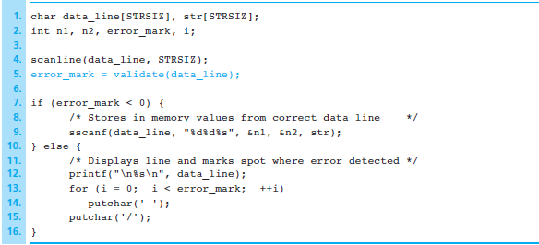
Figure 8.17 Program Segment That Validates Input Line Before Storing Data Values
1-<number>

Slide 21
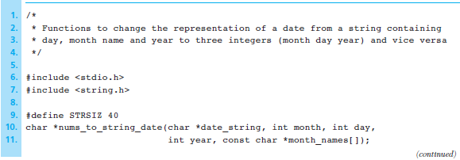
Figure 8.18 Functions That Convert Representations of Dates
1-<number>

Slide 22
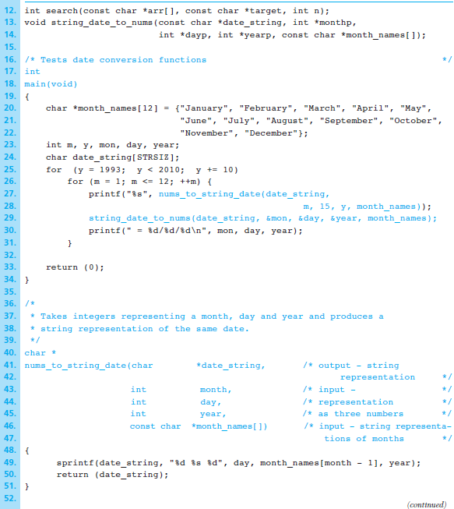
Figure 8.18 Functions That Convert Representations of Dates
(cont’d)
1-<number>

Slide 23
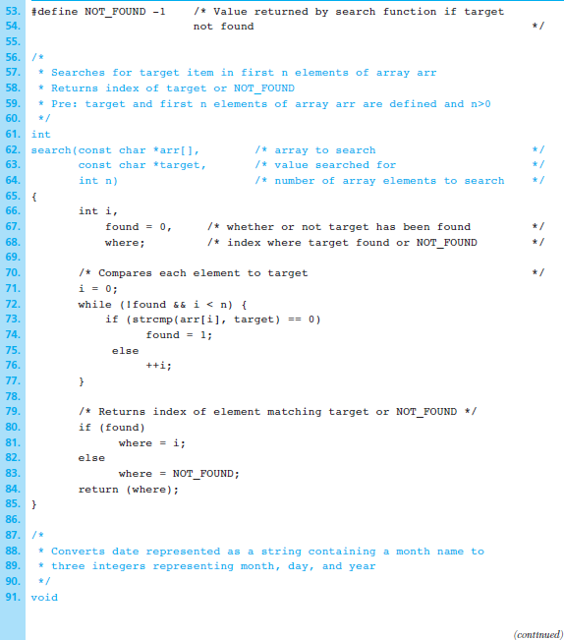
Figure 8.18 Functions That Convert Representations of Dates
(cont’d)
1-<number>

Slide 24
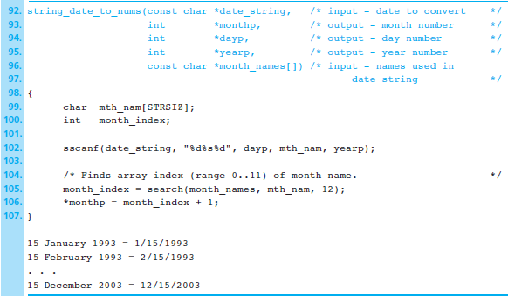
Figure 8.18 Functions That Convert Representations of Dates
(cont’d)
1-<number>

Slide 25
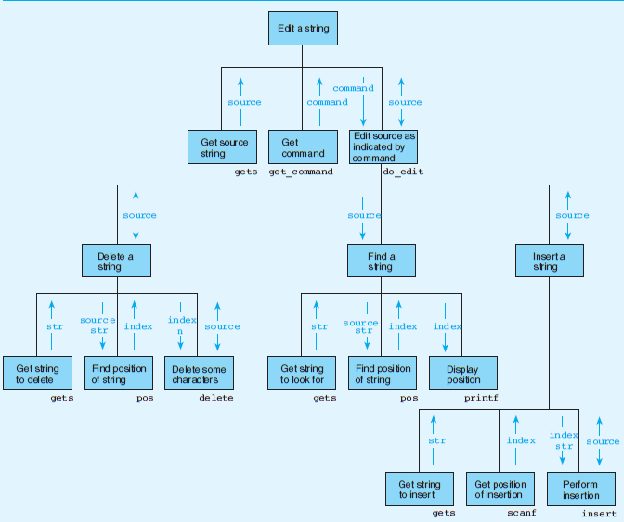
Figure 8.19 Structure Chart for Text Editor Program
1-<number>

Slide 26
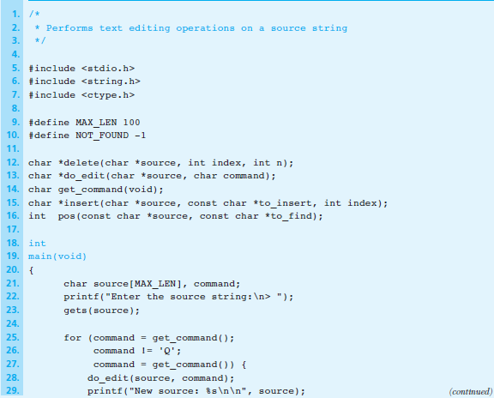
Figure 8.20
Text Editor
Program
1-<number>

Slide 27
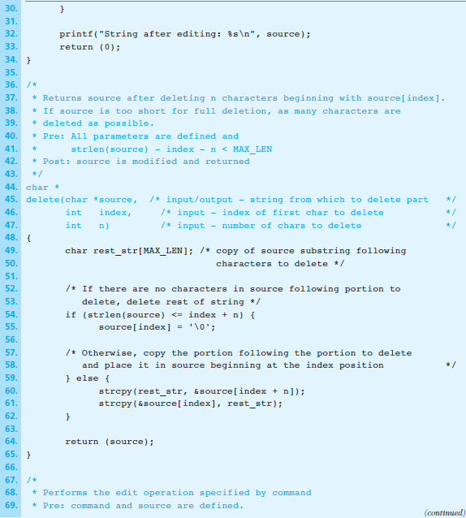
Figure 8.20
Text Editor
Program
(cont’d)
1-<number>

Slide 28
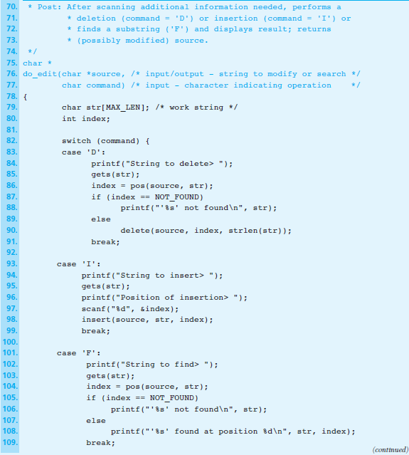
Figure 8.20
Text Editor
Program
(cont’d)
1-<number>

Slide 29
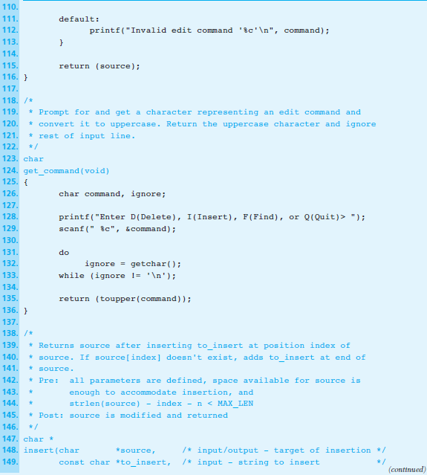
Figure 8.20
Text Editor
Program
(cont’d)
1-<number>

Slide 30
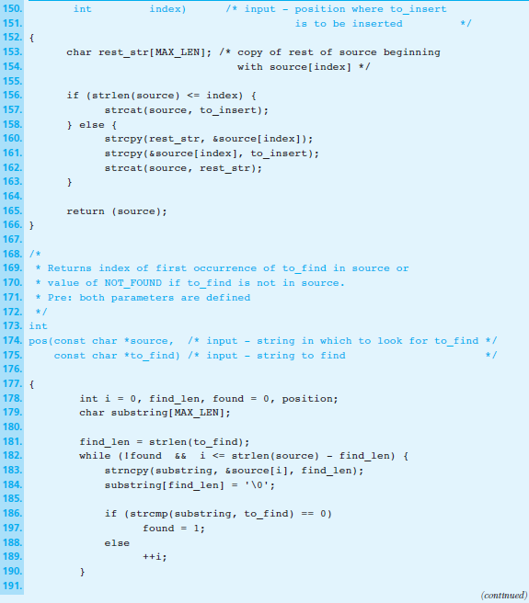
Figure 8.20
Text Editor
Program
(cont’d)
1-<number>

Slide 31
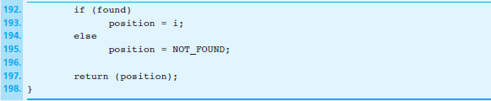
Figure 8.20
Text Editor
Program
(cont’d)
1-<number>

Slide 32
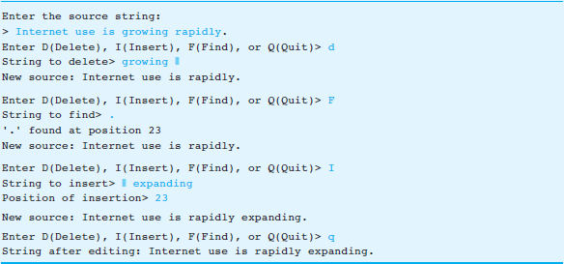
Figure 8.21
Sample Run of
Text Editor
Program
1-<number>

