Slide 1
Chapter 1:
Overview of Computers and Programming
Problem Solving & Program Design in C
Seventh Edition
By Jeri R. Hanly &
Elliot B. Koffman

Slide 2
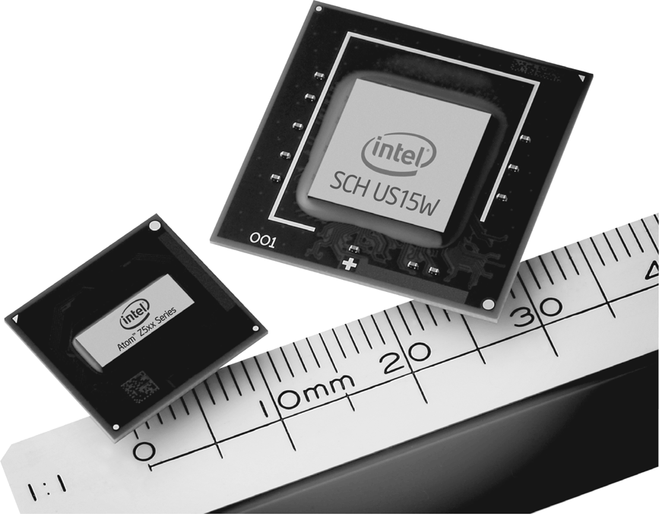
Figure 1.1
The Intel Atom processor chip contains the full circuitry of a central processing unit in an integrated circuit whose small size and low power requirements make it suitable for use in mobile internet devices. (Intel Corporation Pressroom Photo Archives)
1-<number>

Slide 3
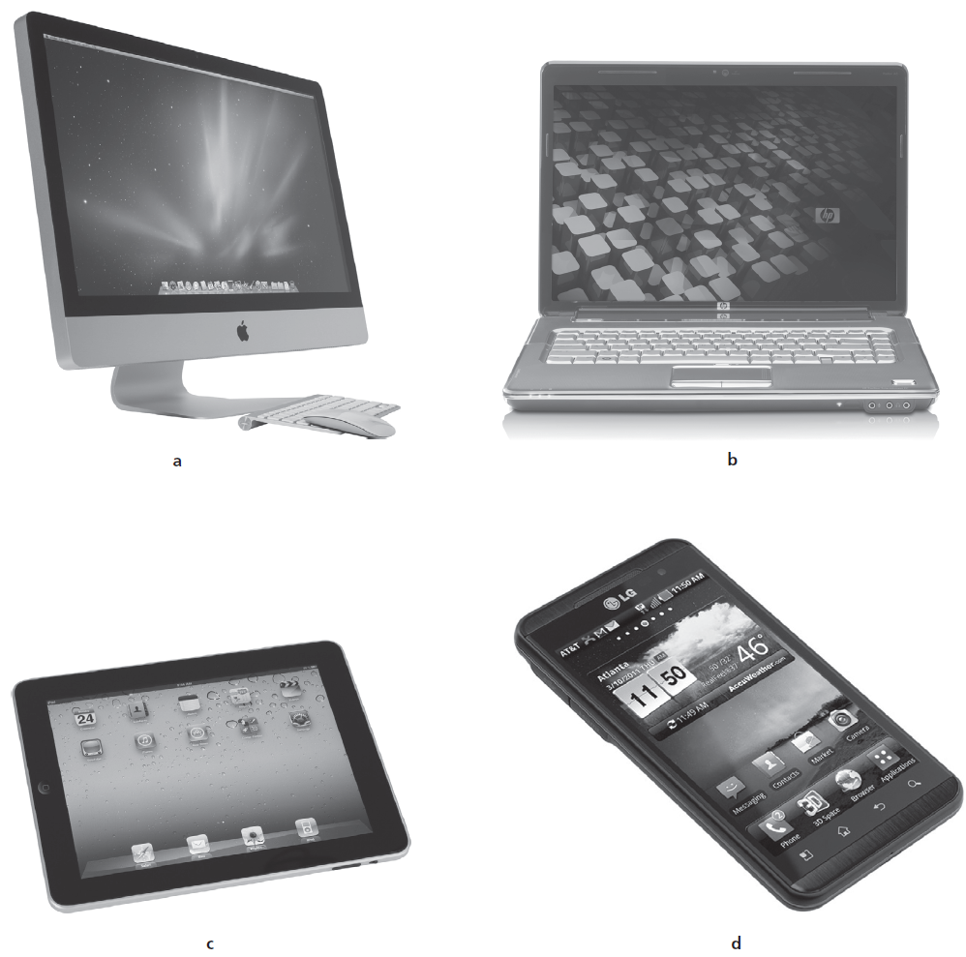
Figure 1.2
(a) Desktop Computer, iMac.
(© Hugh Threlfall/Alamy).
(b) Hewlett-Packard
Laptop.
(© Hewlett-Packard Company).
(c) iPad.
(© D. Hurst/Alamy). d) Android phone, LG Thrill 4G.
(© Handout/MCT/Newscom).
1-<number>

Slide 4
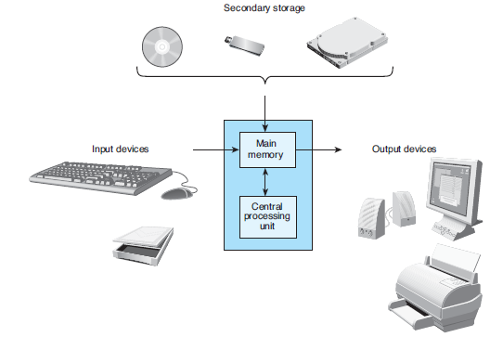
Figure 1.3
Components of a Computer
1-<number>

Slide 5
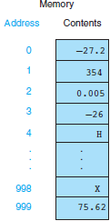
Figure 1.4
1000 Memory Cells in Main Memory
1-<number>

Slide 6

Figure 1.5
Relationship Between a Byte and a Bit
1-<number>

Slide 7
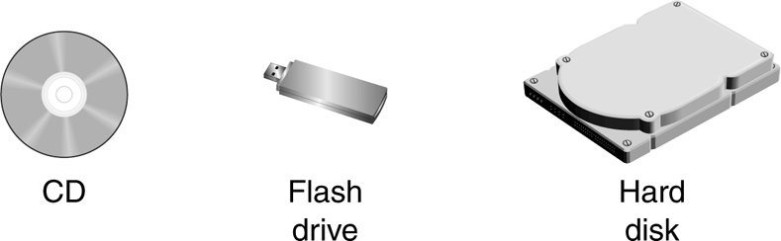
Figure 1.6 Secondary Storage Media
1-<number>

Slide 8
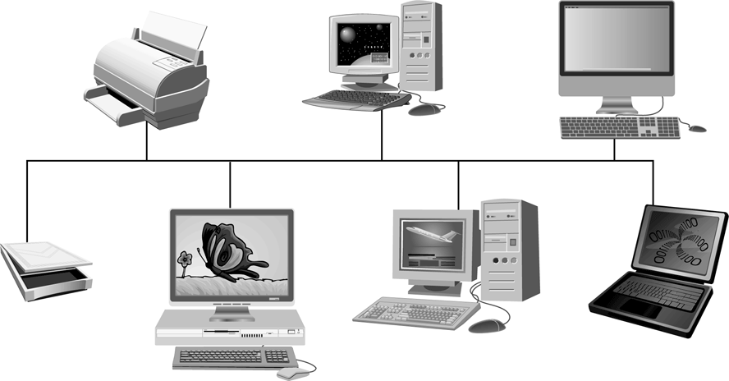
Figure 1.7 Local Area Network
1-<number>

Slide 9
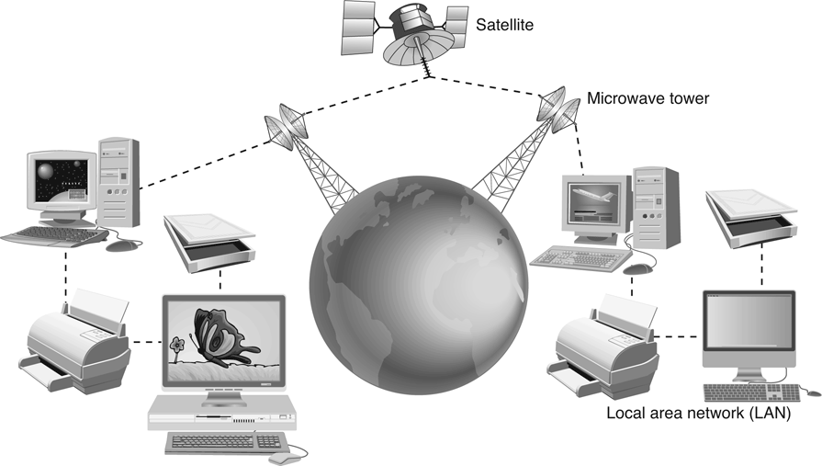
Figure 1.8
A Wide Area Network with Satellite Relays of Microwave Signals
1-<number>

Slide 10
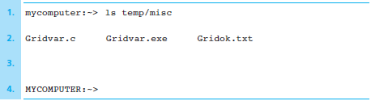
Figure 1.9 Entering a UNIX Command for Directory Display
1-<number>

Slide 11
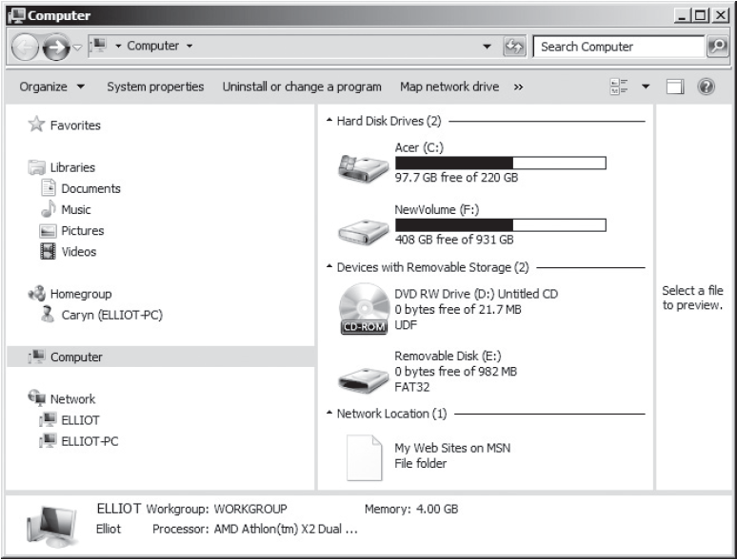
Figure 1.10
Accessing Secondary Storage Devices through Windows
1-<number>

Slide 12
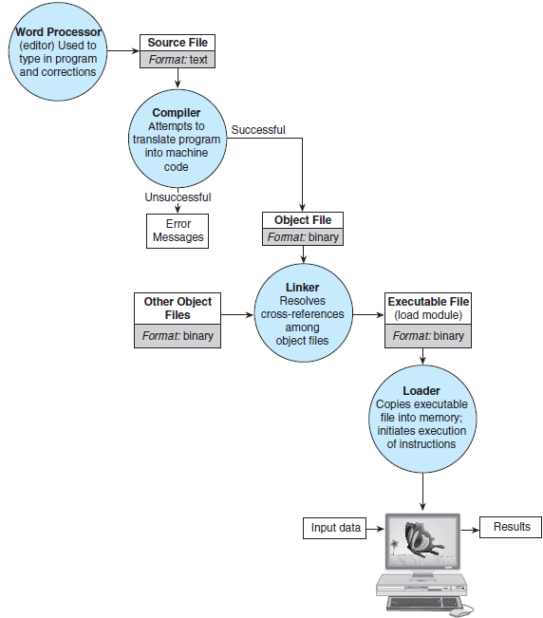
Figure 1.11 Entering, Translating, and Running a High-Level Language Program
1-<number>

Slide 13
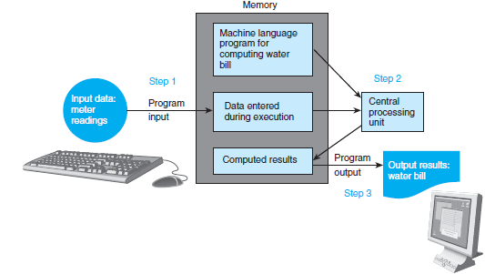
Figure 1.12 Flow of Information During Program Execution
1-<number>

Slide 14
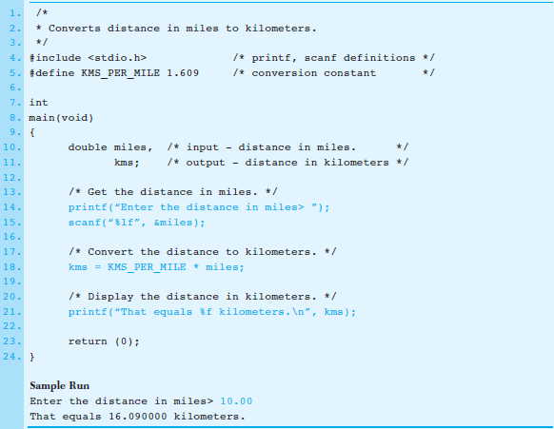
Figure 1.13 Miles-to-Kilometers Conversion Program
1-<number>

