Slide 1
Chapter 11:
Text and Binary File Processing
Problem Solving & Program Design in C
Seventh Edition
By Jeri R. Hanly &
Elliot B. Koffman

Slide 2
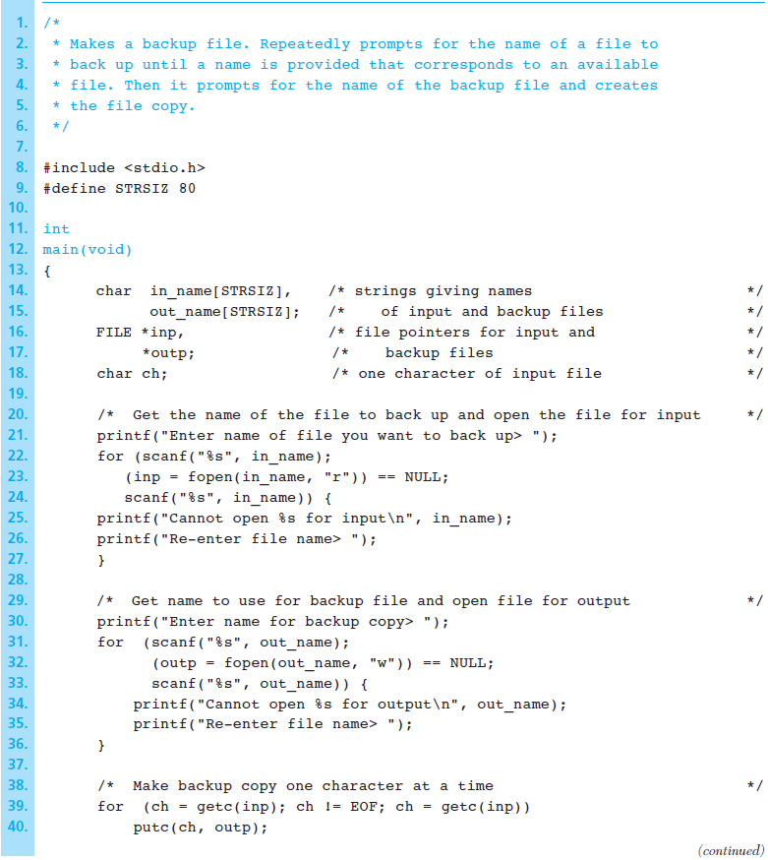
Figure 11.1
Program to
Make a Backup
Copy of a
Text File
1-<number>

Slide 3
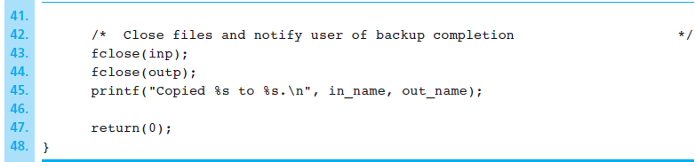
Figure 11.1 Program to Make a Backup Copy of a Text File (cont’d)
1-<number>

Slide 4
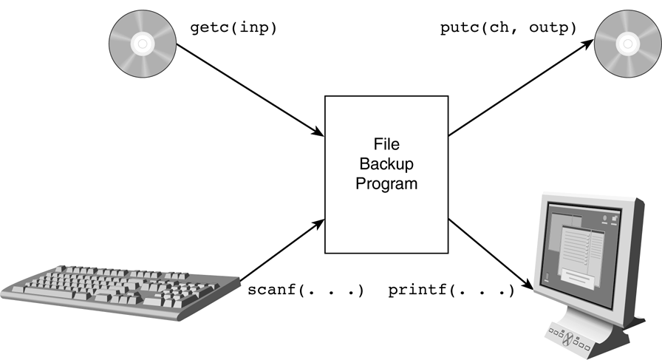
Figure 11.2 Input and Output Streams for File Backup Program
1-<number>

Slide 5
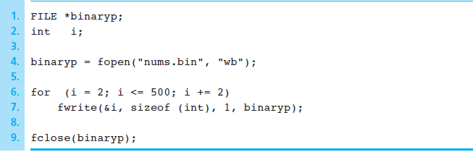
Figure 11.3 Creating a Binary File of Integers
1-<number>

Slide 6
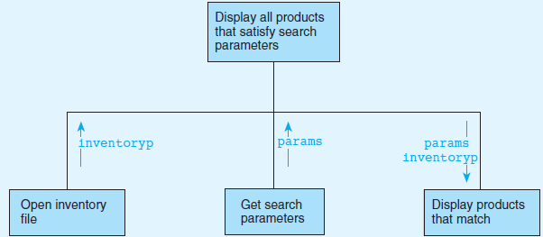
Figure 11.4 Structure Chart for Database Inquiry Problem
1-<number>

Slide 7
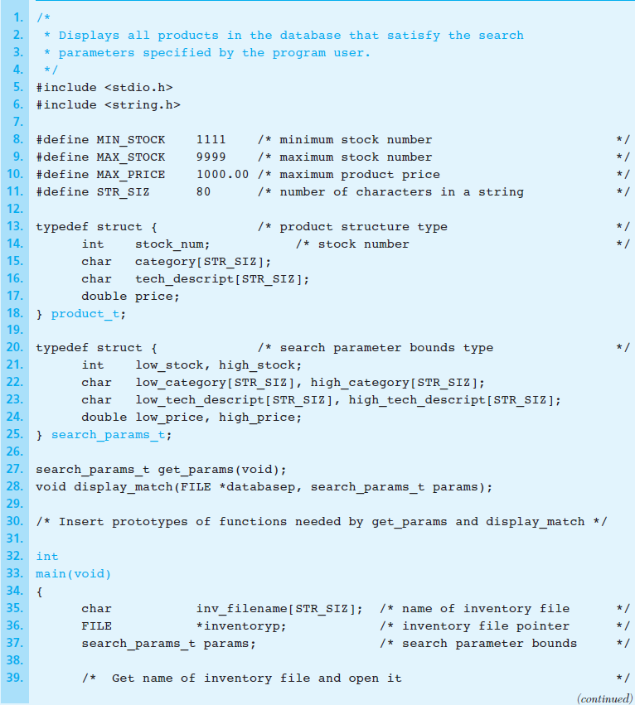
Figure 11.5
Outline and
Function main for
Database
Inquiry
Program
1-<number>

Slide 8
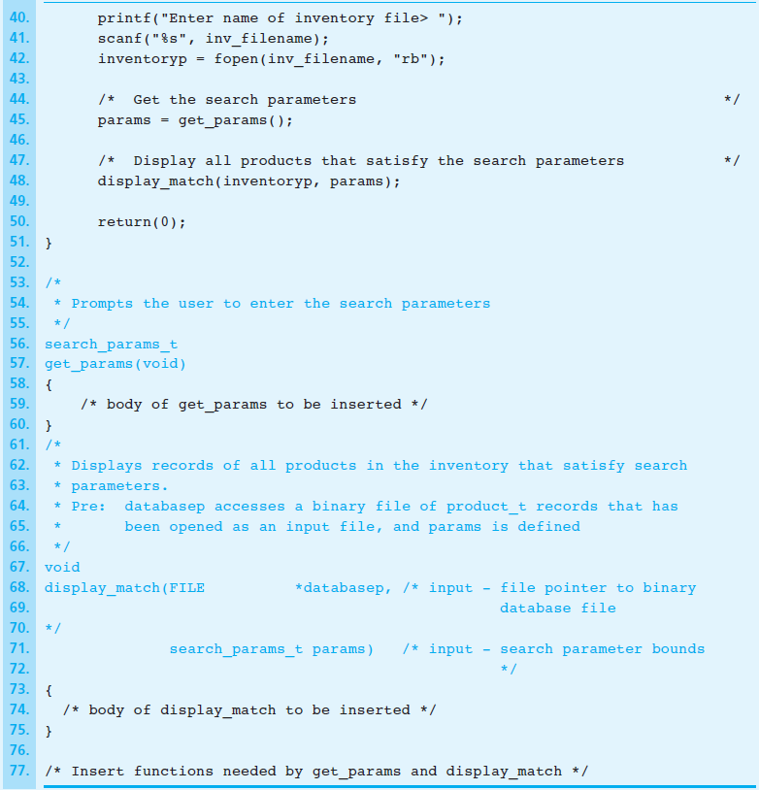
Figure 11.5 Outline and Function main for Database Inquiry Program (cont’d)
1-<number>

Slide 9
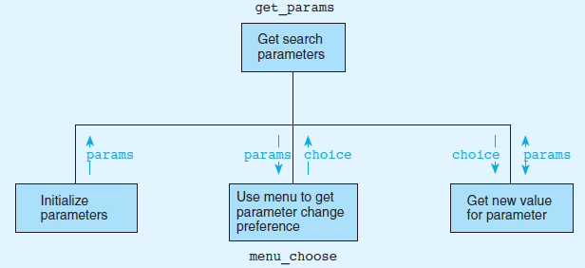
Figure 11.6 Structure Chart for get_params
1-<number>

Slide 10
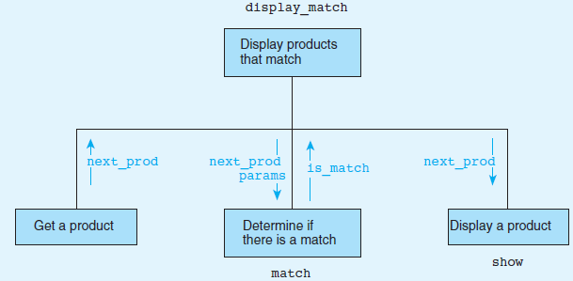
Figure 11.7 Structure Chart for display_match
1-<number>

Slide 11
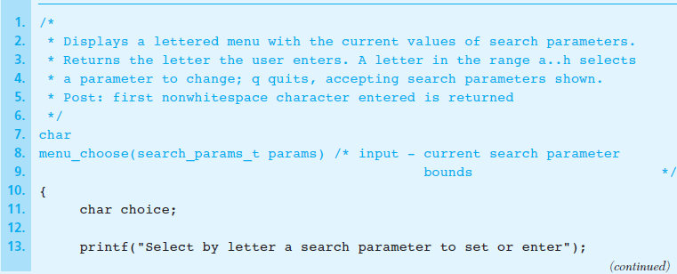
Figure 11.8 Functions display_match, menu_choose, and match
1-<number>

Slide 12
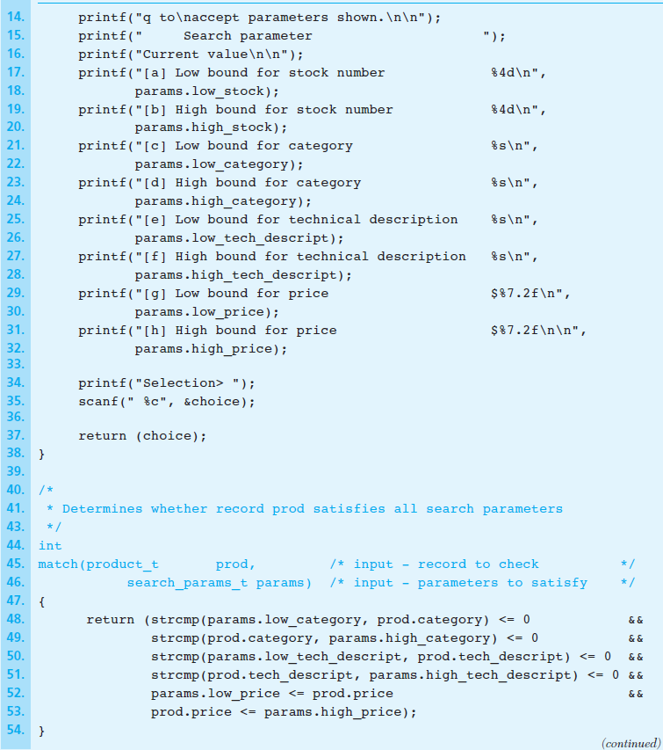
Figure 11.8 Functions display_match, menu_choose, and match (cont’d)
1-<number>

Slide 13
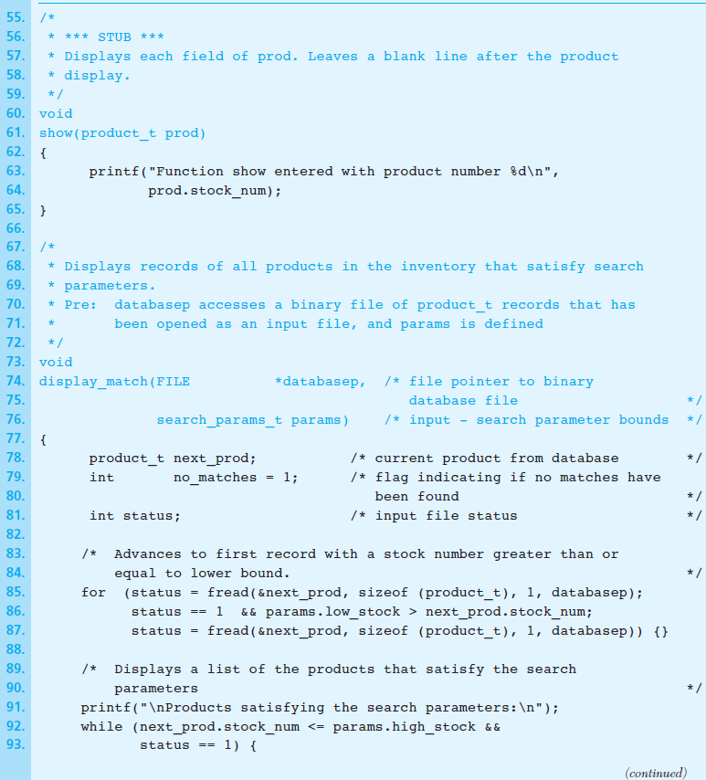
Figure 12.8 Functions display_match, menu_choose, and match (cont’d)
1-<number>

Slide 14
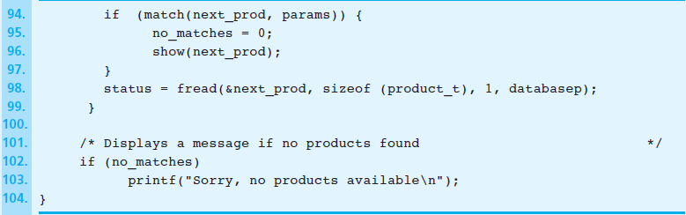
Figure 11.8 Functions display_match, menu_choose, and match (cont’d)
1-<number>

