Slide 1
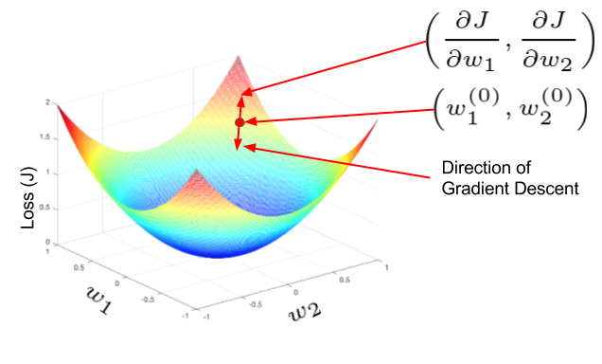
Notes on Developing a
Multimodal Deep Learning Network to Classify Cancers using Whole Slide Image and Gene Expression Data
Bioinformatics Seminar
Thu 25th June 2020
Peter Donnelly
peter.donnelly@petermac.org
Gradient Descent: the main opimization algorithm used in neural networks
'The Hard Thing About Deep Learning (blog) retrieved on 18 Nov 2019

Slide 2
Agenda
Project Motivation and Objective
Background: Supervised Neural Networks
Sources of Experimental Data
Experimental Software Set-up
Some Results
What’s next

Slide 3





Motivation & Objective
Objective
Use machine learning to Identify and classify tumours which are challenging for pathologists to classify manually, espcially T-cell Lymphomas. As one example, ALK positive and ALK negative ALCL
Proposition
A multi-modal neural network trained with WSI images + gene expression data may be an effective tool for automatically classifying such tumours
Success Criteria
Classifications and mis-classifications at similar levels to to that of human pathologist
Upper three image: “A Pathologist’s Guide to Accurate Diagnosis of Peripheral T-Cell Lymphonas” on Medscape
Lower two images: “End-to-end Training of Deep Probabilistic CCA on Paired Biomedical Observations” (Gunderson et all, NIPS 2018)
Notes:
So relating this to my thesis, the main proposition is that a particular kind of neural network called a multi-modal neural network, which is able to accept and learn from more than one data modality– in our case image data AND gene expression data – might be effective at lymphoma classification; and more effective at lymphoma classification than a network that uses just one of these data modes, and might hopefully be able to differentiate some of the more difficult to classify T-Cell Lyphomas that we’re interested in
The group of three images at the top shows two kinds of T-Cell Lymphoma - ALK postive ALCL and ALK negative ALCL - that are very difficult to classify from cell morphology alone. And these two types of Lymphoma actually have quite different survival rates, and it may also be that the optimum treatments for each of these might be different.
And a secondary proposition is that using genomic data in combination with image data may reduce the number of examples required for training compared to using images alone or gene expression data alone, and that matters because it’s always hard to get training data.

Slide 4
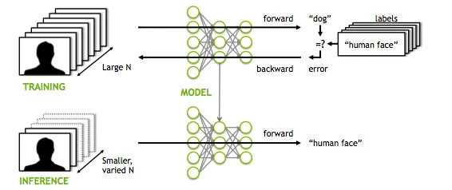
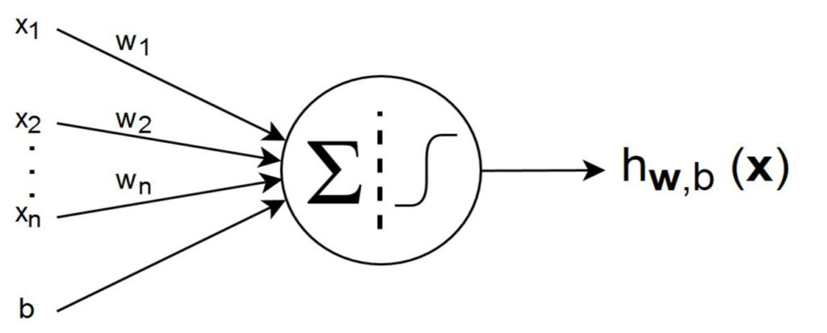
Background: Supervised Neural Networks
Supervised Neural Networks
The most successful / widely used category of Neural Network (ANN, CNN, RNN, DL networks are all SLNs)
Characterized by distinct Training and Inference phases
Illustrated is an image classification task, but many tasks are possible (eg. language translation, speech to text ...)
Structure
Layers of “Neurons” and weighted connections
Can be, and often are, millions of neurons & dozens of layers.
Only a few kinds of neurons, and all neurons in a layer are of the same kind
Each neuron has a numeric weight.
The weights plus the (operations represented by) the neurons together constitue a vast high dimensional non-linear function space that’s traversed in Training
Training Phase
Purpose is to find a function within the space which will correctly classify never seen examples later in the Inference phase. Overfitting is a constant concern.
In Training phase batches of inputs – here images - are pushed through the network . In the case of a classification, outputs are (pseudo-)probabilities.
The outputs are subtracted from true values, giving an error
The error function is differentiated w.r.t each weight and the weights updated accordingly, changing the function to one that’s a little nearer the one with the lowest possoble loss (within the function space). This process is called “Back Propagation”.
Rinse and repeat many times until the network is suitably Trained, at which point the weights are frozen.
Inference Phase
In the Inference phase, examples which have never been seen are before presented to the network, and will hopefully be classified correctly
Left Image: Applying Deep Neural Network Training - MITXPC
Right Image: Introduction to Artiﬁcial Neural Networks (ANNs)Posted by Rahmad Sadli on February 7, 2020 in Deep Learning, Machine Learning

Slide 5

VGG16: A Famous Network Model

Slide 6
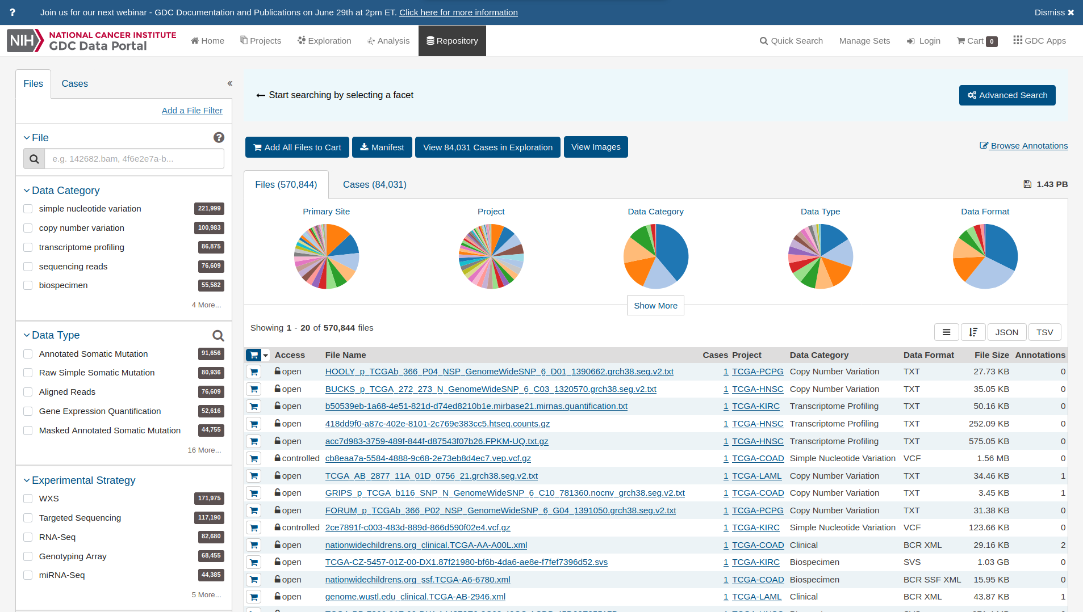
Experiment Data
Need matched slide image and gene expression data
In general; available datasets are either histopathology image oriented or -omics oriented (but not both)
They’re usually small and poorly structured
NIH Genomica Data Commons is an exception
Great deal of data covering diverse cancer types and including a lot of multi-modal data
Extremely well structured and has a very good API for programmatic access (which I use extensively)

Slide 7
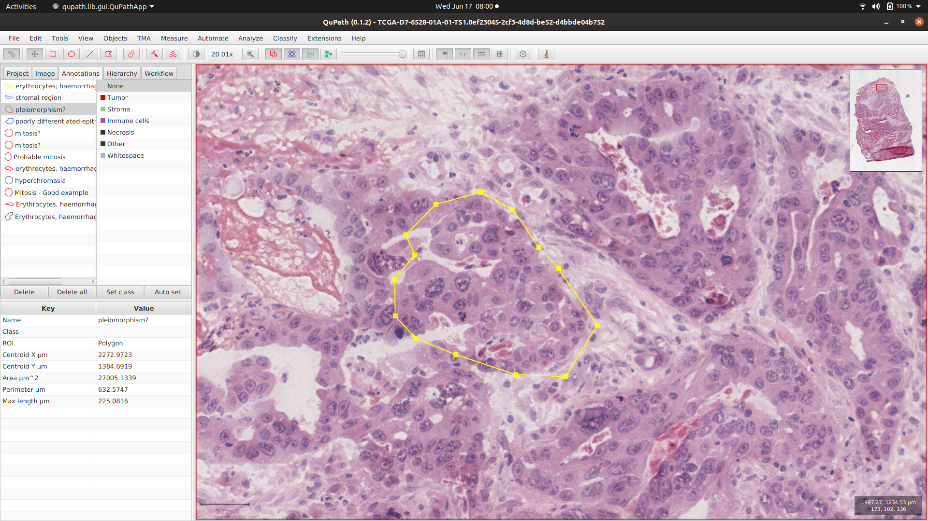
Stomach Adenocarcima
Image data
  scan of an H&E stained microscope slide
  usally in SVS format (Leica/Aperio proprietary)
  Relatively low resolution (21,000x29,000). Can be e.g. >100,000x70,000
  Very little normal tissue, and that’s common
  Opened in QuPath image annotation tool
Gene expression data
  is given as UQ FPKM
    Fragments Per Kilobase Of Exon Per Million Fragments Mapped
  A single number for each of 60,483 gene

Slide 8

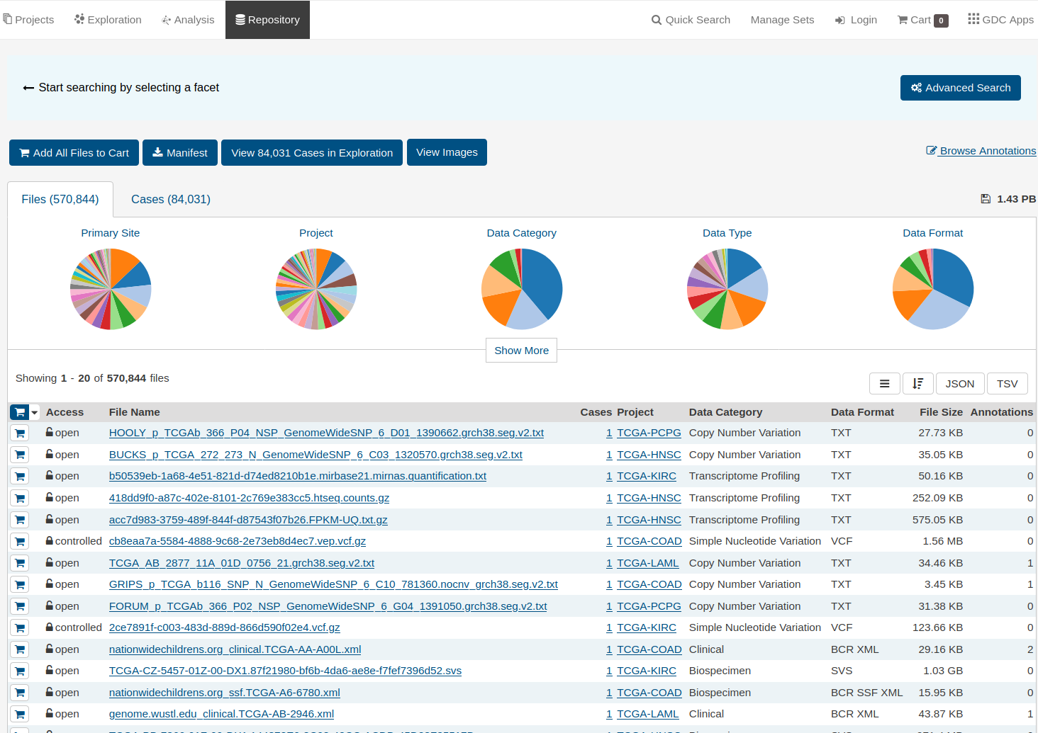
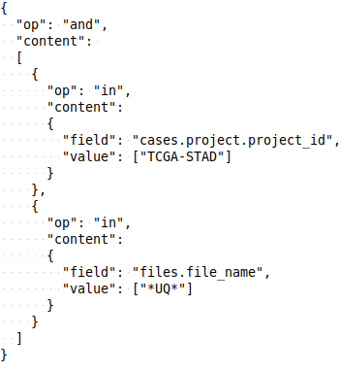
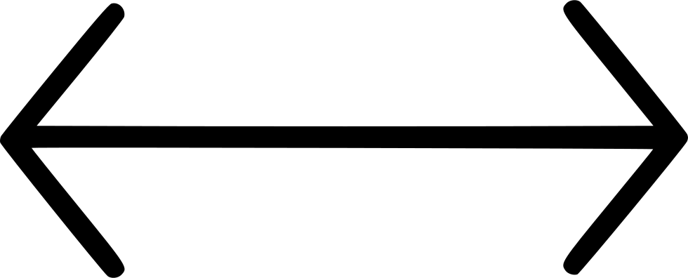
Experimental System
Desirable Attributes:
Make it easy to obtain data and change to new dataset <- data fetch subsystem
Automate pre-processing of raw input data for feeding into model <- pre-processing subsystem
Really quick turnaround between experiments <- modular and parameter driven run susbsystem
Define and run a batch of experiments in one go <- multi-experimentjJob
Make it easy to compare multiple experiments <- multi-experiment job / Tensorboard
Results vizualization results <- Tensorboard hooks
Multi-experiment Job
Data
Fetch
Data
Pre-process
Run Sub-system
Parameterize / Train / Test / Monitor / Visualize
Filter
library
Image filter
Image tiler
Image patch
Genes filter
Stain
Normalize
etc
Mode
Image
RNA
Dual
NN Model
VGG11
VGG13
VGG16
VGG19
INCEPT3
DENSE
Optimizer
ADAM
ADAGRAD
ADAMAX
SGD
etc
Loss
Function
Cross
Entropy
Custom
NIH GDC Repository
x
x
x
x
XML
REST
Gunderson ‘DPCCA’ (Adapted)
Gunderson ‘DPCCA’
Gunderson ‘DPCCA’ (Adapted)
Gunderson ‘DPCCA’ (Adapted)
Python / PyTorch / Matplotlib / Openslide
OS: Linux
Currently -> Hardware: CPU: AMD 2950X 16/32 core GPU: dual NVIDIA Titan RTX

Slide 9
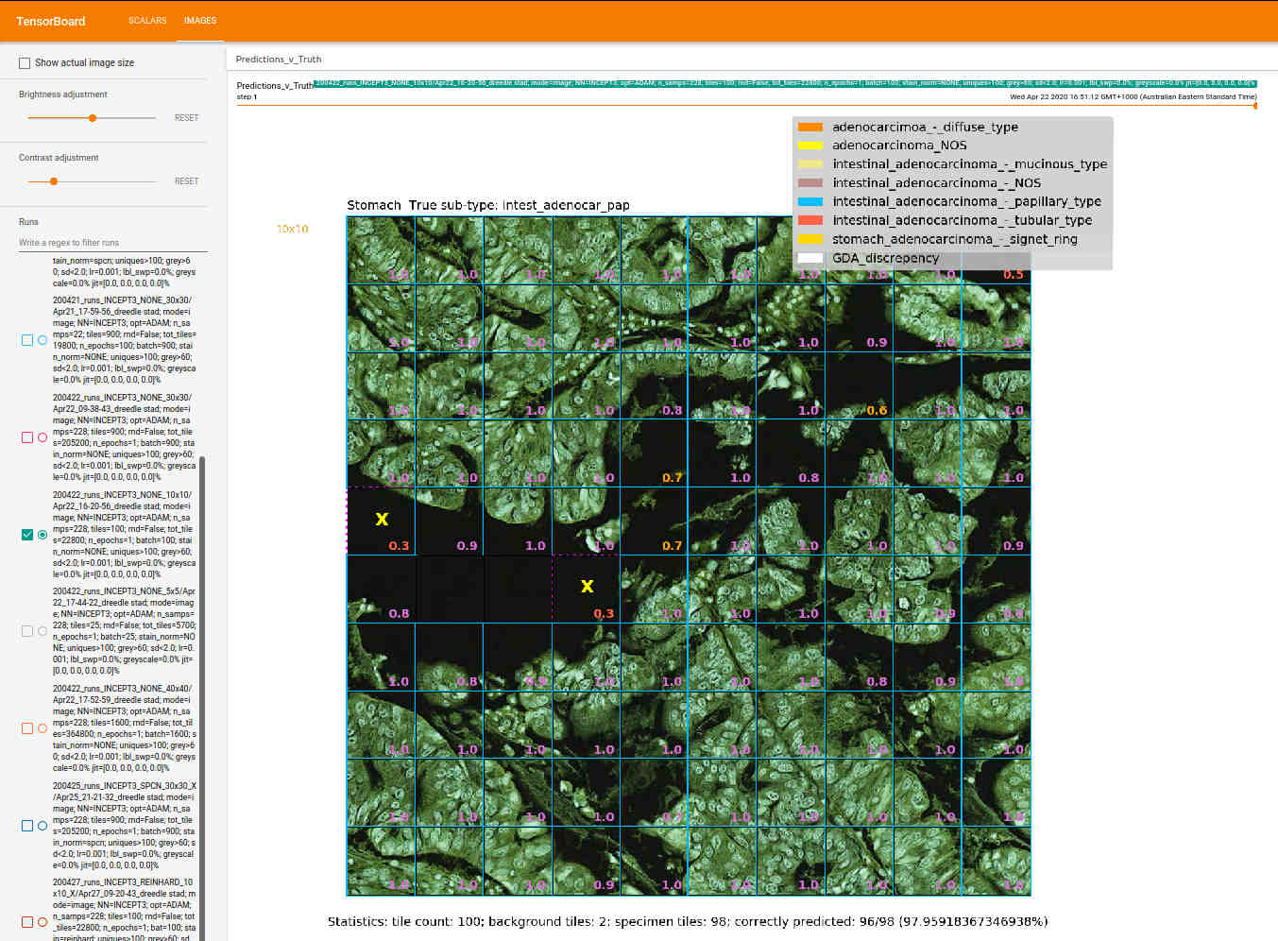
A Confident Prediction: Intestinal AD, Papillary type
Inception 3 Network; ADAM optimiser; Learing rate=0.001; no stain normalization; patch of 100 128x128 tiles

Slide 10
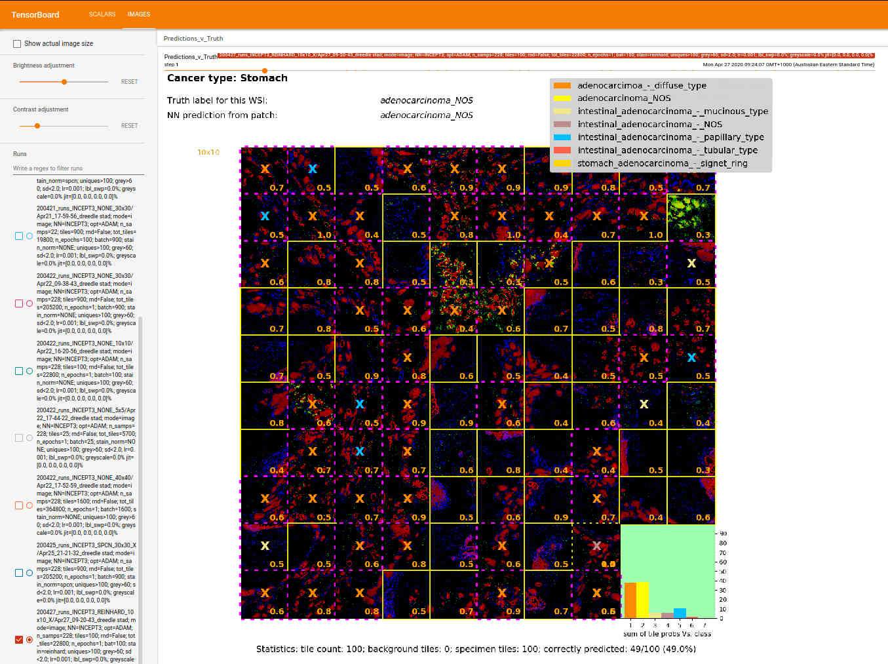
An Unconfident Prediction: Stomach AD NOS
Inception 3 Network; ADAM optimiser; Learing rate=0.001; Reinhard stain normalization; patch of 100 128x128 tiles

Slide 11
What’s next?
Refine RNA-Seq mode
  Selection of relevant gene subsets
Introduce Multi-modal learning
Start Using PMCC samples as these become available
  And they’re just starting to

Slide 12
Extras

Slide 13
Neural Networks - Supervised Learning (SL)
Network (up.per figure):
With SL there are separate training and inference phases. Same network model for both.
Train on labeled data, infer on unseen data.
Can be millions of neurons & dozens of layers. Only a few kinds of neurons, and all neurons in a layer are of the same kind
Each neuron has a weight, randomally initialized. The weights and the neurons together represent a vast high dimensional non-linear function space which is traversed during training.
Training (lower figure):
point of training is to try to find the function (represented by the set of weights) within the available function space that produces outputs nearest to the true outputs (i.e. has the least error (“loss”). Think of it as a generalization of least squares.
To do this, batches of inputs – here images - are pushed through the network; the values output compared to the true values, and the error calculated for the batch by means of a convex loss funtion (J)
The loss is then differentiated w.r.t each weight and the weights updated: new weight = old weight + fraction of dJ/dw; thereby changing the function to one that’s a little nearer the function with the lowest possoble loss. Rinse and repeat many times. This process is called “Back Propagation”
It’s a deterministic process that’s guaranteed to find the function within the function space that has the lowest error. Definitely not guaranteed to generalize to unseen examples however! For generalization to succeed, The ‘pattern’ sought must really exist withoin the data, & the network has to be sufficiently powerful for to succeed. Overfitting is a constant concern..
Top Image: Applying Deep Neural Network Training - MITXPC
Bottom image: Understanding Activation Functions in Deep Learning - Aditya Sharma

