Slide 1
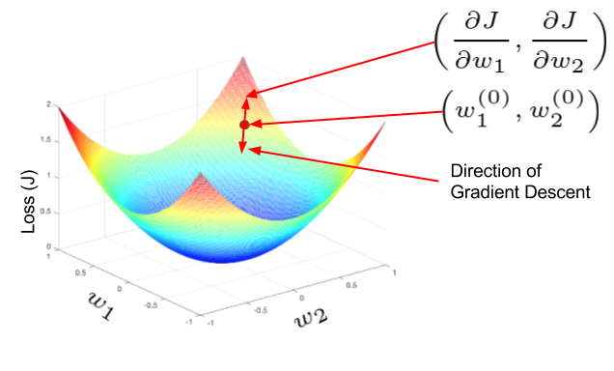
Notes on Developing a
Multimodal Deep Learning Network to Classify Cancers using Whole Slide Image and Gene Expression Data
Bioinformatics Seminar
Thu 25th June 2020
Peter Donnelly
peter.donnelly@petermac.org
Gradient Descent: the main opimization algorithm used in neural networks
Understanding Activation Functions in Deep Learning - Aditya Sharma

Slide 2
Agenda
Motivation & Objective
Backgrounder on Supervised Neural Networks
Sources of Experimental Data
Experimental Software Set-up
Some Early Results
Lessons Learned

Slide 3



Motivation & Objective
Objective
Use machine learning to Identify and classify tumours that are challenging for pathologists to classify manually, especially T-cell Lymphomas.
Eg ‘ALK positive’ and ‘ALK negative’ Anaplastic Large Cell Lymphoma (74% interpathologist consensus in one study)
Proposition
A multi-modal neural network trained with Whole Slide Images + gene expression data may be an effective tool for automatically classifying such tumours
Success Criteria
Classifications and mis-classifications at similar levels to to that of human pathologist
“A Pathologist’s Guide to Accurate Diagnosis of Peripheral T-Cell Lymphonas” via Medscape
Notes:
So relating this to my thesis, the main proposition is that a particular kind of neural network called a multi-modal neural network, which is able to accept and learn from more than one data modality– in our case image data AND gene expression data – might be effective at lymphoma classification; and more effective at lymphoma classification than a network that uses just one of these data modes, and might hopefully be able to differentiate some of the more difficult to classify T-Cell Lyphomas that we’re interested in
The group of three images at the top shows two kinds of T-Cell Lymphoma - ALK postive ALCL and ALK negative ALCL - that are very difficult to classify from cell morphology alone. And these two types of Lymphoma actually have quite different survival rates, and it may also be that the optimum treatments for each of these might be different.
And a secondary proposition is that using genomic data in combination with image data may reduce the number of examples required for training compared to using images alone or gene expression data alone, and that matters because it’s always hard to get training data.

Slide 4
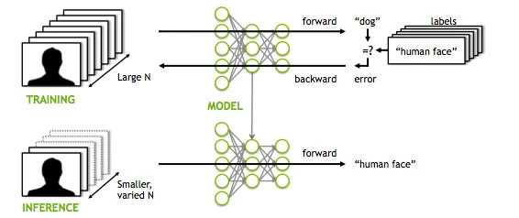
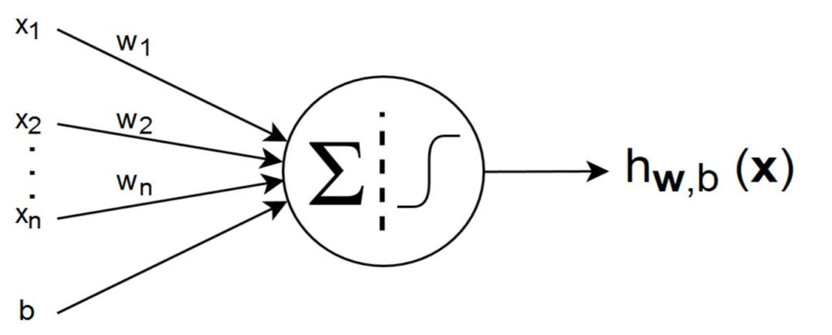
Background: Supervised Neural Networks
Supervised Neural Networks
The most successful / widely used category of Neural Network (ANN, CNN, RNN, DL networks are all SLNs)
Characterized by distinct Training and Inference phases
Illustrated is an image classification task, but many tasks are possible (eg. language translation, speech to text ...)
Structure
Layers of “Neurons” and weighted connections
Can be, and often are, millions of neurons & dozens of layers.
Only a few kinds of neurons, and all neurons in a layer are of the same kind
Each neuron has a numeric weight.
The weights plus the (operations represented by) the neurons together constitue a vast high dimensional non-linear function space that’s traversed in Training
Training Phase
Purpose is to find a function within the space which will correctly classify never seen examples later in the Inference phase. Overfitting is a constant concern.
In Training phase batches of inputs – here images - are pushed through the network . In the case of a classification, outputs are (pseudo-)probabilities.
The outputs are subtracted from true values, giving an error
The error function is differentiated w.r.t each weight and the weights updated accordingly, changing the function to one that’s a little nearer the one with the lowest possoble loss (within the function space). This process is called “Back Propagation”.
Rinse and repeat many times until the network is suitably Trained, at which point the weights are frozen.
Inference Phase
In the Inference phase, examples which have never been seen are before presented to the network, and will hopefully be classified correctly
Left Image: Applying Deep Neural Network Training - MITXPC
Right Image: Introduction to Artiﬁcial Neural Networks (ANNs)Posted by Rahmad Sadli on February 7, 2020 in Deep Learning, Machine Learning

Slide 5

VGG16: A Famous Learning Algorithm
Karen Simonyan and Andrew Zisserman of Oxford Robotics Institute, 2014

Slide 6

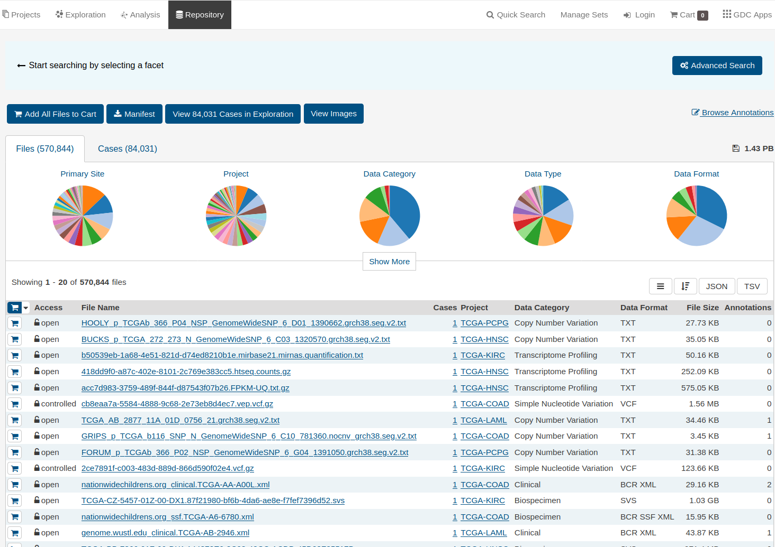
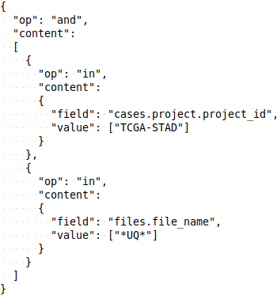

Experimental System
Core functionality:
PyTorch via an adaptation of Gregory Gunderson’s ‘DPCCA’ software
Openslide
Matplotlib
PD extensions:
Make it easy to change hyperparameters and NN algorithms<- modular and parameter driven run subsystem
Automate the acquisition of data <- data fetch module
Automate the pre-processing of data (eg. tiling, patching) <- pre-processing subsystem
Define and run a batch of experiments in one go <- multi-experiment Job
Dashboard for monitoring training and vizualization results <- Tensorboard hooks
Multi-experiment Job
Data
Fetch
Data
Pre-process
Run Sub-system
Parameterize / Train / Test / Monitor / Visualize
NIH GDC Repository
Filter
library
Image filter
Image tiler
Image patch
Genes filter
Stain
Normalize
etc
Mode
Image
RNA
Dual
Algorithm
VGG11
VGG13
VGG16
VGG19
INCEPT3
DENSE
Optimizer
ADAM
ADAGRAD
ADAMAX
SGD
etc
Loss
Function
Cross
Entropy
Custom
x
x
x
x
XML
REST
Gunderson ‘DPCCA’ (Adapted)
Gunderson ‘DPCCA’
Gunderson ‘DPCCA’ (Adapted)
Gunderson ‘DPCCA’ (Adapted)
Python / PyTorch / Matplotlib / Openslide
Python / PyTorch / Matplotlib / Openslide
OS: Linux
Currently -> Hardware: CPU: AMD 2950X 16/32 core GPU: dual NVIDIA Titan RTX

Slide 7
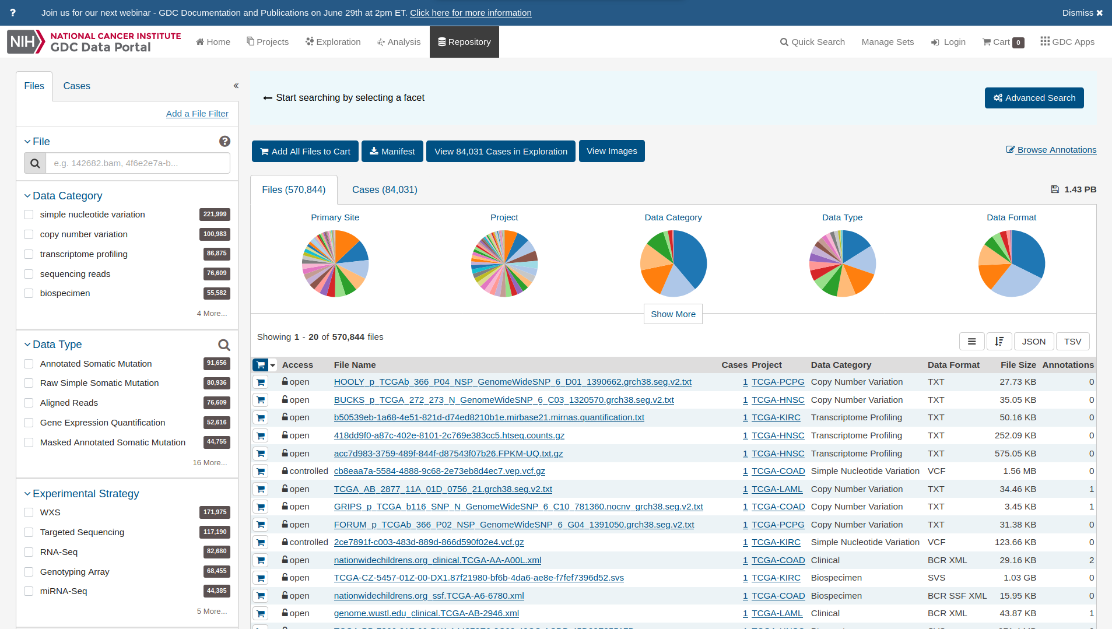
Source of Experimental Data
In general; available datasets are either histopathology image oriented or -omics oriented (but not both)
They’re usually small and poorly structured
Need matched slide image and gene expression data
NIH Genomica Data Commons (GDC) is an exception:
Great deal of data covering diverse cancer types and includes a lot of cases that have multi-modal data
Extremely well structured, and has a very good API for programmatic access (which I use extensively)

Slide 8
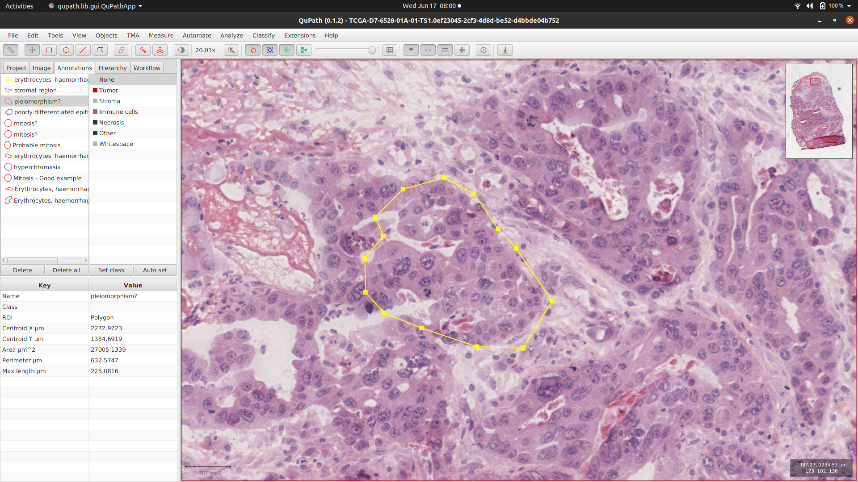
Example from GDC: Stomach Adenocarcima Dataset
Case ID: TCGA-KB-A6F7
Image Data
  scan of an H&E stained biposy slide
  usually in SVS format (Leica/Aperio proprietary format based on TIFF)
  relatively low resolution (29,000px x 21,000px). Can be e.g. >100,000px x >70,000px
  very little normal tissue, and that’s quite common for the STAD dataset
  Opened here in “QuPath” open source image annotation tool
Gene Expression Data
  UQ FPKM (Upper Quartile value of - Fragments Per Kilobase Of Exon Per Million Fragments Mapped)
  A single number for each of 60,483 mRNAs
  Not interested in all of these!
Truth Label for training
  “Intestinal Adenocarcinoma, Not Otherwise Specified (NOS)”
  This class is represented in the NN by the integer ‘1’ (there are 7 classes in total)

Slide 9
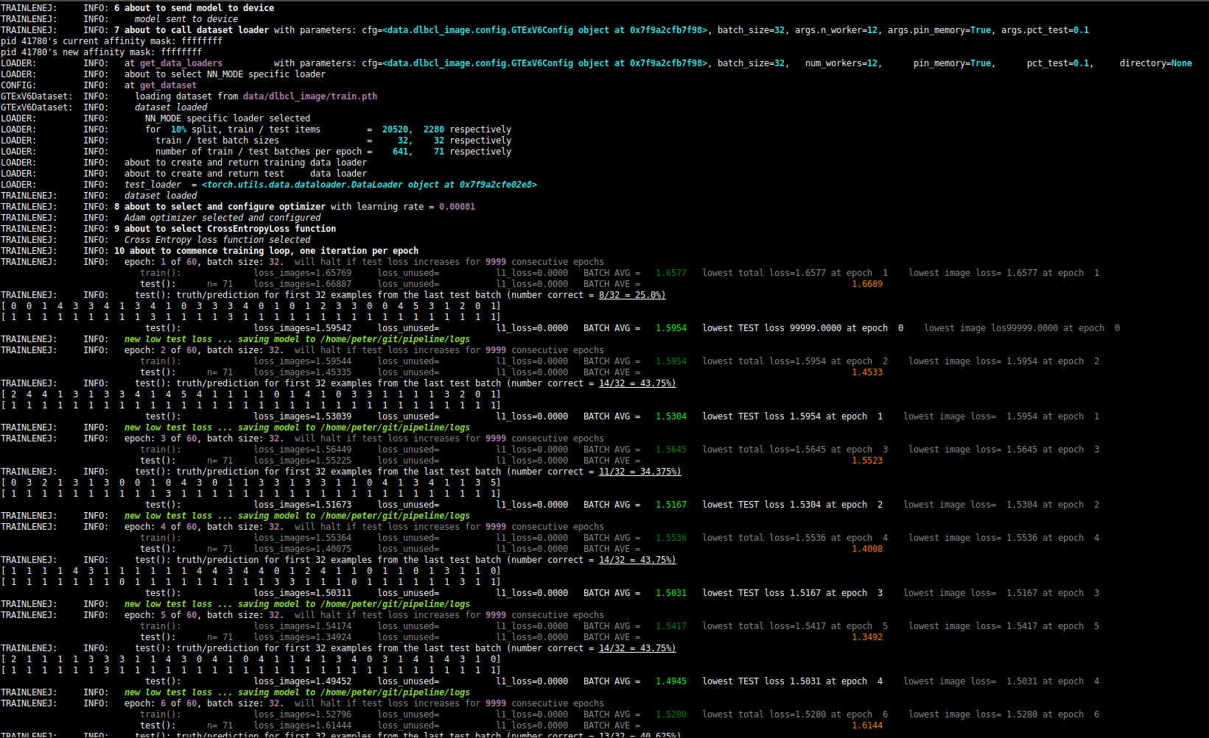
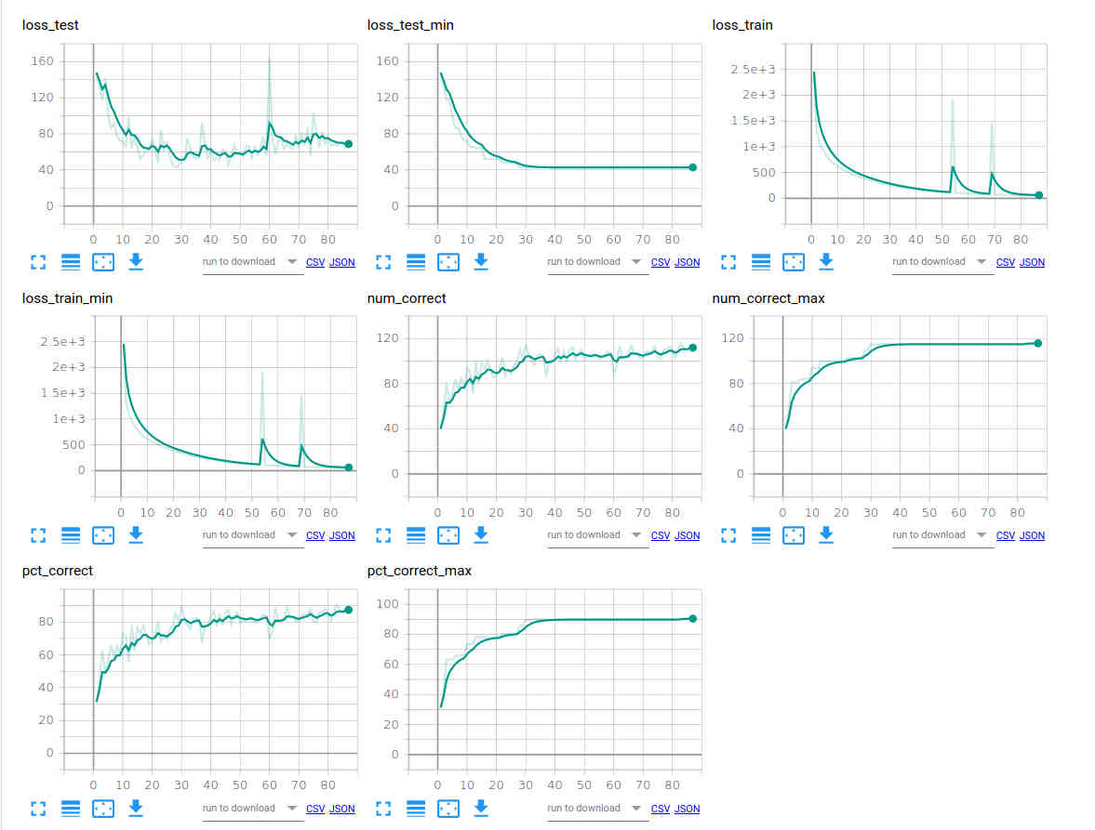
Monitoring Jobs & Visualizing Results
(1) Console output to monitor training jobs
(2) results visualization using Tensorboard
  Graphs showing how key parameters vary during course of training (Tensorboard makes this very easy)
  Example below: A single ‘job’ comprising nine distinct training runs each 60 epochs:
    3 different batch sizes (32, 64, 128) x 3 different CNNs (VGG11, VGG16, VGG19)
  Annotated images (Matplotlib for grunt work – Tensorboard just displays)

Slide 10
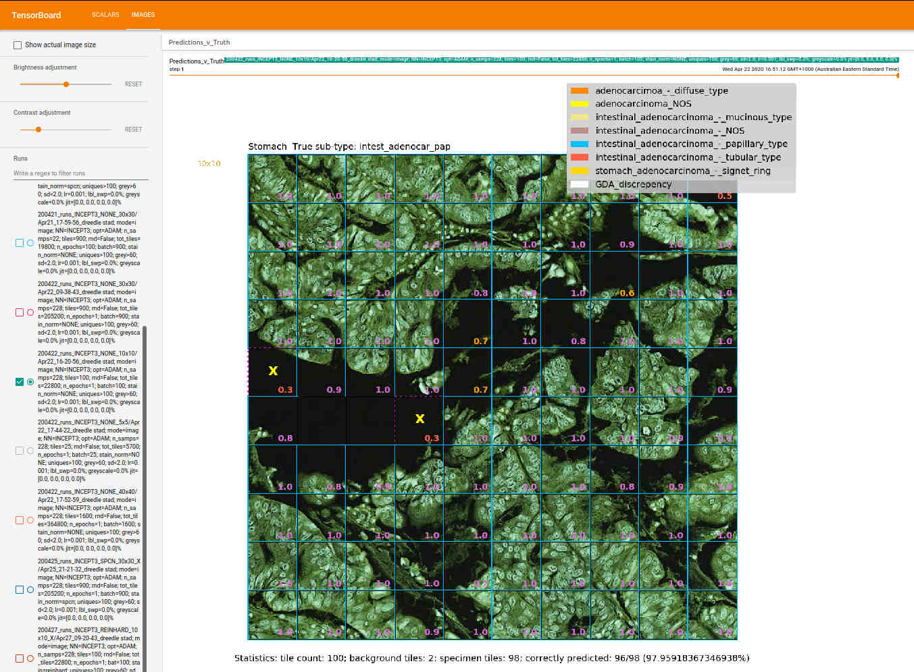
A Confident Prediction: Intestinal AD, Papillary type
Inception 3 Network; ADAM optimiser; Learing rate=0.001; no stain normalization; patch of 100 128x128 tiles

Slide 11
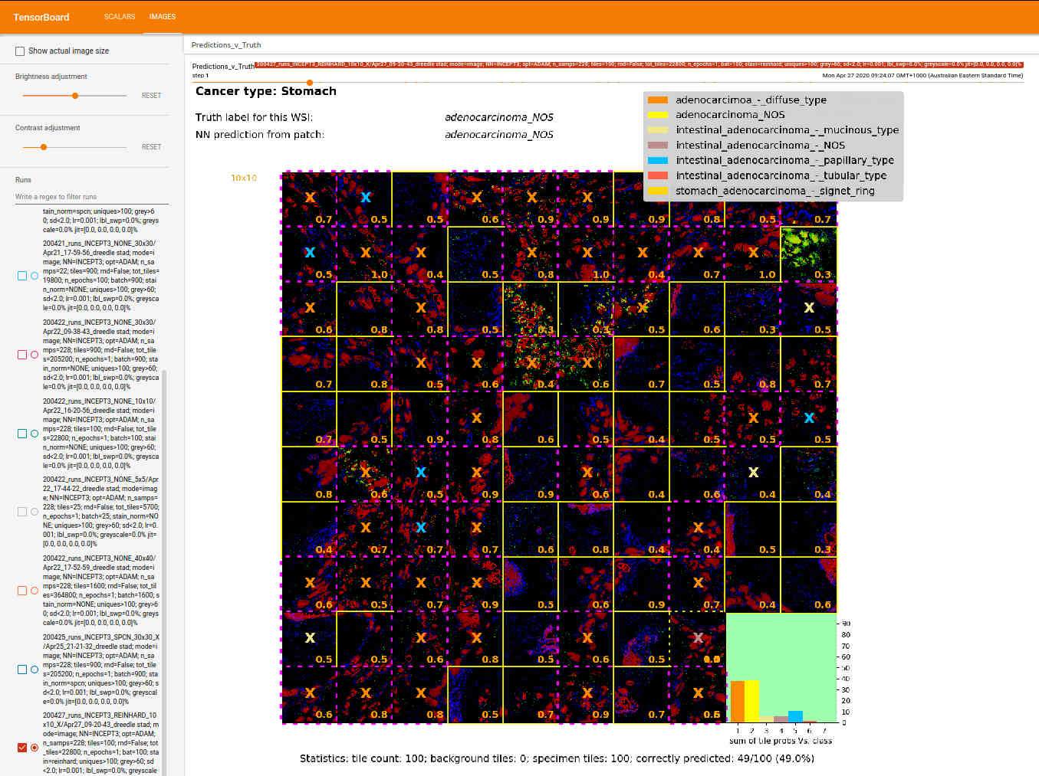
An Unconfident Prediction: Stomach AD NOS
Inception 3 Network; ADAM optimiser; Learing rate=0.001; Reinhard stain normalization; patch of 100 128x128 tiles

Slide 12
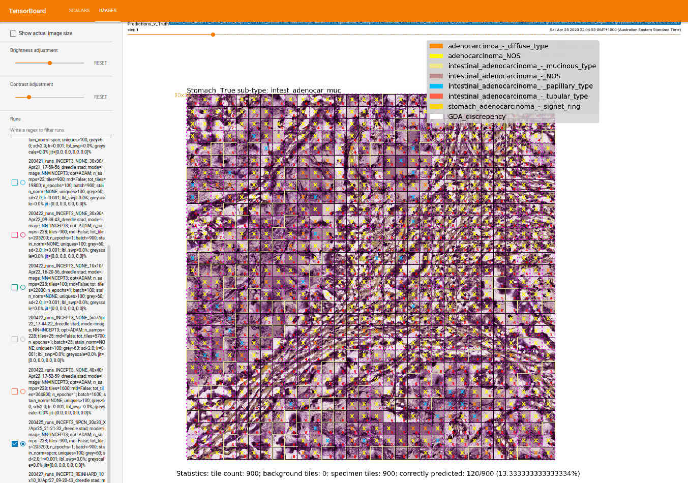
A Badly Wrong Prediction: Intestinal AD - Mucinous Type
Inception 3 Network; ADAM optimiser; Learing rate=0.001; SPCN stain normalization; patch of 900 128x128 tiles
Only 13% of tiles correctly classified. Most tiles classified as NOS
23/232 samples are Mucinous Type, so it’s a somewhat under-represented in the training set

Slide 13
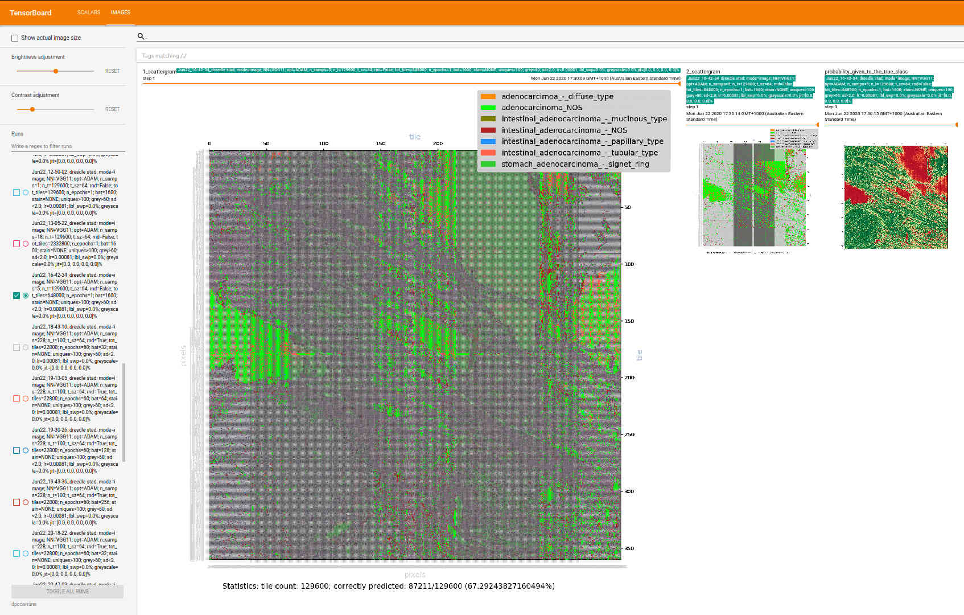
Increasing the Size of the Annotated Patch
129,000 128x128 tiles (23,040 x 23,040 pixels), but still only about 8% of the area of the image

Slide 14
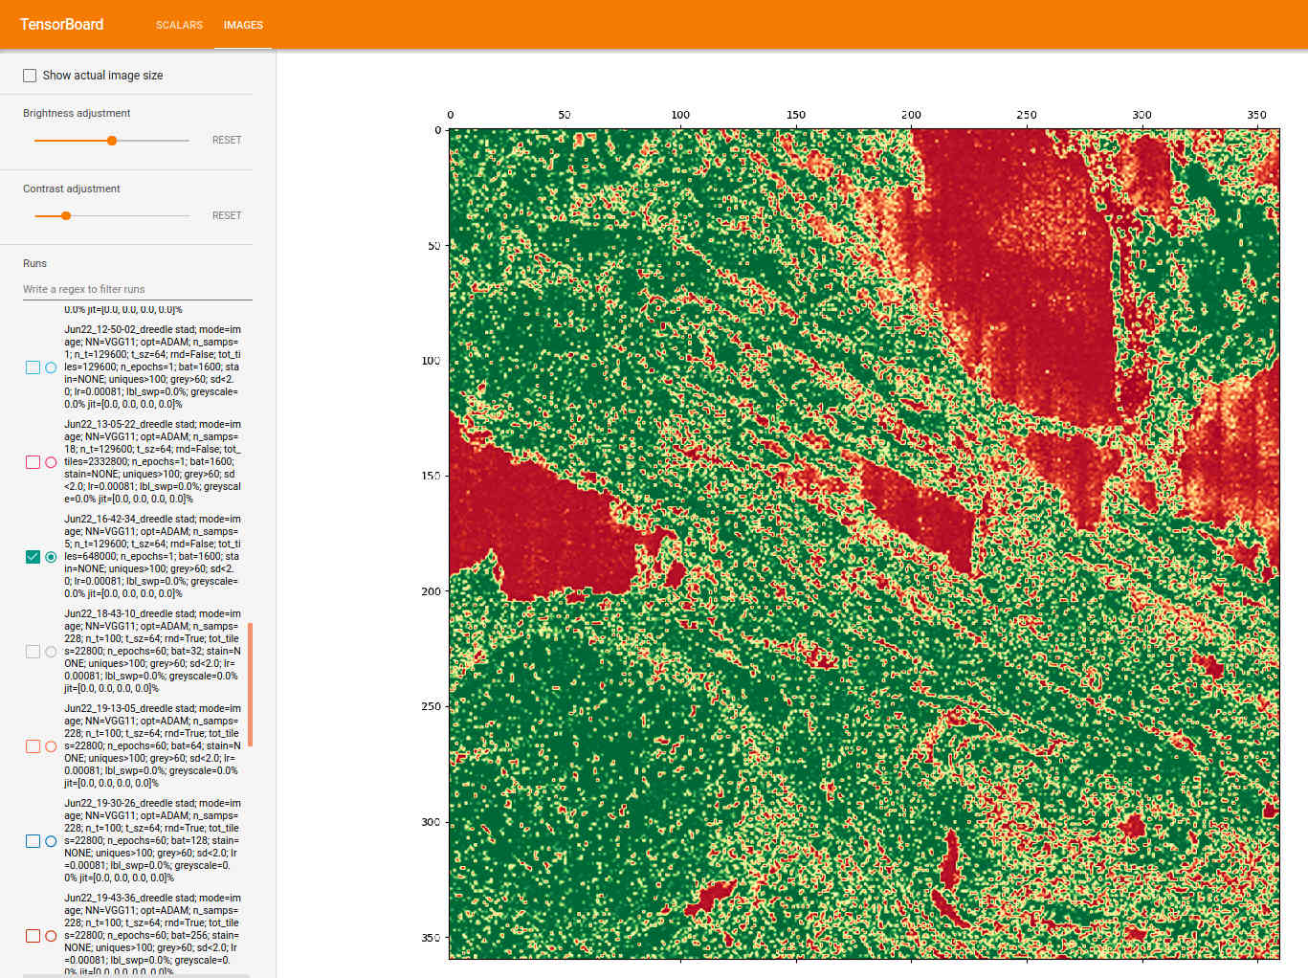
Visualizing Other Interesting Aspects
Eg. Here, probability given to the true class on continuous green-red spectrum

Slide 15
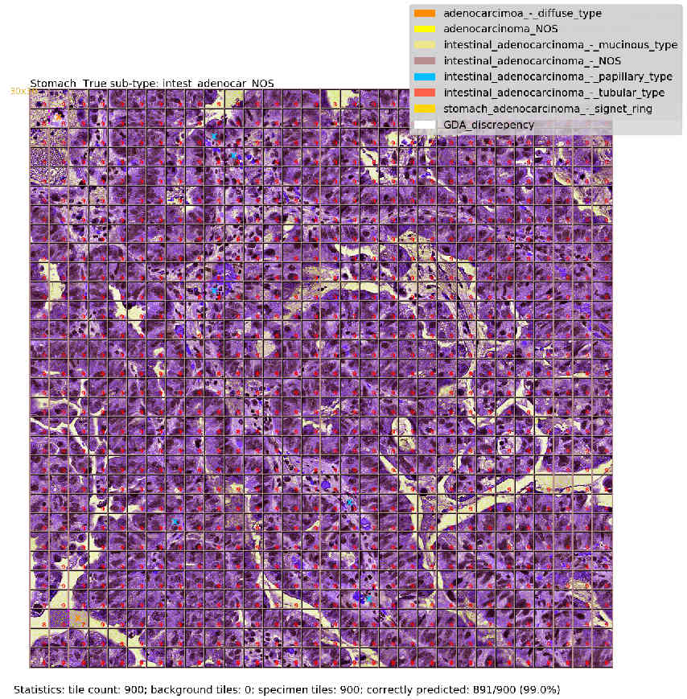

Slide 16
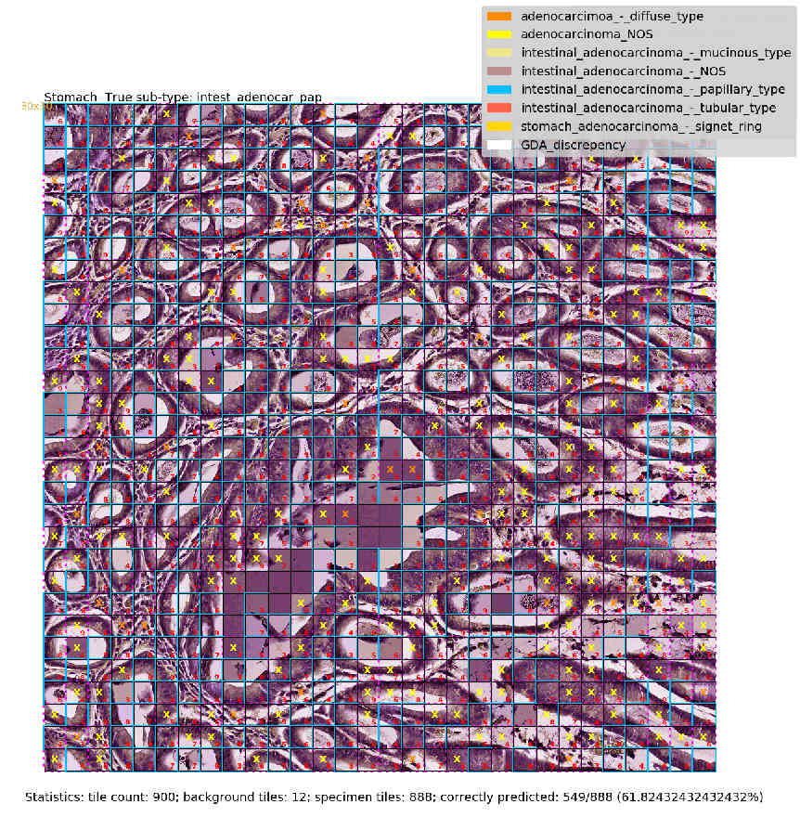

Slide 17
Lessons so far
Not so easy to find usable data
Essential to automate pre-processing
Highly desirable to automate data fetch
Tensorboard is super useful
To make progress, have to be able to turnover experiments very rapidly: multiple runs per day
Very handy to be sitting a few feet from the hardware (near zero set-up and tear down time)
It works (at least on “easy” samples)

