Slide 1
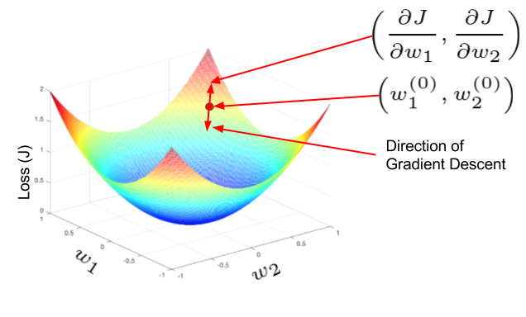
Notes on Developing a
Multimodal Deep Learning Network to Classify Cancers using Whole Slide Image and Gene Expression Data
Bioinformatics Seminar
Thu 25th June 2020
Peter Donnelly
peter.donnelly@petermac.org
Gradient Descent: the main opimization algorithm used in neural networks
Understanding Activation Functions in Deep Learning - Aditya Sharma

Slide 2
Topics
Objective & Hypothesis
Backgrounder: Supervised Neural Networks
Sources of Experimental Data
Experimental Software Set-up
Some Early Results
Remaining to be Done

Slide 3



Objective & Hypothesis
Project Objective
To use neural networks to classify tumours that are challenging for pathologists; esp. a large class of T-cell Lymphomas
E.g. ‘ALK positive’ and ‘ALK negative’ variants of Anaplastic Large Cell Lymphoma (74% interpathologist consensus in one study)
Hypothesis
A multi-modal neural network trained with Whole Slide Images + gene expression data may be an effective tool for automatically classifying such tumours
Success Criteria
Achieve classifications and mis-classifications at similar levels to human pathologist
Current Status
Image mode: largely complete
Gene mode: basically complete
Dual mode: just started
Will only be showing image-mode results in this talk
Images: “A Pathologist’s Guide to Accurate Diagnosis of Peripheral T-Cell Lymphonas” via Medscape
Notes:
So relating this to my thesis, the main proposition is that a particular kind of neural network called a multi-modal neural network, which is able to accept and learn from more than one data modality– in our case image data AND gene expression data – might be effective at lymphoma classification; and more effective at lymphoma classification than a network that uses just one of these data modes, and might hopefully be able to differentiate some of the more difficult to classify T-Cell Lyphomas that we’re interested in
The group of three images at the top shows two kinds of T-Cell Lymphoma - ALK postive ALCL and ALK negative ALCL - that are very difficult to classify from cell morphology alone. And these two types of Lymphoma actually have quite different survival rates, and it may also be that the optimum treatments for each of these might be different.
And a secondary proposition is that using genomic data in combination with image data may reduce the number of examples required for training compared to using images alone or gene expression data alone, and that matters because it’s always hard to get training data.

Slide 4
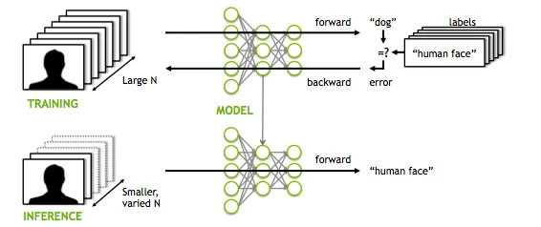
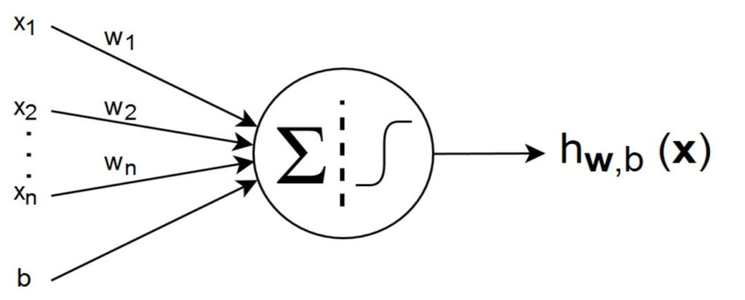
Background: Supervised Neural Networks
Supervised Neural Networks
The most successful / widely used category of Neural Network (ANN, CNN, RNN, DL networks are all SLNs)
Characterized by distinct Training and Inference phases
Illustrated is an image classification task, but many tasks are possible (eg. language translation, speech to text ...)
Structure
Layers of “Neurons” and weighted connections
Can be, and often are, millions of neurons & dozens of layers.
Only a few kinds of neurons, and all neurons in a layer are of the same kind
Each neuron has a numeric weight.
The weights plus the (operations represented by) the neurons together constitue a vast high dimensional non-linear function space that’s traversed in Training
Training Phase
Purpose is to find a function within the space which will correctly classify never seen examples later in the Inference phase. Overfitting is a constant concern.
In Training phase batches of inputs – here images - are pushed through the network . In the case of a classification, outputs are (pseudo-)probabilities.
The outputs are subtracted from true values, giving an error
The error function is differentiated w.r.t each weight and the weights updated accordingly, changing the function to one that’s a little nearer the one with the lowest possoble loss (within the function space). This process is called “Back Propagation”.
Rinse and repeat many times until the network is suitably Trained, at which point the weights are frozen.
Inference Phase
In the Inference phase, examples which have never been seen are before presented to the network, and will hopefully be classified correctly
Left Image: Applying Deep Neural Network Training - MITXPC
Right Image: Introduction to Artiﬁcial Neural Networks (ANNs)Posted by Rahmad Sadli on February 7, 2020 in Deep Learning, Machine Learning

Slide 5
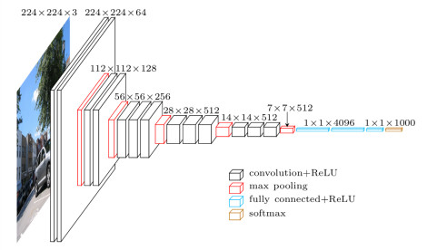
VGG16: A Famous Learning Algorithm
Due to Karen Simonyan and Andrew Zisserman of Oxford Robotics Institute, 2014
Actually a family of closely related algorithms: VGG11, VGG13, VGG16, VGG19
Example of a Convolutional Neural Network (CNN)
There are fancier CNNs, but VGG is computationally light, very fast and works well
For image processing, I’m mainly using VGG11 and Google Inception V3
* tiling
* multiple instance learning
Image: Step by step VGG16 implementation in Keras for beginners - Rohit Thakur – Aug 2019

Slide 6
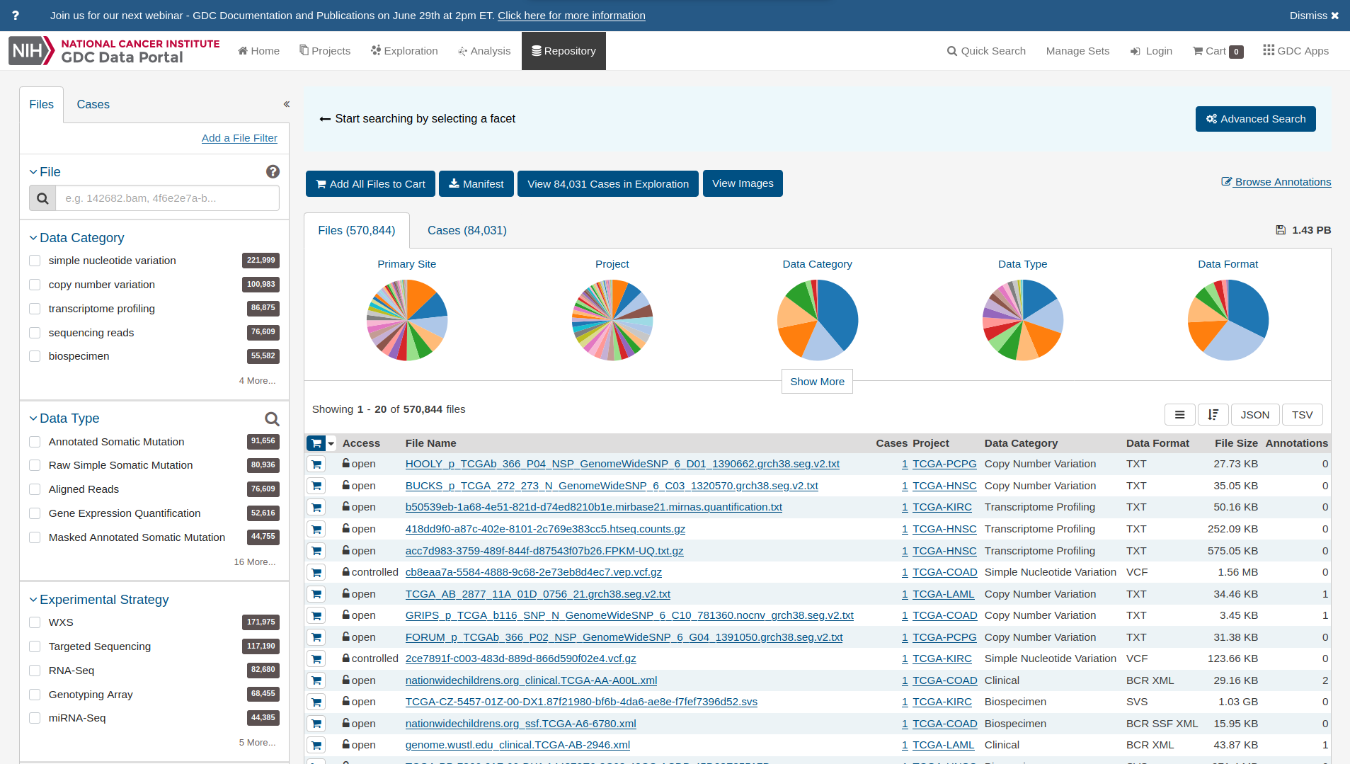
Sourcing Experimental Data
Need matched slide image and gene expression data
In general; available datasets are either histopathology image oriented or -omics oriented (but not both)
Usually small and poorly structured
NIH Genomic Data Commons (GDC) is an exception:
Great deal of data covering diverse cancer types and includes a lot of cases that have multi-modal data
Extremely well structured, and has a very good API for programmatic access (which I use extensively)
Have used DLBCL, SARC and STAD datasets

Slide 7
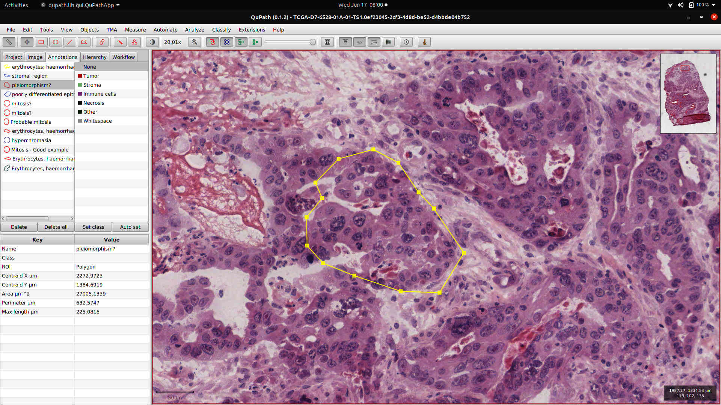
Stomach Adenocarcima (STAD) Example
Image File
  scan of an H&E stained biposy slide
  usually in SVS format (Leica/Aperio proprietary format based on TIFF)
  relatively low resolution (29,000px x 21,000px). Can be e.g. >100,000px x >70,000px
  very little normal tissue, which is common for the STAD dataset
  Opened here in “QuPath” open source image annotation tool; pleiomorphism in yellow
Case ID: TCGA-KB-A6F7
Gene Expression File
  RNA-Seq. UQ FPKM (Upper Quartile value of Fragments Per Kilobase Of Exon Per Million Fragments Mapped)
  A single number for each of 60,483 mRNAs. Not interested in all of these!
Class Label for training
  “Intestinal Adenocarcinoma, Not Otherwise Specified (NOS)”
  Represented in the NN by the integer ‘1’ (there are 7 classes in total)

Slide 8
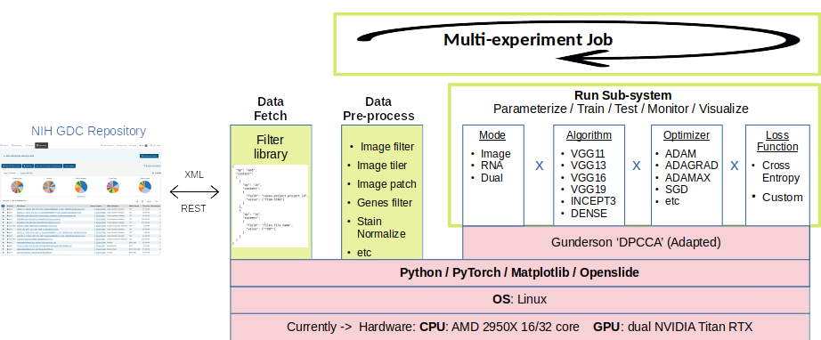
Experimental System
Core functionality:
PyTorch via an adaptation of ‘DPCCA’ software (Gregory Gunderson / Princeton)
+ Openslide
+ Matplotlib + Tensorboard
+ NVIDIA TITAN RTX GPUs
PD extensions:
To make it easy to change hyperparameters and NN algorithms on the fly <- modular and parameter driven run subsystem
To automate the acquisition of data from GDC <- data fetch module
To automate the pre-processing of data (eg. tiling, patching, removal of background and degenerate tiles) <- pre-processing subsystem
To define and run a batch of experiments in one go <- multi-experiment Job
To monitor training and vizualize results <- Tensorboard hooks

Slide 9
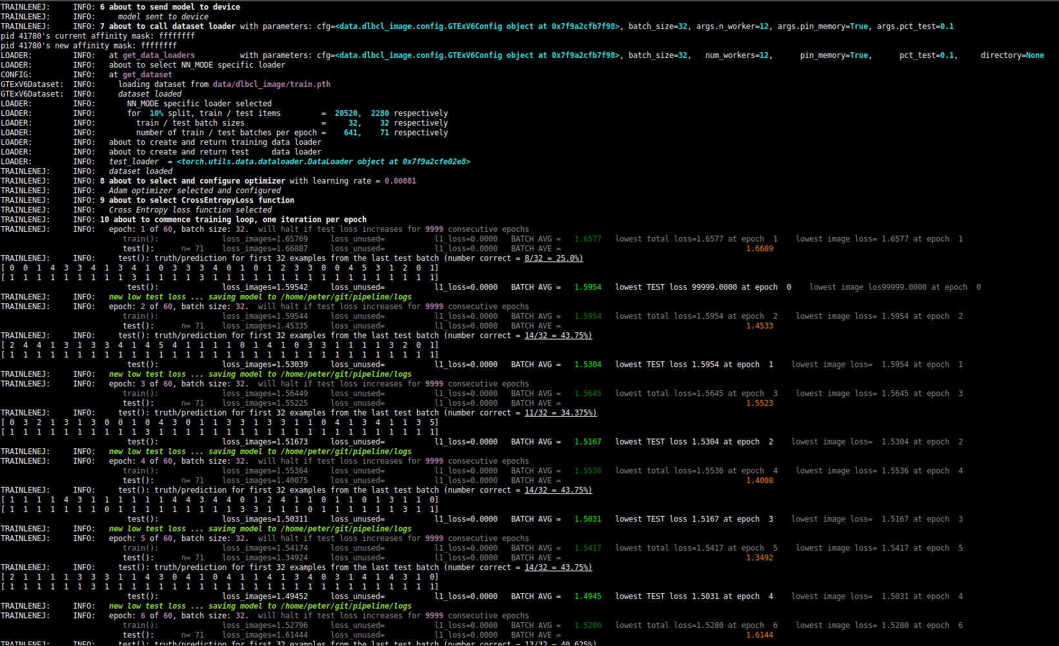
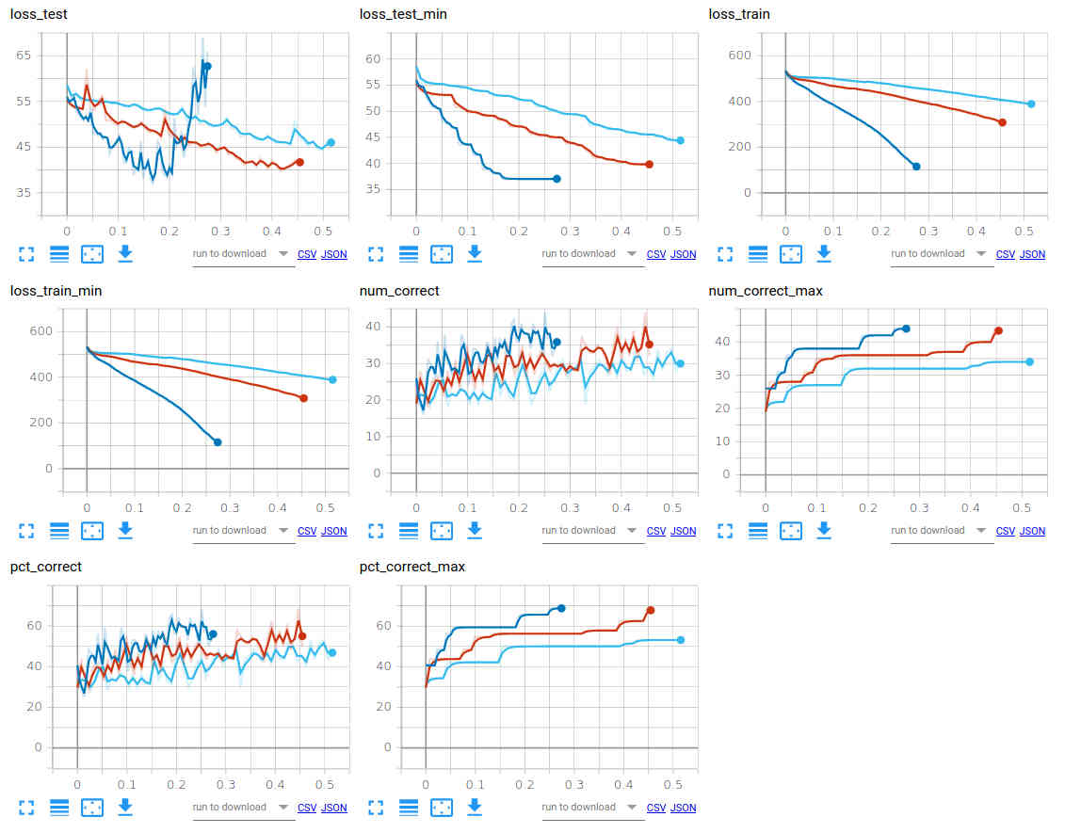
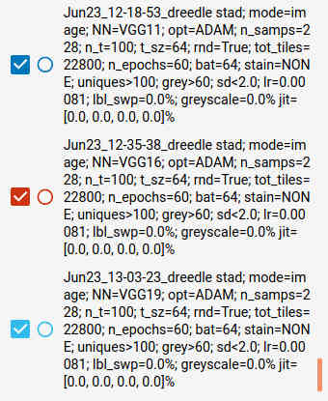
Monitoring Jobs & Visualizing Results
(1) Terminal console to monitor training jobs
(2) Results visualization using Tensorboard
  Graphs showing how key parameters vary during course of training
  Annotated images (Matplotlib for grunt work – Tensorboard just displays)
  E.g. Comparing 3 types of CNN (VGG11, VGG16, VGG19), other hyper-parameters constant

Slide 10
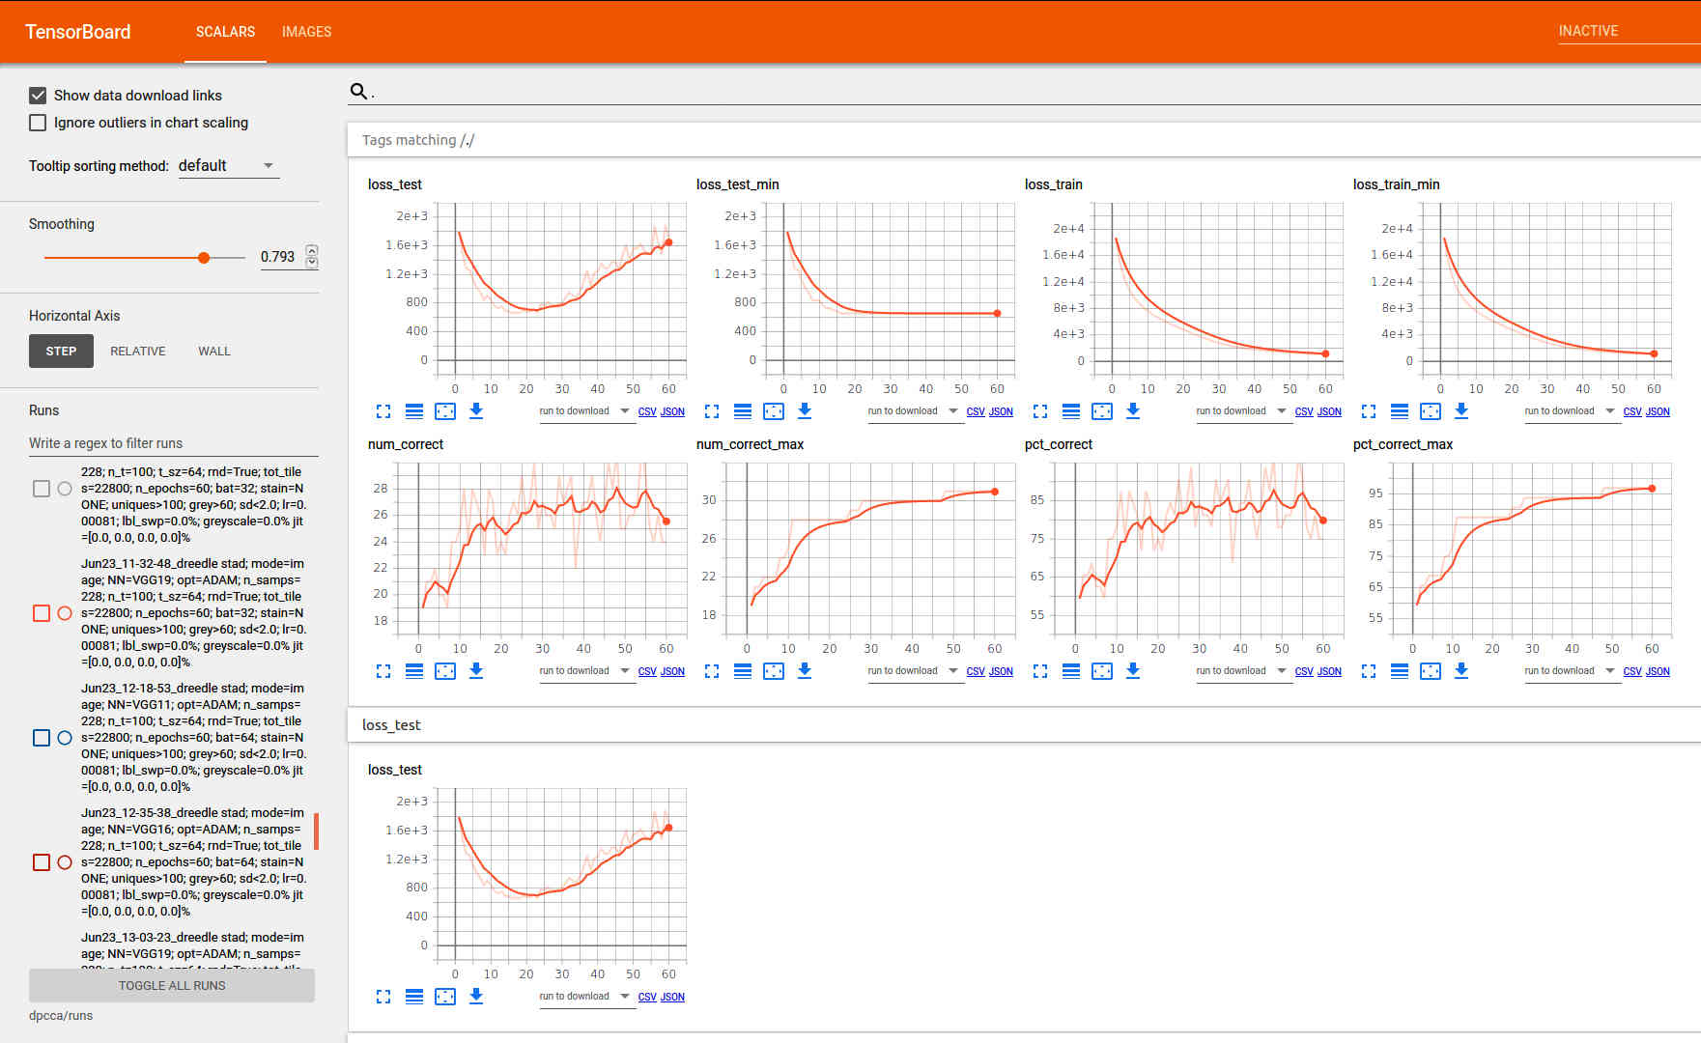
Typical Training Run with STAD Dataset
Network: VGG11 + ADAM (AdaGrad and RMSProp) optimizer + cross entropy loss function
Samples = 228, 2000 tiles/sample, tile size = 64pxx64px, random batches, batch size 32, learning rate 0.00081, 60 epochs, Training:Test = 90:10
(Number of tiles “seen” during training = 2000x0.9*228x60=24,624,000)
80-90% correct tumour classifications after about 20 epochs on test samples, and that’s been typical for experiments with STAD

Slide 11
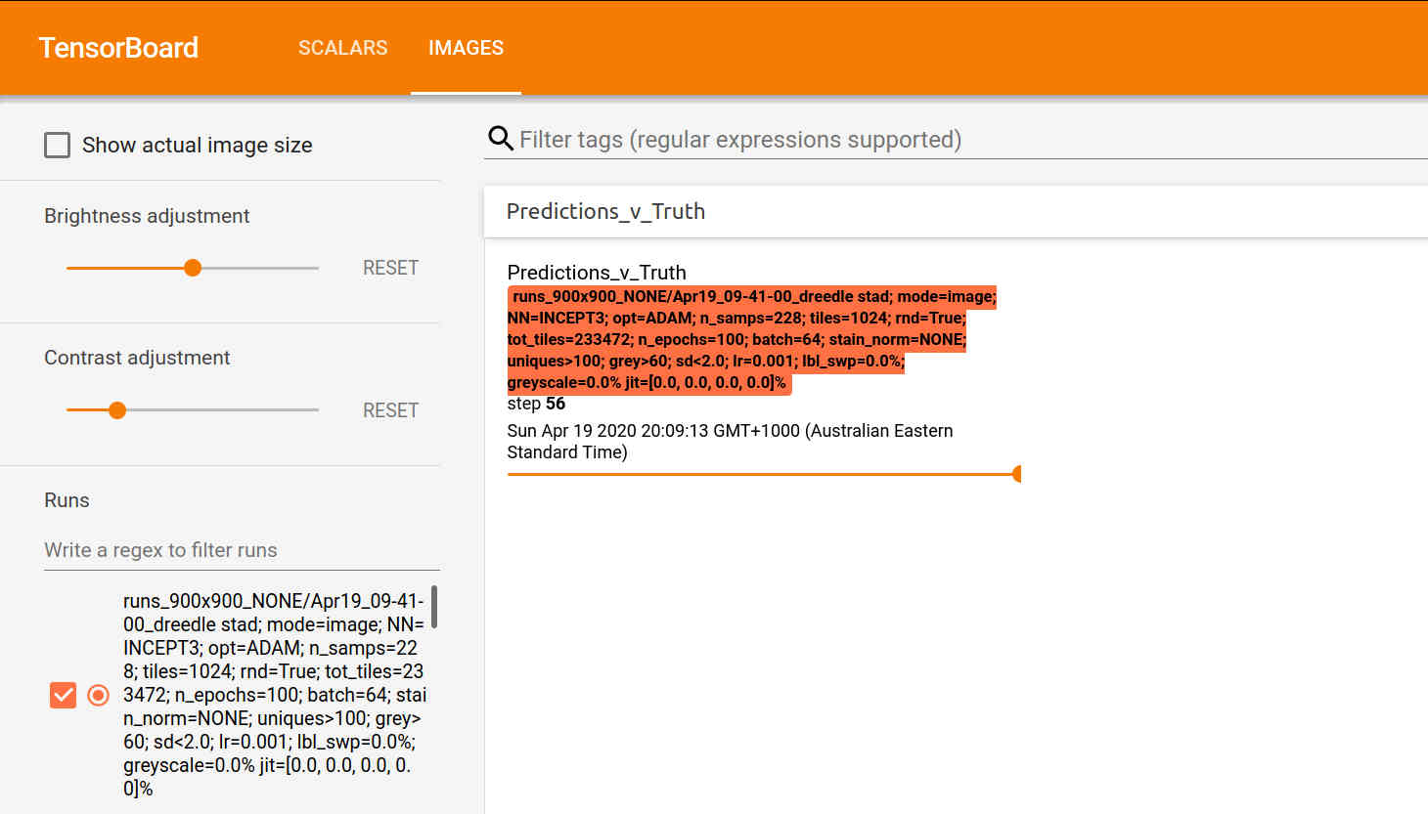
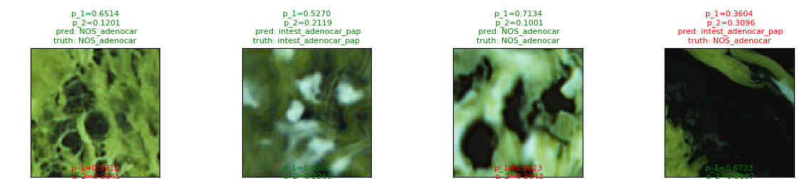
Tile-level Outputs Aren’t Very Informative
We’re training the network on individual tiles drawn at random from a giant bag of tiles
The image shows some tile level results: each has the predicted cancer sub-type and confidence level (probability)
But we’d really like to see what’s going on at the level of an entire sample or at least a decent portion of it
Need to give the trained model (NN) a set of tiles corresponding to a contiguous 2D patch and aggregregate the results

Slide 12
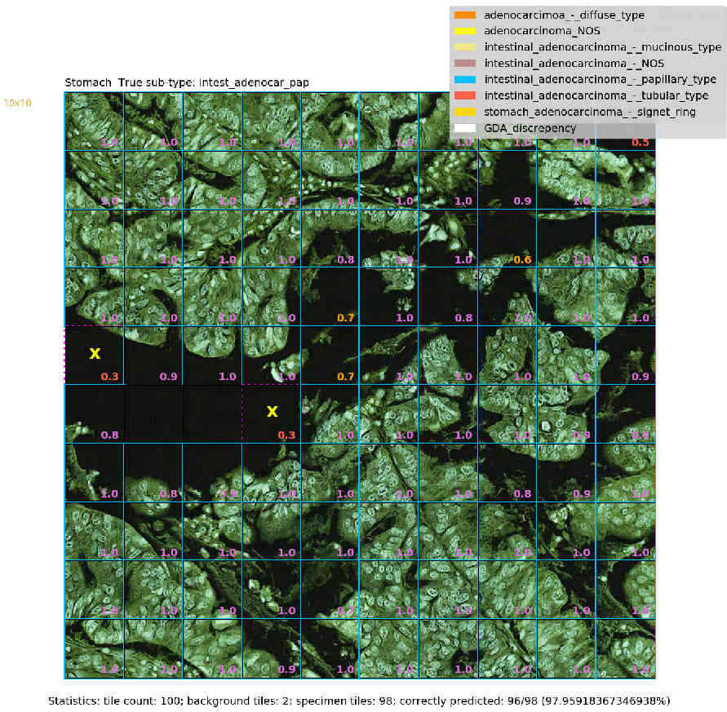
A Confident Correct Prediction: Intestinal AD, Papillary type
Inception 3 Network; ADAM optimiser; Learing rate=0.001; no stain normalization; patch of 100 128x128 tiles
Note: predictions are always ‘tile-level’. They are aggregated to produce an overall prediction for the patch
1
Dataset
True class
Blue boundary
around tile
100 tiles
Correctly predicted
to be papillary type
papillae
incorrectly predicted to be adenocarcinoma_NOS
Probability assigned to true class
1 patch
Tiles without p-values are background or degenerate tiles & excluded during pre-processing
Patch level statistics

Slide 13
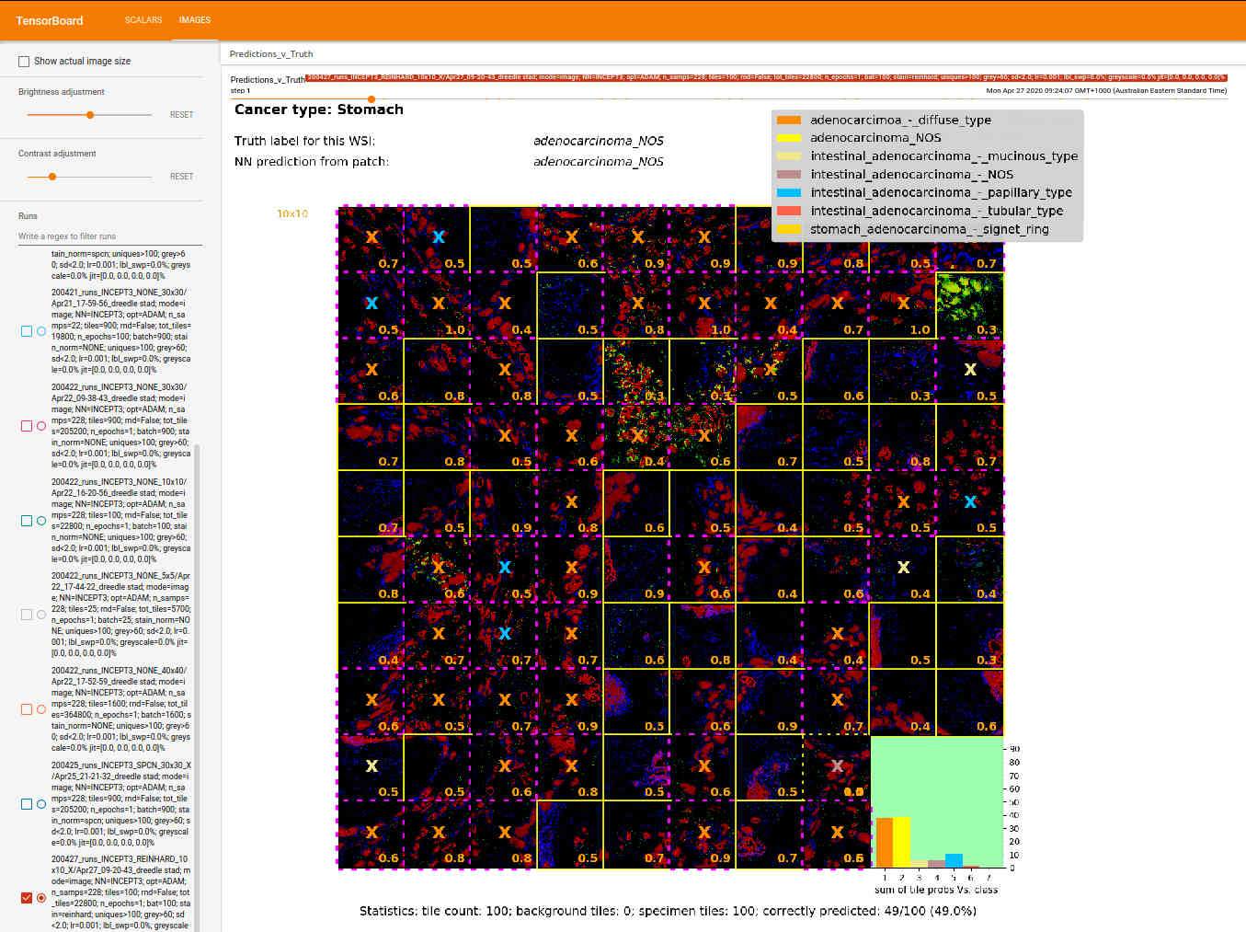
An Unconfident Correct Prediction: Stomach AD NOS
Inception 3 Network; ADAM optimiser; Learing rate=0.001; Reinhard stain normalization; patch of 100 128x128 tiles

Slide 14
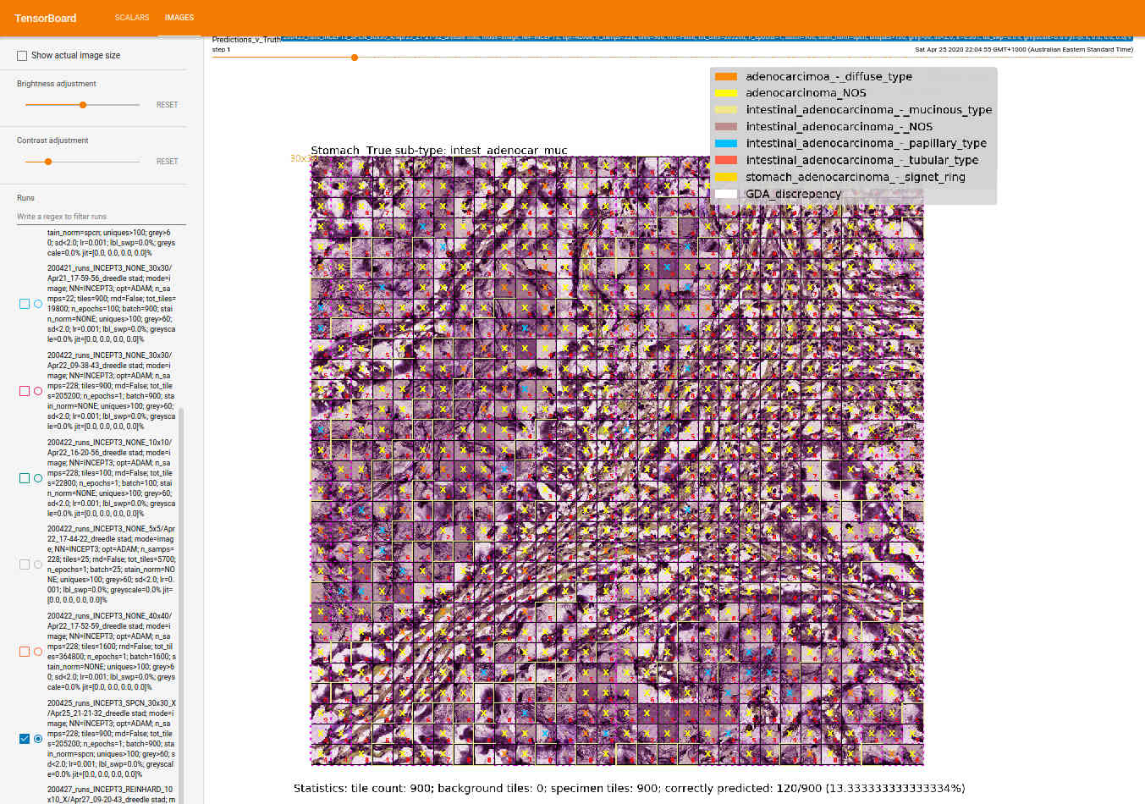
A Badly Wrong Prediction: Intestinal AD - Mucinous Type
Inception 3 Network; ADAM optimiser; Learing rate=0.001; SPCN stain normalization; patch of 900 128x128 tiles
Only 13% of tiles correctly classified. Most tiles classified as NOS
23/232 samples are Mucinous Type, so it’s a somewhat under-represented in the training set

Slide 15
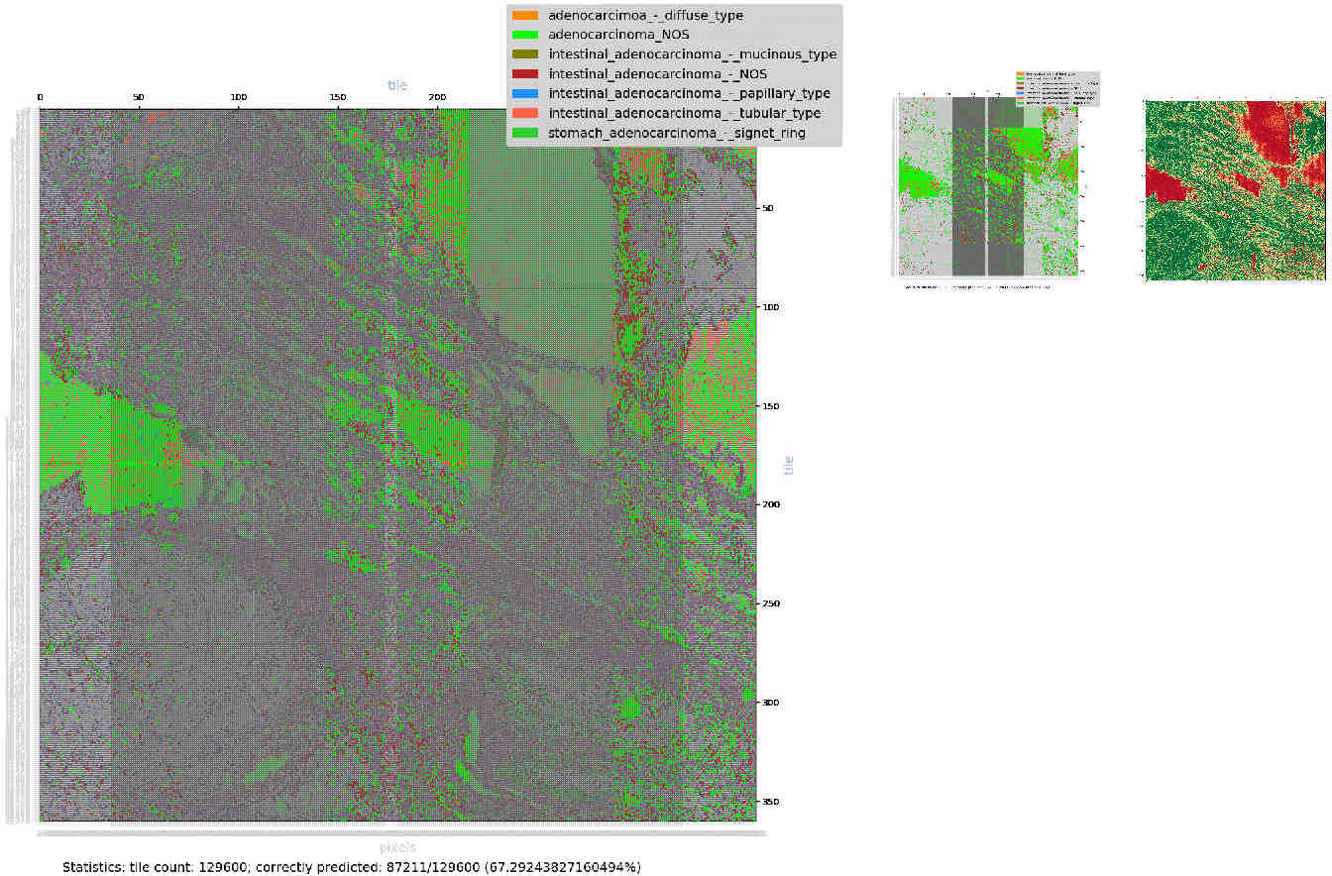
Increasing the Size of the Annotated Patch
Here, 360x360 (=129,000) 64x64px tiles (23,040x23,040 pixels), but still only about 8% of the area of the orginal slide image
360 tiles
360 tiles

Slide 16
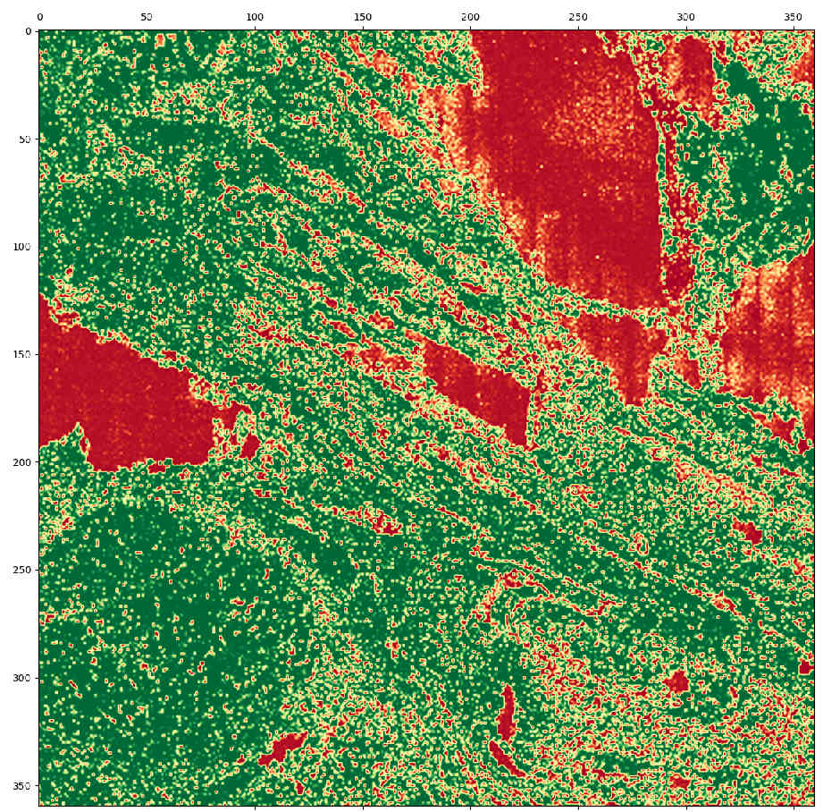
Visualizing Other Interesting Aspects
Eg. Here, p(true_class) visualized using green-red spectrum (deep red=0, deep green=1) and cubic spline interpolation

Slide 17
Remaining to be Done
Image mode
  Visualize even larger patches
    The full sample if possibe
  Have the NN accept tiles with different resolutions as inputs
    At the moment NN is getting only a very close up view of the samples
    human pathologists consider macro-level, micro-level visual structures and textures in series-parallel fashion
Gene mode
  Automate the extraction of subsets of genes appropriate to the cancer super-type (eg. STAD)
  Suitable visualization for gene mode
Get Dual mode working
Make sure it works with bone marrow aspirate samples
  Totally different visual appearance to H&E stained slides

