Slide 1
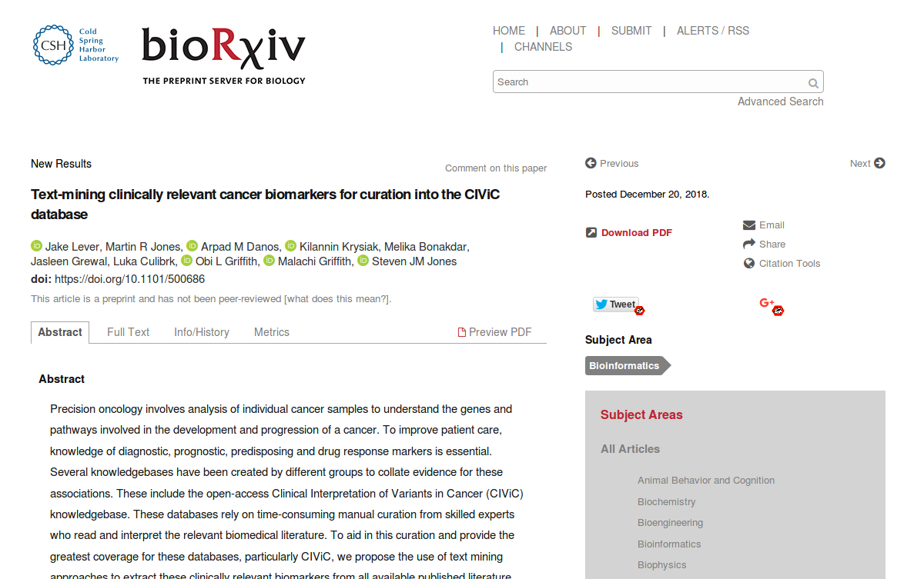
‘CIViCMine’

Slide 2
Interesting paper/project because...
Real problem
Recent
Simple objective, but ambitious in scope
Well executed
It worked
Largely reused existing tools
Points to some future development directions

Slide 3
CIViCMine
Objective
Extract cancer biomarkers from PubMed articles using supervised learning for potential inclusion in the ‘CIViC’ knowledgebase
Motivation
Variants are manually curated into CIViC, so progress is slow and hard won.
Vast amount of such information in the literature, but scattered willy-nilly, and completely unstructured
Why not automatically extract this information to accelerate rate of population of of CiViC?
Domain
Natural Language Processing >> Text Mining >> Relationship Extraction

Slide 4
‘CIViC’ Knowledgbase
CIViC = ‘Clinical Interpretation of Variants in Cancer’
Crowdsourced knowledgebase of curated cancer biomarkers
Launched in 2015
“Several groups have created knowledgebases to aid clinical interpretation of cancer genomes, many of whom have joined the Variant Interpretation for Cancer Consortium (VICC). VICC is an initiative that aims to coordinate variant interpretation efforts and, to this end, has created a federated search mechanism to allow easier analysis across multiple knowledgebases . The CIViC project is co-leading this effort along with OncoKB, the Cancer Genome Interpreter, Precision Medicine Knowledge base Molecular Match, JAX-Clinical Knowledge base and others.
Each CiViC entry contains:
Free text ‘Evidence Statement’
Structured statement assertiing one of four relationships (Diagnostic, Predictive, Predisposing, Prognostic) between 1+ gene(s), variant(s), disease(s) drug(s)
Uses standard Ontologies for genes/variants/disease names

Slide 5
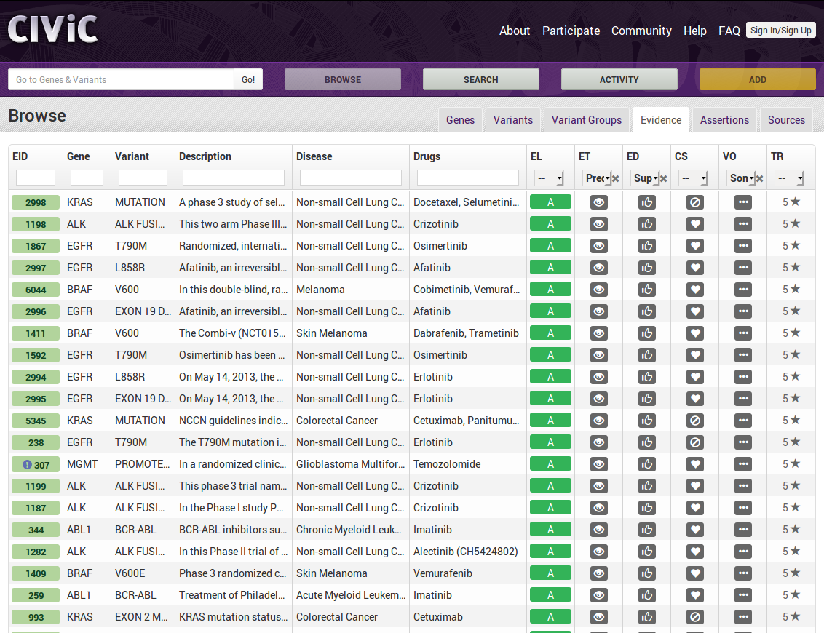

Slide 6
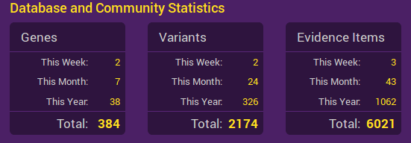
CIViC
Stats as of this week

Slide 7
Method
Preliminary Setup
Extract Candidate Sentences from PubMed
Establish Training Set using humans
Train Model on just the Training Set sentences
Run Model on all other sentences
Post-processing Steps

Slide 8

Learn What?
For each candidate sentence from PubMed…
For each of four relationships of interest ...
Does the relationship actually exist within the sentence?
(i.e. Is the probability that the relationship exists near to 1?)

Slide 9
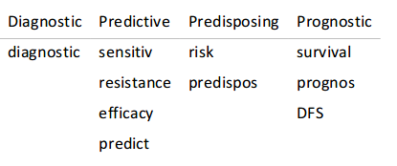
1 Preliminary Setup
Define term lists for genes, variants, cancer types and drugs
Cancer types: Disease Ontology + UMLS Metathesaurus
Genes: NCBI Entrez Gene ID + UMLS
Variants: Custom list (Jake Lever’s “Biowordlist”)
Drugs: WikiData
Define relationship keywords for each relationship of interest
Download all of PubMed (not just the Public bit)
Using ‘pubrunner’
Convert to BioC format
Relationships: Diagnostic, Predictive, Predisposing, Prognistic
Objects: gene, cancer type, variant, drug

Slide 10
2 Extract Candidate Sentences
Extract every sentence from PubMed that meets the following criteria:
The sentence mentions:
at least one gene AND
at least one variant AND
at least one cancer type AND
at least one relationship keyword
(AND OPTIONALLY ALSO one or more drugs)
To produce a large set of sentences which might instantiate a biomarker (= relationship of interest)
Relationships: Diagnostic, Predictive, Predisposing, Prognistic
Entities: gene, cancer type, variant, drug

Slide 11
3.1 Establish Training Set
Load a random subset of candidate Sentences into a web-based annotation tool (based on ‘bootstrap’)
Get curators to assess presence/absence of a relationships within a sentence presented to them, using the annotation tool << KEY STEP
High degree of consensus among curators needed. Went through some hoops to achieve this
continue until 200 relationship containing sentences have been accumulated for each of the four relationship keywords.
call the set of 800 annotated sentences ‘Training Set’
Relationships: Diagnostic, Predictive, Predisposing, Prognistic
Entities: gene, cancer type, variant, drug

Slide 12
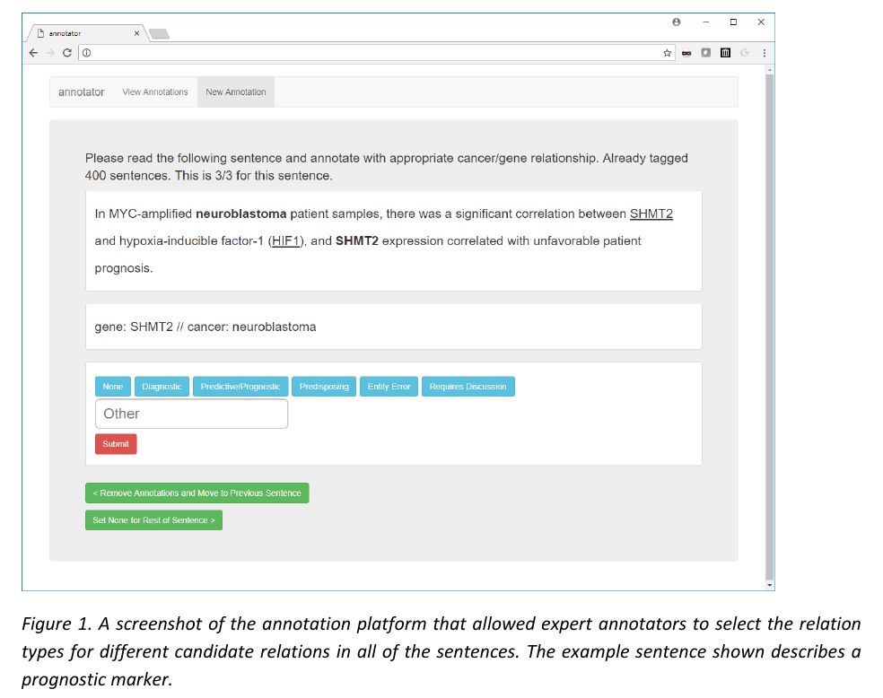
3.2 Anotation Tool
here, an example of a ‘prognosis’ relationship

Slide 13
4.1 Train Model
Use Training Data to train a Supervised Learning Tool
Logistic Regression Model
Support Vector Machine was also tried, but ‘The logistic regression classifier was more amenable to adjustment of precision-recall tradeoff’
Using the ‘Kindred’ relationship extraction tool
Kindred:
Development inspired by 2016 BioNLP shared task
Built on top of:
‘scikit-learn’ libraries (classifiers)
Stanford ‘NLPCore’ (sentence splitting and tokenization)
Relationships: Diagnostic, Predictive, Predisposing, Prognistic
Entities: gene, cancer type, variant, drug

Slide 14
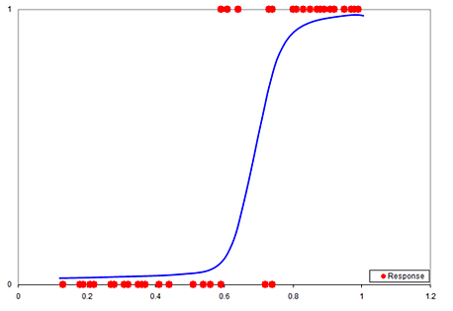
4.2 Logistic Regression Learning Algorithm
Represent each sentence by (numeric) feature vectors
Eg. entities as one-hot vectors, unigrams between entities as bag-of-words count etc
Actual Feature vectors defined in scilearn-kit tool.
Find best fit sigmoid curve for Training Set sentences (feature vectors of)
Curve with least aggregate error when summed across all training examples
Using ‘maximum likelihood’ algorithm
This curve defines the model
Feed in the remainder of sentences
Feed in (the Feature Vectors of) any sentence the model hasn’t seen before and a number between 0 and 1 will be returned.
Interpret this as the propbability the that relationship exists in the sentence
Provided the model isn’t overfit, underfit etc.
1 = ‘the relationship certainly exists’
>=0.95 = ‘we’ll say the relationship exists
<0.95 = ‘we’ll say the relationship does not exists
0 = ‘the relationship certainly does not exist’
Relationships: Diagnostic, Predictive, Predisposing, Prognistic
Entities: gene, cancer type, variant, drug

Slide 15
5 Run Model
Apply the trained model to the remainder of the candidate sentences to identify those which, according to the model, contain valid relationships
i.e. model will assign a probability to the proposition: ‘how likely is it that this sentence instantiates the relationship of interest between the entities of interest’
Relationships: Diagnostic, Predictive, Predisposing, Prognistic
Entities: gene, cancer type, variant, drug

Slide 16
6 Post-Processing Steps
‘CIViCMine’
Store the confirmed sentences and their assocated relationships in a database
Provide a Web-based dashboard for users access the results
Compare the automatically extracted biomarkers to those which were already in CIViC
Ask human curators to review/validate some of them
Update weekly against additions to PubMed
Using the ‘pubrunner’ tool
Relationships: Diagnostic, Predictive, Predisposing, Prognistic
Entities: gene, cancer type, variant, drug

Slide 17
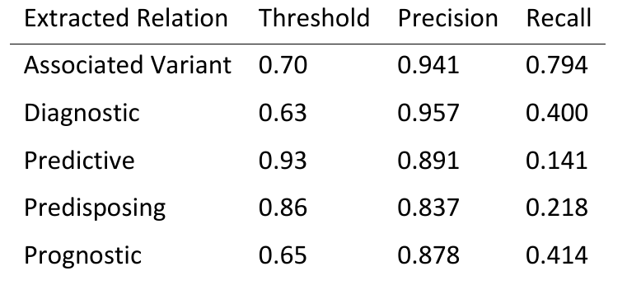
Thresholds
Favoured higher precision/lower recall, to reduce false positives that CIViC curators will have to sift through
Relationships: Diagnostic, Predictive, Predisposing, Prognistic
Entities: gene, cancer type, variant, drug

Slide 18
Results
Input: All articles in PubMed
Rule-Processed Input: 202,390 candidate sentences (from 69,258 papers)
Output after Learning: 128,857 relationship-containing sentences, embodying 90,992 biomarkers
Not a 1:1 correspondence, because:
some sentences embody more than one relationship; and,
many biomarkers supported by more than one sentence (e.g. ‘BRCA1 mutation is predisposing for breast cancer’ in 725 papers)
The 90,992 biomarkers include mentions of 7,866 genes, 667 cancers and 402 drugs
Relationship metrics
~66,000 for 'Prognostic' (by far the most common)
~10,000 for 'Diagnostic'
~10,000 for 'Predictive'
~6,000 for 'Predisposing'
Relationships: Diagnostic, Predictive, Predisposing, Prognistic
Entities: gene, cancer type, variant, drug

Slide 19
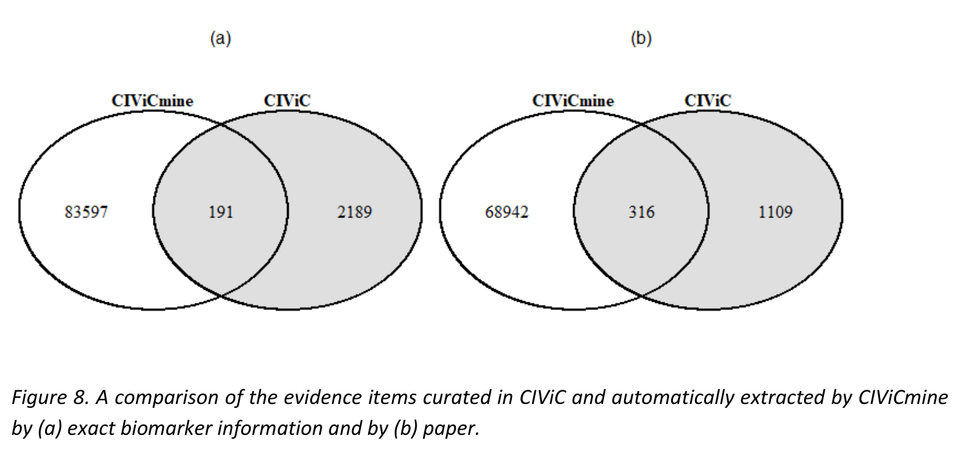
Overlap with CIViC
Almost no overlap with items already in CiVic

Slide 20
Validation
Review by human curators
For a sample of the biomarkers found by CIViCMine: Does human curator agree with CIViCMine finding?
Three questions: ‘Correctness’, Needed for Inclusion in CIViC’, ‘Sufficient Data to include in CIViC’
73% of evaluated biomarkers deemed ‘appropriate’ for inclusion in CIViC
Bias: only biomarkers with a high citation count were selected for manual review
The percentage was a lot lower for the ‘Predictive’ relationship than for the other three relationships
Relationships: Diagnostic, Predictive, Predisposing, Prognistic
Entities: gene, cancer type, variant, drug

Slide 21
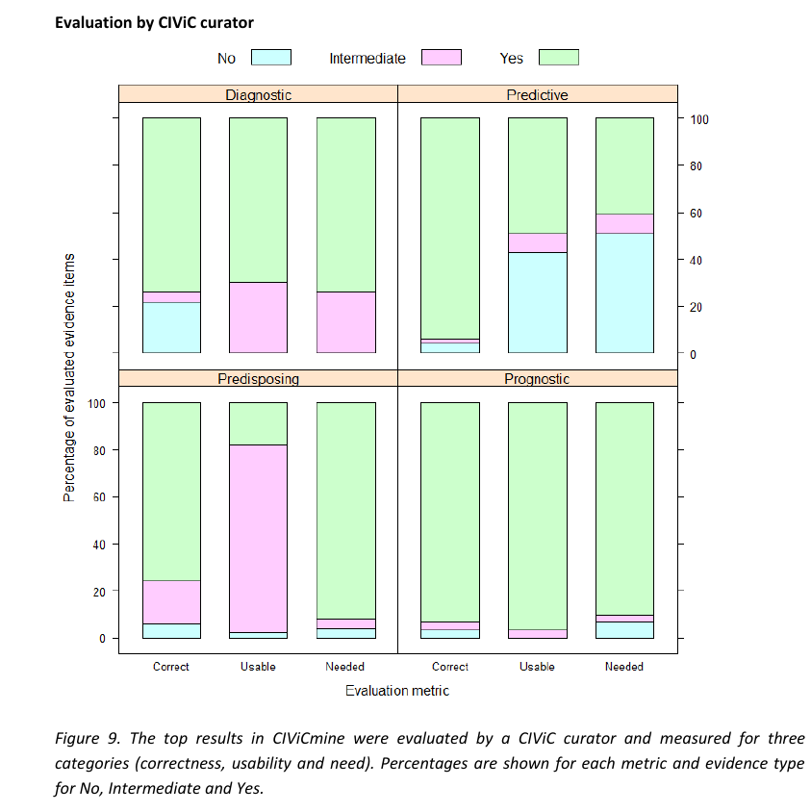

Slide 22
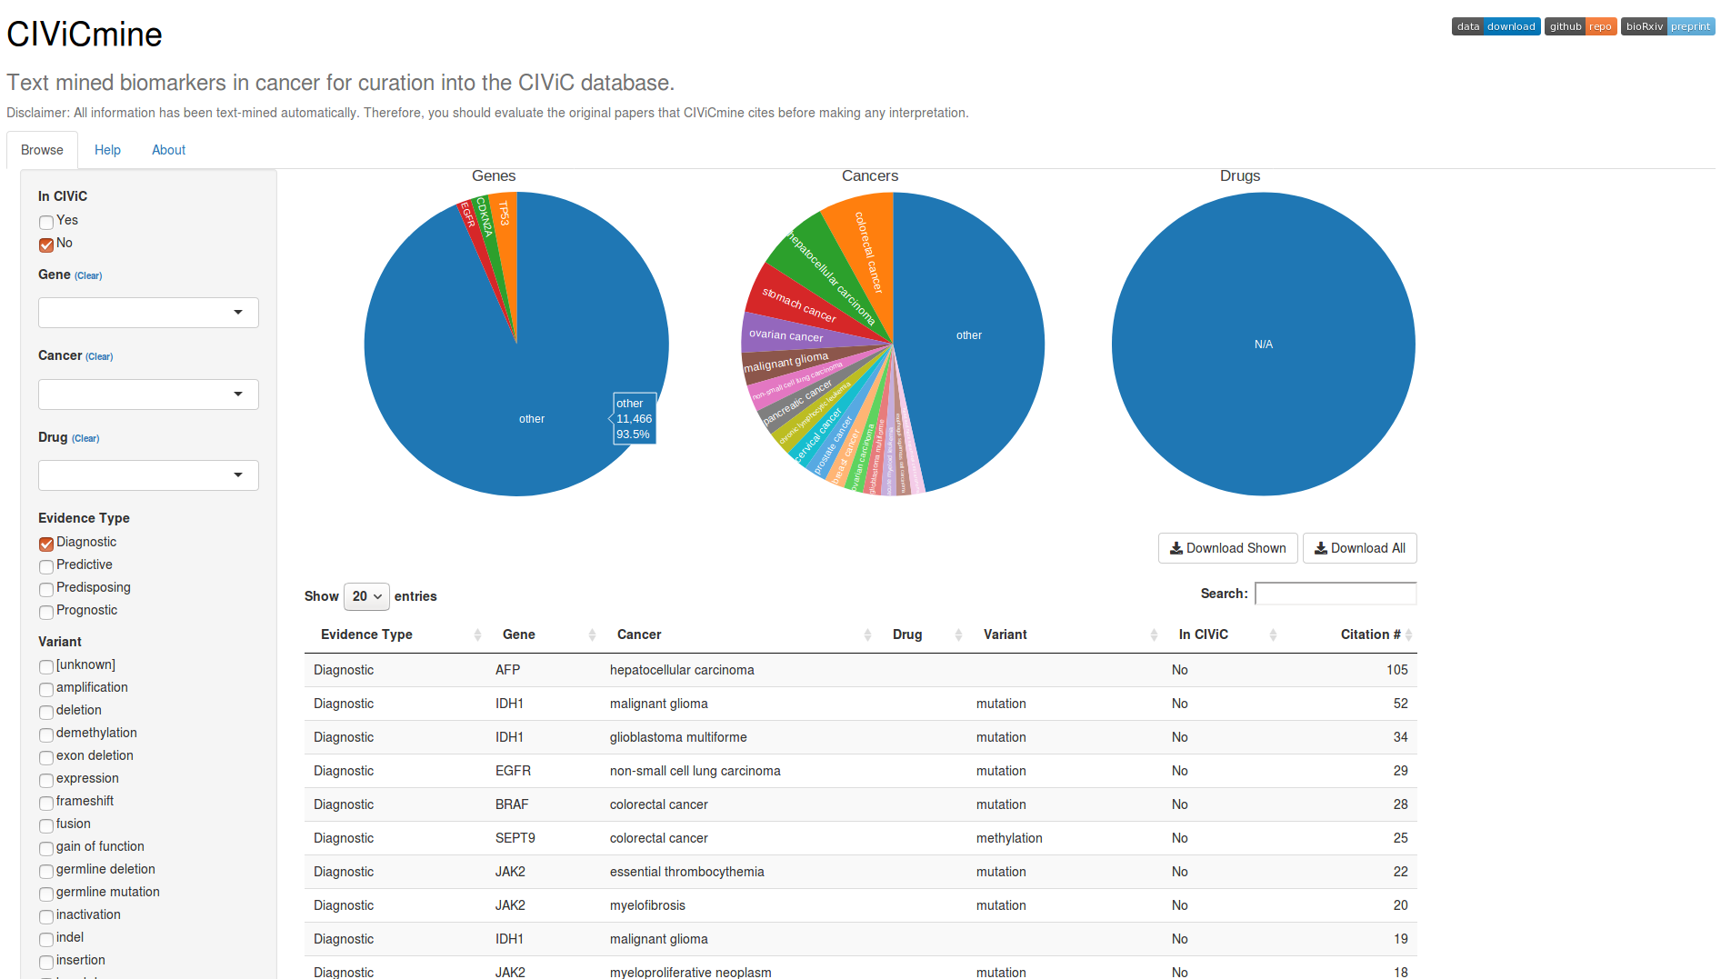
CIViCMine User Interface
http://bionlp.bcgsc.ca/civicmine/

Slide 23
Comments
Observations:
Didn’t work equally well for all relationships (volumes and quality)
What does very high proportion of ‘prognostic’ results mean?
Relationships spanning more than one sentence were out out of scope
Used a relatively low powered algorithm (Logistic Regression)
Initial PubMed extraction was rule based
Possible future directions:
Cast net wider for the initial sentence extraction step. Probably didn’t left quite a few valid associations behind
Include specific variant IDs (eg. HGVS names) as well as descriptive words
Maybe skip candidate extraction, and just include every sentence
Maybe use a higher powered ML technique than Logistic Regression, such as an Recursive Neural Network (RNN), e.g. particular LSTM, to pick up relationships that span more >1 sentence.
Maybe use Transfer learning or Cross-Corpus Learning The task of identifying relationships between sets of words in texts is a very general one.
What further processing/learning could be applied to the output set?

Slide 24


Slide 25
Bucket

Slide 26
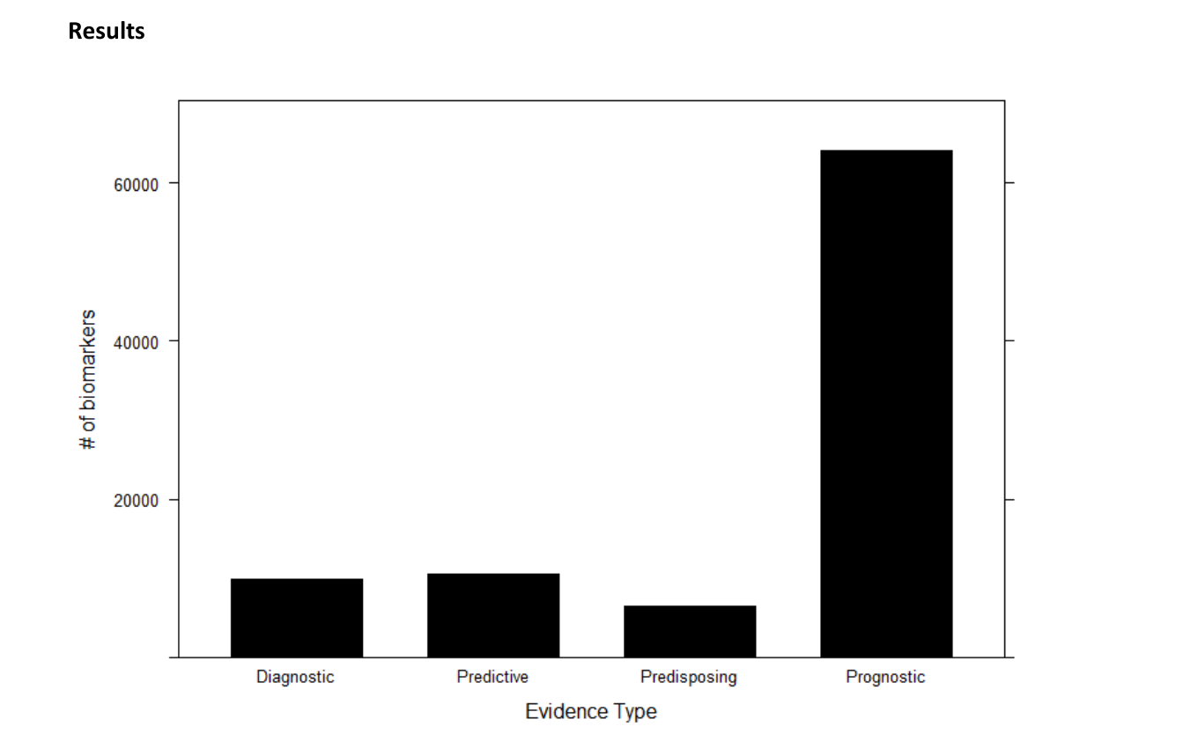
Results
Relationships: Diagnostic, Predictive, Predisposing, Prognistic
Entities: gene, cancer type, variant, drug

Slide 27
Background: CiViC
‘The manner in which the clinical relevance of variants in cancer is presented in the published literature is highly heterogeneous.
‘The CIViC data model is highly structured and ontology driven
‘Clinical interpretations are captured and displayed as evidence records consisting of a free-form ‘evidence statement’ and several structured attributes.
‘Each evidence record is associated with a specific gene, variant, disease and clinical action.
‘Evidence records belong to one of four evidence types indicating whether a variant is predictive of response to therapy, prognosis, diagnosis and/or predisposition for the cancer.
‘Evidence records also assigned to an evidence level ranging from established clinical utility (level A) to inferential (level E) evidence (Supplementary Figs. 3 and 4). The quality of the underlying published evidence is rated from one to five stars
Highly Manual !

Slide 28
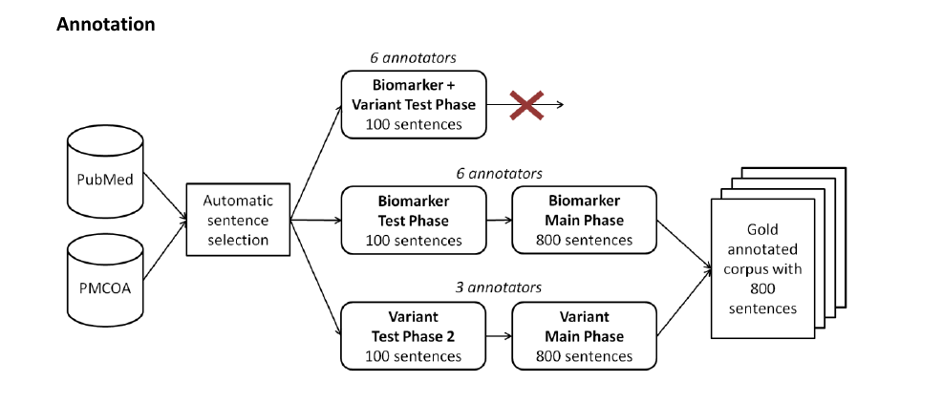
3.2 Establish Training Set

