Slide 1
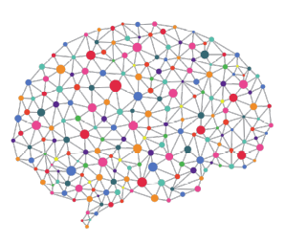


Additional Progress Review Meeting
Peter Donnelly
20 May 2021
peter.donnelly@petermac.org

Slide 2
Agenda
Current Status and Proposed Change to MPhil
Aim 1 of my PhD -‘Develop Suitable Experiment System’ as MPhil
Title, Objectives, Benefits
Draft Chapter Plan
Timeline
Description of Experiment System
Notes:
Thanks David and good afternoon everyone.
Can you see the slides and hear me OK?
My thesis topic is “Cancer Classification using Deep Learning on Matched Biopsy Images and RNA-Seq data”, and these are the topics I’m going to cover, fairly quickly, in the next 25 minutes or so
First I’ll provide the clinical motiviation for my thesis and state the hypothesis, and the project aims and objectives
I’ll go on to describe how neural network classifiers work, and also how their performance can be measured and compared, which is necessary to enable my hypothesis to be tested in a scientifically rigorous manner
I’ll then talk about the progress I’ve made over the last 12 months, and show you that I’ve built a flexible experiment system capable of testing the hypothesis and share the results from some preliminary experiments
And finally I’ll discuss how I’m going to bring it all together over the next 18 months

Slide 3
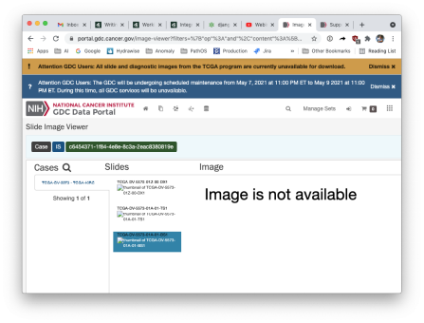
Current Status & Proposed Change to MPhil
Status
My PhD faces two significant and probably insurmountable challenges
Non-availability of expected T-Cell Lymphoma samples
NIH has, without notice, shut down access to the TCGA Whole Slide Image (WSI) image repository
Proposal
Change to MPhil (Part Time) based on Aim 1 of my PhD already completed
  Essentially aim 1 of my PhD:
  “Develop an automated classifier capable of testing the hypothesis”
  This was a substantial piece of work (2 years effort) that drew on my 20 years+ software engineering experience
Notes:
Thanks David and good afternoon everyone.
Can you see the slides and hear me OK?
My thesis topic is “Cancer Classification using Deep Learning on Matched Biopsy Images and RNA-Seq data”, and these are the topics I’m going to cover, fairly quickly, in the next 25 minutes or so
First I’ll provide the clinical motiviation for my thesis and state the hypothesis, and the project aims and objectives
I’ll go on to describe how neural network classifiers work, and also how their performance can be measured and compared, which is necessary to enable my hypothesis to be tested in a scientifically rigorous manner
I’ll then talk about the progress I’ve made over the last 12 months, and show you that I’ve built a flexible experiment system capable of testing the hypothesis and share the results from some preliminary experiments
And finally I’ll discuss how I’m going to bring it all together over the next 18 months

Slide 4
Title, Objectives, Benefits
Title
“An end-to-end software system to automate the conduct of machine learning classification experiments on cancer Whole Slide Images (WSI) and genomic data"
Objectives
Describe and develop such a system (already done)
Locate it in the context of the literature (not done)
Evaluate its performance (not done)
Benefits
Such an experiment system does not currently exist:
Typically, researcher must build an experiment system before they can conduct experiments. Time and energy that could otherwise be devoted to testing hypotheses
Raw data - especially images - requires a great deal of pre-processing before it can be used in a Machine Learning system
Neural Networks are still empirical and heuristic, and when training a non-trivial datset it is necessary to traverse a broad parameter space to get a good result. Hundreds of experiments necessary to optimise paramaters
Other researchers conducting cancer classification and similar experiments on Haemoxylin and Eosin (H&E) image and genomic data may find such a system beneficial
Notes:
Thanks David and good afternoon everyone.
Can you see the slides and hear me OK?
My thesis topic is “Cancer Classification using Deep Learning on Matched Biopsy Images and RNA-Seq data”, and these are the topics I’m going to cover, fairly quickly, in the next 25 minutes or so
First I’ll provide the clinical motiviation for my thesis and state the hypothesis, and the project aims and objectives
I’ll go on to describe how neural network classifiers work, and also how their performance can be measured and compared, which is necessary to enable my hypothesis to be tested in a scientifically rigorous manner
I’ll then talk about the progress I’ve made over the last 12 months, and show you that I’ve built a flexible experiment system capable of testing the hypothesis and share the results from some preliminary experiments
And finally I’ll discuss how I’m going to bring it all together over the next 18 months

Slide 5
Draft Chapter Plan
1 Literature Review
Chapter Summary
Recent Developments in Machine Learning and Neural Networks
The Application of Neural Networks to Pathology and Genomics
Cancer Classification Using Neural Networks
Image and Genomic Datasets
Reusable Tools and Frameworks
Conclusion
2 A Reusable Experiment System for Cancer Classification Using Neural Networks
Chapter Summary
Benefits of Such a System
System Description
Software Architecture
Functionality
Experiment types supported
User interface
Outputs
Technical Description
  Software Requirements
  Hardware Requirements
3 Applications of the Experiment System
Chapter Summary
Methods
Experiments
Subtyping Stomach Cancerusing RNA-Seq
Subtyping <Breast Cancer?> using Whole Slide Images)
Locating and Labeling Normal Tissue on Cancer WSI Samples Using Unsupervised Learning and Clustering
4 Evaluation
Chapter Summary
Metrics
Performance compared to other published results
6 Summary and Future Directions
Chapter Summary
Limitations
Future Directions
7 Contribution to the Field

Slide 6
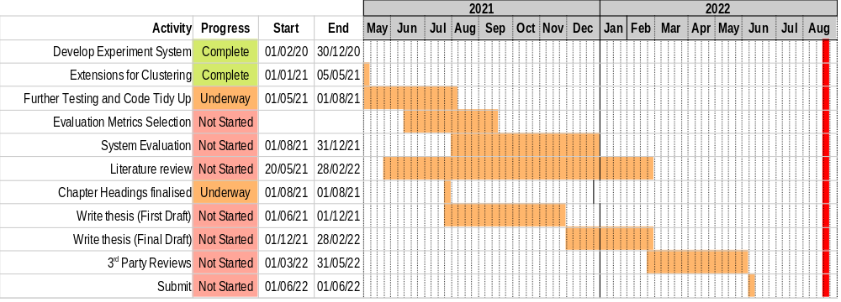
Timeline
Notes:
And finally, this chart puts the three Aims into the overall timeline for my thesis
It’s also on Page 18 of my report.

Slide 7


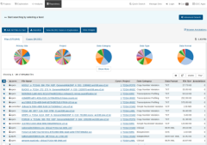
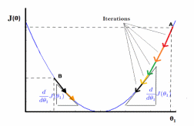

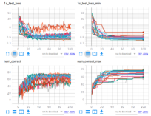
Experiment System
Fetch Raw Data
Pre-process Raw Data
Realize Optimum Model
Classify
Analyse Results
break
images
into tiles
remove background & degenerate
tiles
normalize
Colors
Image Branch
tiles
patches
Numerical normalization
TCGA
Extract
RNA-Seq
data
Reduce dimens-
ionality
resolve
gene
names
RNA Branch
RNA-Seq
Three main benefits for users:
  Handles all aspects of pre-processing
  Can define and run arbitrarily large batch of individual experminents from a single command
  Results logging and real-time graphic vizualisations are built in
Notes:
This is a schematic of the Experiment System and Classifier that I’ve developed over the past 12 months and am using for my experiments.
As mentioned, it’s almost complete. The only outstanding piece is the RNA-Seq portion of the multimode classifier, and that will take me 2-4 weeks to finish
It’s currently able to classify cancers using either image data, or rna-seq data, but not yet matched image and rna-seq data
So I can use it to establish a baseline for testing the hypothesis, but I can’t yet test the hypothesis.
I hope it comes through from this slide, that while the sysem incorporates a classifier – in fact, multiple classifiers - it’s a lot more than a classifier, it’s an end to end experiment system that automates much of the experiment process. I took this approach for two main reasons: first, it turns that acquiring and pre-processing the input data requires an enormous amount of effort, and it’s just not something that you’d want to do manually, for reasons of both time and quality control; and secondly, neural networks require a significant amount of tuning to get good performance: so having a system that allows experiments to be defined parametrically and run in batches is very efficient.
For example I can set up a job to run overnight which might have five different learning rates and three different classifiers - so 15 individual experiments - and set it running; then look at the results the next day and observe the effect of the combination of choices on outcomes.

Slide 8
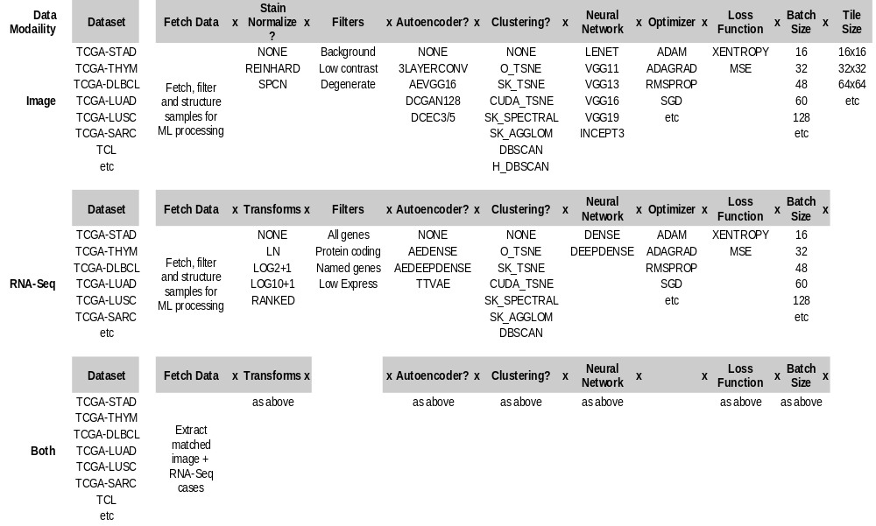
‘Mix and Match’ Options

Slide 9
Experiment System - Illustrative Examples
Acquire Stomach Cancer Dataset from GDC Repository
Classify Stomach Cancer Subtypes by Training Deep NN on RNA-Seq
Classify Stomach Cancer Subtypes by Training Deep NN on WSI Images
Unsupervised Feature Extraction of Stomach Cancer Whole Slide Images followed by T-SNE clustering
Notes:
Thanks David and good afternoon everyone.
Can you see the slides and hear me OK?
My thesis topic is “Cancer Classification using Deep Learning on Matched Biopsy Images and RNA-Seq data”, and these are the topics I’m going to cover, fairly quickly, in the next 25 minutes or so
First I’ll provide the clinical motiviation for my thesis and state the hypothesis, and the project aims and objectives
I’ll go on to describe how neural network classifiers work, and also how their performance can be measured and compared, which is necessary to enable my hypothesis to be tested in a scientifically rigorous manner
I’ll then talk about the progress I’ve made over the last 12 months, and show you that I’ve built a flexible experiment system capable of testing the hypothesis and share the results from some preliminary experiments
And finally I’ll discuss how I’m going to bring it all together over the next 18 months

Slide 10
1 Fetch Stomach Cancer Cancer Dataset from GDC Repository
Purpose:
Download STAD data from TCGA to use in ML and clustering experiments
Command:
.python ./gdc-fetch.py --debug=9 --dataset stad
--case_filter="filters/TCGA-stad_case_filter"
--file_filter="filters/GLOBAL_file_filter_SVS"
--max_cases=500 --max_files=2
--global_max_downloads=2000 --output_dir=stad"
What it does:
Downloads all stomach cancer cases which have BOTH Whole Slide Images and RNA-Seq data, for use ML experiments using the TCGA API
Filters for wanted files, structures and stores in a manner suitable for immediate use in subsequent experiments

Slide 11
2 Classify Stomach Cancer Subtypes by Training Deep NN on RNA-Seq
Purpose:
Trying to locate best performing network model for classification by traversing range of parameters
Command:
./do_all.sh -d stad -i rna -S 475 -a DENSE -b 64 -q 0.2 -o 100 -L ".001 .003 .007 .01 .03 .07" -5 "NONE LOG2PLUS1 LOG10PLUS1" -6 "NONE JUST_SCALE GAUSSIAN"
Trains 54 different Neural Networks in accordance with user provide parameters:
Base case:
  475 RNA-Seq samples drawn from TCGA STAD dataset
  3 layer DENSE network used for training
  10% dropout regularization
  20% of samples held out for testing
  200 epochs
… for every combination of the following parameters:
  Learning rate: .001 .003 .007 .01 .03 .07
  Numeric normalization: NONE LOG2PLUS1 LOG10PLUS1
  Scaling: NONE JUST_SCALE GAUSSIAN
Training curves are logged and plotted. Easy to see parameter combination producing best model
Takes about 120min to run all 54 jobs on my high-end GPU equipped laptop
Making it easy to systemtically traverse parameter space
Tiling isn’t repeated if a suitable tile set already exists. This saves a lot of time

Slide 12
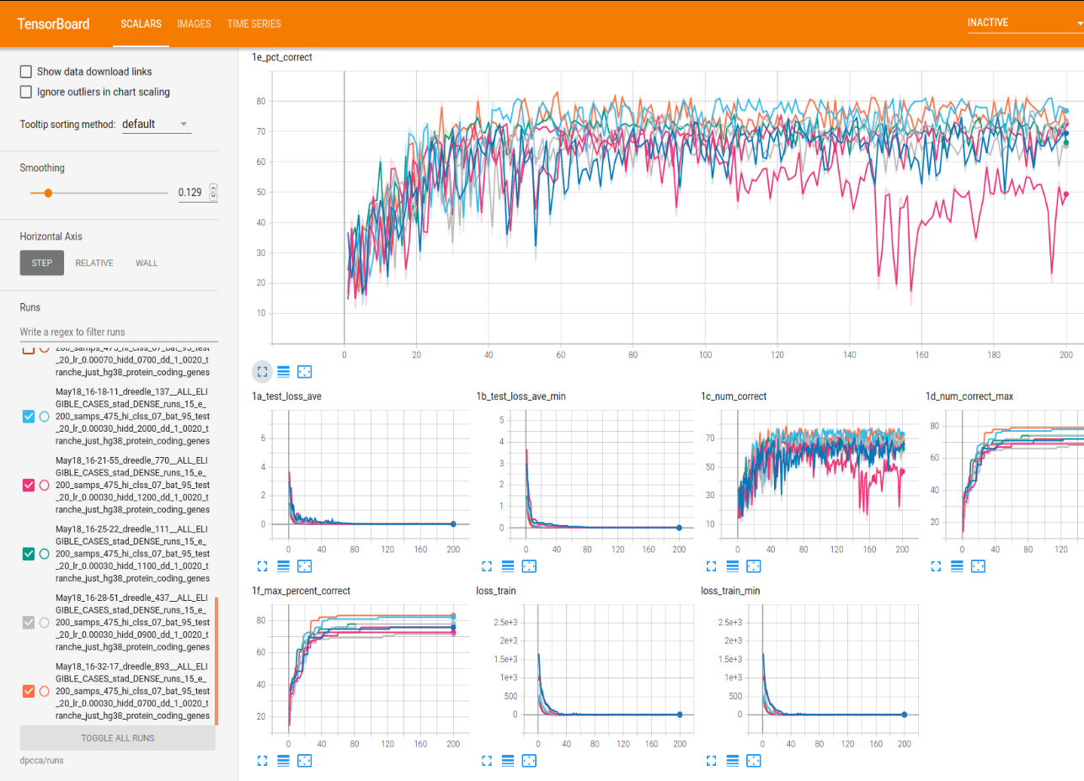
2 Easy to Locate the Model that Performed Best

Slide 13
3 Classify Stomach Cancer Subtypes by Training Deep NN on WSI Images
Purpose:
Multi-run job
Trying to locate best network model by traversing range of parameters
Command:
./do_all.sh -d stad -i rna -S 475 -a DENSE -b 64 -q 0.2 -o 100 -L ".001 .003 .007 .01 .03 .07" -5 "NONE LOG2PLUS1 LOG10PLUS1" -6 "NONE JUST_SCALE GAUSSIAN"
Initiates and runs a job comprising 54 experiments:
Base case:
  475 RNA-Seq samples drawn from TCGA STAD dataset
  3 layer DENSE network used for training
  10% dropout regularization
  20% of samples held out for testing
  200 epochs
...plus every combination of the following parameter variations:
  Learning rates: .001 .003 .007 .01 .03 .07
  Numeric normalizations NONE LOG2PLUS1 LOG10PLUS1
  Scalings: NONE JUST_SCALE GAUSSIAN
Training curves are logged and plotted using Tensorboard so that it is easy to determine best parameter combination produces the best model
Takes about 120min to run all 54 jobs on my high-end GPU equipped laptop
Makes it easy to systemtically traverse parameter space

Slide 14
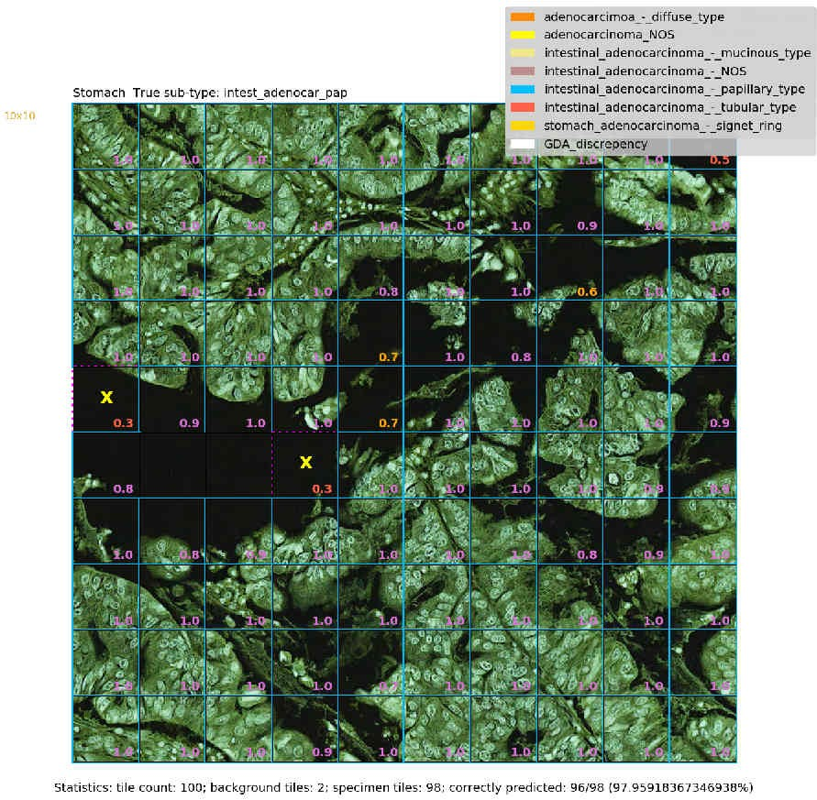
A Confident Correct Prediction: Intestinal AD, Papillary type
Inception 3 Network; ADAM optimiser; Learning rate=0.001; no stain normalization; patch of 100 128x128 tiles
1
Dataset
True class
Blue boundary
around tile
Correctly predicted
to be papillary type
papillae
incorrectly predicted to be adenocarcinoma_NOS
Probability assigned to true class

Slide 15
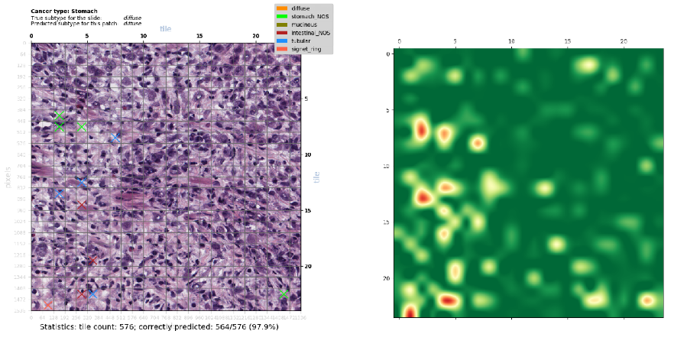
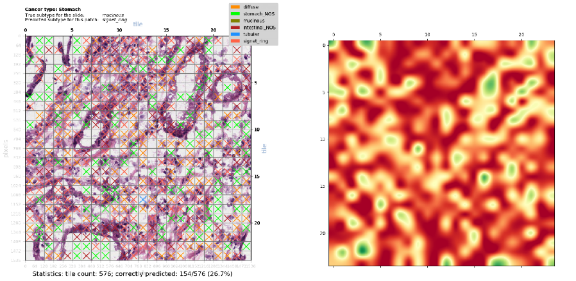
Heat Maps Show Prediction Confidence
Highly Confident and
Correct Prediction of Diffuse Subtype
(564/576=97.9% of tiles)
Badly Wrong Prediction of Mucinous Subtype
as Signet Ring Subtype
(154/576=26.7% of tiles)
This is the worst misclassification of all 229 images
Notes:
Here we have a second view of the image results, showing things at a more “zoomed out” level
To do this, the system extracts and classifies a contiguous 2D patch of tiles from each sample and makes a single, patch-level, prediction, either by tallying the number of tiles in the patch classified as each sub-type, or by adding up the probabilities assigned to each subtype in each tile; and I’ve implemented both of these scoring methods
The results here are classifications of 24x24 tile patches drawn from two of the 228 image samples from the same experiment run as before; and I’ve chosen two extreme results
For the patch images – so the left column - if a tile has a coloured X in it, that tile has been misclassified, and the colour of the X indicates the subtype it was misclassified to. If a tile doesn’t have an x in it, it was correctly classified.
The heatmaps in the right column show the confidence of the classifier’s predictions on a green-red spectrum, where dark green means highly confident and dark red means highly unconfident
So the top result is showing a highly confident prediction of Diffuse Subtype – highly confident because 98% of the tiles are classified correctly, and the heatmap further shows that the tile-level predictions were mostly quite high for the correct subtype and therefore quite low for all other subtypes
And the example at bottom shows a badly wrong pediction of Mucinous Subtype as Signet Ring subtype. You can see from the colored Xs that there was a lot of confusion with Diffuse and also the two ‘Not Otherwise Specified’ subtypes.
I’ve reviewed a number of these patch-level classifications with Pathologist Registrar Dr James Rickard, who has been very generous with his time in helping me to see these images through a pathologist’s eyes.

Slide 16
4 Unsupervised Feature Extraction of Stomach Cancer Whole Slide Images followed by T-SNE clustering
Purpose:
Looking for features in unlabelled pathology images. E.g. cancer subtype
Traversing a range of parameters
Command:
./cuda_tsne_multi_run.sh -d stad -i image -S 310 -f 10 -T 64 -b 32 -B 100 -q 0.2 -w 1.0 -h 7 -o 100 -a AEVGG16 -3 0.05 -t 50 -l cuda_tsne -R True
Initiates and runs a job comprising 112 experiments::
Extracts 10 64x64 pixel tiles at random x,y coordinates from each of the 310 TCGA STAD WSI image samples – in doing so filtering out background, low-contrast and degenerate tiles – to produce 3,100 image tiles
Divides the 3,100 tiles into a Training Set (80%) and a Test Set (20%) and encodes them for Machine Learning
Uses a VGG16 deep denoising convolutional autoencoder (ADAM optimiser, Mean Squared Error, Learning Rate=0.0005) with 5% peer noise to reduce dimensionality (100 epochs of training) reducing the 64x64x3=12,228 dimensions to 400 dimension embeddings
Performs very fast (GPU based) t-sne clustering on the embeddings, for each of 16 user provided ‘Perplexity’ values
Displays and saves the results of the clusterings, one page per embedding dimension value – see next slide
This example uses 7 values of embedding and 16 values of Perplexity, for a total of 112 experiments and takes about 4 hours to run

Slide 17
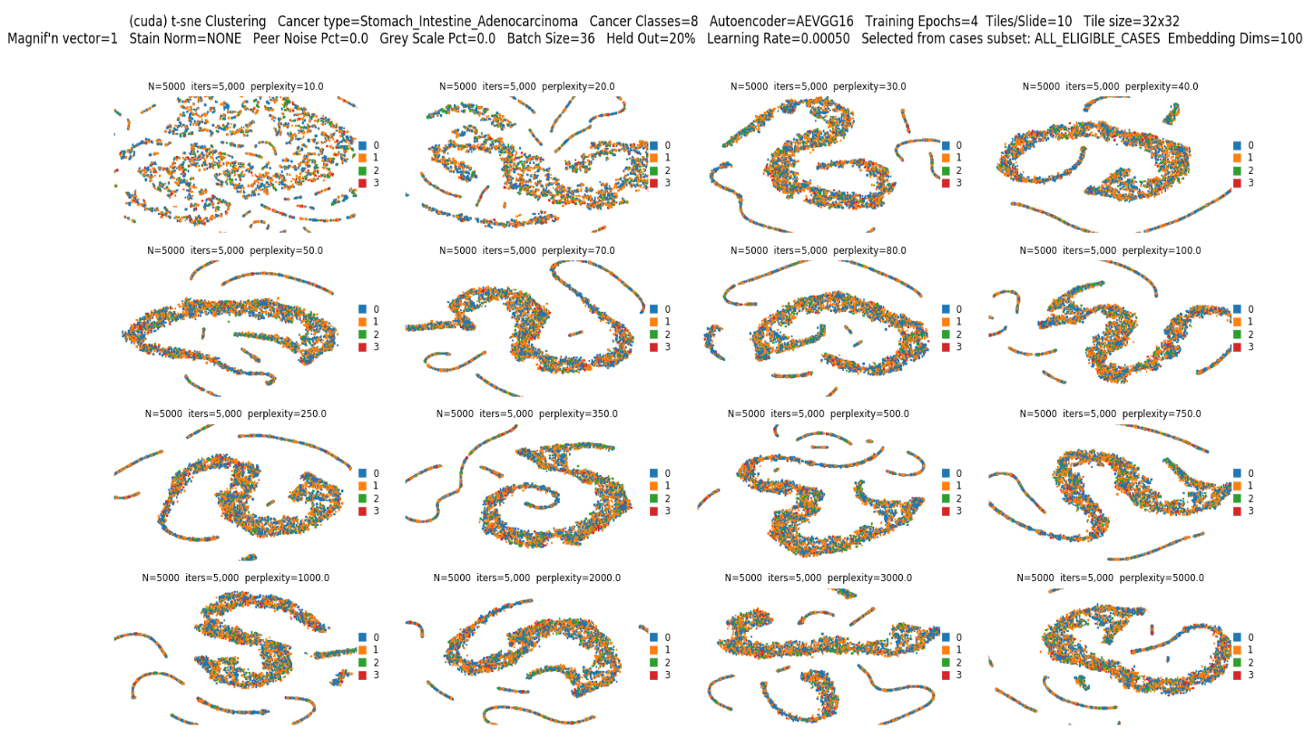
4 Cluster Plots (one of seven)
T-SNE cluster plot for 16 Perplexity values
Each colored dot is an image tile

Slide 18


Slide 19
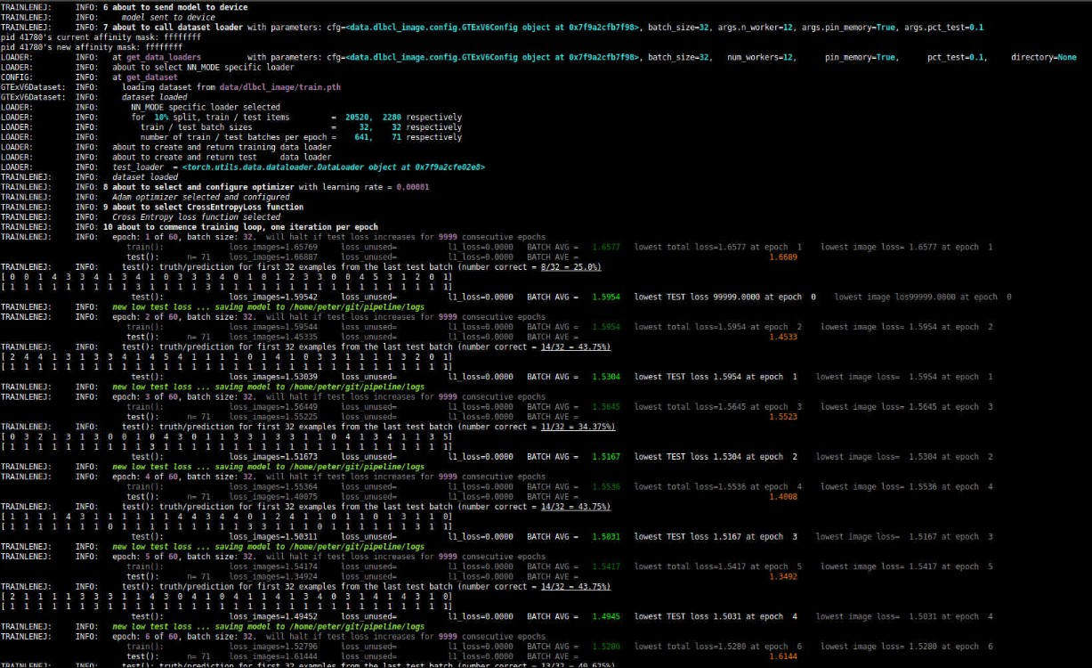
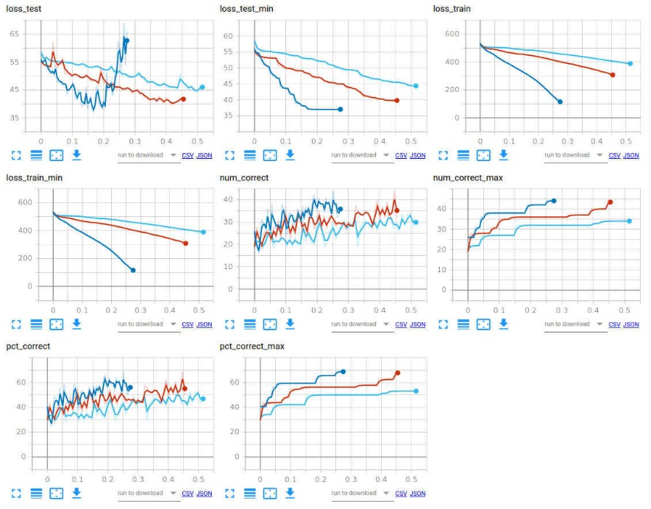
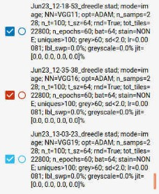
Monitoring Jobs & Visualizing Results
(1) Terminal console to monitor training jobs
(2) Results visualization using Tensorboard
  Graphs showing how key parameters vary during course of training
  Annotated images (Matplotlib for grunt work – Tensorboard just displays)
  E.g. Comparing 3 types of CNN (VGG11, VGG16, VGG19), other hyper-parameters constant

Slide 20
