Slide 1
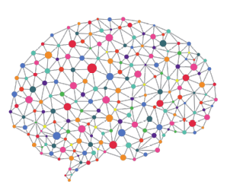


Additional Progress Review Meeting
Peter Donnelly
20 May 2021
peter.donnelly@petermac.org

Slide 2
Agenda
Clinical Context, Hypothesis, Aims, Objectives
Automated Classifiers
How they work
How to evaluate classifier performance
Progress
Classifier developed over the past 12 months (Aim 1)
Results of preliminary experiments: classifying stomach cancer
The Next 18 months
Testing the hypothesis (Aim 2 and Aim 3)
Notes:
Thanks David and good afternoon everyone.
Can you see the slides and hear me OK?
My thesis topic is “Cancer Classification using Deep Learning on Matched Biopsy Images and RNA-Seq data”, and these are the topics I’m going to cover, fairly quickly, in the next 25 minutes or so
First I’ll provide the clinical motiviation for my thesis and state the hypothesis, and the project aims and objectives
I’ll go on to describe how neural network classifiers work, and also how their performance can be measured and compared, which is necessary to enable my hypothesis to be tested in a scientifically rigorous manner
I’ll then talk about the progress I’ve made over the last 12 months, and show you that I’ve built a flexible experiment system capable of testing the hypothesis and share the results from some preliminary experiments
And finally I’ll discuss how I’m going to bring it all together over the next 18 months

Slide 3
Current Status of PhD, MPhil Proposal
Status
My PhD faces two signficant and probably insurmountable challenges
Non-availability of expected T-Cell Lymphoma samples
TCGA have shut down access to WSI image repository
Proposal
Change to MPhil, centering on experiment system developed by me to date
  This is a substantial piece of work (2 years effort)
  It is well defined
  I expect it will be useful for other researchers wish to conduct ML experiments on pathology image and genomic data without having to develop a great deal of software
  Drawing on my 30 years experience of software engineering
Possible thesis title:
  “An end-to-end software system to simplify the conduct of machine learning experiments on cancer WSI image and genomic data"
Notes:
Thanks David and good afternoon everyone.
Can you see the slides and hear me OK?
My thesis topic is “Cancer Classification using Deep Learning on Matched Biopsy Images and RNA-Seq data”, and these are the topics I’m going to cover, fairly quickly, in the next 25 minutes or so
First I’ll provide the clinical motiviation for my thesis and state the hypothesis, and the project aims and objectives
I’ll go on to describe how neural network classifiers work, and also how their performance can be measured and compared, which is necessary to enable my hypothesis to be tested in a scientifically rigorous manner
I’ll then talk about the progress I’ve made over the last 12 months, and show you that I’ve built a flexible experiment system capable of testing the hypothesis and share the results from some preliminary experiments
And finally I’ll discuss how I’m going to bring it all together over the next 18 months

Slide 4
Motivation
Notes:
The images on the right are microscope slide scans of four of the main types of Stomach Adenocarcinoma: Diffuse, Tubular, Mucinous and Signet Ring and perhaps surprisingly, despite the many breakthroughs in genomics of the past 20 year or so, cancers are still mainly detected and classified by a pathologist looking at stained biopsy tissue under a microscope, and that’s probably because, it’s pretty effective, relatively cheap, and has a 100 year head start on genomics.
Cancer classification is the primary determinent of treatment, at least in the first instance, so timely and accurate classification is highly consequential
Using computers to automate classification is an active area of research; and the best computerised classifiers are able to classify and subtype straightforward cancer types very well, but these have yet to make much of a clinical impact
They essentially all use either images or genomic data to perform classification, but it seems reasonable to thnk that using matched image and genomic data from the same patient - would be a more effective strategy. Iin machine learning parlance that’s known as multimodal learning. And that’s the strategy I’m pursuing

Slide 5
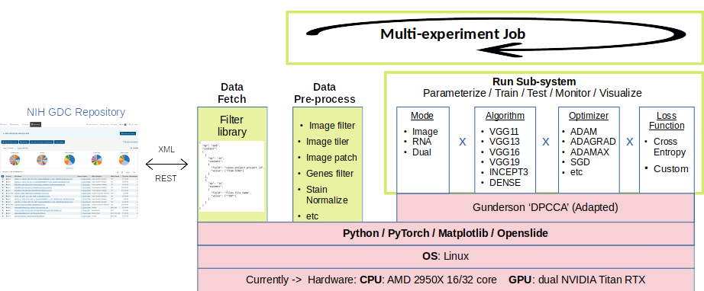
Experimental System
Core functionality:
PyTorch via an adaptation of ‘DPCCA’ software (Gregory Gunderson / Princeton)
+ Openslide
+ Matplotlib + Tensorboard
+ NVIDIA TITAN RTX GPUs
PD extensions:
To make it easy to change hyperparameters and NN algorithms on the fly <- modular and parameter driven run subsystem
To automate the acquisition of data from GDC <- data fetch module
To automate the pre-processing of data (eg. tiling, patching, removal of background and degenerate tiles) <- pre-processing subsystem
To define and run a batch of experiments in one go <- multi-experiment Job
To monitor training and vizualize results <- Tensorboard hooks

Slide 6
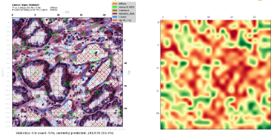
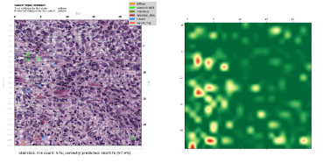
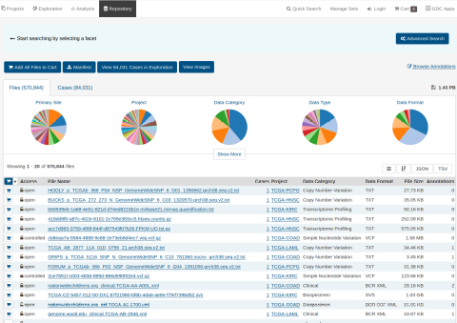
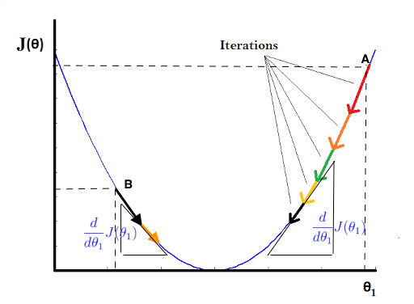
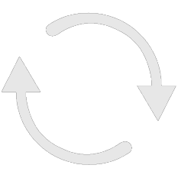
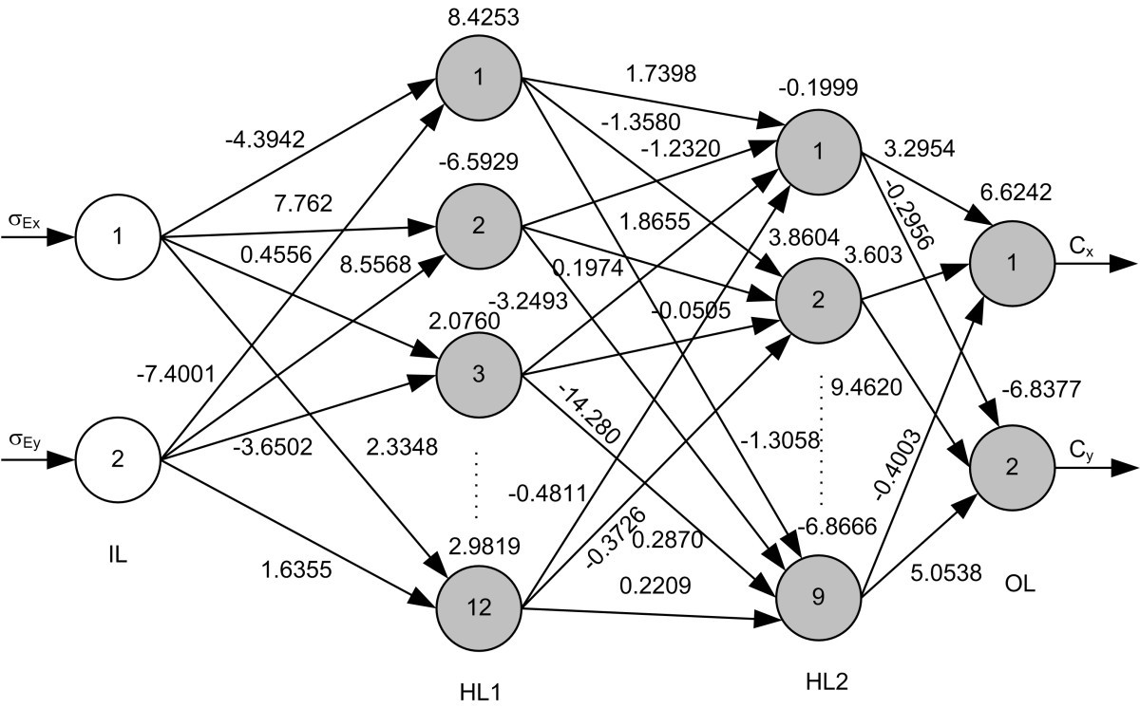
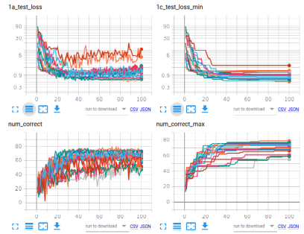
Aim 1: Build the Experiment System
Status: 95% complete. Able to subtype cancers using either Images or RNA-seq data
Fetch Raw Data
Pre-process Raw Data
Realize Optimum Model
Classify
Analyse Results
break
images
into tiles
remove background & degenerate
tiles
normalize
Colors
Image Branch
tiles
patches
Numerical normalization
TCGA
Extract
RNA-Seq
data
Reduce dimens-
ionality
resolve
gene
names
RNA Branch
RNA-Seq
Comprising 13 shell files, 48 python files and many libraries
Only the RNA-Seq portion of the matched Image+RNA-Seq classifier remains to be complete (2-4 weeks)
‘End-to-end’ system. The classification sub-system is just the piece inside the arrowhead graphic
The (otherwise labour intensive and error prone) data acqusition and pre-processing aspects are largely automated
Able to dispatch & run multiple experminent jobs without user intervention
Produces scalar and graphical results in real-time
Based on the Pytorch machine learning library
Hardware: 16 x 3.5GHz core CPU, 132GB RAM; dual Nvidia Titan GPUs each with 576 tensor cores and 24GB memory
Notes:
This is a schematic of the Experiment System and Classifier that I’ve developed over the past 12 months and am using for my experiments.
As mentioned, it’s almost complete. The only outstanding piece is the RNA-Seq portion of the multimode classifier, and that will take me 2-4 weeks to finish
It’s currently able to classify cancers using either image data, or rna-seq data, but not yet matched image and rna-seq data
So I can use it to establish a baseline for testing the hypothesis, but I can’t yet test the hypothesis.
I hope it comes through from this slide, that while the sysem incorporates a classifier – in fact, multiple classifiers - it’s a lot more than a classifier, it’s an end to end experiment system that automates much of the experiment process. I took this approach for two main reasons: first, it turns that acquiring and pre-processing the input data requires an enormous amount of effort, and it’s just not something that you’d want to do manually, for reasons of both time and quality control; and secondly, neural networks require a significant amount of tuning to get good performance: so having a system that allows experiments to be defined parametrically and run in batches is very efficient.
For example I can set up a job to run overnight which might have five different learning rates and three different classifiers - so 15 individual experiments - and set it running; then look at the results the next day and observe the effect of the combination of choices on outcomes.

Slide 7
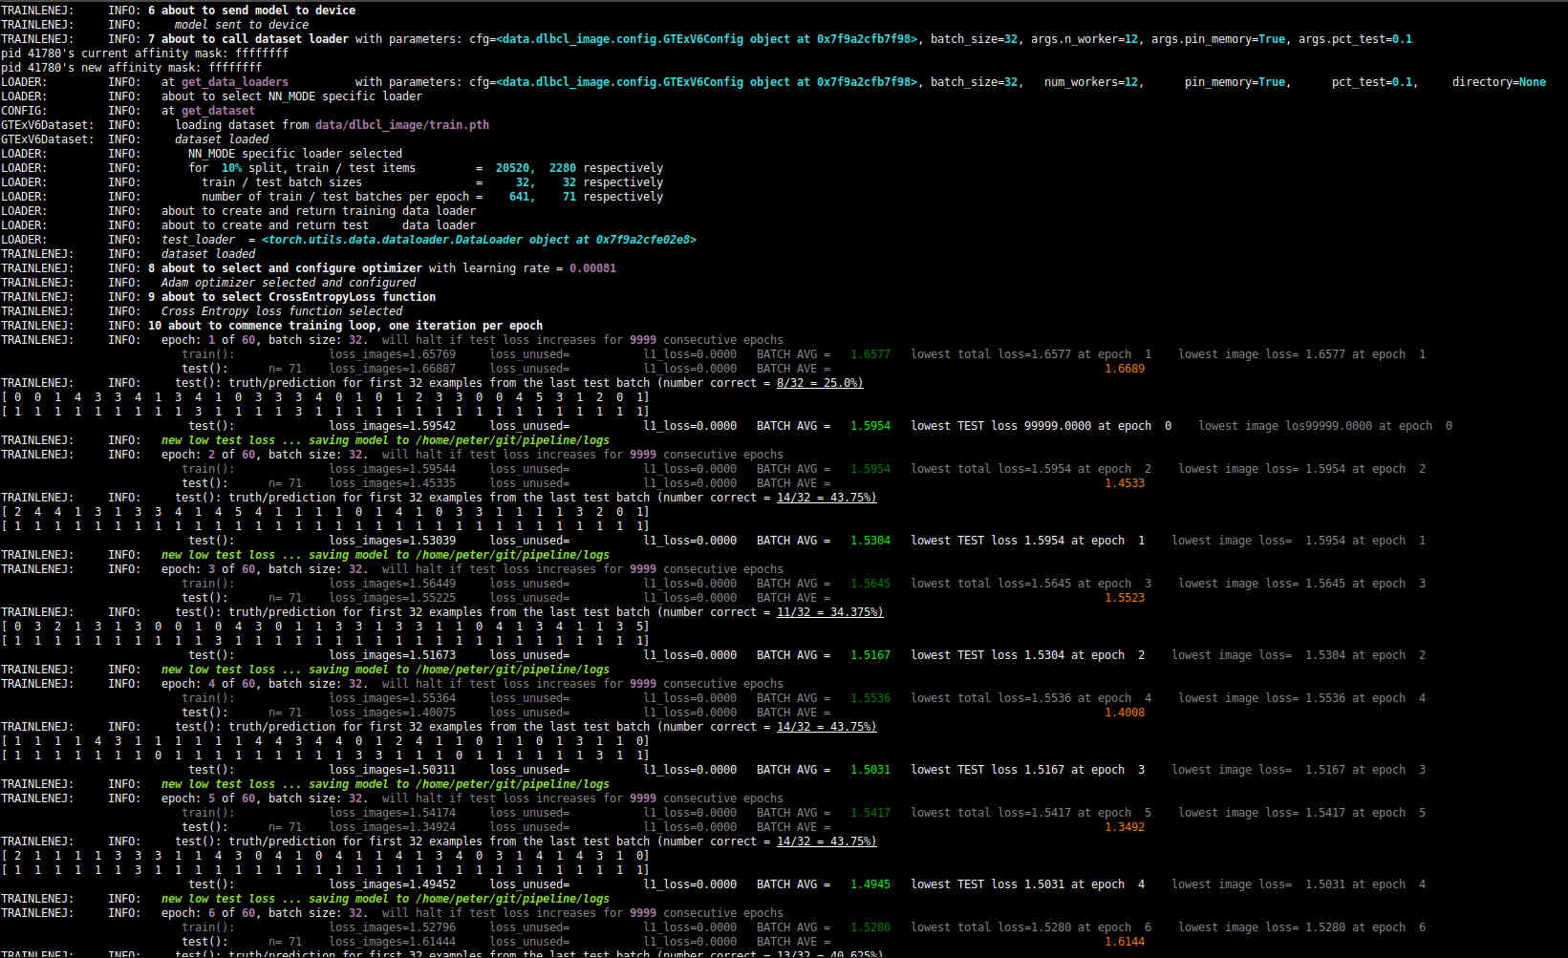
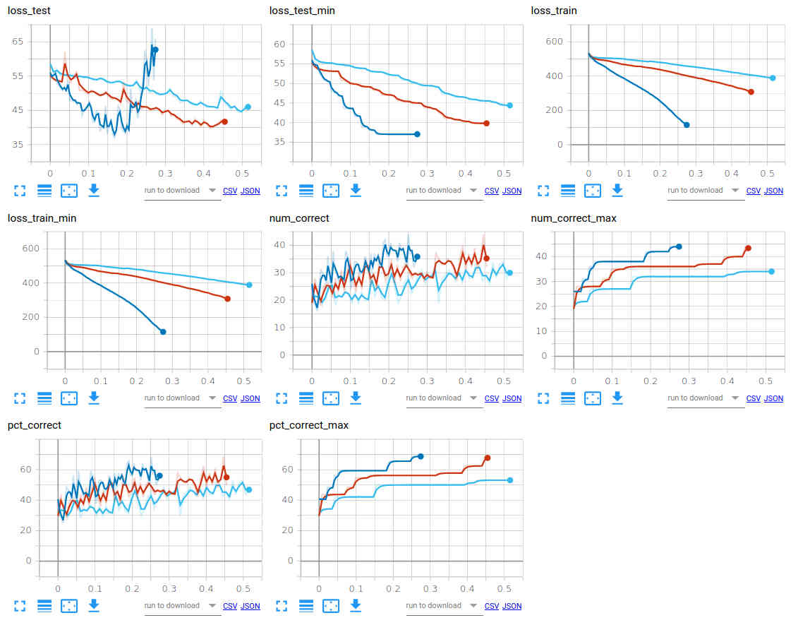
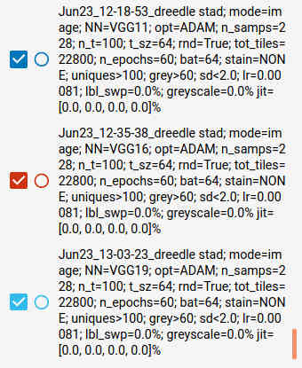
Monitoring Jobs & Visualizing Results
(1) Terminal console to monitor training jobs
(2) Results visualization using Tensorboard
  Graphs showing how key parameters vary during course of training
  Annotated images (Matplotlib for grunt work – Tensorboard just displays)
  E.g. Comparing 3 types of CNN (VGG11, VGG16, VGG19), other hyper-parameters constant

Slide 8
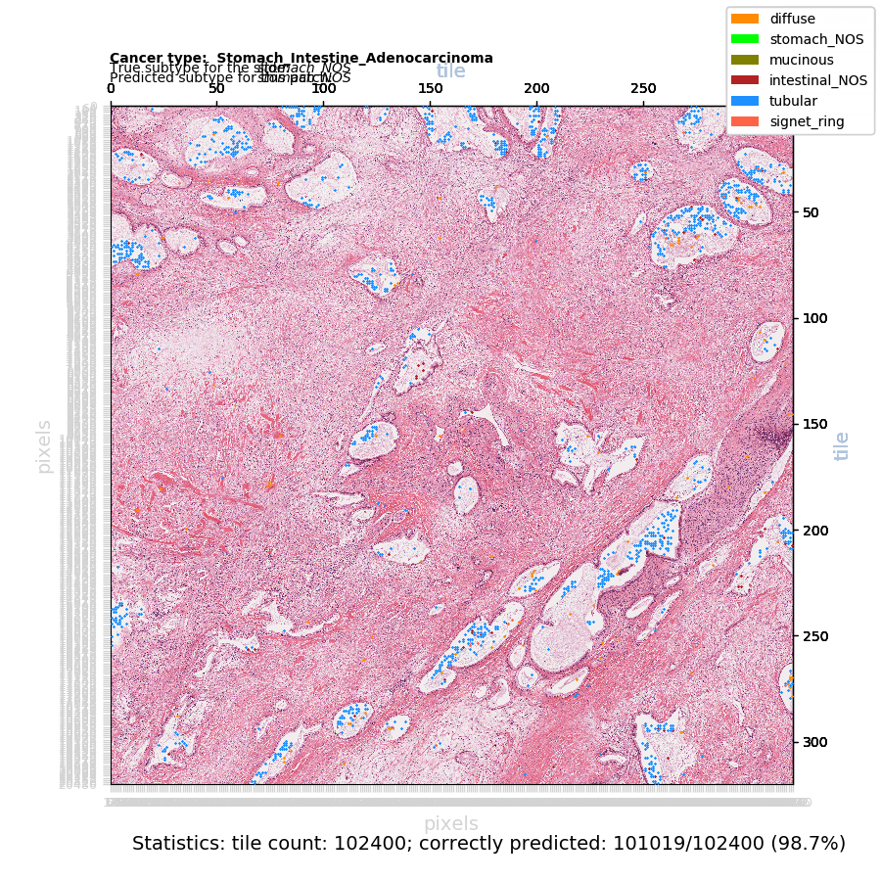
Aim 1: Classification of a Large Patch:
Patch of 320 x 320 = 102,400 tiles (420 mega-pixels)
The pink areas are correctly classified
The blue and orange areas are misclassified
Notes:
Those example used quite small patch sizes. But patch size can be arbitrarily large, subject only to available computing memory.
So here we have an example of classification of a 420 megapixel patch comprising 102,400 contiguous tiles, and it’s a correct prediction of a Stomach NOS sample.
The blue areas, and the small orange if you can see those, are incorrectly classified, but all of the rest - the pink and white areas - are correctly classified.

Slide 9
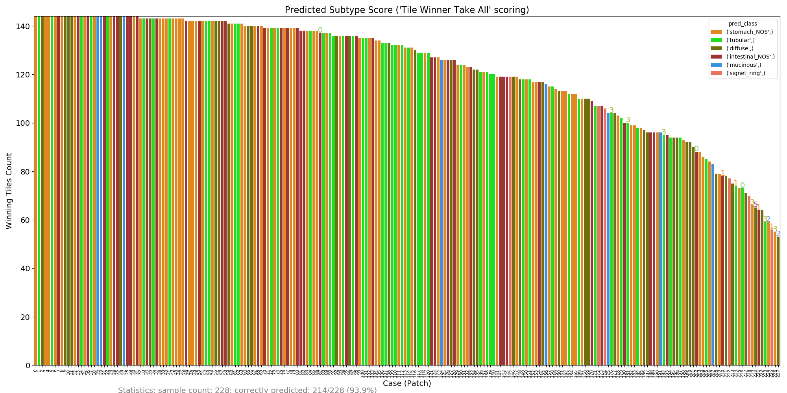
Aim 1: Results: Image Classification – All Samples
Classificaton of 12x12 tile patches from each of the 228 image samples
Scored by counting the number of tiles predicted by the classifier for each of the six subtypes
Bar colour indicates predicted subtype based on this scoring, and the bar height is the score
214 of 228 classifications correct (with widely varying scores)
Notes:
Here we have a third view of image classification performance, which uses the technique I just outlined to give predictions for all 228 image samples
The bar colour indicates the predicted subtype, and the bar height is the score.
Incorrect classifications have the class number of the correct subtype just above the bar, but you might find these tricky to see – have a look over towards the right for some of these
Overall, 214 of the 228 predictions are correct
Here ‘tile-level winner take all’ scoring is used but the results are almost the same using aggregated tile-level probabilities scoring
========
So concluding this section:
an experiment system has been developed and validated (which is the main Aim 1 Objective)
Some preliminary experiments were conducted, and the results of these are pretty typical of what others achieve with single mode classifiers on TCGA data

Slide 10
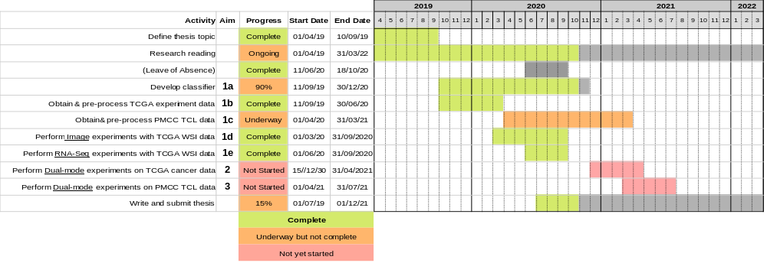
Timeline
Notes:
And finally, this chart puts the three Aims into the overall timeline for my thesis
It’s also on Page 18 of my report.

Slide 11
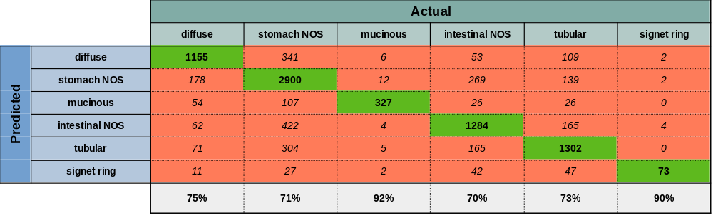
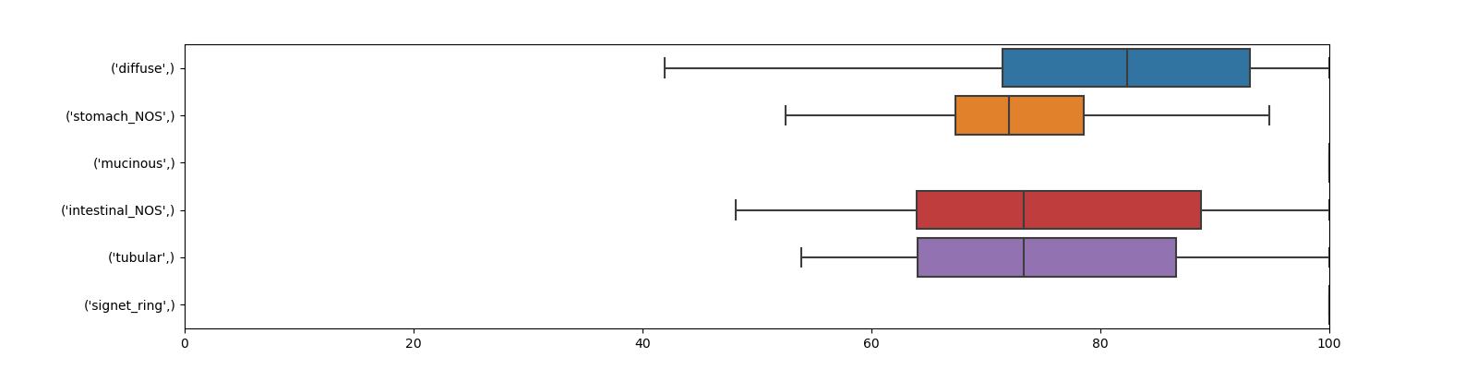
Preliminary Results: Subtyping 479 TCGA STAD RNA-Seq Samples
Predicted vs True subtype for held out samples. 101 runs.
Classification of 479 TCGA STAD RNA-seq samples (Six subtypes)
Each example is a vector comprising 60,483 mRNA + lnRNA Upper Quartile FPKM values (Frequency per kilobase per million reads mapped)
479 RNA-Seq examples per run for training & validation testing: 80% (n=383) training + 20% (n=96) validation testing
All held-out samples are tested after each run yielding 96 x 101 = 9,696 total predictions of held out samples over the 101 runs
Neural Network details: 3 layer fully connected network (relu + softmax activation); ADAM optimiser. Reasonably well tuned
200 epochs per run. Each of the 101 runs produces a slightly different optimised classifier. See box plot.
Observations
Absolute (rather than differential) RNA-seq expression data contains sufficient information to classify STAD subtypes quite well
Classification accuracy ranges from 70-90%% across the six subtypes
Misclassification to NOS accounts for most misclassifications (48%). This makes sense, as NOS is a heterogeneious catch-all subtype.
Classification accuracy rises to 94-98%% when the two NOS categories are removed (next slide)
Classification of held-out test sets for each run (=9,696 predictions total) - All Six Subtypes
Replicability: percent correct for each category over the 101 runs

Slide 12
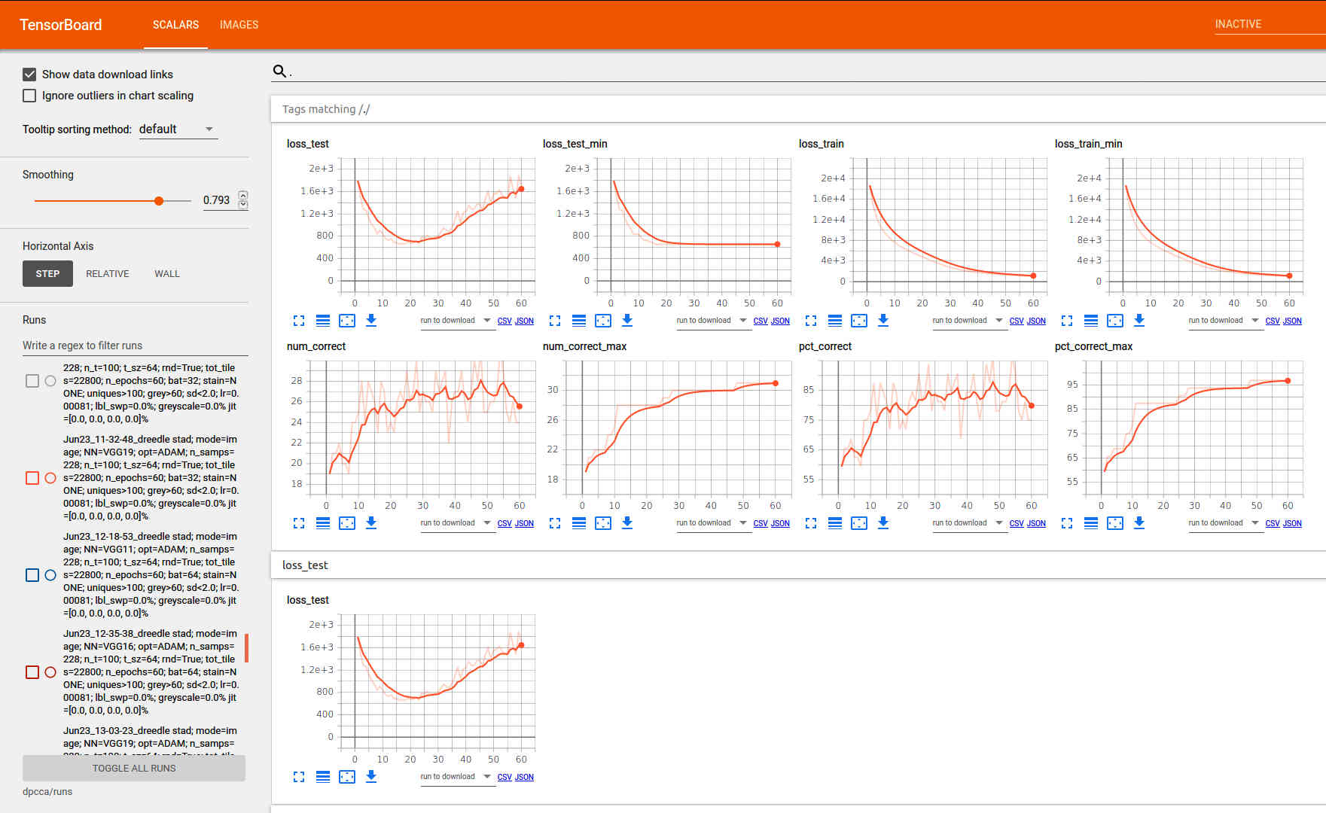
Typical Training Run with STAD Dataset
Network: VGG11 + ADAM (AdaGrad and RMSProp) optimizer + cross entropy loss function
Samples = 228, 2000 tiles/sample, tile size = 64pxx64px, random batches, batch size 32, learning rate 0.00081, 60 epochs, Training:Test = 90:10
(Number of tiles “seen” during training = 2000x0.9*228x60=24,624,000)
80-90% correct tumour classifications after about 20 epochs on test samples, and that’s been typical for experiments with STAD

Slide 13
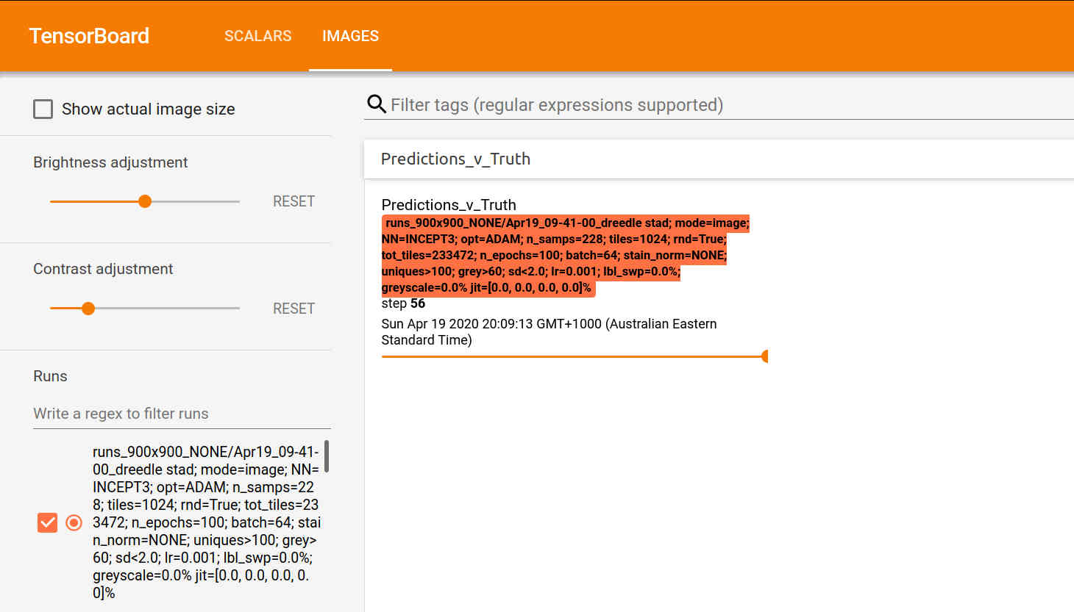
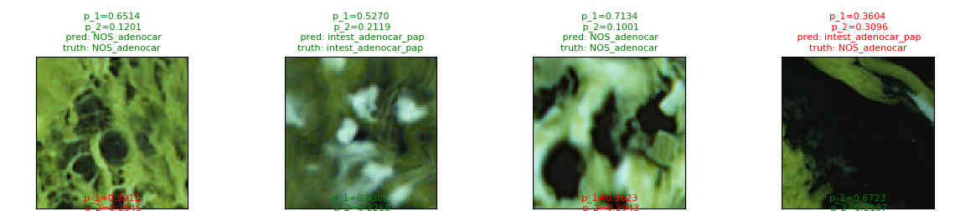
Tile-level Outputs Aren’t Very Informative
We’re training the network on individual tiles drawn at random from a giant bag of tiles
The image shows some tile level results: each has the predicted cancer sub-type and confidence level (probability)
But we’d really like to see what’s going on at the level of an entire sample or at least a decent portion of it
Need to give the trained model (NN) a set of tiles corresponding to a contiguous 2D patch and aggregate the results

Slide 14
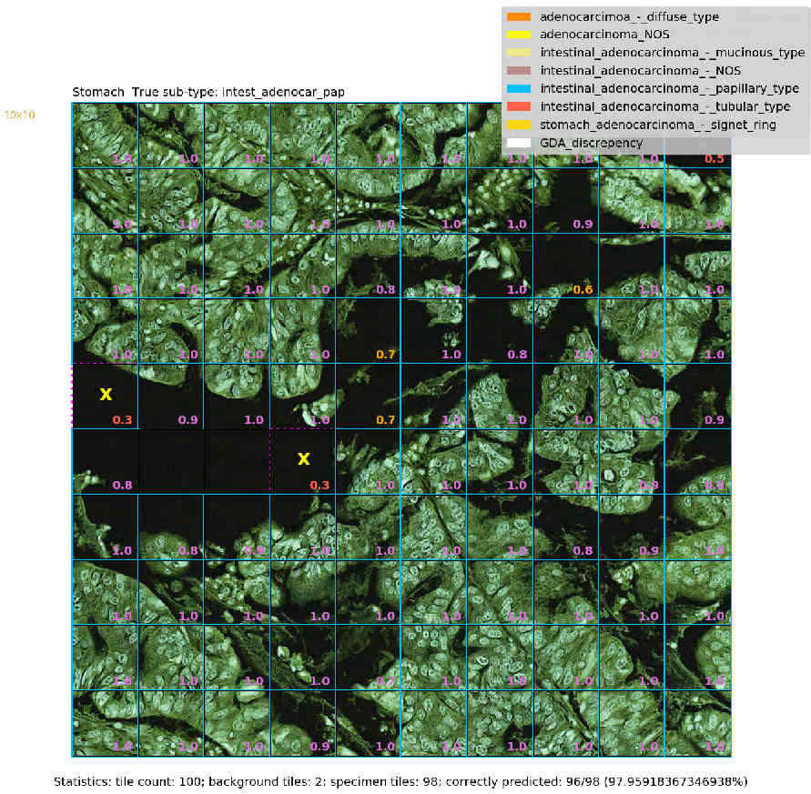
A Confident Correct Prediction: Intestinal AD, Papillary type
Inception 3 Network; ADAM optimiser; Learning rate=0.001; no stain normalization; patch of 100 128x128 tiles
Note: predictions are always ‘tile-level’. They are aggregated to produce an overall prediction for the patch
1
Dataset
True class
Blue boundary
around tile
100 tiles
Correctly predicted
to be papillary type
papillae
incorrectly predicted to be adenocarcinoma_NOS
Probability assigned to true class
1 patch
Tiles without p-values are background or degenerate tiles & excluded during pre-processing
Patch level statistics

Slide 15
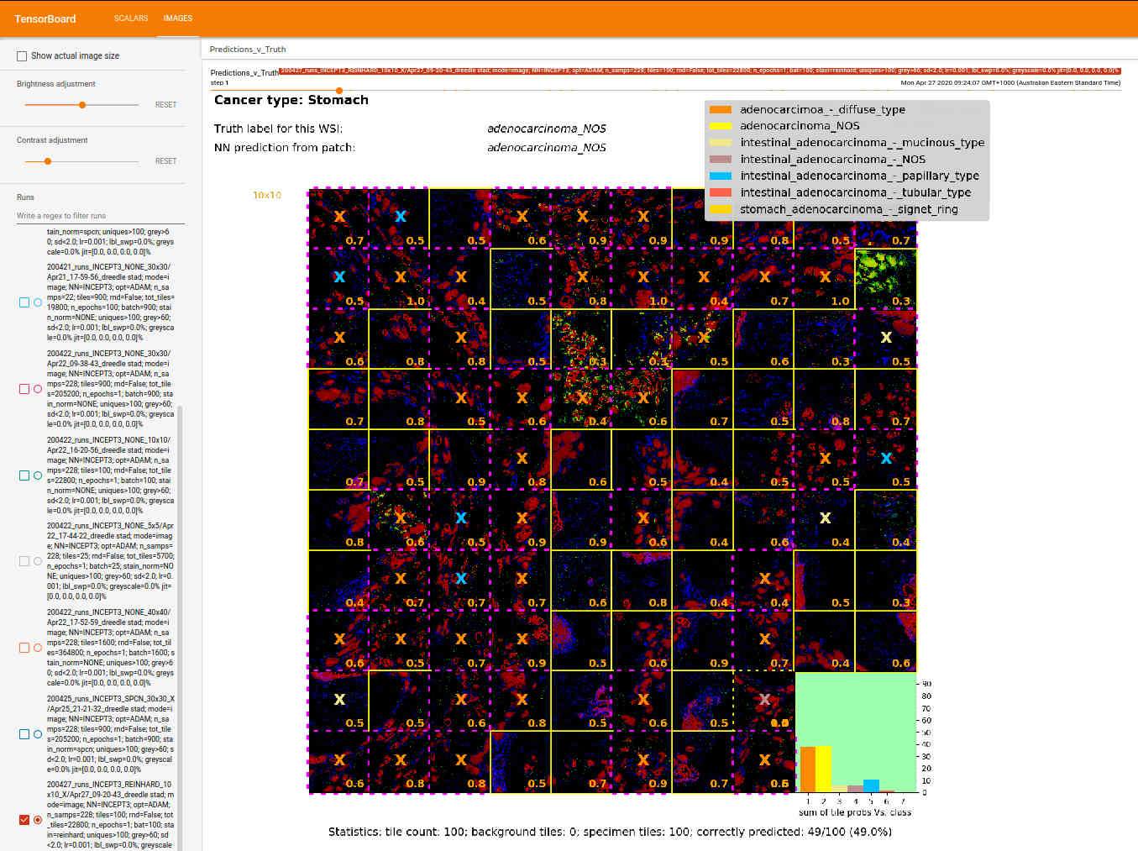
An Unconfident Correct Prediction: Stomach AD NOS
Inception 3 Network; ADAM optimiser; Learing rate=0.001; Reinhard stain normalization; patch of 100 128x128 tiles

