Slide 1
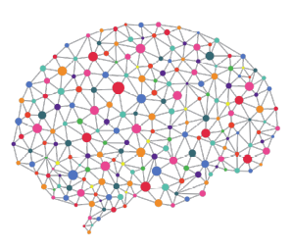


Additional Progress Review Meeting
Peter Donnelly
20 May 2021
peter.donnelly@petermac.org

Slide 2
Agenda
Current Status and Proposed Change to MPhil
Aim 1 of my PhD: ‘Experiment System’ → MPhil
Title and Objectives
Motivation
Experiment System Scope & Capabilities
Timeline
Notes:
Thanks David and good afternoon everyone.
Can you see the slides and hear me OK?
My thesis topic is “Cancer Classification using Deep Learning on Matched Biopsy Images and RNA-Seq data”, and these are the topics I’m going to cover, fairly quickly, in the next 25 minutes or so
First I’ll provide the clinical motiviation for my thesis and state the hypothesis, and the project aims and objectives
I’ll go on to describe how neural network classifiers work, and also how their performance can be measured and compared, which is necessary to enable my hypothesis to be tested in a scientifically rigorous manner
I’ll then talk about the progress I’ve made over the last 12 months, and show you that I’ve built a flexible experiment system capable of testing the hypothesis and share the results from some preliminary experiments
And finally I’ll discuss how I’m going to bring it all together over the next 18 months

Slide 3
Current Status and Proposed Change to MPhil
Status
My PhD faces two signficant and probably insurmountable challenges
Non-availability of expected T-Cell Lymphoma samples
TCGA have shut down access to WSI image repository
Proposal
Change to MPhil, centering on experiment system already completed
  It was Aim 1 of my PhD:
  “Develop an automated classifier capable of testing the hypothesis”
  A substantial piece of work (2 years effort)
  Drawing on my software engineering experience
  Should be useful for other researchers wish to conduct ML experiments on H&E image and genomic data
Notes:
Thanks David and good afternoon everyone.
Can you see the slides and hear me OK?
My thesis topic is “Cancer Classification using Deep Learning on Matched Biopsy Images and RNA-Seq data”, and these are the topics I’m going to cover, fairly quickly, in the next 25 minutes or so
First I’ll provide the clinical motiviation for my thesis and state the hypothesis, and the project aims and objectives
I’ll go on to describe how neural network classifiers work, and also how their performance can be measured and compared, which is necessary to enable my hypothesis to be tested in a scientifically rigorous manner
I’ll then talk about the progress I’ve made over the last 12 months, and show you that I’ve built a flexible experiment system capable of testing the hypothesis and share the results from some preliminary experiments
And finally I’ll discuss how I’m going to bring it all together over the next 18 months

Slide 4
Title and Objectives
Title
“An end-to-end software system to automate the conduct of machine learning experiments on cancer WSI image and genomic data"
Objectives
Describe and develop such a system (already done)
Locate it in the context of the literature (not done)
Notes:
Thanks David and good afternoon everyone.
Can you see the slides and hear me OK?
My thesis topic is “Cancer Classification using Deep Learning on Matched Biopsy Images and RNA-Seq data”, and these are the topics I’m going to cover, fairly quickly, in the next 25 minutes or so
First I’ll provide the clinical motiviation for my thesis and state the hypothesis, and the project aims and objectives
I’ll go on to describe how neural network classifiers work, and also how their performance can be measured and compared, which is necessary to enable my hypothesis to be tested in a scientifically rigorous manner
I’ll then talk about the progress I’ve made over the last 12 months, and show you that I’ve built a flexible experiment system capable of testing the hypothesis and share the results from some preliminary experiments
And finally I’ll discuss how I’m going to bring it all together over the next 18 months

Slide 5
Motivation
When embarking on my PhD, knew I’d need to develop an experiment system to test my thesis, and that this be a substantial undertaking:
Raw samples require much pre-processing before they can be used as input into a ML system, especially images Not feasible to do manually
ML is still largely empirical and heuristic, and it is necessary to traverse a broad parameter space when training a non-trivial datset. Need to conduct many experiments.
Researchers tend to ‘hard wire’ their software to conduct a single or very narrow range of experiments so nothing available for me to reuse. Hence other researchers starting out (including PMCC researchers) may find my software useful
Notes:
Thanks David and good afternoon everyone.
Can you see the slides and hear me OK?
My thesis topic is “Cancer Classification using Deep Learning on Matched Biopsy Images and RNA-Seq data”, and these are the topics I’m going to cover, fairly quickly, in the next 25 minutes or so
First I’ll provide the clinical motiviation for my thesis and state the hypothesis, and the project aims and objectives
I’ll go on to describe how neural network classifiers work, and also how their performance can be measured and compared, which is necessary to enable my hypothesis to be tested in a scientifically rigorous manner
I’ll then talk about the progress I’ve made over the last 12 months, and show you that I’ve built a flexible experiment system capable of testing the hypothesis and share the results from some preliminary experiments
And finally I’ll discuss how I’m going to bring it all together over the next 18 months

Slide 6
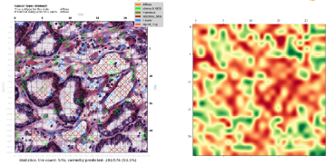
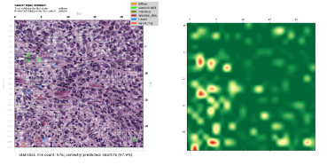
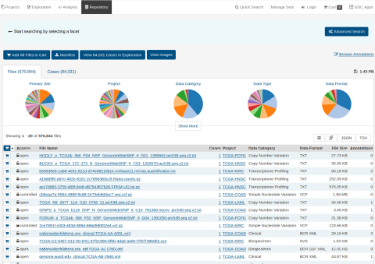
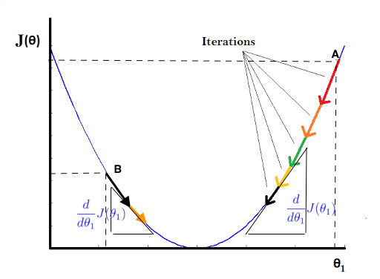
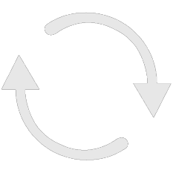
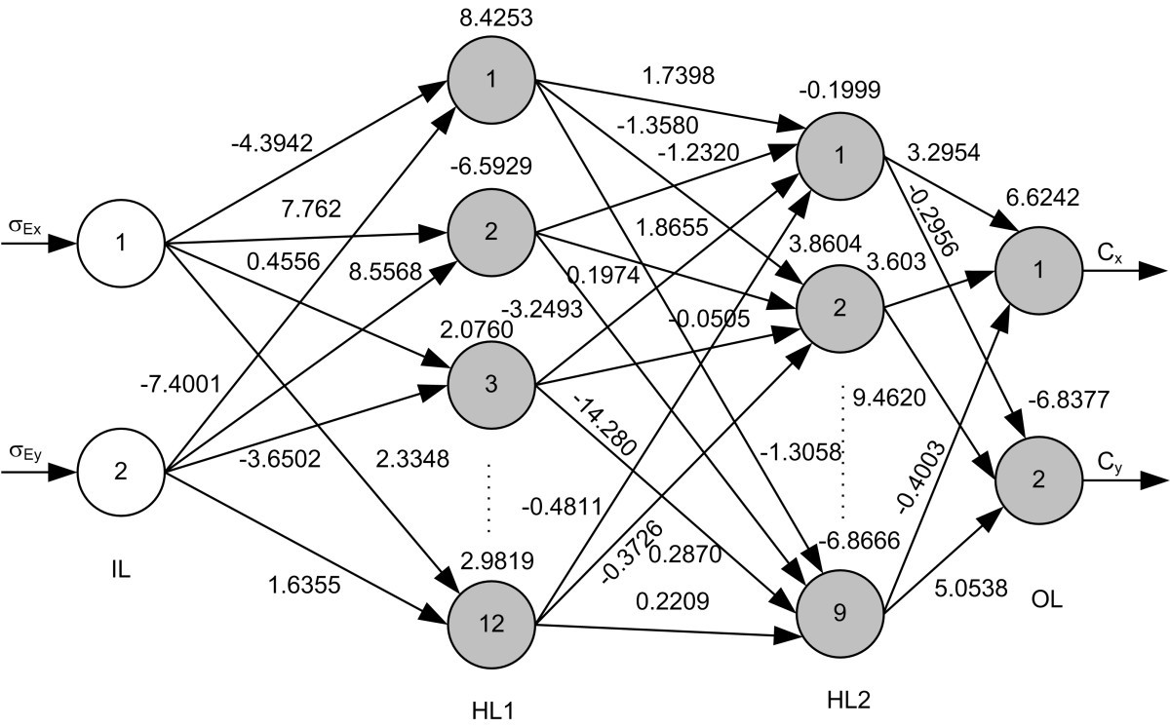
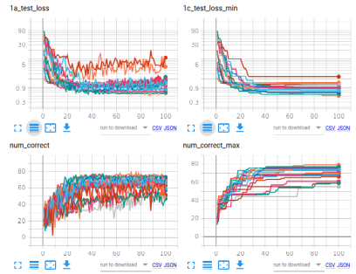
Experiment System Scope
Fetch Raw Data
Pre-process Raw Data
Realize Optimum Model
Classify
Analyse Results
break
images
into tiles
remove background & degenerate
tiles
normalize
Colors
Image Branch
tiles
patches
Numerical normalization
TCGA
Extract
RNA-Seq
data
Reduce dimens-
ionality
resolve
gene
names
RNA Branch
RNA-Seq
‘End-to-end’ system. The classification sub-system is just the piece inside the arrowhead graphic
Automated download and structuring of data from GDC repository
The (otherwise labour intensive and error prone) pre-processing aspects are fully automated
Able to define batch of experminents and run with without user intervention
Modular and parameter driven.
Easy to change hyperparameters and NN algorithms on the fly
Produces scalar and graphical results in real-time
Notes:
This is a schematic of the Experiment System and Classifier that I’ve developed over the past 12 months and am using for my experiments.
As mentioned, it’s almost complete. The only outstanding piece is the RNA-Seq portion of the multimode classifier, and that will take me 2-4 weeks to finish
It’s currently able to classify cancers using either image data, or rna-seq data, but not yet matched image and rna-seq data
So I can use it to establish a baseline for testing the hypothesis, but I can’t yet test the hypothesis.
I hope it comes through from this slide, that while the sysem incorporates a classifier – in fact, multiple classifiers - it’s a lot more than a classifier, it’s an end to end experiment system that automates much of the experiment process. I took this approach for two main reasons: first, it turns that acquiring and pre-processing the input data requires an enormous amount of effort, and it’s just not something that you’d want to do manually, for reasons of both time and quality control; and secondly, neural networks require a significant amount of tuning to get good performance: so having a system that allows experiments to be defined parametrically and run in batches is very efficient.
For example I can set up a job to run overnight which might have five different learning rates and three different classifiers - so 15 individual experiments - and set it running; then look at the results the next day and observe the effect of the combination of choices on outcomes.

Slide 7
Experiment System Capabilities
Illustrative Examples:
Fetch Stomach Cancer Dataset from GDC Repository
Classify Stomach Cancer Subtypes by Training Deep NN on RNA-Seq
Classify Stomach Cancer Subtypes by Training Deep NN on WSI Images
Unsupervised Feature Extraction of Stomach Cancer Whole Slide Images followed by T-SNE clustering
Notes:
Thanks David and good afternoon everyone.
Can you see the slides and hear me OK?
My thesis topic is “Cancer Classification using Deep Learning on Matched Biopsy Images and RNA-Seq data”, and these are the topics I’m going to cover, fairly quickly, in the next 25 minutes or so
First I’ll provide the clinical motiviation for my thesis and state the hypothesis, and the project aims and objectives
I’ll go on to describe how neural network classifiers work, and also how their performance can be measured and compared, which is necessary to enable my hypothesis to be tested in a scientifically rigorous manner
I’ll then talk about the progress I’ve made over the last 12 months, and show you that I’ve built a flexible experiment system capable of testing the hypothesis and share the results from some preliminary experiments
And finally I’ll discuss how I’m going to bring it all together over the next 18 months

Slide 8
1 Fetch Stomach Cancer Cancer Dataset from GDC Repository
Purpose:
Download STAD data from TCGA to use in ML and clustering experiments
Command:
.python ./gdc-fetch.py --debug=9 --dataset stad
--case_filter="filters/TCGA-stad_case_filter"
--file_filter="filters/GLOBAL_file_filter_SVS"
--max_cases=500 --max_files=2
--global_max_downloads=2000 --output_dir=stad"
What it does:
Downloads all stomach cancer cases which have BOTH Whole Slide Images and RNA-Seq data, for use ML experiments using the TCGA API
Filters for wanted files, structures and stores in a manner suitable for immediate use in subsequent experiments

Slide 9
2 Classify Stomach Cancer Subtypes by Training Deep NN on RNA-Seq
Purpose:
Trying to locate best performing network model for classification by traversing range of parameters
Command:
./do_all.sh -d stad -i rna -S 475 -a DENSE -b 64 -q 0.2 -o 100 -L ".001 .003 .007 .01 .03 .07" -5 "NONE LOG2PLUS1 LOG10PLUS1" -6 "NONE JUST_SCALE GAUSSIAN"
Trains 54 different Neural Networks in accordance with user provide parameters:
Base case:
  475 RNA-Seq samples drawn from TCGA STAD dataset
  3 layer DENSE network used for training
  10% dropout regularization
  20% of samples held out for testing
  200 epochs
… for every combination of the following parameters:
  Learning rate: .001 .003 .007 .01 .03 .07
  Numeric normalization: NONE LOG2PLUS1 LOG10PLUS1
  Scaling: NONE JUST_SCALE GAUSSIAN
Training curves are logged and plotted. Easy to see parameter combination producing best model
Takes about 120min to run all 54 jobs on my high-end GPU equipped laptop
Making it easy to systemtically traverse parameter space

Slide 10
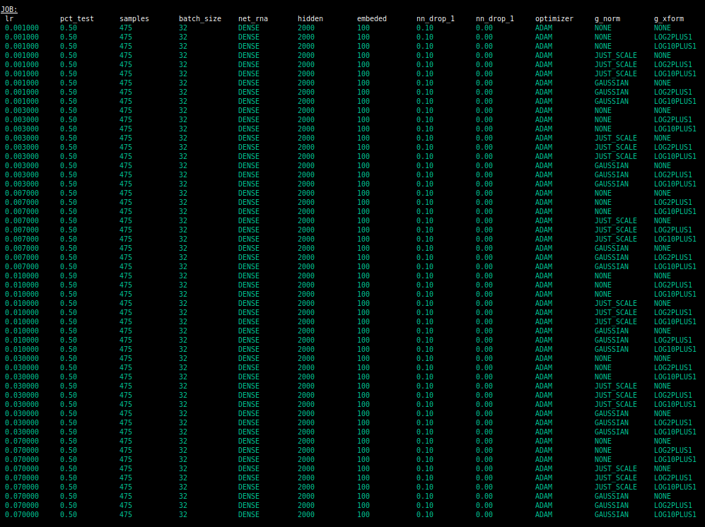

Slide 11
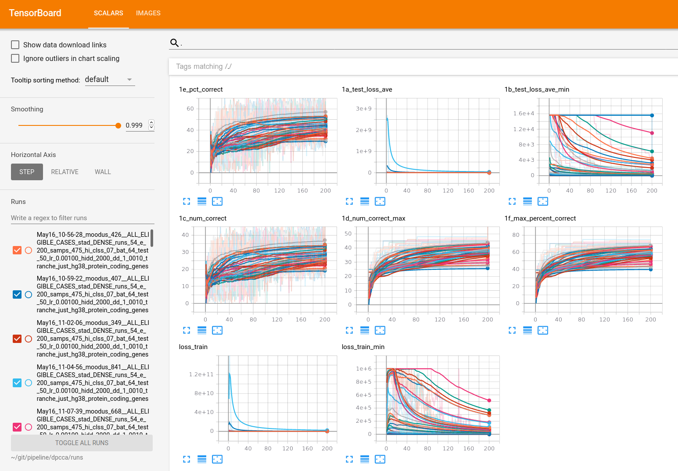
2 Learning Curves

Slide 12
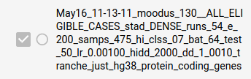
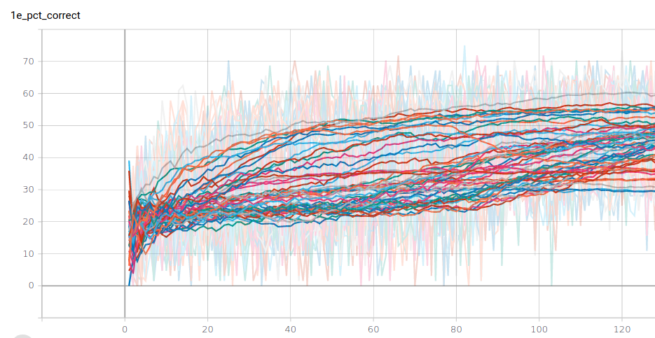
2 Best Model

Slide 13
3 Classify Stomach Cancer Subtypes by Training Deep NN on WSI Images
Purpose:
Multi-run job
Trying to locate best network model by traversing range of parameters
Command:
./do_all.sh -d stad -i rna -S 475 -a DENSE -b 64 -q 0.2 -o 100 -L ".001 .003 .007 .01 .03 .07" -5 "NONE LOG2PLUS1 LOG10PLUS1" -6 "NONE JUST_SCALE GAUSSIAN"
Initiates and runs a job comprising 54 experiments:
Base case:
  475 RNA-Seq samples drawn from TCGA STAD dataset
  3 layer DENSE network used for training
  10% dropout regularization
  20% of samples held out for testing
  200 epochs
...plus every combination of the following parameter variations:
  Learning rates: .001 .003 .007 .01 .03 .07
  Numeric normalizations NONE LOG2PLUS1 LOG10PLUS1
  Scalings: NONE JUST_SCALE GAUSSIAN
Training curves are logged and plotted using Tensorboard so that it is easy to determine best parameter combination produces the best model
Takes about 120min to run all 54 jobs on my high-end GPU equipped laptop
Makes it easy to systemtically traverse parameter space

Slide 14
3

Slide 15
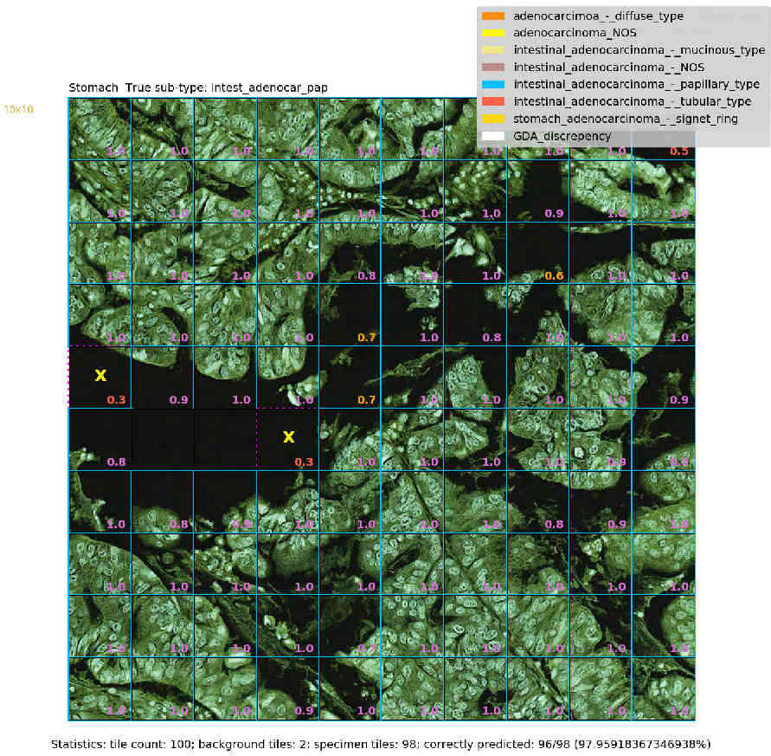
A Confident Correct Prediction: Intestinal AD, Papillary type
Inception 3 Network; ADAM optimiser; Learning rate=0.001; no stain normalization; patch of 100 128x128 tiles
Note: predictions are always ‘tile-level’. They are aggregated to produce an overall prediction for the patch
1
Dataset
True class
Blue boundary
around tile
100 tiles
Correctly predicted
to be papillary type
papillae
incorrectly predicted to be adenocarcinoma_NOS
Probability assigned to true class
1 patch
Tiles without p-values are background or degenerate tiles & excluded during pre-processing
Patch level statistics

Slide 16
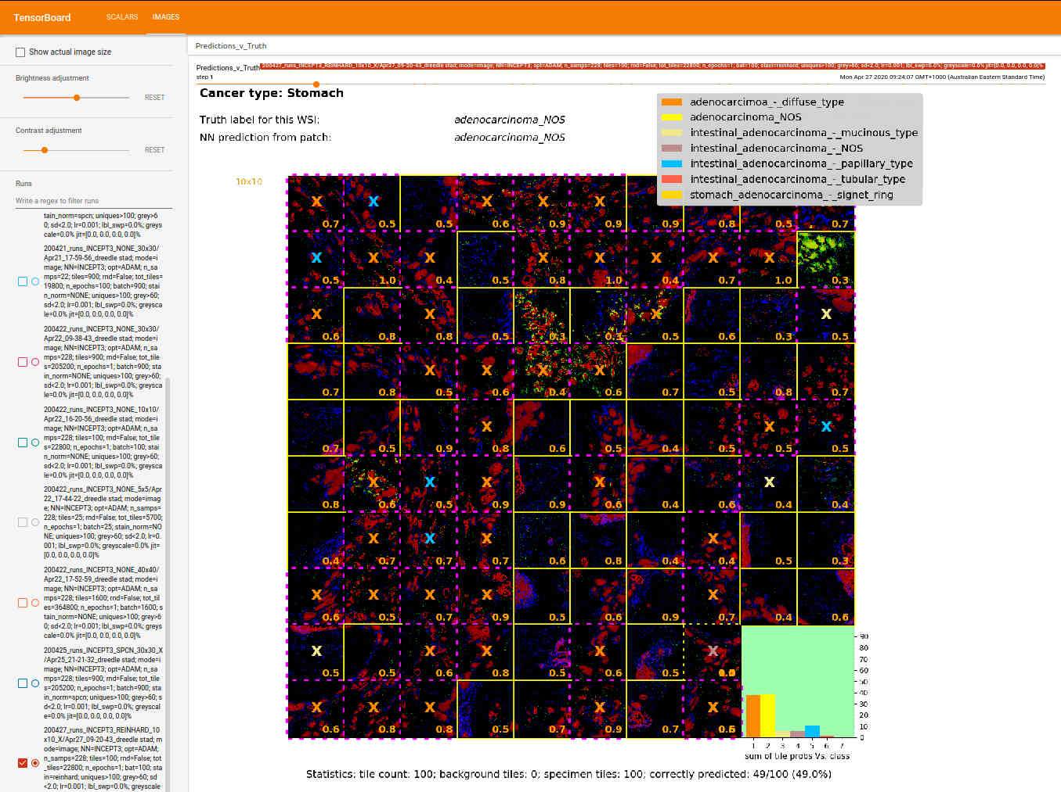
An Unconfident Correct Prediction: Stomach AD NOS
Inception 3 Network; ADAM optimiser; Learing rate=0.001; Reinhard stain normalization; patch of 100 128x128 tiles

Slide 17
4 Unsupervised Feature Extraction of Stomach Cancer Whole Slide Images followed by T-SNE clustering
Purpose:
Looking for features in unlabelled pathology images. E.g. cancer subtype
Traversing a range of parameters
Command:
./cuda_tsne_multi_run.sh -d stad -i image -S 310 -f 10 -T 64 -b 32 -B 100 -q 0.2 -w 1.0 -h 7 -o 100 -a AEVGG16 -3 0.05 -t 50 -l cuda_tsne -R True
Initiates and runs a job comprising 112 experiments::
Extracts 10 64x64 pixel tiles at random x,y coordinates from each of the 310 TCGA STAD WSI image samples – in doing so filtering out background, low-contrast and degenerate tiles – to produce 3,100 image tiles
Divides the 3,100 tiles into a Training Set (80%) and a Test Set (20%) and encodes them for Machine Learning
Uses a VGG16 deep denoising convolutional autoencoder (ADAM optimiser, Mean Squared Error, Learning Rate=0.0005) with 5% peer noise to reduce dimensionality (100 epochs of training) reducing the 64x64x3=12,228 dimensions to 400 dimension embeddings
Performs very fast (GPU based) t-sne clustering on the embeddings, for each of 16 user provided ‘Perplexity’ values
Displays and saves the results of the clusterings, one page per embedding dimension value – see next slide
This example uses 7 values of embedding and 16 values of Perplexity, for a total of 112 experiments and takes about 4 hours to run
Tiling isn’t repeated if a suitable tile set already exists. This saves a lot of time
No upper limit on the number of embedding dimensions or perplexity values

Slide 18
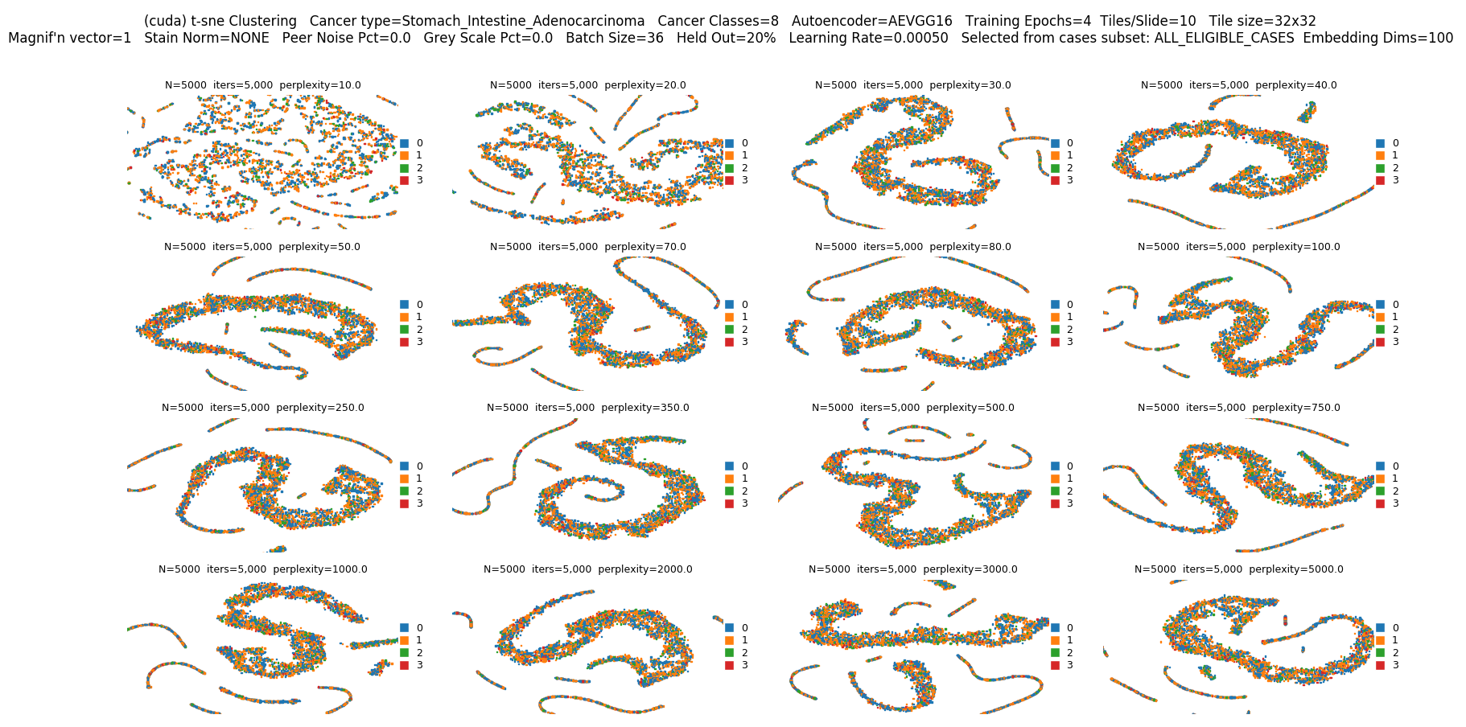
4 Cluster Plots (one of seven)
T-SNE cluster plot for 16 Perplexity values
Each colored dot is an image tile

Slide 19
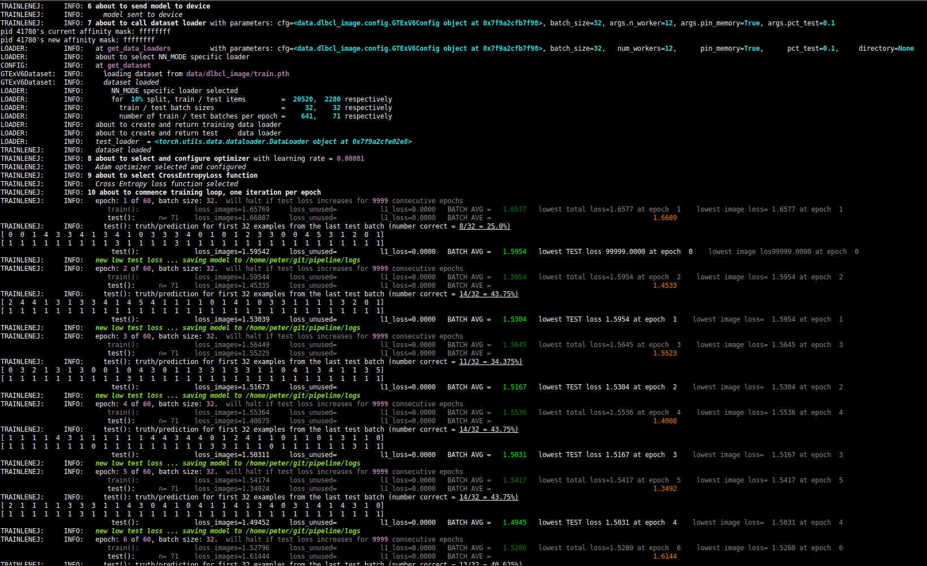
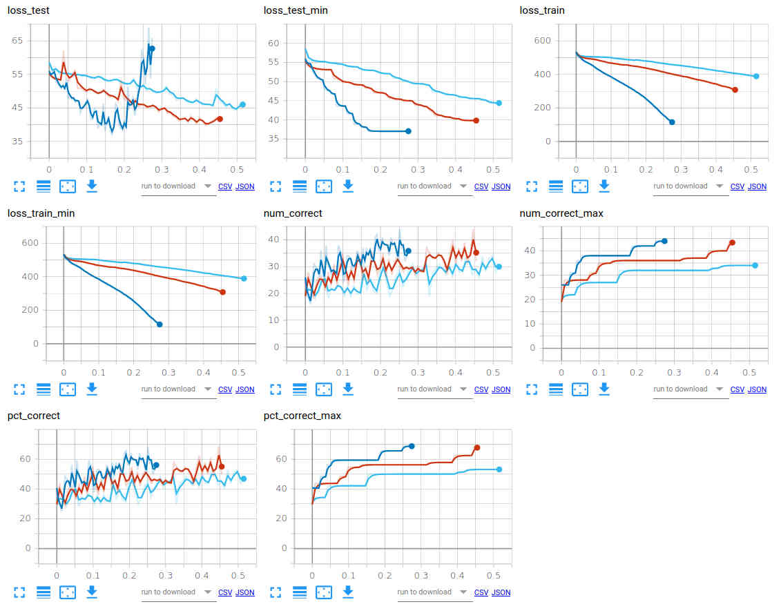
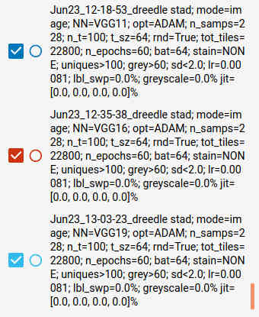
Monitoring Jobs & Visualizing Results
(1) Terminal console to monitor training jobs
(2) Results visualization using Tensorboard
  Graphs showing how key parameters vary during course of training
  Annotated images (Matplotlib for grunt work – Tensorboard just displays)
  E.g. Comparing 3 types of CNN (VGG11, VGG16, VGG19), other hyper-parameters constant

Slide 20
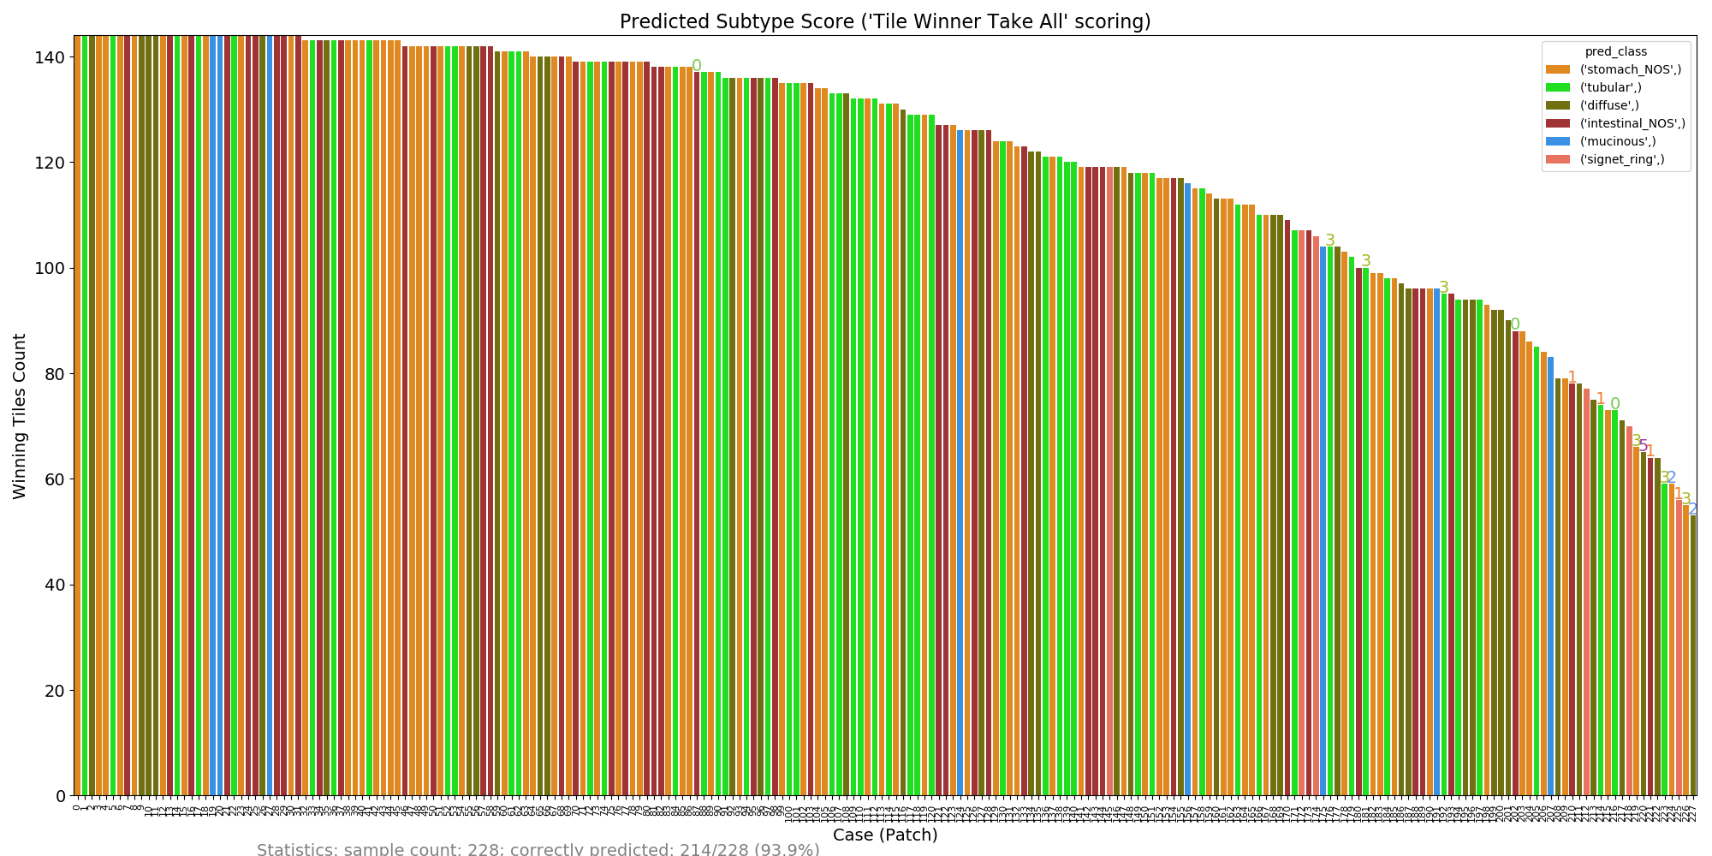
Aim 1: Results: Image Classification – All Samples
Classificaton of 12x12 tile patches from each of the 228 image samples
Scored by counting the number of tiles predicted by the classifier for each of the six subtypes
Bar colour indicates predicted subtype based on this scoring, and the bar height is the score
214 of 228 classifications correct (with widely varying scores)
Notes:
Here we have a third view of image classification performance, which uses the technique I just outlined to give predictions for all 228 image samples
The bar colour indicates the predicted subtype, and the bar height is the score.
Incorrect classifications have the class number of the correct subtype just above the bar, but you might find these tricky to see – have a look over towards the right for some of these
Overall, 214 of the 228 predictions are correct
Here ‘tile-level winner take all’ scoring is used but the results are almost the same using aggregated tile-level probabilities scoring
========
So concluding this section:
an experiment system has been developed and validated (which is the main Aim 1 Objective)
Some preliminary experiments were conducted, and the results of these are pretty typical of what others achieve with single mode classifiers on TCGA data

Slide 21
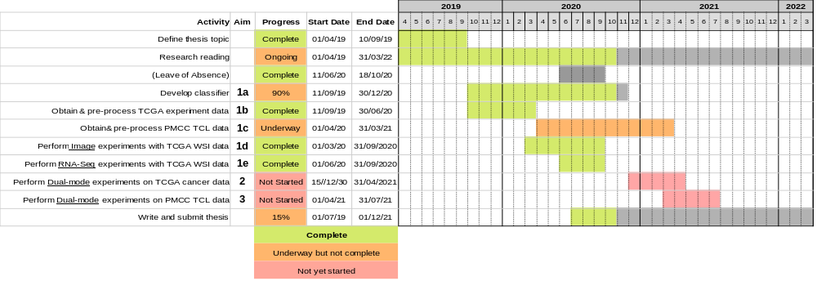
Timeline
Notes:
And finally, this chart puts the three Aims into the overall timeline for my thesis
It’s also on Page 18 of my report.

Slide 22
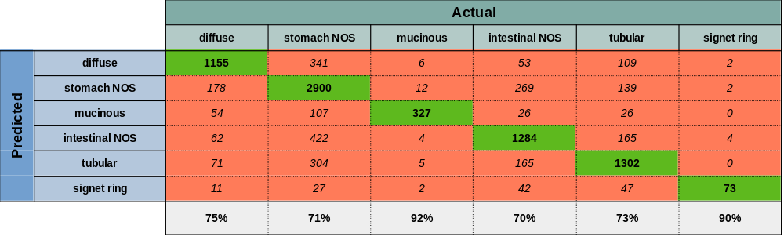
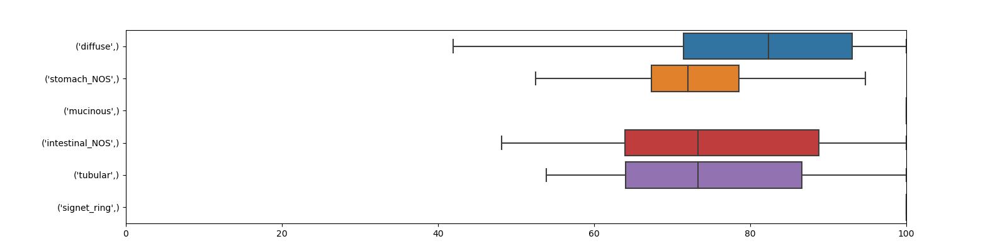
Preliminary Results: Subtyping 479 TCGA STAD RNA-Seq Samples
Predicted vs True subtype for held out samples. 101 runs.
Classification of 479 TCGA STAD RNA-seq samples (Six subtypes)
Each example is a vector comprising 60,483 mRNA + lnRNA Upper Quartile FPKM values (Frequency per kilobase per million reads mapped)
479 RNA-Seq examples per run for training & validation testing: 80% (n=383) training + 20% (n=96) validation testing
All held-out samples are tested after each run yielding 96 x 101 = 9,696 total predictions of held out samples over the 101 runs
Neural Network details: 3 layer fully connected network (relu + softmax activation); ADAM optimiser. Reasonably well tuned
200 epochs per run. Each of the 101 runs produces a slightly different optimised classifier. See box plot.
Observations
Absolute (rather than differential) RNA-seq expression data contains sufficient information to classify STAD subtypes quite well
Classification accuracy ranges from 70-90%% across the six subtypes
Misclassification to NOS accounts for most misclassifications (48%). This makes sense, as NOS is a heterogeneious catch-all subtype.
Classification accuracy rises to 94-98%% when the two NOS categories are removed (next slide)
Classification of held-out test sets for each run (=9,696 predictions total) - All Six Subtypes
Replicability: percent correct for each category over the 101 runs

