Slide 1
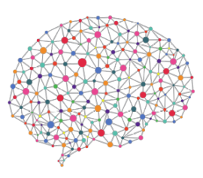


Cancer Classification using Deep Learning on Matched Biopsy Images and RNA-Seq
One Year Confirmation Seminar
Peter Donnelly
9 November 2020
peter.donnelly@petermac.org

Slide 2
Agenda
Clinical Context, Hypothesis, Aims, Objectives
Automated Classifiers
How they work
How to evaluate classifier performance
Progress
Classifier developed over the past 12 months (Aim 1)
Results of preliminary experiments: classifying stomach cancer
The Next 18 months
Testing the hypothesis (Aim 2 and Aim 3)

Slide 3
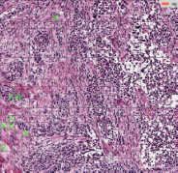
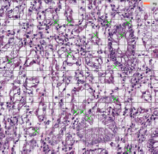
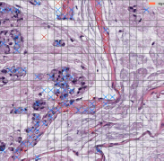
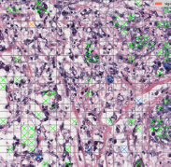
Clinical Motivation
Clinical Context
Cancers are still mainly detected and classified by inspection of biopsy tissue
but some are difficult or impossible to classify visually ...
… and two pathologists can classify the same sample differently
Classification determines treatment, so accurate classification matters
Automated Classification
Active area of research
The best classify ‘straightforward’ cancer subtypes very well
They use either images or RNA-Seq
Why not use both ?
Biopsy images of the four main Stomach Adenocarcinoma
cancer sub-types (classified by my classifier)
Diffuse
Tubular
Diffuse
Mucinous
Signet Ring

Slide 4
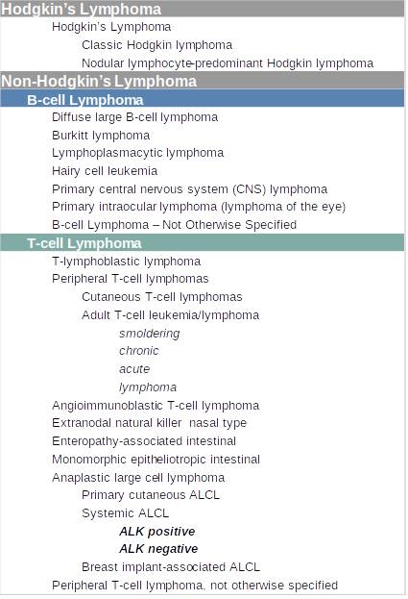

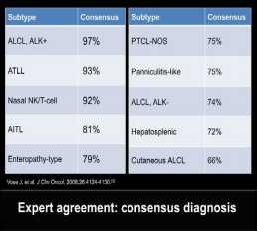
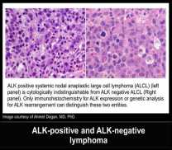
Lymphoma Classification
Pathologists find some T-Cell Lymphomas very difficult to classify
A Pathologists Guide to the Accurate Diagnosis of Peripheral T-Cell Lymphoma

Slide 5
Hypothesis and Objective
Hypothesis
A classifier trained on BOTH images AND RNA-Seq will
classify any cancer; and,
classify challenging cancers,
better than existing image or RNA-Seq specific classifiers
Key Assumption
Image & RNA-Seq don’t embody completely
identical classification-relevant information
Project Objective
Develop such a classifier and show that it performs
better than existing classifiers

Slide 6
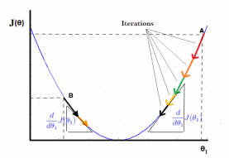

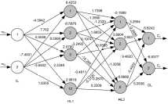

How it Works: Classifier Overview
Phase 1: Training (80% of examples)
Inputs
Process
Output
Examples labelled with classes
iteratively improve model weights
optimized model
Muc
Tub
Tub
Diff
Muc
Muc
Diff
Tub
Muc
Diff
Diff
Sig
Tub
Diff
Phase 2: Testing (20% of examples)
Inputs
Process
Outputs
unlabelled examples
push inputs through optimized model
labels
?
Diff

?
Muc

?
Muc


Slide 7
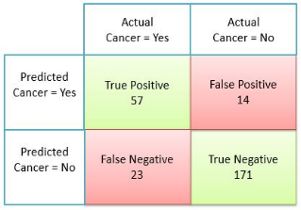
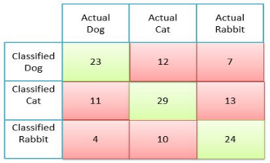
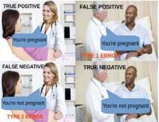
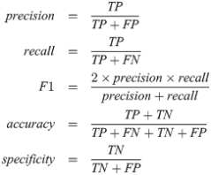
What Makes a Good Classifier?
Classifier effectiveness is evaluated with a Confusion Matrix
The confusion matrix below is for two classes ...
… but multi-class confusion matrices work identically
n=265
n=133
Demystifying Confusion Matrix and Performance Metrics in Machine Learning
All key statistics come directly from the Confusion Matrix
Understanding the Confusion Matrix

Slide 8
Aims
Aim 1 is by far the largest task
Progress
Aim 1 – Develop Classifier
Develop an automated classifier capable of testing the hypothesis
Success criteria: demonstration of a classifier able to classify arbitray TCGA (i) image (ii) RNA-seq data (iii) matched data
Metrics: existence of classifier; validation testing
Aim 2 – Test Part I of the Hypothesis using TCGA Data
Success criterion: Classification performance better than best performing classifiers in the literature for at least three TCGA cancer types
Metrics: Accuracy, Precision, Recall, F1, AUC
Aim 3 – Test Part II the Hypothesis for T-Cell Lymphoma
Success criterion: Classification performance better than best performing classifiers in the literature for T-Cell Lymphoma
Metrics: Accuracy, Precision, Recall, F1, AUC
95%
10
%
5
%

Slide 9


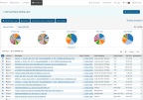



Aim 1: Build the Experiment System
Status: 95% complete. Able to subtype cancers using either Images or RNA-seq data
Fetch Raw Data
Pre-process Raw Data
Realize Optimum Model
Classify
Analyse Results
break
images
into tiles
remove background & degenerate
tiles
normalize
Colors
Image Branch
tiles
patches
Numerical normalization
TCGA
Extract
RNA-Seq
data
Reduce dimens-
ionality
resolve
gene
names
RNA Branch
RNA-Seq
Comprising 13 shell files, 48 python files and many libraries
Only the RNA-Seq portion of the matched Image+RNA-Seq classifier remains to be complete (2-4 weeks)
‘End-to-end’ system. The classification sub-system is just the piece inside the arrowhead graphic
The (otherwise labour intensive and error prone) data acqusition and pre-processing aspects are largely automated
Able to dispatch & run multiple experminent jobs without user intervention
Produces scalar and graphical results in real-time
Based on the Pytorch machine learning library
Hardware: 16 x 3.5GHz core CPU, 132GB RAM; dual Nvidia Titan GPUs each with 576 tensor cores and 24GB memory

Slide 10


Aim 1: Preliminary Experiment: Sub-typing Stomach Cancer
Scope
Use the system to classify TCGA Adenocarcinoma samples into the six TCGA defined subtypes
Image and RNA-Seq separately (can’t yet do matched Image and RNA-Seq)
Purpose
Validate the experiment system and classifiers
Establish a baseline for Aim 2 and Aim 3 experiments
Whole Slide Image Model
228 TCGA STAD H&E tissue samples
Each sample → 2500 randomly selected 64x64 pixel tiles
5,000 randomly selected held-out tiles tested after each of 4 runs = 20,000 total predictions
Neural Network: VGG11 = 11 layer convolutional network; ADAM optimiser; 80% training set + 20% held-out
RNA-Seq Model
479 TCGA STAD mRNA + lnRNA samples
Each sample → 60,483 Upper Quartile FPKM values
All held-out samples tested after each run yielding 96 x 101 = 9,696 total predictions
Neural Network: 3 layer fully connected network (relu + softmax activation); ADAM optimiser; 80% training + 20% held-out
Dual Mode Model
228 case-level matched STAD samples
Each image → 2500 tiles; each tile → embedding using CNN or autoencoder
Each RNA-Seq sample reduced to an embedding using either an FCN or autoencoder
Neural Network: fully connected network (relu + softmax activation); ADAM optimiser; 80% training + 20% held-out

Slide 11
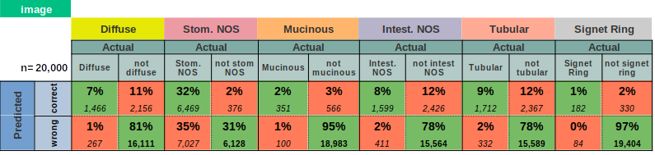
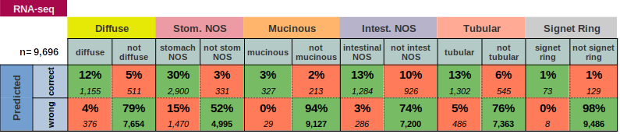
Aim 1: Results – Confusion Matrices
Classification of 20% held-out examples for Stomach Cancer: 4 runs (Images); 101 runs RNA-Seq

Slide 12

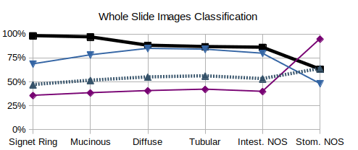
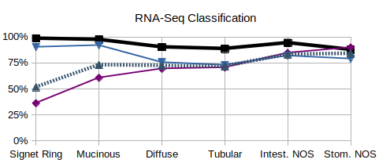
Aim 1: Results - Summary Statistics
Observations
Results look quite good (Accuracy), but this is superficial (Precision, Recall)
  Accuracy: 80-90%-ish for both Image and RNA-Seq
  Precision: 36-95% for image and 36-90% for RNA-Seq
  Recall: 48-85% for image and 73-92% for RNA-Seq
RNA-Seq model performed better and more consistently than Image model
Performance varies greatly between subtypes, probably indicating some are easier to classify than others
Conclusions
The system is validated (Aim 1 Objective)
Results are typical of what others achieve with single mode classifiers
Benchmark to used when testing the hypothesis

Slide 13
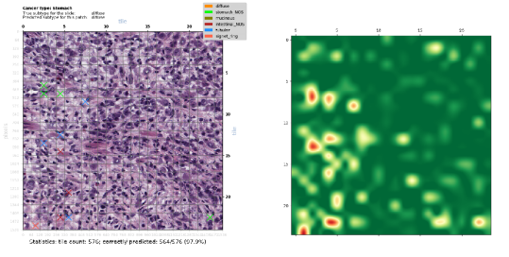
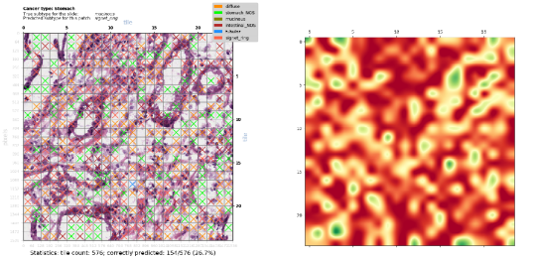
Aim 1: Classification of Contiguous Patches: Many Tiles From Same Sample
Randomly selected 24x24 tile patches (576 tiles)
Cross (‘X’) colour shows misclassified tile subtype; heatmaps show tile-level prediction confidence p(0→1)
Highly Confident and
Correct Prediction of Diffuse Subtype
(564/576=97.9% of tiles)
Badly Wrong Prediction of Diffuse Subtype
as Signet Ring Subtype
(154/576=26.7% of tiles)
This is the worst misclassification of all 229 images

Slide 14
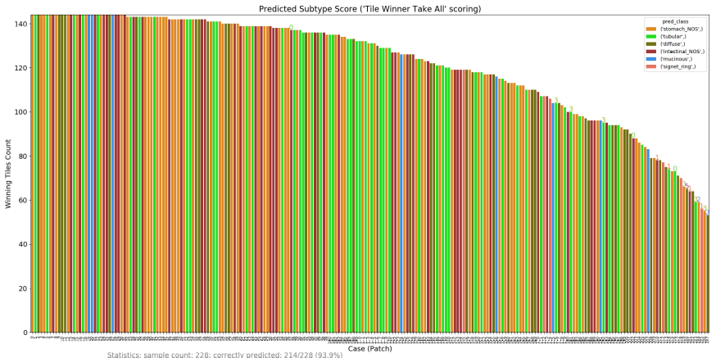
Aim 1: Image Classification – All Samples
Classificaton of 12x12 tile patches from each of the 228 image samples
Scored by counting the number of tiles predicted by the classifier for each of the six subtypes
Bar colour indicates predicted subtype based on this scoring, and the bar height is the score
214 of 228 classifications correct (with widely varying scores)

Slide 15
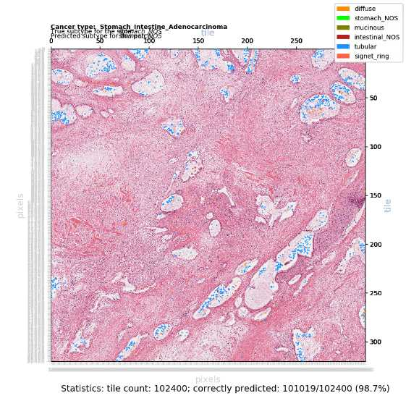
Aim 1: Classification of a Large Patch:
Patch of 320 x 320 = 102,400 tiles (420 mega-pixels)
The pink areas are correctly classified
The blue and orange areas are misclassified

Slide 16
Aim 2: Test Part I of the Hypothesis using TCGA Data
Objective
Test the first part of the hypothesis, viz.
“A classifier trained on BOTH images AND RNA-Seq will classify and subtype any cancer better than existing Image specific or RNA-Seq specific classifiers”
Method
Using the experiment system and classifiers developed in Aim 1:
Test as many matched TCGA cancer types and cases as is (practically) possible
Compare performance against my Image-only & RNA-Seq-only classifiers’ performance (Aim 1)
Compare performance against best performing classifiers in the literature
Metrics
Accuracy, Precision, Recall, F1, Area Under Curve
Timing
Mid December 2020 – End of March 2021 (3.5 Months)

Slide 17
Aim 3: Test Part II of the Hypothesis using T-Cell Lymphoma Data
Objective
Test the second part of the hypothesis, viz.
“A classifier trained on BOTH images AND RNA-Seq will classify T-Cell Lymphoma better than any existing classifier”
Method
Using the experiment system and classifiers developed in Aim 1:
Test 200 matched T-Cell Lymphoma samples provided by PMCC molecular haematology laboratory
Compare performance against best performing classifiers in the literature
Metrics
Accuracy, Precision, Recall, F1, Area Under Curve
Timing
Start of April 2021 – End of July 2021 (4 months)

Slide 18
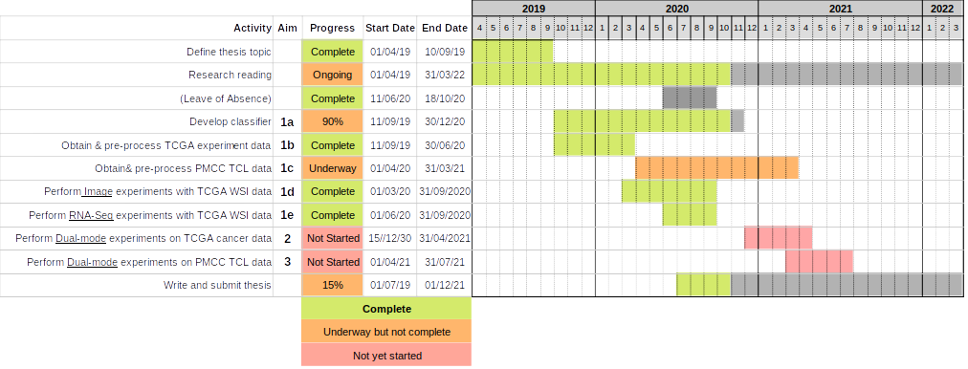
Timeline

Slide 19
Acknowledgements
Supervisors: Dr Ken Doig, Dr Thomas Conway
Mentor: Dr Huiling Xu
Pathology advice: Dr James Rickard
Concept & provision of Lymphoma Samples: Dr Piers Blombury

Slide 20


Slide 21
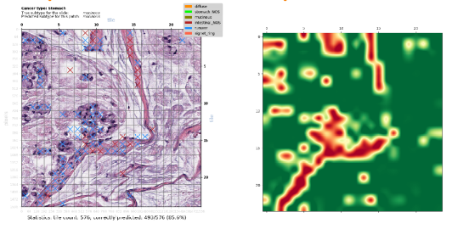
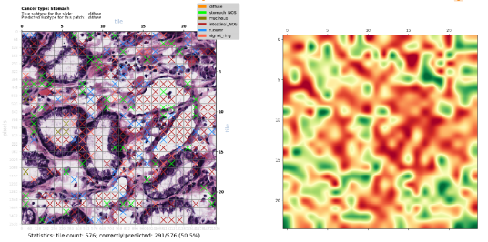
Aim 1: Classification of Contiguous Patches: Many Tiles From Same Sample
Randomly selected 24x24 tile patches (576 tiles)
Cross (‘X’) colour shows misclassified tile subtype; heatmaps show tile-level prediction confidence p(0,1)
Moderately Confident and Correct Prediction of Mucinous Subtype
(485/576=85.6% of tiles)
Unconfident
but Correct Prediction of Diffuse Subtype
(291/576=50.5% of tiles)

Slide 22
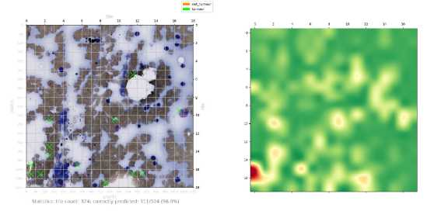
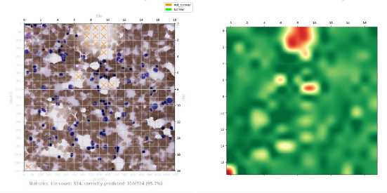
TCL Images:
Trained on only 9 images – ignore classifications

Slide 23
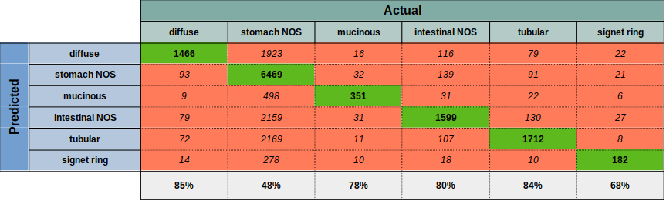
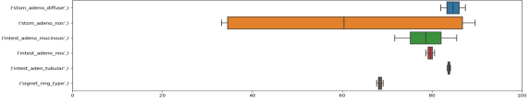
Preliminary Results: Subtyping 229 TCGA STAD Whole Slide Image Samples
Predicted vs True subtype for held out samples. 4 runs
Classification of 229 TCGA STAD H&E stained tissue samples (Six subtypes including two NOS subtypes)
Each sample is represented by 2500 randomly selected 64x64 pixel tiles. Background and degenerate tiles are excluded
Total of 229 x 2,500 = 572,500 tiles used for training and validation testing: 80% (n=458,000) training set + 20% (n=114,500) validation
5000 randomly chosen held-out tiles are tested after each run, yielding 20,000 total predictions of held-out tiles
Neural Network details: VGG11 = 11 layer convolutional (relu + softmax activation) network; ADAM optimiser. Reasonably well tuned
20 epochs per run. Each of the 4 runs produces a slightly different optimised classifier. See box plot
Observations
Classification accuracy ranges from 48-85% (all subtypes). Misclassification to NOS accounts for most misclassifications (35%)
Classification accuracy rises to 95-98% when the two NOS categories are removed (slide after next)
Much less variance between runs than for RNA-Seq, except for stomach NOS which has very high variance
No obvious explanation for the high variance between runs seen with stomach NOS
Classification of 5000 held-out tiles for each run (=20,000 predictions total) - All Six Subtypes
Replicability: percent correct for each category over the 4 runs

Slide 24

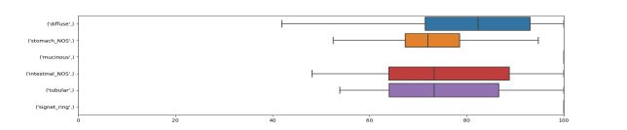
Preliminary Results: Subtyping 479 TCGA STAD RNA-Seq Samples
Predicted vs True subtype for held out samples. 101 runs.
Classification of 479 TCGA STAD RNA-seq samples (Six subtypes)
Each example is a vector comprising 60,483 mRNA + lnRNA Upper Quartile FPKM values (Frequency per kilobase per million reads mapped)
479 RNA-Seq examples per run for training & validation testing: 80% (n=383) training + 20% (n=96) validation testing
All held-out samples are tested after each run yielding 96 x 101 = 9,696 total predictions of held out samples over the 101 runs
Neural Network details: 3 layer fully connected network (relu + softmax activation); ADAM optimiser. Reasonably well tuned
200 epochs per run. Each of the 101 runs produces a slightly different optimised classifier. See box plot.
Observations
Absolute (rather than differential) RNA-seq expression data contains sufficient information to classify STAD subtypes quite well
Classification accuracy ranges from 70-90%% across the six subtypes
Misclassification to NOS accounts for most misclassifications (48%). This makes sense, as NOS is a heterogeneuous catch-all subtype.
Classification accuracy rises to 94-98%% when the two NOS categories are removed (next slide)
Classification of held-out test sets for each run (=9,696 predictions total) - All Six Subtypes
Replicability: percent correct for each category over the 101 runs

Slide 25
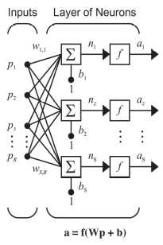

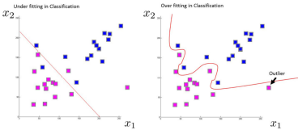
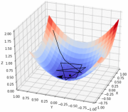
Neural Networks for Cancer Classification: Learning from Data
While there are many good classification algorithms (SVN, Random Forest ...), supervised neural networks are particularly effective classifiers
A Deep Learning network is just a neural network with many layers of neurons
With any kind of supervised neural network:
experts (e.g. pathologists) supply correctly labelled examples;
the network iteratively learns from this ‘Training Set’, resulting in a model which, hopefully;
generalizes well and can classify new, unseen examples (Test Set)
In more detail:
Start off with random weights (w_{i,i})
process a batch of inputs (p) from the Training Set
quantify batch loss: true ‘minus’ predicted classes
apply chain rule to loss, then update weights
try again with new weights
do over and over
Periodically validate with examples randomly drawn from the Test Set
signet_ring_type
intest_adeno_nos
stom_adeno_diffuse
Vito Gentile on Stack Overflow forum
With a pencil: 1 dimensional curve classifying 2 classes
With an NN: perhaps 100,000 dimensional hyperplane classifying (say) 6 cancer subtypes
When training a well parameterized model, most iterations will result in the loss (black line) reducing; stepping towards the minimum of the red/blue sheet corresponding to maximum classification accuracy
Microsoft - Tokyo DMM Machine Learning Tech Talk
Introduction to Optimization in Deep Learning: Gradient Descent

Slide 26
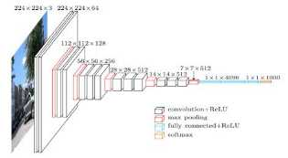
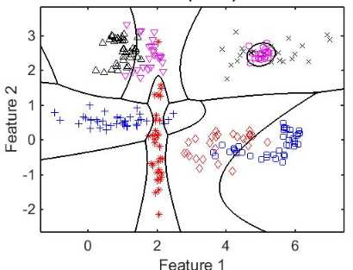

Automatic Classification: Learning from Data
‘VGG16’ – A Convolutional Neural Network
Many good classification algorithms (SVN, Random Forest …)
Supervised neural networks are particularly good
Deep Learning network = neural network with many layers
The classifier below is using 2 features to classify 8 classes
For the TCGA Stomach Cancer dataset (8 classes) I use:
  Images: 3x64x64=12,288 features
  RNA-Seq: 60,482 features
Understand the architecture of CNN
multi-class classification

