Slide 1
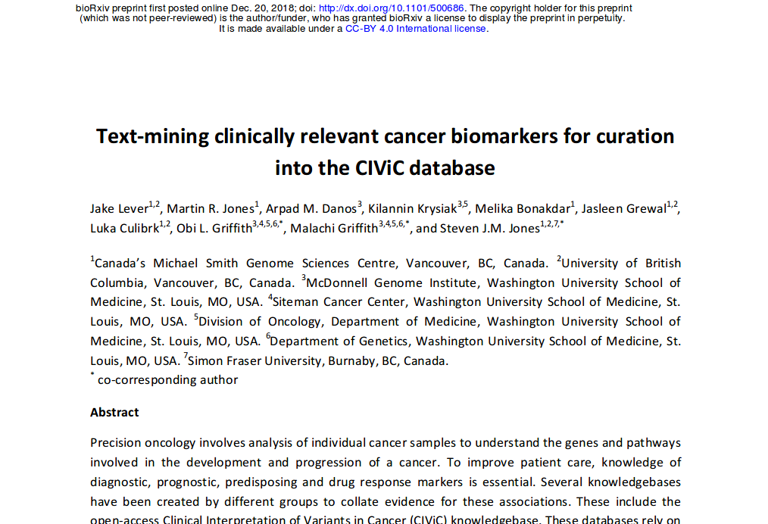

Slide 2
It’s an Interesting paper because...
Recent (Dec 2018)
Credible Group
Ambitious
Well executed
Contemporary ML Techniques
Worked
Extendable

Slide 3
‘CivicMine’
Project Goal Text mine cancer biomarkers from the literature which meet inclusion criteria knowledgebase but which aren’t currently in the CIViC knowledgebase.
Scope All of PubMed
Method Machine Learning techiques

Slide 4
What is CiViC?
Context: CIViC is an open access, open souce, community-driven (‘crowdsourcing’) web resource for Clinical Interpretation of Variants in Cancer. Launched in 2015.

Slide 5
‘Civic’
‘The manner in which the clinical relevance of variants in cancer is presented in the published literature is highly heterogeneous.
OTOH ‘The CIViC data model is highly structured and ontology driven
‘Clinical interpretations are captured and displayed as evidence records consisting of a free-form ‘evidence statement’ and several structured attributes.
‘Each evidence record is associated with a specific gene, variant, disease and clinical action.
‘Evidence records belong to one of four evidence types indicating whether a variant is predictive of response to therapy, prognosis, diagnosis and/or predisposition for the cancer.
‘Evidence records also assigned to an evidence level ranging from established clinical utility (level A) to inferential (level E) evidence (Supplementary Figs. 3 and 4). The quality of the underlying published evidence is rated from one to five stars
Highly Manual !

Slide 6
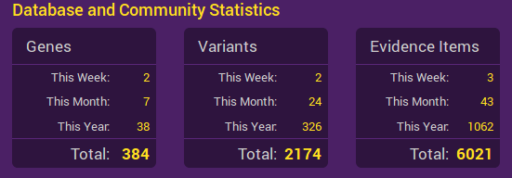
Civic Stats, as of 25/4/19

Slide 7
Method
Preliminary setup
Extract Sentence List from PubMed
Establish Truth Set
Train the Model
Run the Model
Post-process

Slide 8
Preliminary Setup
Establish Term Lists (including synonyms) for genes, mutations, cancer types and drugs (together: 'entities of interest')
Define a list of relationship keywords for each of four basic 'evidence types', viz: 'Diagnostic', 'Predictive', 'Predisposing', 'Prognostic'
Downloaded all of PubMed (not just the Public bit)

Slide 9
Extract Sentence List
extract every sentence from PubMed that meets the following criteria:
contains references to at least one gene AND
at least one mutation
AND at least one cancer type
AND OPTIONALLY ALSO 1+ drugs AND at least one relationship keywor

Slide 10
Establish Truth Set
load a subset of the Sentence List into a web-based annotation tool (based on ‘bootstrap’)
ask curators to assess to view sentences presented to them by the annotation tool and make a judgment on the validity or otherwise of the embodied relationship << KEY STEP
there also had to be a high degree of consensus among annotations and they had to go through some hoops before they achieved this
continue until 200 sentences containing valid relationships have been accumulated for each of the four relationship keywords
call this set of 800 annotated sentences the Training Set

Slide 11
Train Model
train a supervised learning tool to learn relationships from the Training Set
Specifically, Stanford's NLPCore relationship extraction tool: 'Kindred'

Slide 12
Run Model
use the now trained model against the Sentence List to identify sentences which (according to the model) contain valid relationships << KEY STEP

Slide 13
Post-Process
post process the relationship-containing sentences to tag the entities of interest and putative relationships and store in a structured database
provide a friendly web-based dashboard for users access the results
compared the positive matches to those which were already in CIVIC
update weekly against PubMed (using pubrunner)

Slide 14
Results
From 69,258 PubMed papers processed, 128,857 relationship-containing sentences found embodying 90,992 biomarkers corresponding to 7,866 genes, 667 cancer types and 402 drugs
'prognostic' was by far the most common type of relationship found in the sentences (about 66,000 hits) compared to about 10,000 each for 'diagnostic' and 'predictive' and about 6,000 for 'predisposing'
keep in mind that in some cases, individual sentences embodied multiple valid relationships, and in other cases, many distinct sentences embodied the same relationship (eg 725 times for BRCA1)

Slide 15
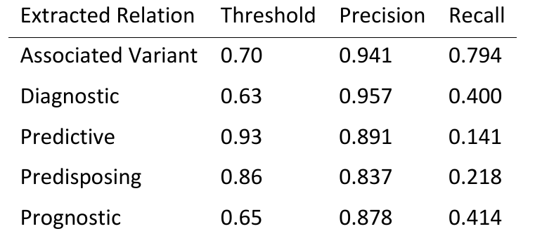
Results

Slide 16
Observations
Emphasis on precision rather than recall, which of course makes sense but it means that they're leaving it for the user to manually filter out false positives.
In essence it automates the extraction of grammatically and syntactically compliant sentences. Inevitably then, information is being thrown away which might have otherwise have been used by a less explicitly grammar & ontology based approach.
It might beneficially have used a Recursive Neural Network (RNN), e.g. particular LSTM, to pick up relationships that span more >1 sentence.
It might beneficially have used word embeddings for the relationship words (but not the entities of interest, which are not dictionary words). Eg Google's word2vec or Stanford's Glove)
It might beneficially have used Transfer learning or Cross-Corpus Learning
The task of identifying relationships between sets of words in texts is a very general one, so Transfer learning or Cross-Corpus Learning are definitely relevant

Slide 17
Working ML is Pretty New
Not so much the algorithms, but the ability to get results
Planets aligned around 2011:
Algorithms, plus now also:
Hardware (esp. cheap fast GPUs and memory)
Massive Data (Google, Facebook and the like)

Slide 18
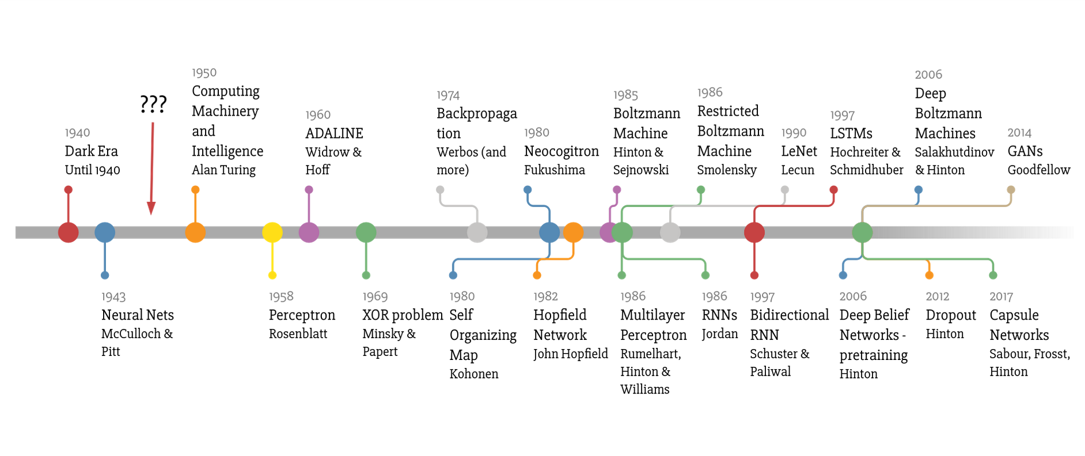
Chronology
~2011
Favio Vasquez: ‘A Weird Introduction to Machine Learning.

Slide 19
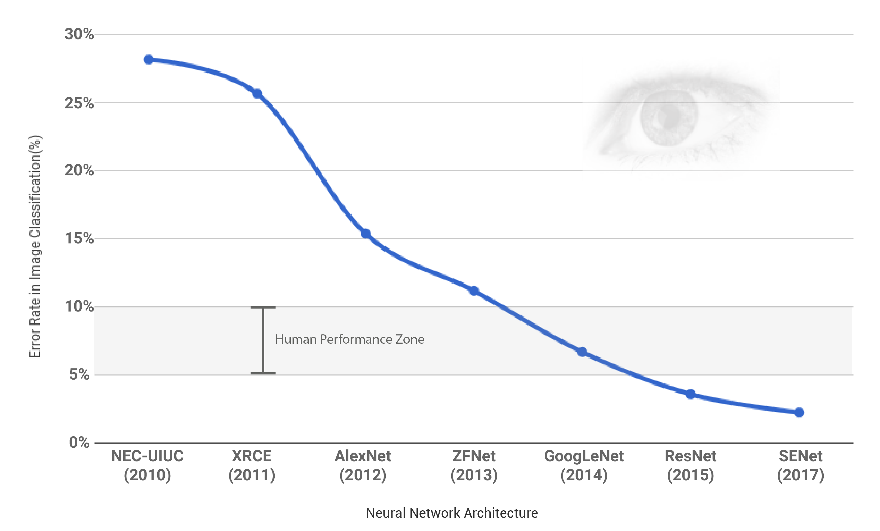
ILSVRC (ImageNet) Shared Task Results
2010-2017
Muktabh Mayank 2017: ‘Parallel Dots’

Slide 20
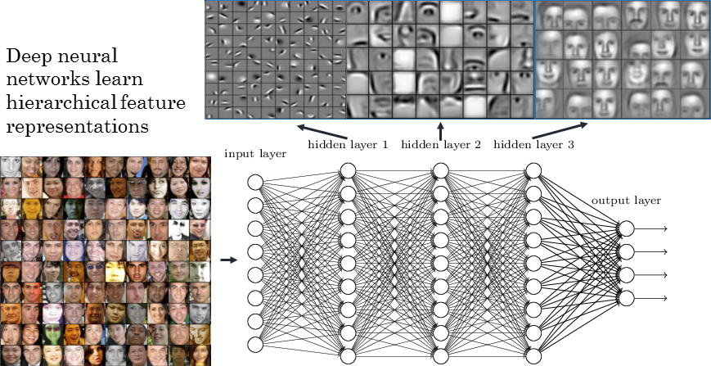
Convolutional Neural Network
Layers of Filters that Learn and Specialize
RSIP Vision: ‘Exploring Deep Learning & CNNs’

