Slide 1
Getting started with
ExtJS and Catalyst
  An introduction to ExtJS and Catalyst
  Perl Mova conference 2008
  Kyiv, Ukraine
  Peter Edwards, Dragonstaff Ltd.

Slide 2

About me
Name: Peter Edwards
Day job: IT consultant developer
Web applications using Catalyst
MiltonKeynes.pm perlmonger
peterdragon on Perlmonks.org
CPAN: PEDWARDS
peter@dragonstaff.com
Wonders: is this the venue?

Slide 3

Contents
ExtJS overview
Catalyst overview
Putting them together
  Example application
Conclusion
Download this presentation from
http://perl.dragonstaff.co.uk

Slide 4
ExtJS overview
What is ExtJS? (“extent”) http://extjs.com
Cross-browser Javascript library for web pages
  Internet Explorer 6+, Firefox 1.5+, Safari 2+, Opera 9+
Web 2.0 effects with little code
Abstracted handling of HTML elements, DOM, event handling and Ajax
Widgets
  window, layout, tabs, form, toolbar, menu, tree,
  data grid, combobox
  http://extjs.com/learn/Ext_Extensions

Slide 5
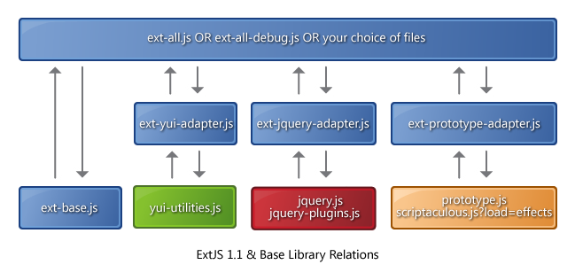
ExtJS structure
Works with other Javascript libraries
  YUI, JQuery, Prototype for legacy code

Slide 6
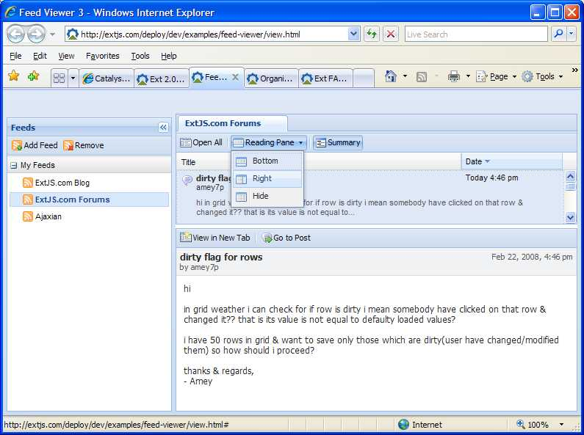
ExtJS in action
Feed
viewer
  panes
  toolbar

Slide 7
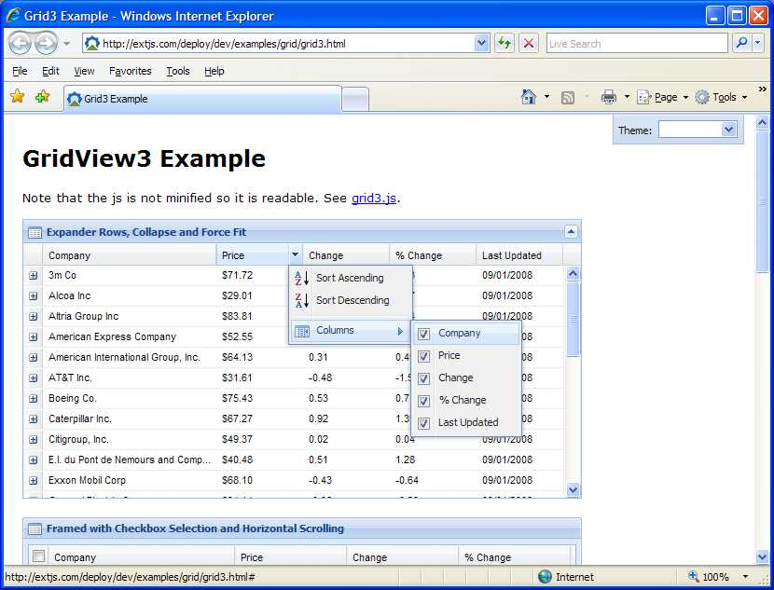
ExtJS in action
Data grid
  sort
  columns
  editable
  data
  source

Slide 8
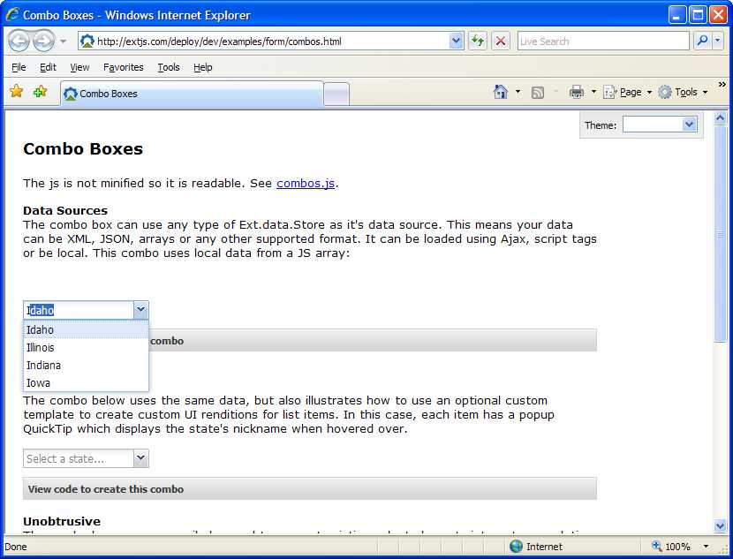
ExtJS in action
Combobox

Slide 9
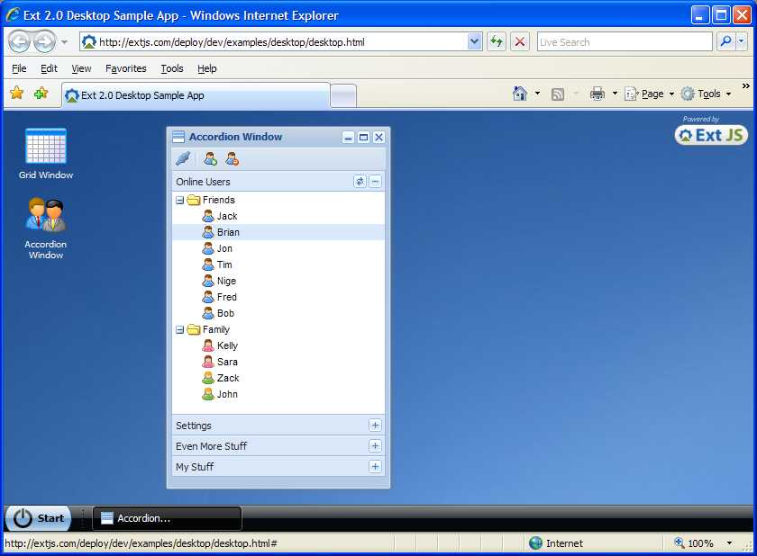
ExtJS in action
Desktop

Slide 10
Start using ExtJS
Learning resources
  http://extjs.com/learn/
  reference manual http://extjs.com/deploy/ext/docs/
Download and install
  http://extjs.com/download
  e.g. to /var/www/html/ext-2.0
Add stylesheet and libraries to web page header
<link rel="stylesheet" type="text/css" href="/ext-1.1/resources/css/ext-all.css" />
<script type="text/javascript" src="/ext-1.1/adapter/ext/ext-base.js"></script>
<script type="text/javascript" src="/ext-1.1/ext-all.js"></script>

Slide 11
Start using ExtJS
Use named DIVs to identify content to enhance
<div id="container"><div id="content" class="welcome"> ... </div></div>
Write Javascript to tell ExtJS what to do
  E.g. create layout with one panel
  Note prototype object-based approach to standardise JS objects and avoid memory leaks (http://extjs.com/learn/Manual:Intro:Class_Design)
<script type="text/javascript">
Thescreen = function(){
return {
init: function(){
var layout = new Ext.BorderLayout(document.body, {
center: {
autoScroll: true,
minTabWidth: 50,
preferredTabWidth: 150,
titlebar: true
}
});
layout.beginUpdate();
layout.add('center', new Ext.ContentPanel('content', {title:'ExtJS demo app'}));
layout.endUpdate();
}
}
}();
Ext.EventManager.onDocumentReady(Thescreen.init, Thescreen, true);
</script>

Slide 12
Catalyst overview
What is Catalyst?
Model-View-Controller perl framework for web apps
Model
  data objects, business logic
View
  HTML templates or JSON or CSV or…
Controller
  parse request, map to action handler

Slide 13
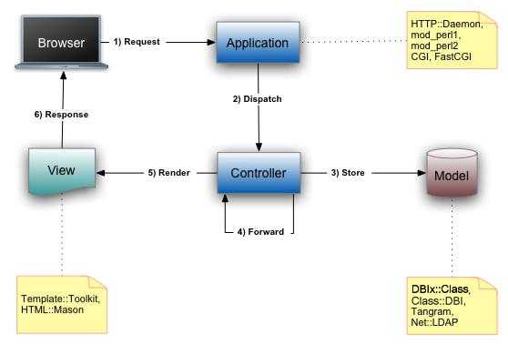
Catalyst overview

Slide 14
Catalyst structure
Catalyst does most of the hard work for you
  URI parsing; map to chained handler routines
  request/response objects, context setup, data stash
  plugins for sessions, authentication, data stores etc.
  logging, exception handling, debug
  External configuration files via Config::Any
    YAML, Perl, …
  automated testing framework
    Test::WWW::Mechanize
  test server, mod_perl, FastCGI
  helpers to generate new model/view/controller code
  $ catalyst.pl My::App
  $ scripts/myapp_create.pl controller My::Controller

Slide 15

Catalyst learning
Book by Jonathon Rockway
  http://www.packtpub.com/
  catalyst-perl-web-application/book
CPAN
  http://search.cpan.org/perldoc?Catalyst::Manual
Mailing lists
  http://lists.scsys.co.uk/mailman/listinfo/catalyst
  http://lists.scsys.co.uk/mailman/listinfo/dbix-class
IRC
  #catalyst on irc.perl.org
Recent talk on writing a Catalyst Moose-based Wiki
  http://www.jrock.us/fp2008/catalyst/start.html

Slide 16
Putting them together
An example Catalyst application with ExtJS
  http://www.dragonstaff.co.uk/extjs/home
Source code – see comments in files
$ svn co http://dev.catalystframework.org/repos/Catalyst/trunk/examples/ExtJS
Accompanying Catalyst advent calendar article
  http://catalyst.perl.org/calendar/2007/1
Features
  Model: SQLite database
  View: Template::Toolkit templates containing Ext JS
  ExtJS: layout, panels, tabs, styles, toolbar

Slide 17
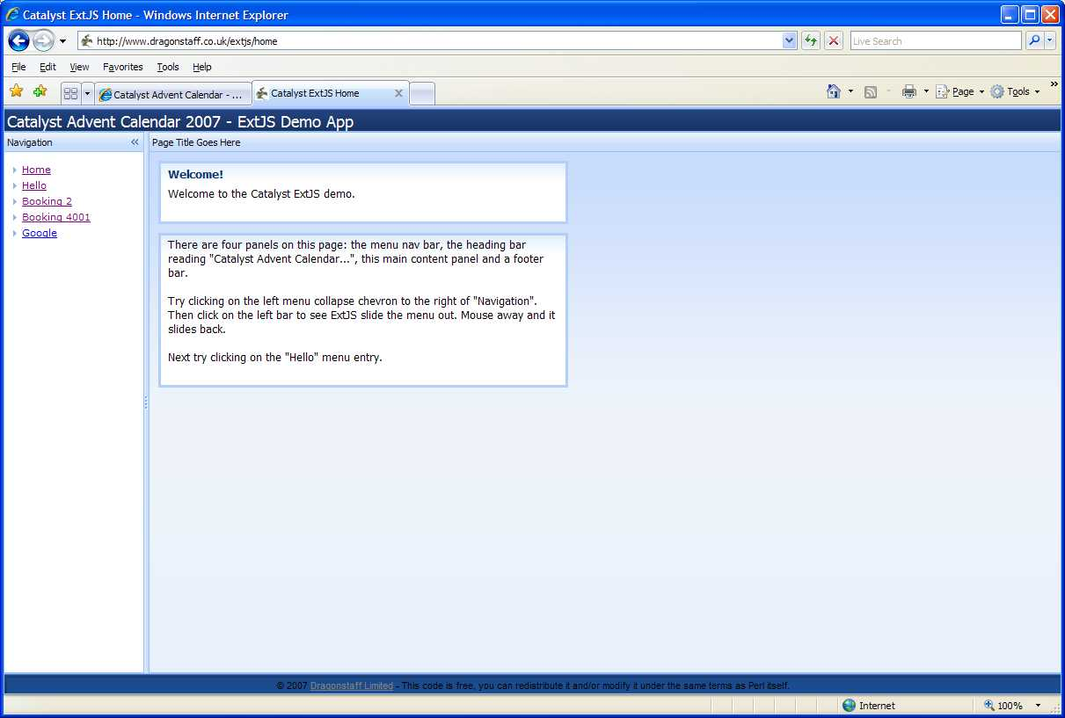
Example application

Slide 18
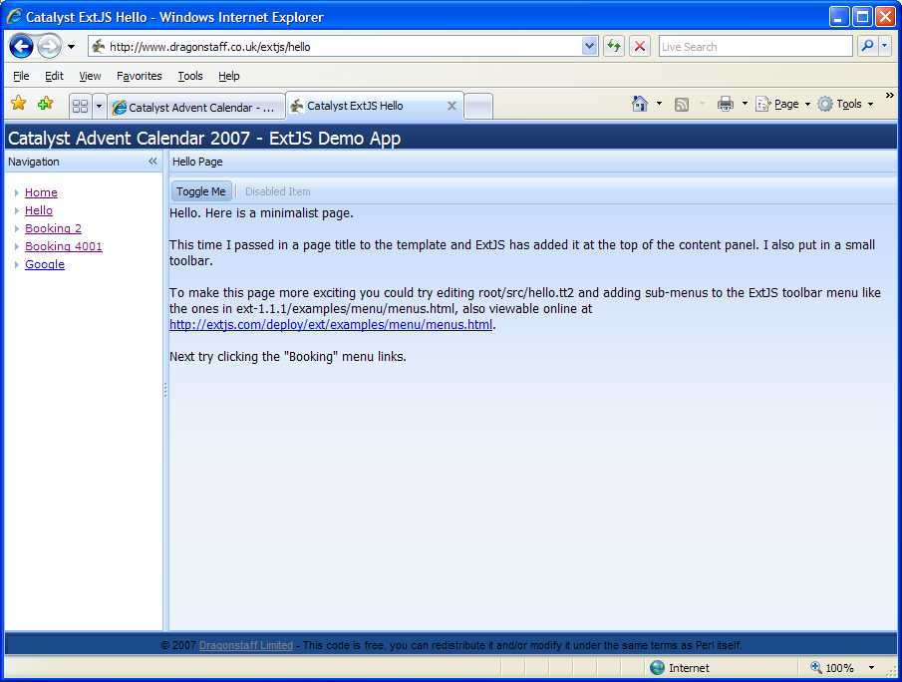
Example application

Slide 19
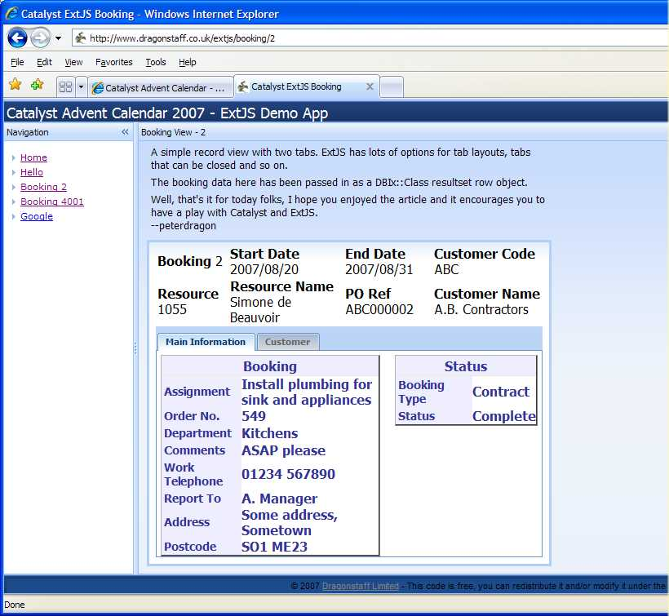
Example application

Slide 20
Conclusion
Catalyst + ExtJS = quick easy Web 2.0 apps
Thank you
and any questions?
Download this presentation from
http://perl.dragonstaff.co.uk

