Slide 1
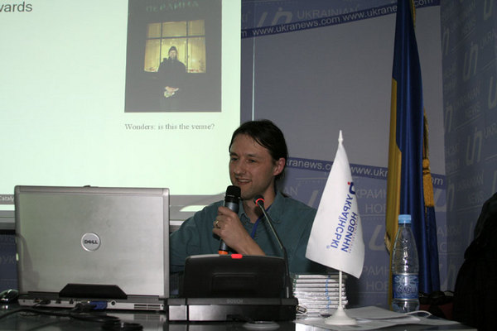
Cross-Platform Testing
Кросс-платформенное тестирование
Peter Edwards
peter@dragonstaff.co.uk
Киёв Перл Мова 2009
Perl Technical Talk
7th March 2009

Slide 2
Contents
Содержание
Background, CMS, Usage
Technology, Client-side, Server-side
Cross-Platform
Existing Testing, Problems
Add Windows Testing Under Unix
Test::MockObject
Running Unix unit tests under Windows
Future Plans For Testing
Summary and Links

Slide 3
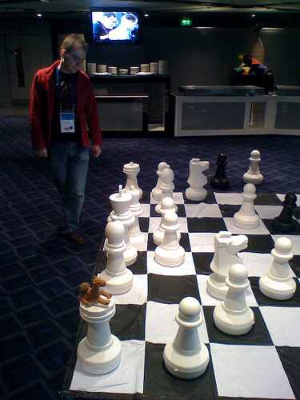
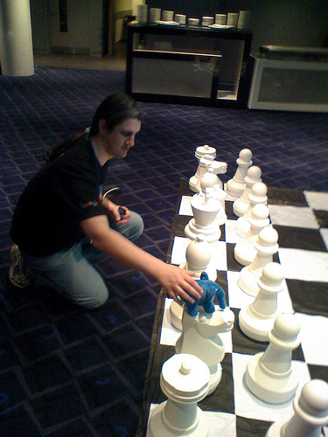
Background
Предыстория
London.pm MiltonKeynes.pm
Google Developer Day 2008 – London – Perl vs. PHP at chess

Slide 4


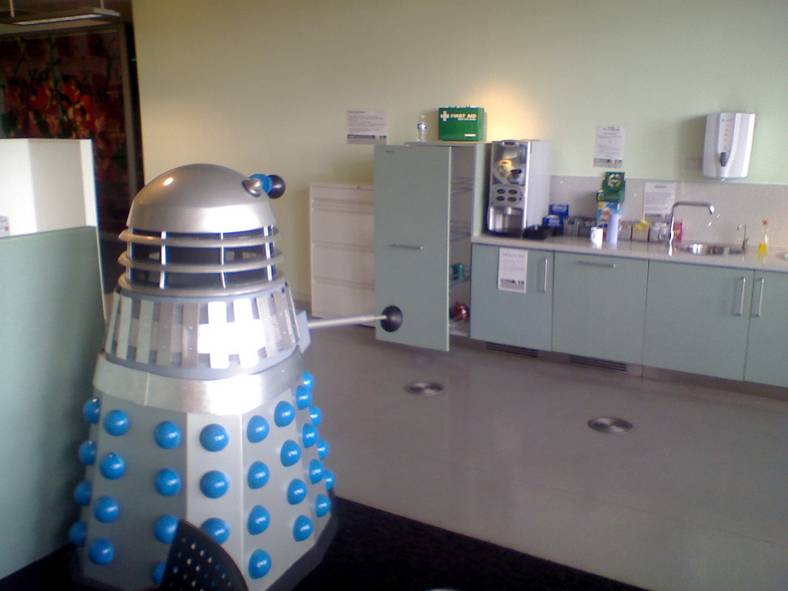
Background
Предыстория
View from BBC
Media Centre
Coffee area | Кухня

Slide 5
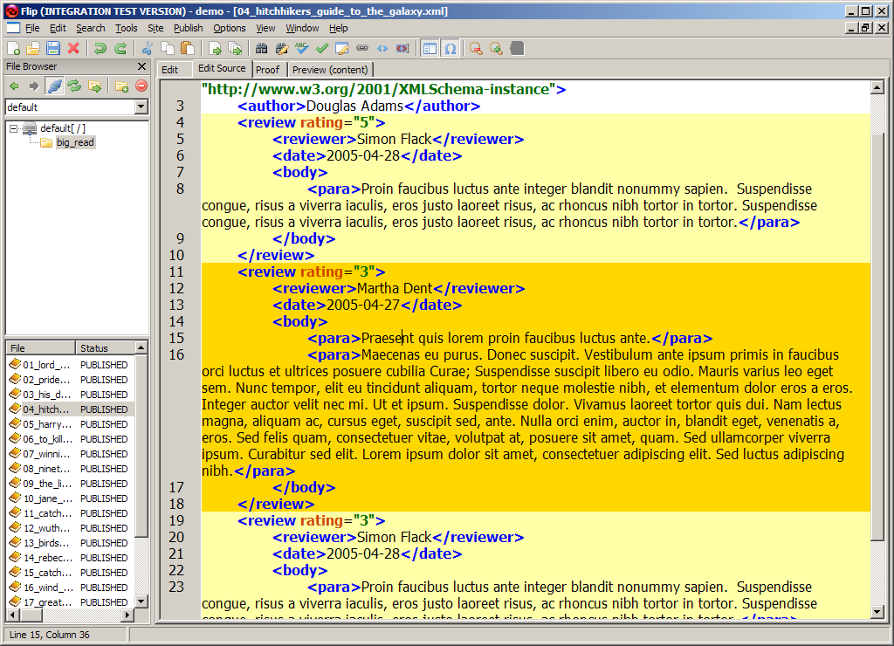
Content Management System
Система управления содержимым
Used to enter XML documents transformed to make bbc.co.uk website

Slide 6

Usage
Использование
  100s of users
  Time-critical publishing
  After software release “failure is not an option”
  Answer: test coverage, and lots of it

Slide 7
Technology
Устройство
Client
ASPerl
Windows
XML doc.
Server
Apache
mod_perl
Solaris
Content
Publishing
System
bbc.co.uk
SOAP
::Lite

Slide 8




Client-side
Клиентская часть
Client-side
  MS Windows
  GUI using WxPerl (WxWidgets)
  WYSIWYG editing
  Talks SOAP over HTTP to server
  Runs under ActiveState Perl

Slide 9

Server-side
Серверная часть
Server-side
  Handles SOAP requests
  Stores document blobs in filesystem
  Stores indexes, metadata in Oracle database
  Runs under Solaris Perl
  Publishes to BBC Central Production Servers

Slide 10
Cross-Platform
Кросс-платформенность
CMS code running on Windows and Solaris
Solaris perl 5.8.8
$ perl -V
Summary of my perl5 (revision 5 version 8 subversion 8) configuration:
Platform:
osname=solaris, osvers=2.10, archname=sun4-solaris
Windows ASPerl 5.8
C:\WINNT>perl –V
Summary of my perl5 (revision 5 version 8 subversion 6) configuration:
Platform:
osname=MSWin32, osvers=4.0, archname=MSWin32-x86-multi-thread

Slide 11
Existing Testing
Существующие тесты
Unit tests for development
Automated overnight smoke testing of unit tests
Dev / Staging Test / Live environments
Manual release test on staging test area using Windows application

Slide 12
Problems With Testing
Проблемы тестирования
Lots of tests for server side code
But few for client side because difficult to run WxWidgets code on Unix in batch (no X display)
Existing tests run on Unix, fail on Windows

Slide 13
Add Windows Testing Under Unix
Добавление Windows-тестирования под Unix
Need to write client-side tests for
GUI WxPerl -> Gtk+ under Solaris
‘Use Wx’ was failing because no X display
Problems with font sizing and window alignment
Windows-specific components, e.g. ActiveX Altova editor
Installation
Shortcuts, registry Win32::OLE, unzipping archives to Windows Apps dir etc.
Test coverage – Devel::Cover

Slide 14
Add Windows Testing Under Unix
Добавление Windows-тестирования под Unix
Solutions
GUI – can use Xvfb (X windows virtual framebuffer)
$ alias runxvfb='Xvfb :10 -dev vfb screen 0 1152x900x8 > /dev/null 2>&1 &'
Lets you check code compiles and can call many routines
But how do you test the UI rendered properly?
- interpreting the virtual screen bitmaps is too hard!

Slide 15
Add Windows Testing Under Unix
Добавление Windows-тестирования под Unix
Solutions
Sand-boxing and mocking
Mock required Win32 functions and check for correct call order, parameters
Make them do file I/O to a sandbox area
Test::MockObject - Perl extension for emulating troublesome interfaces
Test::MockModule - Override subroutines in a module for unit testing

Slide 16
Test::MockObject
Mocking
my $class = 'Win32::OLE';
my $ole_obj = Test::MockObject->new;
$ole_obj->fake_module($class);
$ole_obj->fake_new($class);
$ole_obj->mock( 'AppData',
sub {
return catdir(qw(data win32),
'Application Data');
} );
...
# unit test my routine that uses
# Win32::OLE –> my mocked object
my_routine();

Slide 17
Test::MockObject
Helper
sub make_mock_obj_in_class {
my $class = shift;
my $obj = Test::MockObject->new;
$obj->fake_module($class);
$obj->fake_new($class);
return $obj;
}
my $ole_obj = make_mock_
obj_in_class('Win32::OLE');
$ole_obj->mock('AppData', sub {...});

Slide 18
Test::MockObject
Mocking installer's WxWidgets progress bar
my $wx = make_mock_obj_in_class( 'Wx' );
my $mock_WxPerlSplashProgress = make_mock_obj_in_class(
'Wx::Perl::SplashProgress' );
$mock_WxPerlSplashProgress->set_true(qw(
SetLabelColour
SetIcon
Show
SetValue
Update
Destroy ));
$mock_WxPerlSplashProgress->mock(
SetLabel => sub { diag ' SetLabel: '.$_[1] } );

Slide 19
Test::MockObject
Unit test installer's use of WxWidgets progress bar
use Test::More tests => 3;
# test _install_loginscript()
my $i = FLIPClient::Installation->new(...);
$mock_WxPerlSplashProgress->clear();
is( $i->_install_loginscript, 1,
'_install_loginscript' );
# order of subroutine calling
$mock_WxPerlSplashProgress->
called_pos_ok( 4, 'SetLabel', 'called
Wx::Perl::SplashProgress->SetLabel' );
# arguments passed to subroutine
$mock_WxPerlSplashProgress->
called_args_pos_is( 4, 2, 'Checking login script' );

Slide 20
Test::MockObject
Helper to see order of calls made and arguments
sub dump_mock_calls {
my $mockobj = shift;
my $i = 1;
while (my $name =$mockobj->call_pos($i)) {
diag " call $i: $name";
my @args = $mockobj->call_args($i);
for (0 .. $#args) {
diag ' arg '.($_ +1).': ';
diag Dumper($args[$_]);
}
$i++;
}
}
# then in test script
dump_mock_calls($mock_WxPerlSplashProgress);

Slide 21
Test::MockObject
Direct mocking of variable and subroutines
Wx has > 3000 subroutines/variables – only mock the ones used
BEGIN {
$mock_Wx = make_mock_obj_in_class( 'Wx' );
no strict 'refs';
*{'Wx::wxICON_EXCLAMATION'} = sub { 1 };
*{'Wx::wxOK'} = sub { 1 };
*{'Wx::Yield'} = sub { 1 };
*{'Wx::MessageBox'} = sub {
my ($msg, $caption, $style, $window, $x, $y) = @_;
$msg =~ s/\n/\n# /g;
DUMP sprintf('Wx::MessageBox() caption = <<<%s>>>, style = %d, msg = <<<%s%s>>>', $caption, $style, "\r\n# ", $msg);
};
@{'Wx::EXPORT_OK'} = qw( id );
%{'Wx::EXPORT_TAGS'} = ( id => ['id'], everything => \@{'Wx::EXPORT_OK'} );
}

Slide 22
Running Unix unit tests under Windows
Запуск Unix unit-тестов под Windows
Perl libraries shared between Unix and Windows not being tested properly client-side
Perl Portability
  "perldoc perlport“ http://perldoc.perl.org/5.8.8/perlport.html
  "When the code will run on only two or three operating systems, you may need to consider only the differences of those particular systems. The important thing is to decide where the code will run and to be deliberate in your decision.“
  Only worrying about Windows and Unix; OpenVMS is hard
    binmode and chomp - binmode saves headaches on Windows like EOF ^Z; watch out for CR-LF
    use File::Spec::Functions rather than Unix paths
    YES : my $path = rel2abs( catdir(qw( data local cache file.txt ));
    NO : my $path = './data/local/cache/file.txt';
    Perl functions handle '/', but what about calls to Win32 API?

Slide 23
Running Unix unit tests under Windows
Запуск Unix unit-тестов под Windows
Generic configuration interface with platform-specific subclasses
System.pm
|-- System/Win32.pm
|-- System/Unix.pm
using File::Spec::Functions for paths
Changed tests from path strings to regexes using a quote path separator
my $script = $i->startup('remote');
NO :
is( $script, 'scripts/FLIP_real.PL',
'$i->startup("remote") script’
YES :
$ps = ($^O eq 'MSWin32') ? "\\" : '/';
$qps = quotemeta $ps;
like( $script, qr{
scripts [$qps] FLIP_real.pl \z
}xms, '$i->startup("remote") script' );
(“Perl Best Practices” style regex)
Need to actually run the tests on multiple platforms

Slide 24
Future Plans For Testing
Планы на будущее
Automate application release test under Windows
  Win32::GuiTest (or pay for “WinRunner”)

Slide 25
Summary and Links
Итоги и ссылки
Summary
  "perldoc perlport“
  Write cross-platform tests from the outset; convert old ones
  Mock platform-specific GUI or system library calls
  Automate tests (life is short) and get as much coverage as possible
Links
  WxPerl http://wxperl.sourceforge.net/
  WxWidgets http://docs.wxwidgets.org/trunk/
  "Perl Testing: A Developer's Notebook" Ian Langworth & chromatic, O'Reilly Media, Inc., 2005 http://preview.tinyurl.com/5k6wnc
Thank you. Any Questions?

