Slide 1
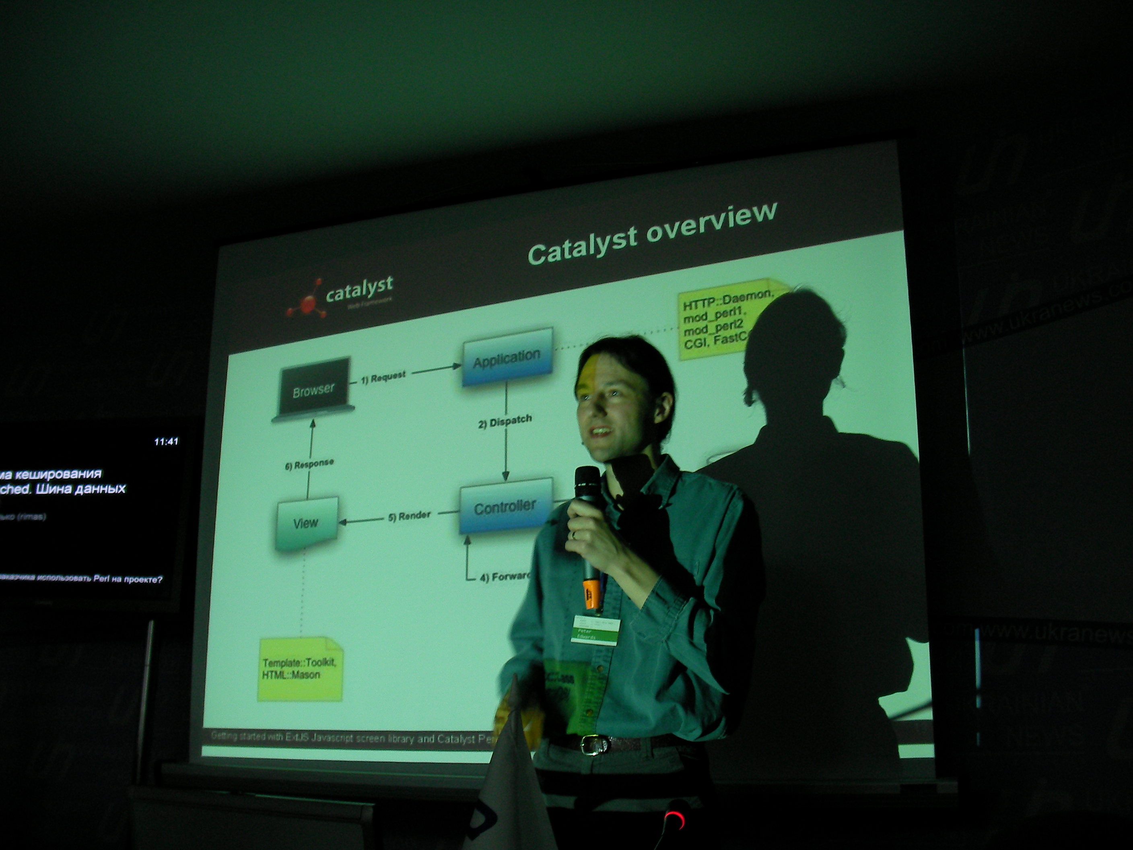
Exceptions
Lightning Talk on Exceptions
MiltonKeynes.pm 12-Jan-2009
Peter Edwards
peter@dragonstaff.co.uk
Slides at http://perl.dragonstaff.co.uk

Slide 2
What Are Exceptions
Defensive programming
  expected behaviour
  you should anticipate bugs or incorrect input
  recovery from
  or reporting of
  "exceptions" to expected behaviour

Slide 3
Exception Handling
detect
  check data and die/throw exception when invalid
  wrap calls in eval:
  eval { $foo->bah() };
  die "foo failed: $@" if $@;
classify
  user error
  program error
  severity level (debug, info, warn, error, fatal)

Slide 4
Exception Handling
report
  warn to STDERR and continue
  die with message to STDOUT
  print to screen
  logging with log4perl - severity level

Slide 5
Exception Methods
Return codes
  don't do this!
  is it 0 or 1 or a special value that is failure?
  system calls vary
  easy to forget to check return code in caller leading to hidden error
  difficult to return code and message
    sub a { return (1, "Invalid file format, file path: $fpath"); }
    my $rc = a(); # oops, only gets message not code

Slide 6
Exception Methods
hierarchy of die/rethrow inside eval
  sub a {
  die "oops"; # should be a croak() for context
  return 1;
  }
  sub b {
  my $rc;
  eval { $rc = a() }; # undef
  die "a() failed: $@" if $@; # rethrow
  return $rc;
  }
  eval { print "b returns " . b() };
  print "b() failed: $@" if $@;
  >>> b() failed: a() failed: oops at t.pl line 2.

Slide 7
Better Exceptions
eval/die/rethrow is a bit clunky
built-in error object methods would be nice
languages like java or javascript give you
try... catch... throw
so use a CPAN exception module... which one?

Slide 8
Modules available
Fatal - makes failed builtins throw exceptions
  use Fatal qw( open close );
Error
  gives you try... catch... throw
  obscure nested closure memory leak

Slide 9
Modules available
Class::Throwable
  lightweight
  easy to use
  controllable levels of verbosity
  extensible exception objects
  I use this one

Slide 10
Modules Available
Exception::Class
  full-powered
  complex
  may be a performance overhead

Slide 11
Modules Available
Others include: Exception
Good discussion of pros/cons in Class::Throwable perldoc

Slide 12
Gotcha
DIE blocks can reset $@
  sub check {
  croak ”invalid parameter” unless $_[0];
  }
  sub DESTROY {
  local $@; # forget me and you've had it
  eval { somefoo() };
  print ”in DESTROY\n”;
  }
  eval { check(undef) };
  print ”$@\n”;
  >>> (empty)
CPAN solution: Devel::EvalError

Slide 13
Perl Best Practices
”Perl Best Practices” pp.273-296 first ed. 2005, D.Conway pub. O'Reilly
  Ten essential development practices
  #8 Throw exceptions instead of returning special values or setting flags
See also Summary of Chapter 13, Error Handling (too many points to list here!)
-end-

