Slide 1
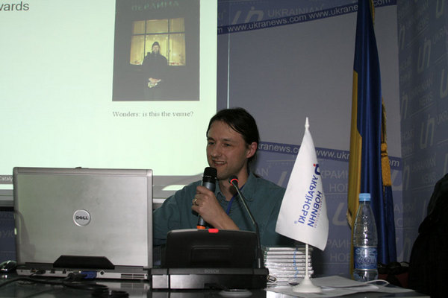
Introduction to WxWidgets
Peter Edwards
peter@dragonstaff.co.uk
MiltonKeynes.pm
Perl Technical Talk
16th April 2009

Slide 2
Contents
What is WxWidgets?
Projects using WxWidgets
Installing pre-requisites
Hello world
Frame, panels, menus, toolbars are classes
Design screens with Python's XRCEd
Events
Using Scintilla editor component
Further information

Slide 3
What is WxWidgets?
  GUI library www.wxwidgets.org
  Native widgets, e.g. GTK+, X11, Motif, Win32, WinCE
  Cross-platform
    Windows
    Linux
    MacOS X
  Language bindings
    Perl
    C++
    C# .NET
    Python

Slide 4
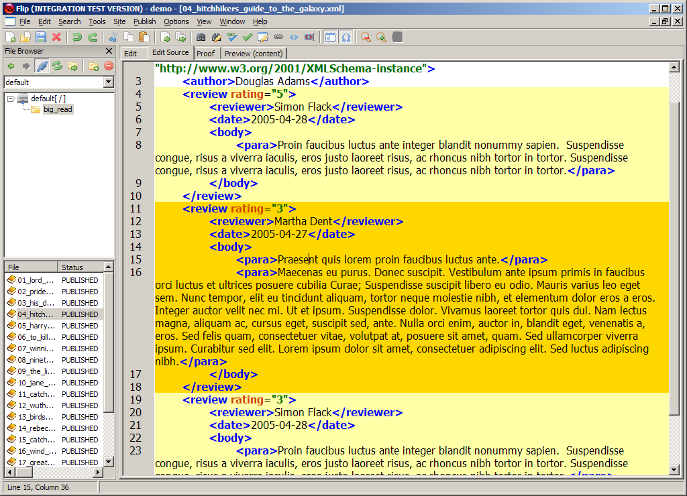
Projects using WxWidgets
  BBC “Flip” content management system
  + Scintilla editor component plugin

Slide 5
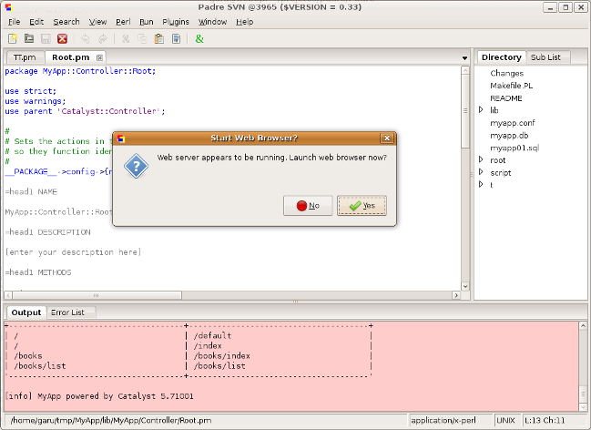
Projects using WxWidgets
  Padre Perl Editor – Ubuntu widgets

Slide 6
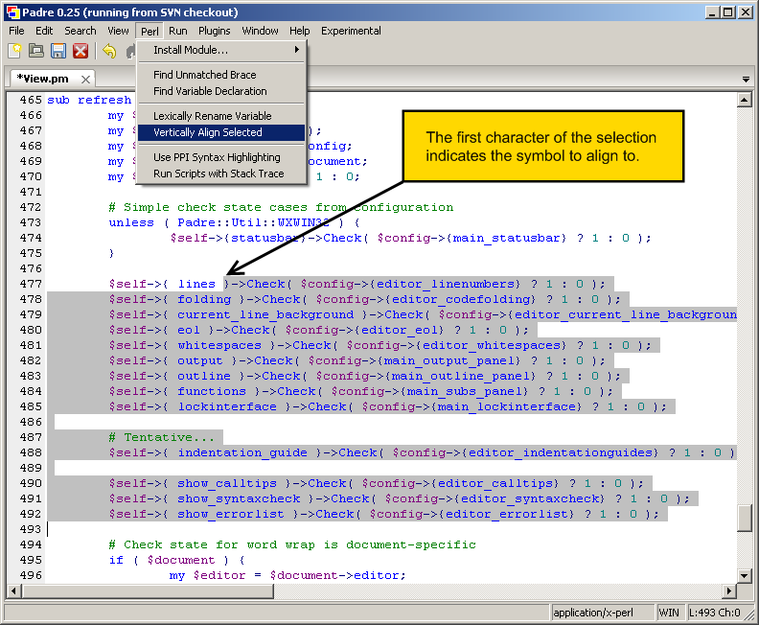
Projects using WxWidgets
  Padre Perl Editor – WinXP widgets

Slide 7
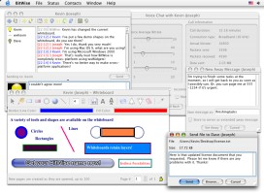
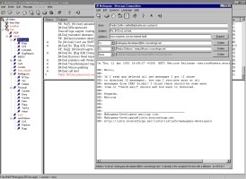
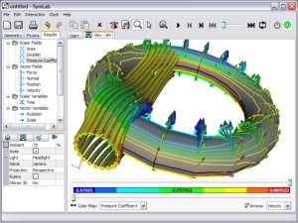
Projects using WxWidgets
From www.wxwidgets.org/about/users.htm
AMD circuit designer, AOL Communicator, Bitwise IM, wxCVS, CMU Audacity audio editor, TortoiseCVS, AVG Anti-virus, Red Hat eCos, W3C Amaya, Mahogany Email, Symlab
Looks promising...

Slide 8
Installing pre-requisites
  For Win32 ASPerl use a PPM for Alien::wxWidgets http://www.wxperl.co.uk/ppm.html
  For Debian/Ubuntu the python bundle is handy http://wiki.wxpython.org/InstallingOnUbuntuOrDebian
  For Linux get repos wx-common etc. or perl-Wx-*.rpm
  Or build it following instructions at
    http://search.cpan.org/perldoc?Install
    Windows prereqs:
    ActivePerl, MinGW, dmake, ExtUtils::FakeConfig, wxPerl (sources), wxWidgets (sources), Alien::wxWidgets (sources), Wx::ActiveX
    Linux:
    wxWidgets, Alien::wxWidgets and wxPerl sources

Slide 9
Hello world
  A simple example
  Similar approach to Visual C++ / MFC
  Main application will loop forever while a top level window exists, dispatching events
Load wxPerl main module
use Wx;
Create an application – global state and events
package MyApp;
use base 'Wx::App';

Slide 10
Hello world
  The application object creation triggers an OnInit event which has as default a similarly named callback
  We use it to build the screen objects starting with a top-level “frame” window
sub OnInit {
my $frame = Wx::Frame->new(
undef, # parent window
-1, # ID -1 means any
'wxPerl rules', # title
[-1, -1], # default position
[250, 150], # size
);
# make it be shown
$frame->Show( 1 );
}

Slide 11
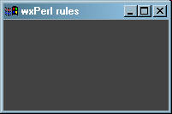
Hello world
  $ perl helloworld.pl
  (Win32 toolkit)

Slide 12
Hello world – button and panel
  We add functionality to Wx::Frame by sub-classing it
package MyFrame;
use base 'Wx::Frame';
sub new {
my $ref = shift;
my $self = $ref->SUPER::new(
undef, # parent window
-1, # ID -1 means any
'wxPerl rules', # title
[-1, -1], # default position
[150, 100], # size
);
package MyFrame;
use base 'Wx::Frame';

Slide 13
Hello world – button and panel
  Panels hold controls and handle navigation
# controls go on a panel in a frame
my $panel = Wx::Panel->new(
$self, # parent window
-1, # ID
);
# create a button
my $button = Wx::Button->new(
$panel, # parent window
-1, # ID
'Click me!', # label
[30, 20], # position
[-1, -1], # default size
);
package MyFrame;
use base 'Wx::Frame';

Slide 14
Hello world – button and panel
  Similar app to before but using our Frame sub-class
package MyApp;
use base 'Wx::App';
sub OnInit {
my $frame = MyFrame->new;
$frame->Show( 1 );
}
package main;
my $app = MyApp->new;
$app->MainLoop;
package MyFrame;
use base 'Wx::Frame';

Slide 15
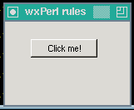
Hello world – button and panel
  Similar app to before but using our Frame sub-class
  (GTK2 toolkit)

Slide 16
Screen objects are classes
  Screen objects
    Frame
    Panels
    Menus
    Toolbars
  Are Classes
    Wx::Frame
    Wx::Panel etc.
  See the documentation for how to use – the C++ docs are very close to the Perl calling syntax

Slide 17
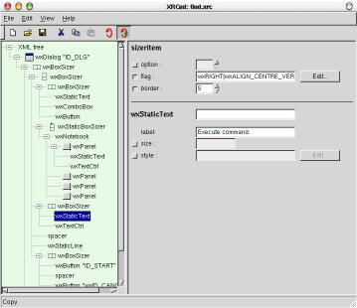
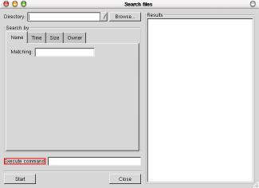
Design screens with Python's XRCed
Editor Sample Dialog
  Easier than manually creating screen object from classes
  Produces .XRC XML format dialog resource files
  Download/install XRCed from xrced.sourceforge.net
  (need to install python first)

Slide 18
Events
  Are accessed through connectors → handlers
  Bubble up until handled or cancelled
Import
package MyFrame;
use base 'Wx::Frame';
# import the event registration function
use Wx::Event qw(EVT_BUTTON);

Slide 19
Events
Connect object method to event
my $button = Wx::Button->new(
$panel, # parent window
-1, # ID
'Click me!', # label
[30, 20], # position
[-1, -1], # default size
);
# register the OnClick method as a
# handler for the 'button clicked'
# event. The first argument is a
# Wx::EvtHandler to receive the event
EVT_BUTTON( $self, $button, \&OnClick );

Slide 20
Events
  When the button is clicked a “button clicked” event fires in $button and goes via the connector EVT_BUTTON to $method->OnClick
  Event handlers have two arguments: the event receiver (e.g. button, panel) and an event object
Hander
sub OnClick {
my( $self, $event ) = @_;
$self->SetTitle( 'Clicked' );
}

Slide 21
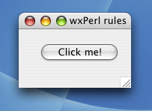
Events
  Result

Slide 22
Using Scintilla editor component
  www.scintilla.org
  WxWidgets bundles the source and wraps it, so if you want the latest you have to rebuild WxPerl
  Lets you build syntax highlighting editors
  XML, HTML, Perl, C++...
    For decent documentation see the python docs http://www.yellowbrain.com/stc/index.html
    Also
    http://docs.wxwidgets.org/trunk/classwx_styled_text_ctrl.html
  You saw a screenshot of it earlier...

Slide 23
Further Information
Documentation
  WxPerl http://wxperl.sourceforge.net/
  WxWidgets http://docs.wxwidgets.org/trunk/
  XRCed http://xrced.sourceforge.net/
  WxCommunity applications
Tutorials/Guides
  http://www.wxwidgets.org/docs/tutorials.htm
  http://wxperl.sourceforge.net/tutorial/tutorial.html
  http://www.ibm.com/developerworks/library/l-wxwidgets/index.html
  http://padre.perlide.org/wiki/wxWidgets
  http://zetcode.com/tutorials/wxwidgetstutorial/ (C++)
Slides at http://perl.dragonstaff.co.uk
Thank you. Any questions?

