Slide 1
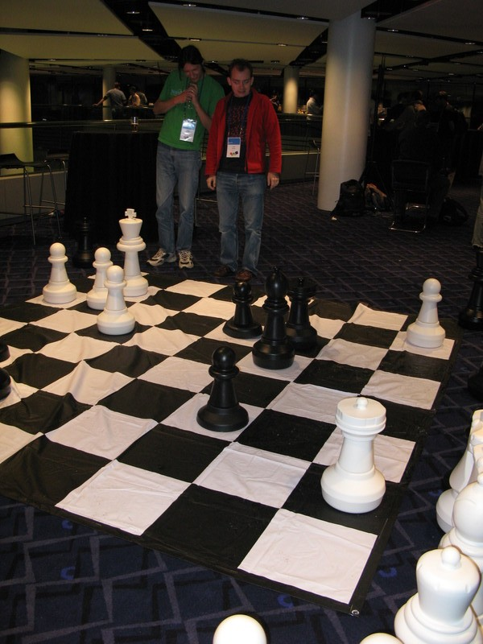
Role Based Access Control
Peter Edwards
peter@dragonstaff.co.uk
Birmingham.pm
Perl Technical Talk
22nd October 2008
Peter and Léon Brocard at Google Dev Day

Slide 2
Contents
1. Requirement and Solution
2. Authentication and Authorisation Definitions
3. Authentication Process
4. Authentication Example
5. Authentication Session
6. More Authentication Session Examples
7. Authorisation Types
8. Article On Simple Authorisation
9. Simple Authorisation in Catalyst
10. CPAN Lattice-Based Access Control Example
14. Role Based Access Control
14.1. Academic Papers
14.2. Emerging Standards and Implementations
14.3. Existing Security Implementations
14.4. Perl Implementations
14.5. RBAC Design
14.6. RBAC Example
15. Further Information

Slide 3
Requirement
Controlling user access to applications and the data within them
Solution
Identify each user
Grant them permissions to work with applications and data
Test for that when they use the application

Slide 4
Authentication and Authorisation
Definitions
Authentication is the validation of a userid that is used by a user or batch process
Authorisation is checking that a userid is allowed to perform certain operations on an object
can <user> "fred" do <operation> "delete" on <object> "/home/fred/somefile.txt" of <object_type> "file"

Slide 5
Authentication Process
user/batch process requests access for <userid> using <credential> from a server
server validates credential (e.g. password or key challenge certificate) against userid and returns an <authentication_token> (e.g. a cookie or hash token) which is linked server side to the userid, typically in a session store
user/batch process supplies the authentication token along with subsequent requests to the server
on receiving a request the server
  validates the authentication token
  checks the linked userid has authorisation to perform the given request

Slide 6
Authentication Example
http://search.cpan.org/perldoc?Authen::Simple
use Authen::Simple::Passwd;
my $passwd = Authen::Simple::Passwd
->new(path => '/etc/passwd');
if ( $passwd->authenticate( $username, $password ) ) {
# successfull authentication
}

Slide 7
Authentication Session
Once authenticated, you'll need a session to persist that, otherwise you'd need to ask for the userid/password every time
Using Authen::Simple with Apache gives us an implicit session
# a mod_perl Authen handler
PerlModule Authen::Simple::Apache
PerlModule Authen::Simple::Passwd
PerlSetVar AuthenSimplePasswd_path "/etc/passwd“
<Location /protected>
PerlAuthenHandler Authen::Simple::Passwd
AuthType Basic
AuthName "Protected Area“
Require valid-user
</Location>

Slide 8
More Auth Session Examples
These modules on CPAN give examples of how to authenticate and have that persisted in an authentication session
CGI::Application::Plugin::Authentication
CGI::Application::Plugin::Session
Catalyst::Manual::Tutorial::Authentication
Catalyst::Plugin::Authentication
Catalyst::Plugin::Authorization::Roles

Slide 9
Authorisation Types / 1
simple
authenticated user has full access to system
auth'd user has roles which each grant full access to a sub-system, either as a process ('can register new users') or data ('can amend customer records')
  the role acts effectively as a grouping mechanism
Lattice-Based Access Control (LBAC)
  users (subjects) mapped to objects (resources, computers, applications)
Role-Based Access Control (RBAC)
  users have hierarchical roles which have permissions that grant operations
  e.g. user "fred" has role "sysadmin" which has permission "security_edit" which grants operations "read" and "write" on security objects
  instead user "fred" might have role "root" which inherits from role "sysadmin" those permissions
RBAC with Access Control List extension
  users have roles which have permissions with a precedence that grant operations on matched objects
  e.g. user "jo" has role "editor" which has permission "food_recipes" which grants operations "read", "write", "delete" to objects "of type 'document' with file path matching '/home/recipes/*'“
enterprise framework, e.g. PERMIS storing permissions via OpenLDAP and authenticating against Windows ADS BBC SSO or Shibboleth
complex

Slide 10
Authorisation Types / 2
The user-role assignment may be inherent in the authorisation system,or might be read externally, say from an ADS server via LDAP
The object matching might involve callouts to more sophisticated checking code plugins that query other systems
Authorisation is usually applied at application level to check actions
It can also be applied at database level to filter all access to data the user is allowedto see, either by a database view or by using a relational database object wrapper layerto provide an additional safety net, e.g.
DBIx::Class::Schema::RestrictWithObject

Slide 11
Article On Simple Authorisation
"Elements of Access Control" at perl.com by Vladi Belperchinov-Shabanski, Feb 13 2008 http://www.perl.com/pub/a/2008/02/13/elements-of-access-control.html
Some nice examples of reading users and groups from file or database
Policy configuration syntax
Policy parser
User group storage and mapping
User group loading
Policy match function
Data fences
I won't go through it now but worth reading on-line

Slide 12
Simple Authorisation in Catalyst
user <-many--many-> role
role has meaning in your application code
Catalyst::Plugin::Authorization::Roles
use Catalyst qw/
Authentication Authentication::Store::ThatSupportsRoles
Authorization::Roles
/;
sub delete : Local {
my ( $self, $c ) = @_;
$c->assert_user_roles( qw/admin/ );
# only admins can delete
$c->model("Foo")->delete_it();
}

Slide 13
CPAN Lattice-Based Access Control Example
WE::Util::Permissions
Uses a single file of permission rules queried via a Perl interface
User or group matches rules which link operations to matched objects
In the terminology of the author, operations are "processes", objects are "pages“
Part of a wider web file editing framework
I wrote a very similar authorisation handler in C for the Open University many years ago although Perl's obviously much better at tokenising text files and handling data!

Slide 14
WE::Utils::Permissions File Format
Based on these tokens
  user list of users
  group list of groups
  process operation like “delete”
  Page file path or regexp or glob

Slide 15
WE::U::P File Examples / 1
Use globbing for matching and allow the "admin" group to have rights for all processes. There is no page restriction, so the rights are valid for all objects
! match: glob
group admin
process *
The chiefeditors have rights for the processes "release", "publish" and "edit". Here too, there are no page restrictions
group chiefeditor
process release publish edit

Slide 16
WE::U::P File Examples / 2
The members of the group "news" are allowed to do the following operations in all objects below "/News/":"edit", "change-folder", "new-doc", "rm-doc", "release" and "publish".A regular expression match is used here (there is no "! match" directive).
! match: regexp
group news
page /News/.*
process edit change-folder new-doc rm-doc release publish
At end of file this rule denies anything not already permitted,similarly to Apache "DENY from all" directive or /etc/hosts.deny "ALL: ALL"
! match: glob
group *
process !*

Slide 17
WE::U::P Querying
use WE::Util::Permissions;
my $perm = WE::Util::Permissions->new(-file => $permissionsfile);
$perm->is_allowed(-user => "some_user", -process => "access");
$perm->is_allowed(-group => [qw( editor admin )], -process => "delete", -page => 'a/b/foo.html');
# get subset of users from list provided who are allowed process (operation) 'publish' on page (object) '/home/index.txt‘
$perm->get_all_users([qw( janet john )], 'publish', '/home/index.txt');

Slide 18
WE::U::P Caveats
You have to provide user and group handling ("The semantics of users, groups, processes and pages are usually defined in another layer")
No admin interface to create rules
"There is currently no way to specify a token with spaces or slashes.”
“Diagnostics is poor. Unrecognized tokens won't cause errors or warnings.”
No precedence other than rule order (e.g. how do I deny a tree except for a sub-tree which is allowed).
No plugin methods matching/precedence caclulation.
But you could use the ideas and code as a basis for your own authorisation library.Have a look at the code on CPAN.

Slide 19
Role Based Access Control
This is an evolving area and it is surprising how recently the standards for it have been written (2001 on)
NIST "Role Based Access Control (RBAC) and Role Based Security
“The NIST Model for Role-Based Access Control: Towards A Unified Standard”
Proposed NIST Standard for Role-Based Access Control
ACM Transactions on Information and System Security, Vol. 4, No. 3, August 2001 by D.F.Ferraiolo et al.
"Beyond Roles: A Practical Approach to Enterprise User Provisioning"

Slide 20
Emerging Standards and Implementations
An evolving area. Surprising how recently the standards for it have been written (2001 on)
XACML
http://en.wikipedia.org/wiki/XACML
"OASIS eXtensible Access Control Markup Language (XACML) TC“
“Core and hierarchical role based access control (RBAC) profile of XACML v2.0”
Sun's XACML Open Source impl. in Java
http://sunxacml.sourceforge.net
Axis2 web service for Apache Maven
http://xacmllight.sourceforge.net/
C/Java providing SOAP stack
Still a moving target!

Slide 21
Existing Security Implementations / 1
Windows ADS
  Using an LDAP connector to authenticate users and determine group memberships and permissions, such as Perl-LDAP http://ldap.perl.org/
  Requires application-side logic to interpret permissions
OpenLDAP
  "LDAP for Security, Part I“
  http://www.linuxjournal.com/article/6789
  Paranoid Penguin "Authenticate with LDAP, Part III“
  http://www.linuxjournal.com/article/6936

Slide 22
Existing Security Implementations / 2
PERMIS Privilege Management Infrastructure
  Enterprise-wide, huge, complex
  http://sec.cs.kent.ac.uk/permis/
  http://www.openpermis.org/download.htm
  PERMIS PMI Architecture "Implementing Role Based Access Controls Using X.509 Attribute Certificates”
  "RBAC POLICIES IN XML FOR X.509 BASED PRIVILEGE MANAGEMENT"

Slide 23
Existing Security Implementations / 3
Shibboleth
  A standards based, open source software package for web single sign-on across or within organizational boundaries that can work with PERMIS http://shibboleth.internet2.edu/
Distributed Access Control System (DACS)
  http://dacs.dss.ca/faq.html
  Written in C, well-designed, modular
  Provides authentication and authorisation
  Doesn't work on Apache 1, which the BBC uses in production :-(

Slide 24
Existing Security Implementations / 4
"A Role-Based Access Control (RBAC) system for PHP“ by Tony Marston
  http://www.tonymarston.net/php-mysql/role-based-access-control.html
  small, well-designed, good for standalone applications
"Fine Grained Role Based Access Control (RBAC) system" for PHP
  reasonable database design and PHP code
POSIX ACL – ACLs from Python
  http://pylibacl.sourceforge.net/
Linux kernel extension "grsecurity“
  http://www.grsecurity.net/index.php
  Unix-based kernel level RBAC, really aimed at Unix files and users

Slide 25
Perl Implementations of RBAC
I know of no solutions in Perl although there are libraries for Python, Ruby, Java. In principle you could wrap one of them
We needed one at the BBC so I wrote one called IFL::Authz and hope to release it to CPAN
Based on Ferraiolo et al. "Proposed NIST Standard for Role-Based Access Control"
This paper has a Functional Specification of an API written in the Z formal language which I adapted to Perl. Z is nice match for the mathematical set theory underlying RBAC though there are some errors in the paper.

Slide 26
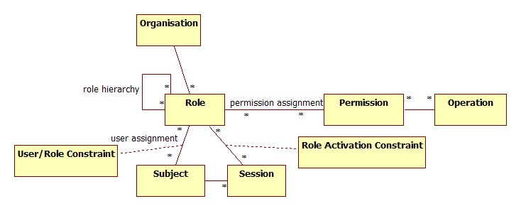
RBAC Model
From Ferraiolo http://csrc.nist.gov/rbac/rbacSTD-ACM.pdf

Slide 27
RBAC Model Detail
When defining an RBAC model, the following conventions are useful:
S = Subject = A person or automated agent
R = Role = Job function or title which defines an authority level
P = Permissions = An approval of a mode of access to a resource
SE = Session = A mapping involving S, R and/or P
SA = Subject Assignment
PA = Permission Assignment
RH = Partially ordered role Hierarchy. RH can also be written: ≥
A subject can have multiple roles.
A role can have multiple subjects.
A role can have many permissions.
A permission can be assigned to many roles.
A constraint places a restrictive rule on the potential inheritance of permissions from opposing roles, thus it can be used to achieve appropriate segregation of duties. For example, the same person should not be allowed to both create a login account for someone, and also be allowed to authorize the procedure.
A subject may have multiple simultaneous sessions with different permissions.

Slide 28
RBAC Example
Subject = user "joe“
Role = "editor“
Operation = "publish“
However, at the BBC we're using it to handle sophisticated authorisation for a CMS system which requires ACLs, so we need object matching too
From the Wikipedia article on RBAC:
  "With the concepts of role hierarchy and constraints, one can control RBAC to create or simulate lattice-based access control (LBAC). Thus RBAC can be considered a superset of LBAC.
I.e. RBAC + ACLs = LBAC
To do this I extended the concept of permission to include within it a reference to an object, or matches against objects using regexps, globs or plugin method
Object = "/home/recipes/*"

Slide 29
Code Examples - Create Authz / 1
use IFL::Authz;
use IFL::Authz::Config::PerlFile;
# load config
my $authzconfig = IFL::Authz::Config::PerlFile
->new({ configfilepath => "authz.xpl" });
# contains
# store => {
# class => 'IFL::Authz::Serialiser::PerlFile',
# storefilepath = 'authz_schema.xpl',
# },
# objectmatch => { class => 'TestAdminAuthz' },
# relies on plugin TestAdminAuthz.pm which gives
# match_object() that understands rings of power

Slide 30
Code Examples - Create Authz / 2
# create authz object
my $authz = IFL::Authz->new({ config => $authzconfig });
$authz->begin_transaction;
$authz->add_object_type({ name => 'ring', ops => ['wear', 'destroy'], precedence => 1 });
$authz->add_user({ user => 'unittest', metadata => { name => 'Ms. Unity Test', country => 'UK' } });
$authz->add_role({ role => 'tester', description => 'Tester Role' });
$authz->grant_permission({role => 'tester', description => 'access rings', operations => [qw( access read )], allow_deny => 'allow', object => { type => 'ring', precedence => 'DEFAULT', id => {} } } );

Slide 31
Code Examples - Create Authz / 3
$authz->add_role({ role => 'ring_bearer', description => 'Ring Bearer Role' });
$authz->grant_permission({ role => 'ring_bearer', description => 'wear rings', operations => [qw( wear )], allow_deny => 'allow', object => { type => 'ring', precedence => 'DEFAULT', id => {} } });
$authz->add_inheritance({ role_asc => 'tester', role_desc => 'ring_bearer' });
$authz->assign_user({ user => 'unittest', role => 'ring_bearer' });
$authz->end_transaction;
$authz->save;

Slide 32
Code Examples - Query Authz / 1
my $session = $authz->create_session({ user => 'unittest', active_roles => [qw( ring_bearer )] });
# user unittest ops access on object_type ring from indirect role tester inherited by assigned role ring_bearer
die unless $authz->check_access({ session => $session, operation => 'access', object => { type => 'ring' } });
# user unittest ops wear on object_type ring from assigned role ring_bearer
die unless $authz->check_access({ session => $session, operation => 'wear', object => { type => 'ring' } });

Slide 33
Code Examples - Query Authz / 2
# not able to destroy 'a pretty ring‘
die if $authz->check_access({ session => $session, operation => 'destroy', object => { type => 'ring', id => { name => 'a pretty ring' } } });
# but we can destroy 'the one ring‘
die unless $authz->check_access({ session => $session, operation => 'destroy', object => { type => 'ring', id => { name => 'the one ring' } } });

Slide 34
Summary and Links
Summary
  There’s a lot to it, evolving standards
  Choice of library depends on language, platform, whether it’s enterprise, any special requirements
  Authentication and Authorisation
  At the simplest, use roles
  Then look at a lattice
  More complex may require RBAC
Links
  Slides at http://miltonkeynes.pm.org
  Sandhu, R., Ferraiolo, D.F. and Kuhn, D.R. (July 2000). "The NIST Model for Role Based Access Control: Toward a Unified Standard" (PDF). 5th ACM Workshop Role-Based Access Control: 47-63.
Thank you. Any Questions?

