Slide 1
Analysis, Design, and Verification of a High-Speed TTL NAND Gate
Digital Electronics (EEE3310.01) Spring 2019
Peter A. Dranishnikov and Jackson Purvis
4/24/2019
Professor: Dr. Zahra Amjadi
Notes:
Hello, my name is Peter Dranishnikov
And Jackson Purvis
We are here to present the analysis, design and verification of a high speed ttl NAND gate

Slide 2
Overview
Abstract (1 slide)
Introduction (1 slide)
Analysis (5 slides)
Results (9 slides)
Conclusion (1 slide)
References (1 slide)
Questions (time permitting)
Demonstration (outside of class on request)

Slide 3
Abstract
A bipolar junction transistor (BJT) is a simple, yet powerful general purpose current-switching transistor. In this presentation, the design and verification of a high speed NAND gate based on the PN2222A BJT is shown. Analysis was performed through algebraic techniques and MATLAB computation. Verification of the design was performed in Multisim and with a physical circuit, with successful results.
Notes:
Peter Dranishnikov
Read it

Slide 4
Introduction
Bipolar Junction Transistor (BJT)
Two p-n junctions
Device used in design: PN2222A
Most common BJT in industry
General purpose
Supports wide variety of current and voltages
Using as digital logic switching
Design of a PN2222A-based High Speed NAND gate
Notes:
Jackson

Slide 5
Analysis overview
Parameters
Datasheet (next slide)
Tuned
Targeting for a lower power, but faster switching speed design
Constants
Resistors
Procedure/Methodology
Solution
Computer-Assisted using MATLAB
Verification
MULTISIM
Real circuit
Notes:
Peter Dranishnikov

Slide 6
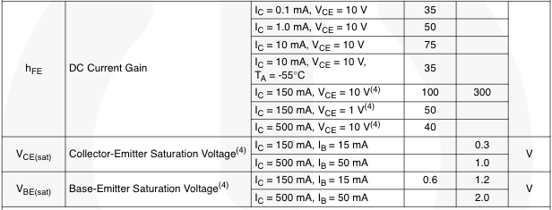
Initial Values
Notes:
Jackson

Slide 7
Methodology
Began by calculating R₁ and R₂
This led to calculating various currents
Low and High states
This allowed us to calculate R₄, R₅ and R_{B}
Finally, we calculated R₃ and R₆
These calculations gave us our designed NAND gate
Notes:
Peter Dranishnikov

Slide 8
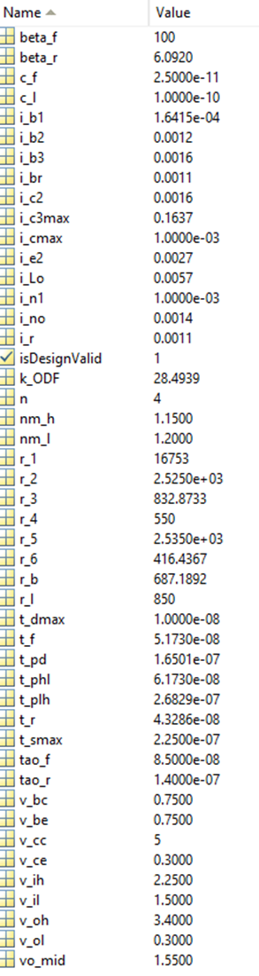
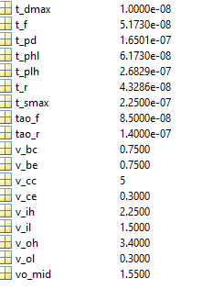
Computer-assisted results
Notes:
Jackson

Slide 9
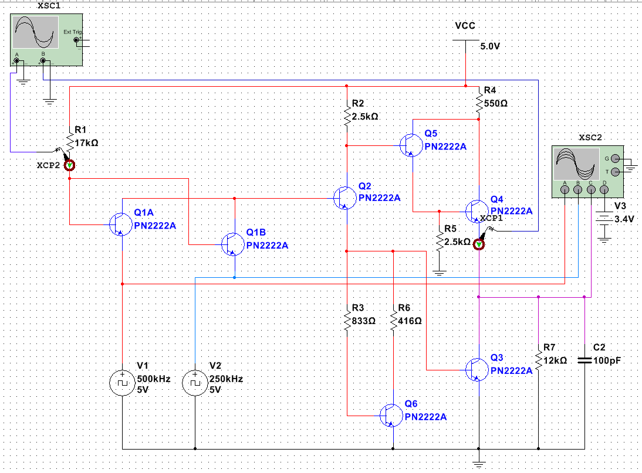
Circuit setup
Notes:
Peter Dranishnikov

Slide 10
Testing
The next step in our process was to test our design
We used our calculated resistor values to model a NAND gate in MULTISIM
We made sure to test all possible inputs and outputs
Both Low and Both High cover all current situations
Notes:
Jackson

Slide 11
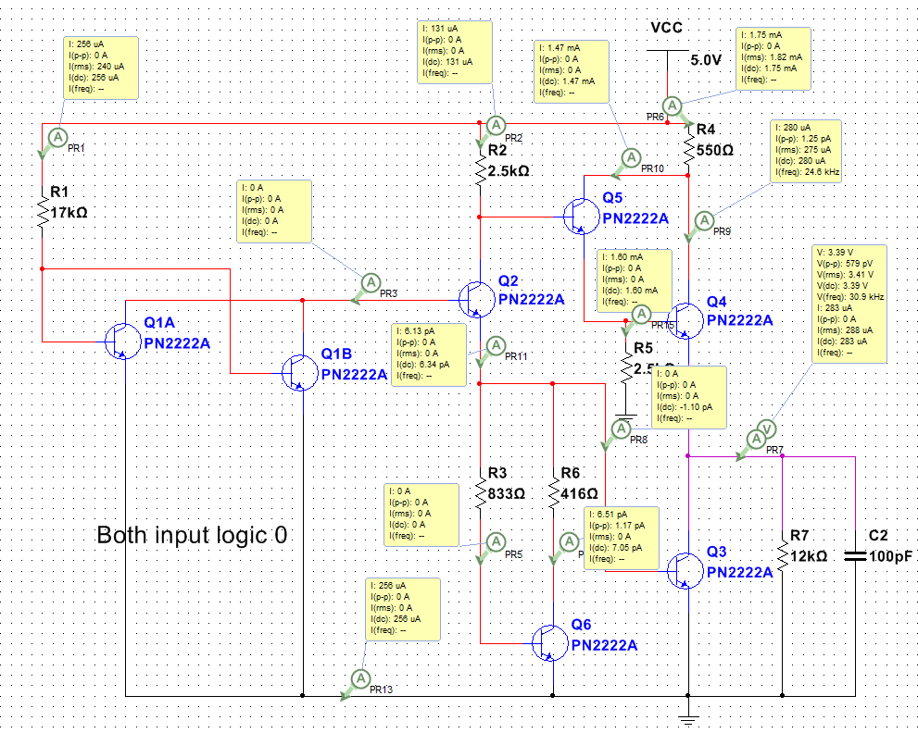
Input 00 (LL)
Notes:
Jackson

Slide 12
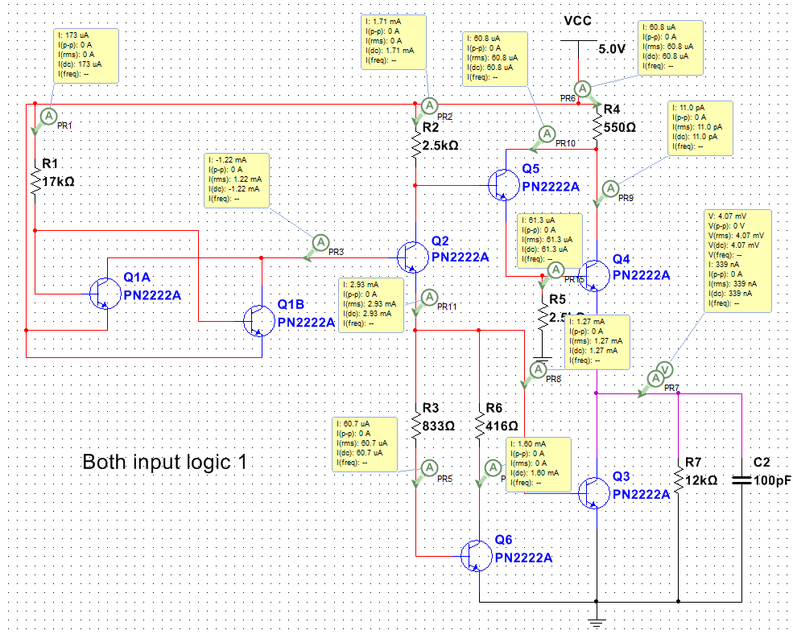
Input 11(HH)
Notes:
Peter Dranishnikov

Slide 13
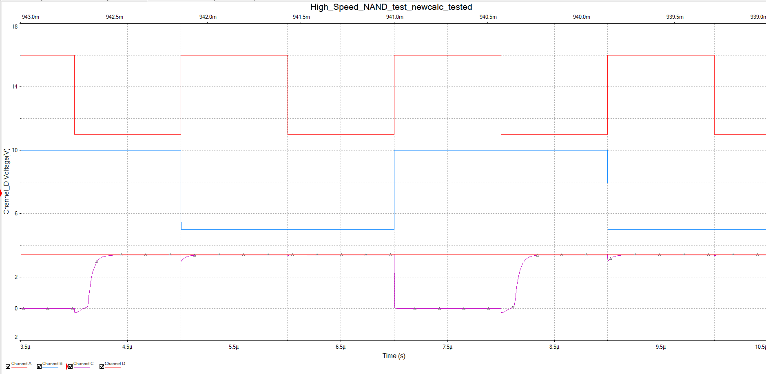
Simulation Oscilloscope output (A_{f}=500khz, b_{f}=250khz)
Notes:
Jackson

Slide 14
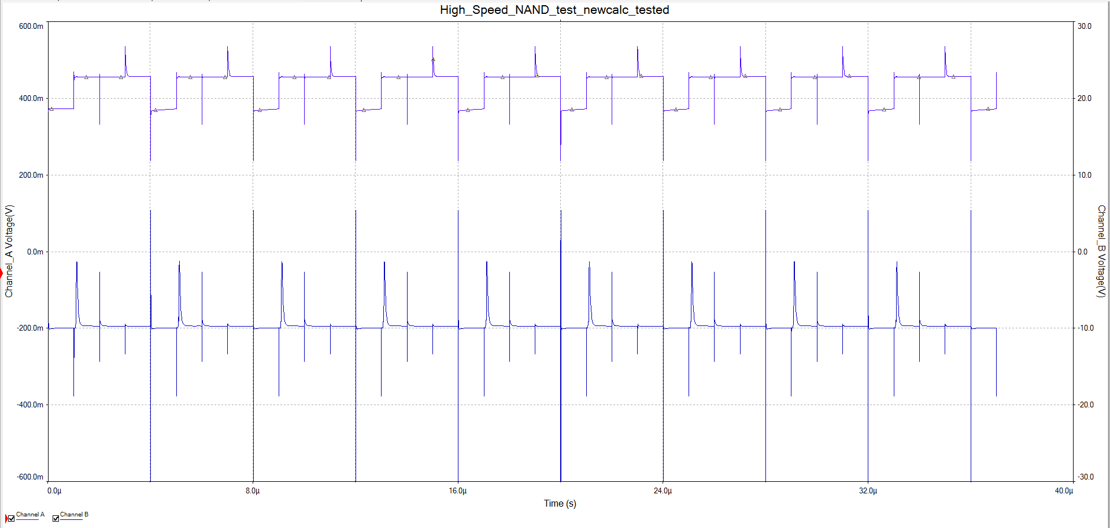
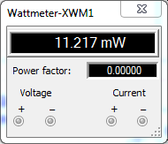
Power
Static Power (bottom)
Dynamic Power based on current (right, current shown )
Notes:
Peter Dranishnikov
Static power is based off of resistor dissipation mostly
Dynamic power is the product of current (graph) and voltage (not shown) (alternatively the integral)

Slide 15
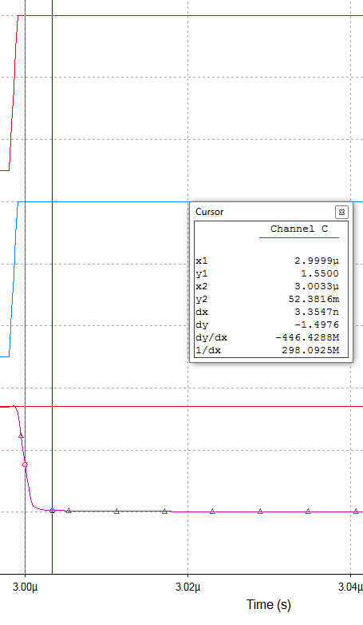
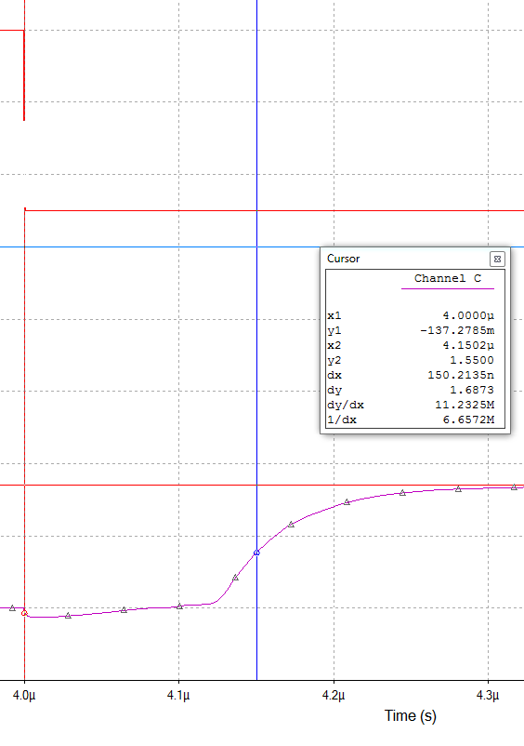
Propagation delay
Notes:
Jackson Purvis dx measurement
Transistor is more general purpose
Used for amplification more than logical output

Slide 16
testing
After the virtual test, we moved on to physical testing
Resistor equivalents found
We constructed a working high-speed NAND gate using our calculated values
We tested this device using a function generator and an oscilloscope
We tested all possible inputs and outputs
Notes:
Jackson

Slide 17
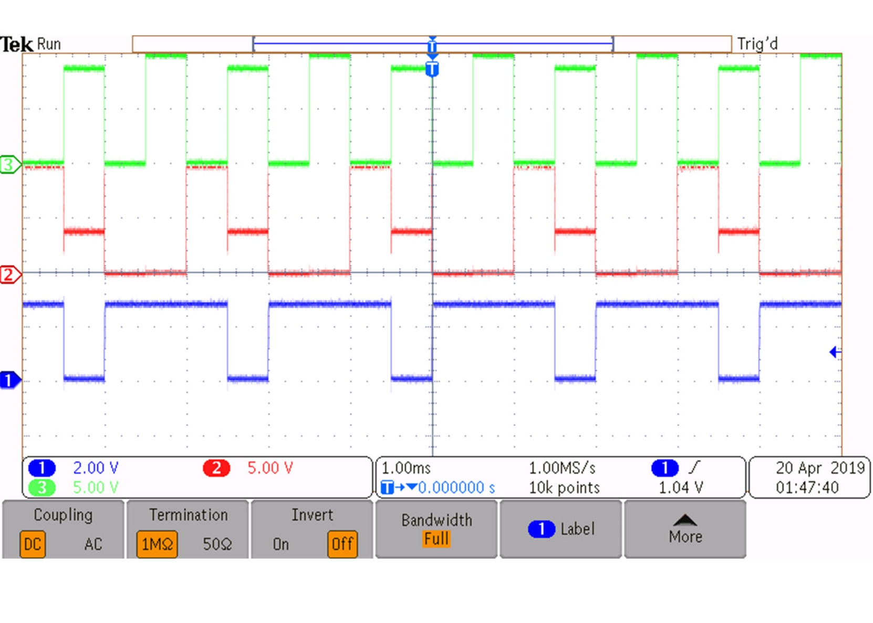
Experimental results
Inputs from the function generator
Green: 500 khz square
Red: 250 khz square
Signals phase synced
The inputs and outputs were measured by an oscilloscope
Inputs were not terminated
Erratic behavior
Lack of equipment in lab
Notes:
Peter Dranishnikov
Real circuit
(read slide)
Mention erratic results due to not terminated, but behaviour does sag the voltage due to input current sink

Slide 18
Results Overview
As you can see, the NAND gate functioned correctly at high frequencies
Simulation and Real circuit
Physical test shows lower V_{OH} due to lower V_{BE}
Higher load resistor chosen in simulation to demonstrate reaching V_{OH}
Notes:
Jackson

Slide 19
Conclusion
As our results demonstrate, the device works as intended in simulation and physically
This shows that our calculations were accurate
Therefore, our high-speed NAND gate design is successful
Room for improvements
Schottky-clamped transistors (as learned in class)
Target higher currents
Higher-power design
Target lower currents
Design for scaling to LSI and VLSI
Transistor chosen may not support low currents reliably
Notes:
Peter Dranishnikov

Slide 20
References
[1] M. Rashid, Microelectronic Circuits: Analysis and Design, 3rd ed. Boston, MA. Cengage Learning, 2017.
[2] Fairchild, “PN2222A NPN General-Purpose Amplifier”, July 2014.
[3] National Semiconductor, MultiSim, “PN2222A”, April 2019

Slide 21
Questions?
Notes:
ALL

