Slide 1
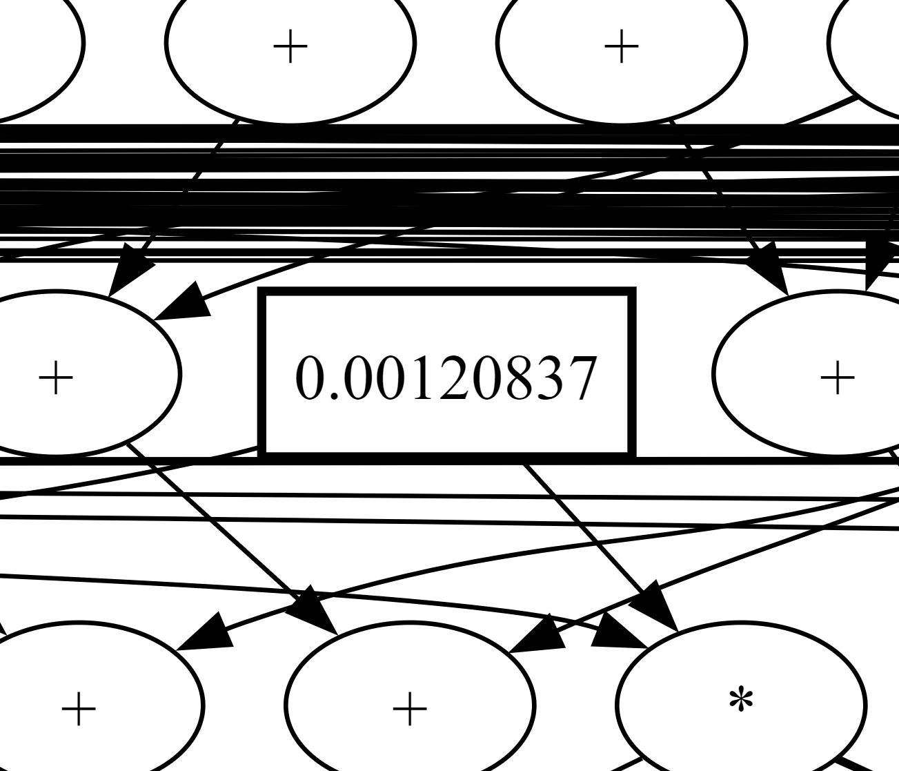
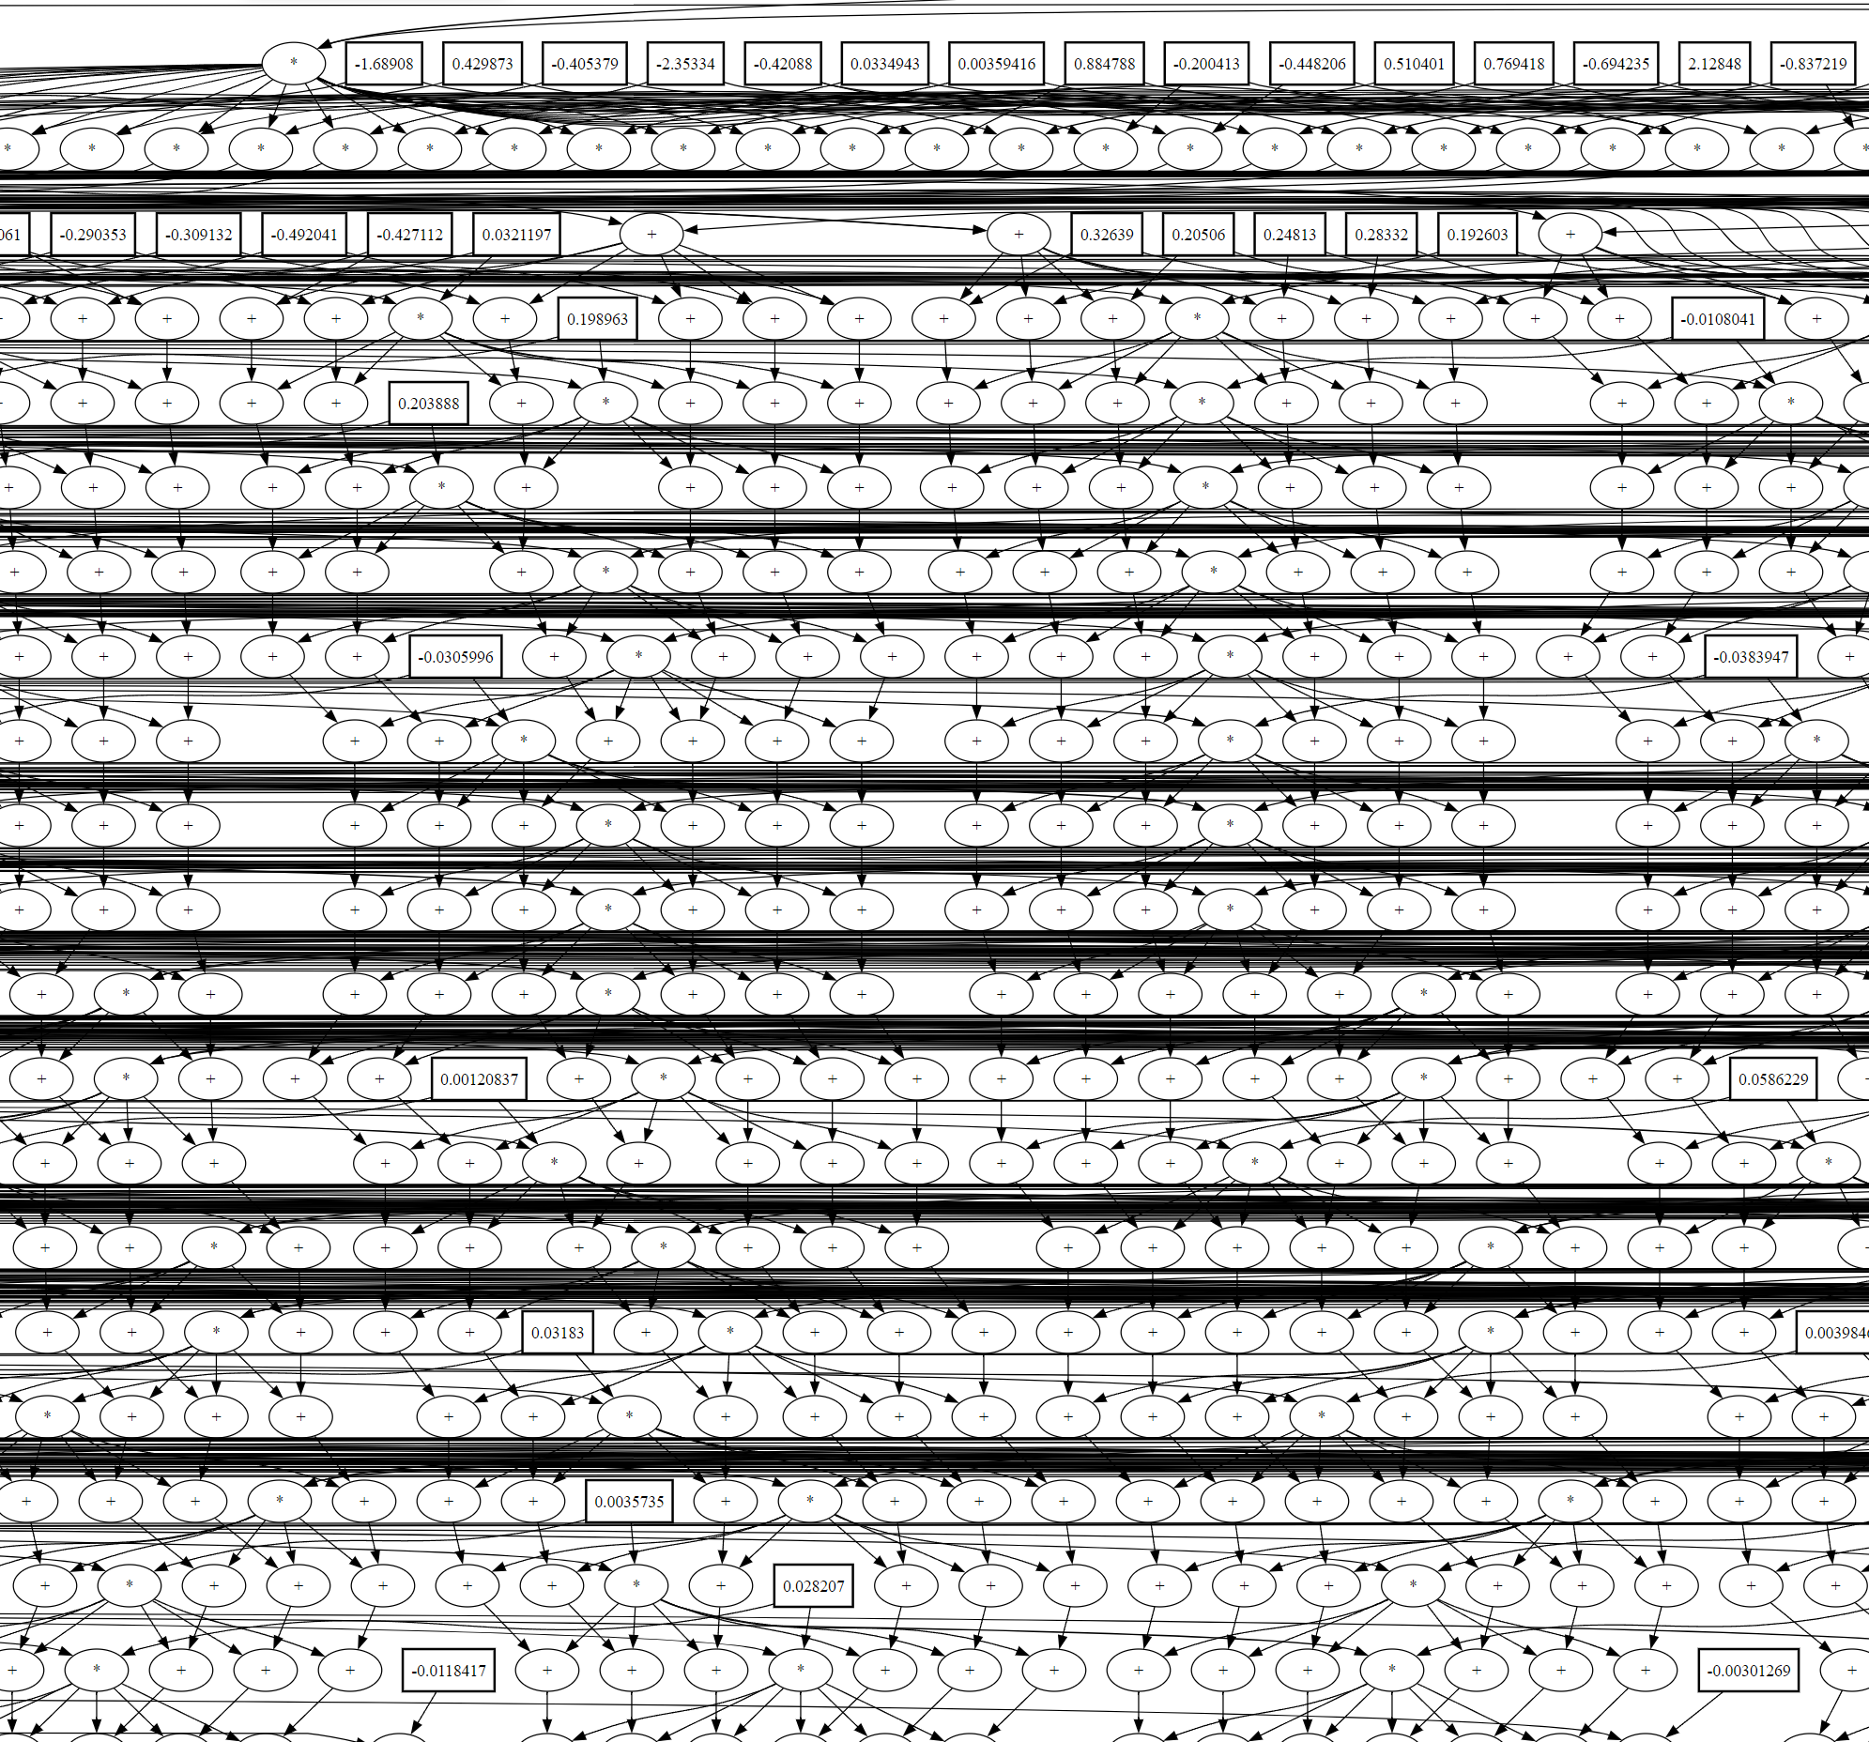
Computational Graph of Airfoil Aerodynamics Analysis:

