Slide 1
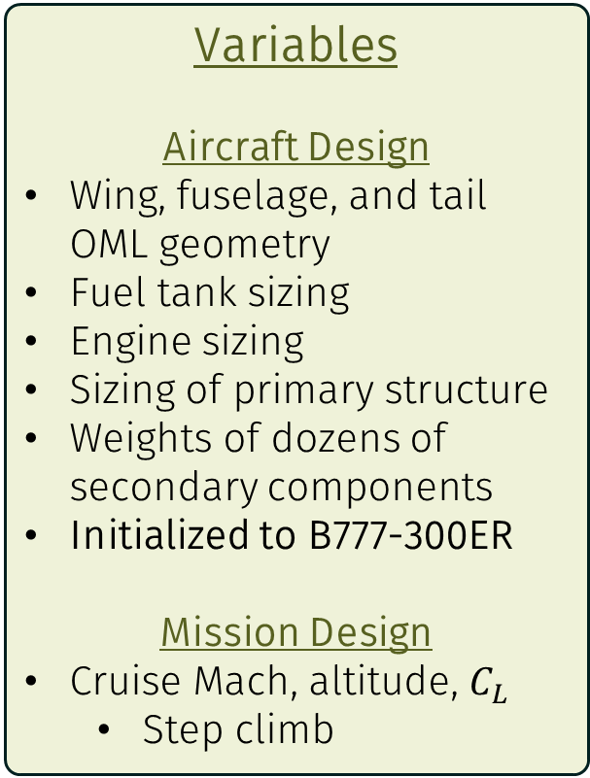
Objective Function
Minimize transport energy per passenger-kilometer
Variables
Aircraft Design
Wing, fuselage, and tail OML geometry
Fuel tank sizing
Engine sizing
Sizing of primary structure
Weights of dozens of secondary components
Initialized to B777-300ER
Mission Design
Cruise Mach, altitude, $C_{L}$
Step climb
Constraints & Models
Requirements
Payload and range
Previously-stated reqs.
Various FAR 25 regulations
Key Models
Aero: DATCOM-like buildup
Propulsion: GE9X w/ physics-based scaling
Structures: Empirical where possible, physics-based for LH2 systems

Slide 2
LH2 major weight changes:
Fuel | ↓↓
Fuel tanks | ↑
Fuselage | ↑
Wing | ↑
Loss of spanloading efficiency

