Slide 1
Configuration and Design Optimization
Peter Sharpe

Slide 2
New Design Tool Capabilities
Over past several months, have worked with BAE FAST Labs to develop new design capabilities for Firefly-class aircraft.
Significantly improved rapid aerodynamics capabilities, particularly with transonics
Ability to consider stability, control, and trim with moving CG at the conceptual design level
First-principles accounting of mass properties and volume for all internal geometry (previously: linearized about initial CAD estimates)
Allows much more detailed internal geometry optimization, which is key since Firefly is strongly volume-constrained.
Notes:
So far, mostly applied to internal BAE vehicles that are very similar to Firefly (size, weight, endurance, rocket propulsion)
Have begun applying them to Firefly too this month, so this is a first-cut at what’s in the pipeline for Firefly optimization this summer.

Slide 3
AeroBuildup: Aerodynamics and Flight Dynamics
Scratch-written aerodynamics engine
Same methodology as Digital DATCOM / Missile DATCOM
Combination of hundreds of best-practices theoretical models and experimental datasets across a wide flight envelope
Viscous, compressible
Optimizer-friendly (differentiable and smooth)
Generalizes many of DATCOM’s models to arbitrary vehicle configurations
End-to-end vectorized across multiple operating points
4 operating points in 0.28 sec
~14 operating points / sec
90,000 operating points in 17.6 sec
~5000 operating points / sec

Slide 4
AeroBuildup: Aerodynamics and Flight Dynamics
Data from Validation Study
Validates very well against existing flight dynamics analysis tools such as AVL:
Orders of magnitude faster
Considers nonlinear aerodynamics
Viscous effects (e.g., post-separation)
Transonic effects
Systematic deviations (>25%) are rare and confined to detailed rate derivatives
Signs are right
AVL may not be accurate here either
Output | AeroBuildup | AVL | VLM | AB & AVL Significantly Different?
CD | 0.02 | 0.01 | 0.01 | Expected
CL | 0.45 | 0.46 | 0.41
CLa | 6.30 | 6.07 | 5.61
CLq | 2.72 | 9.42 | 13.10 | *
CYb | -0.17 | -0.17 | 0.20
CYp | -0.36 | -0.22 | -0.23 | *
CYr | 0.10 | 0.12 | 0.12
Clb | -0.18 | -0.17 | 0.15
Clp | -0.72 | -0.64 | -0.61
Clr | 0.07 | 0.13 | 0.08 | *
Cm | 0.13 | 0.19 | 0.17
Cma | -1.69 | -0.95 | -1.21 | *
Cmq | -11.00 | -12.80 | -14.40
Cnb | 0.01 | 0.02 | -0.02
Cnp | -0.09 | -0.04 | -0.09
Cnr | -0.02 | -0.02 | -0.02
D | 29.50 | 11.70 | 9.95 | Expected
L | 805.00 | 815.00 | 739.00
m_b | 35.80 | 50.60 | 47.00

Slide 5
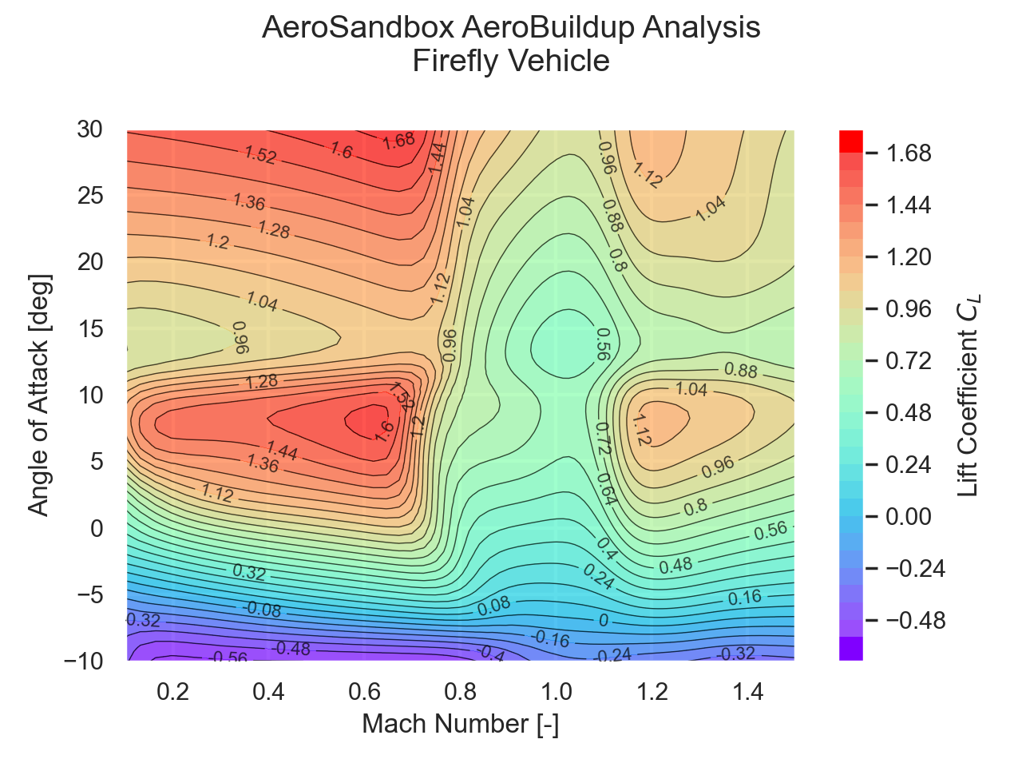
AeroBuildup: Aerodynamics and Flight Dynamics

Slide 6
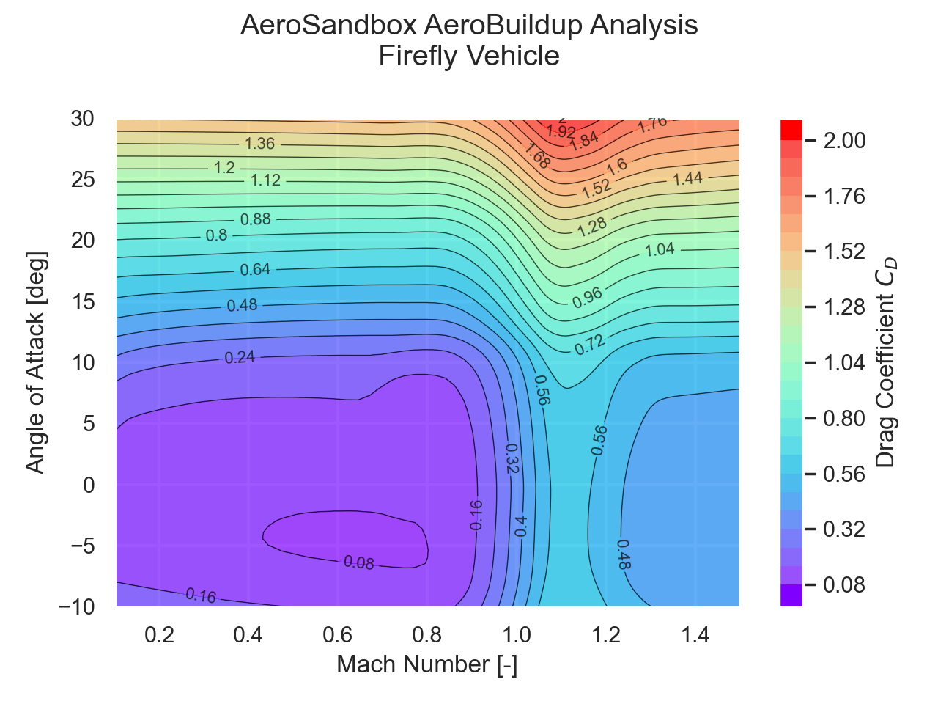
AeroBuildup: Aerodynamics and Flight Dynamics

Slide 7
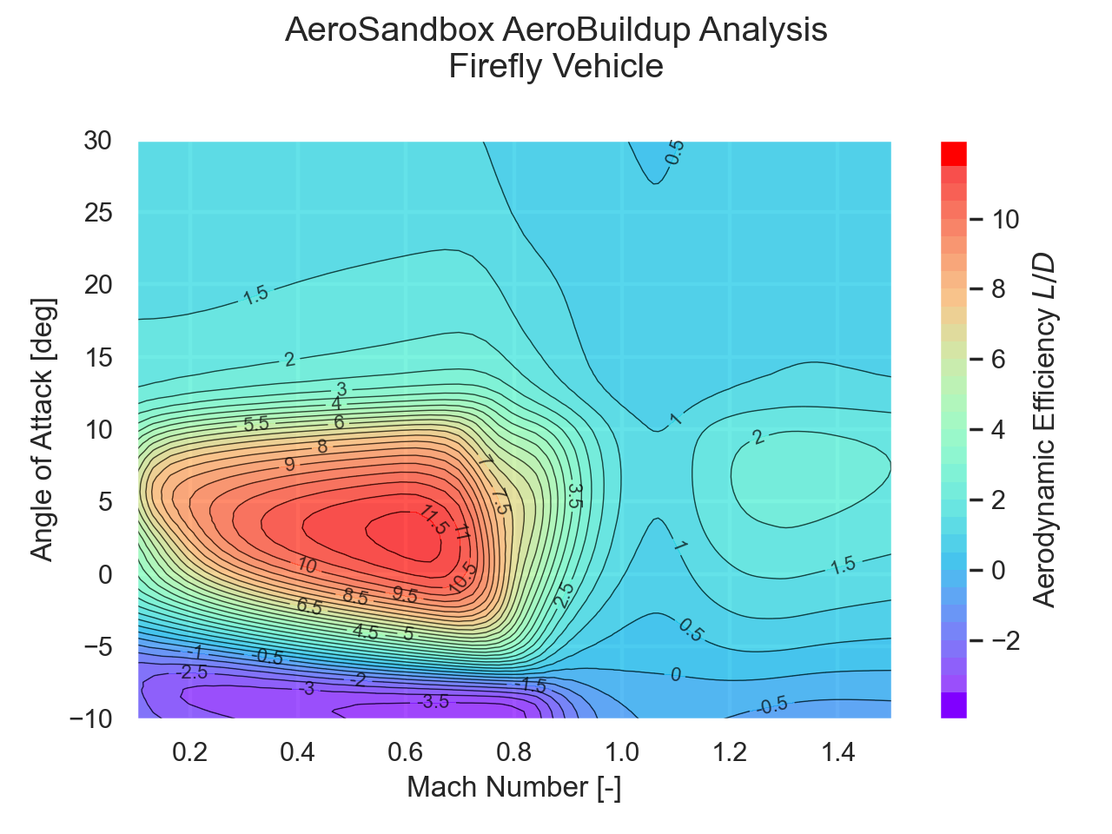
AeroBuildup: Aerodynamics and Flight Dynamics

Slide 8
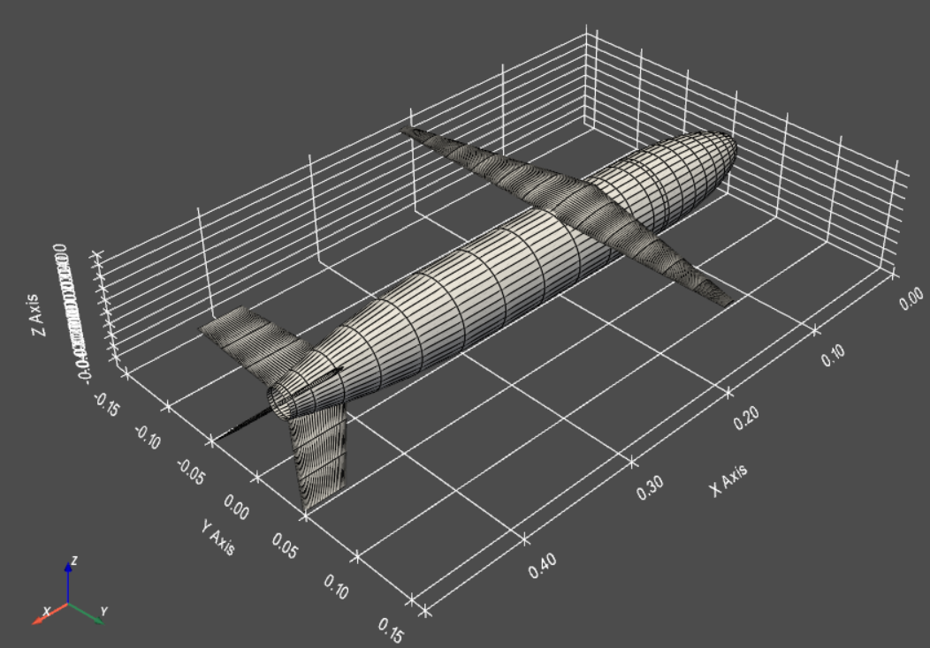
A Re-Optimized Firefly (Boost-Glide)
Assumptions
Optimizing for maximum total range
Boost-glide allowed
Optimizer is converging to similar point in the design space as model fidelity improves
Suggests all relevant low-order effects have been captured
Ready for flight testing of a detailed design

Slide 9
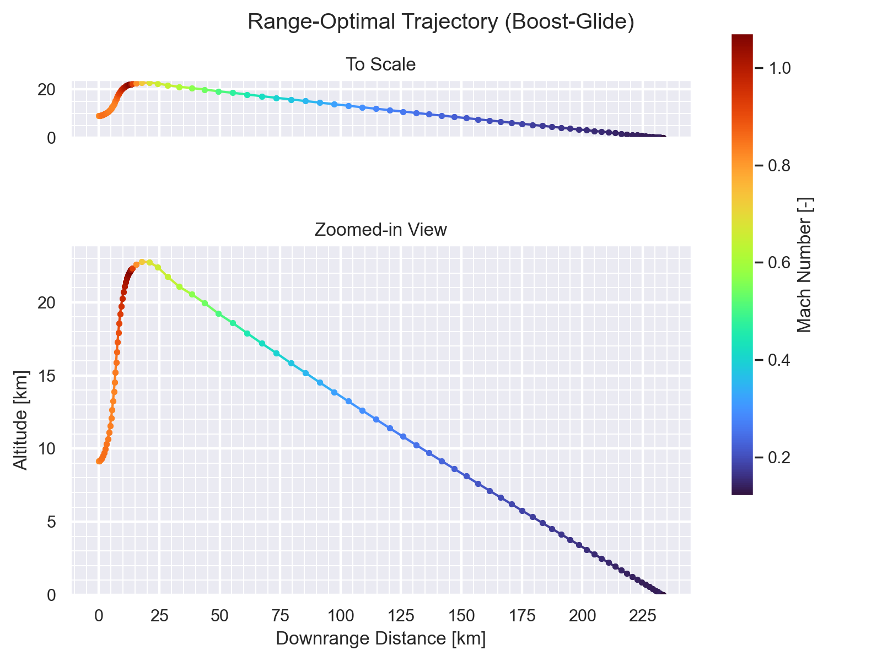
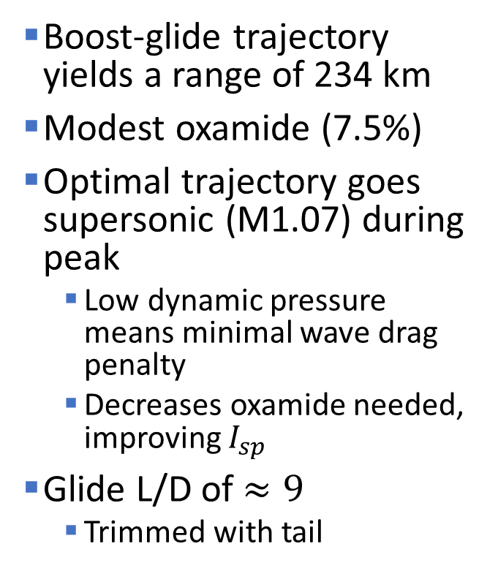
A Re-Optimized Firefly (Boost-Glide)
Boost-glide trajectory yields a range of 234 km
Modest oxamide (7.5%)
Optimal trajectory goes supersonic (M1.07) during peak
Low dynamic pressure means minimal wave drag penalty
Decreases oxamide needed, improving $I_{sp}$
Glide L/D of $≈9$
Trimmed with tail

Slide 10
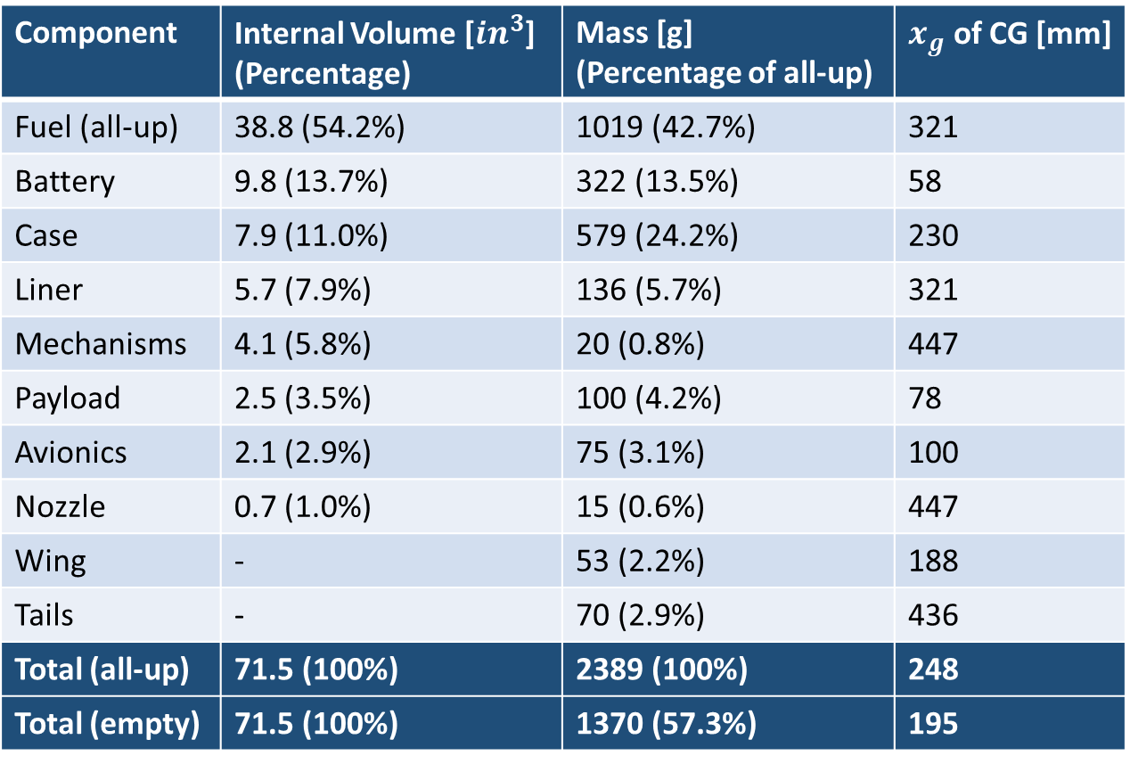
Mass and Volume Accounting (Boost-Glide)
Component | Internal Volume [$in^{3}$] (Percentage) | Mass [g] (Percentage of all-up) | $x_{g}$ of CG [mm]
Fuel (all-up) | 38.8 (54.2%) | 1019 (42.7%) | 321
Battery | 9.8 (13.7%) | 322 (13.5%) | 58
Case | 7.9 (11.0%) | 579 (24.2%) | 230
Liner | 5.7 (7.9%) | 136 (5.7%) | 321
Mechanisms | 4.1 (5.8%) | 20 (0.8%) | 447
Payload | 2.5 (3.5%) | 100 (4.2%) | 78
Avionics | 2.1 (2.9%) | 75 (3.1%) | 100
Nozzle | 0.7 (1.0%) | 15 (0.6%) | 447
Wing | - | 53 (2.2%) | 188
Tails | - | 70 (2.9%) | 436
Total (all-up) | 71.5 (100%) | 2389 (100%) | 248
Total (empty) | 71.5 (100%) | 1370 (57.3%) | 195
Detailed, time-dependent mass properties that feeds into stability during optimization
Volume accounting with internal geometry logic to ensure fit

Slide 11
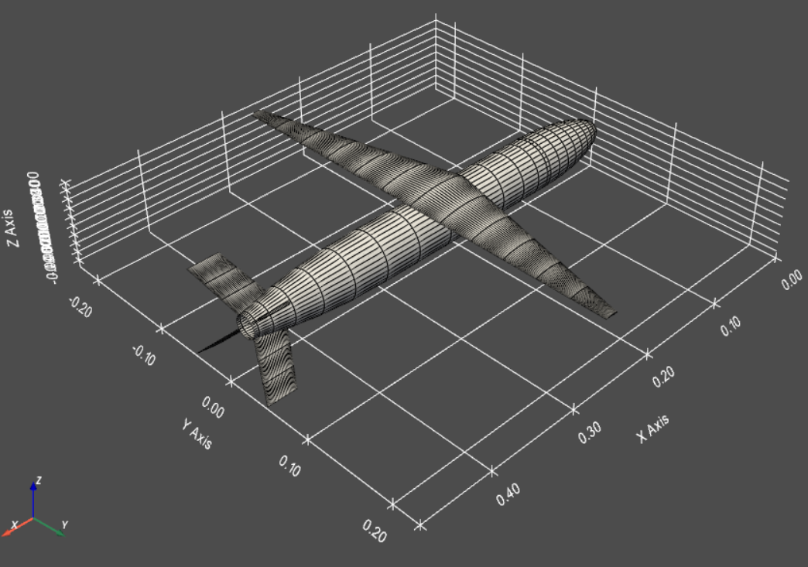
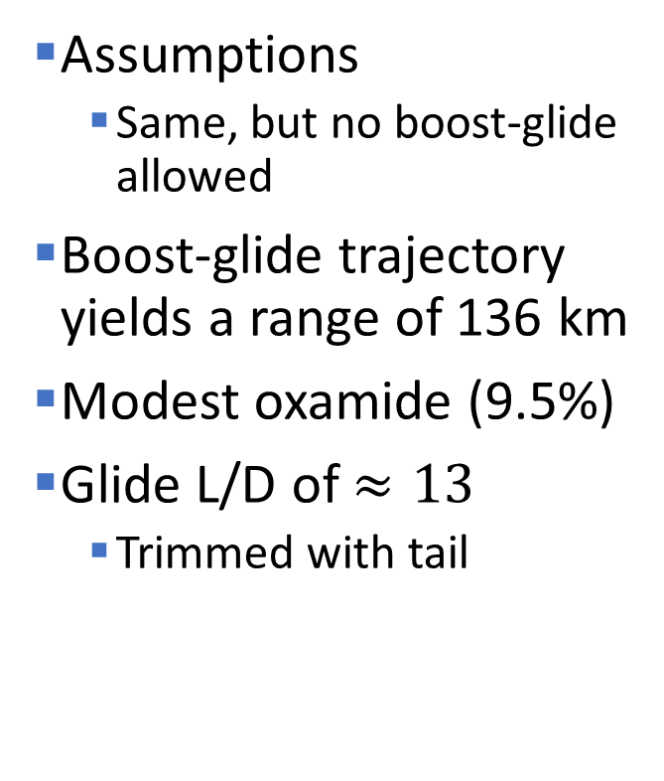
A Re-Optimized Firefly (No Boost)
Assumptions
Same, but no boost-glide allowed
Boost-glide trajectory yields a range of 136 km
Modest oxamide (9.5%)
Glide L/D of $≈13$
Trimmed with tail

Slide 12
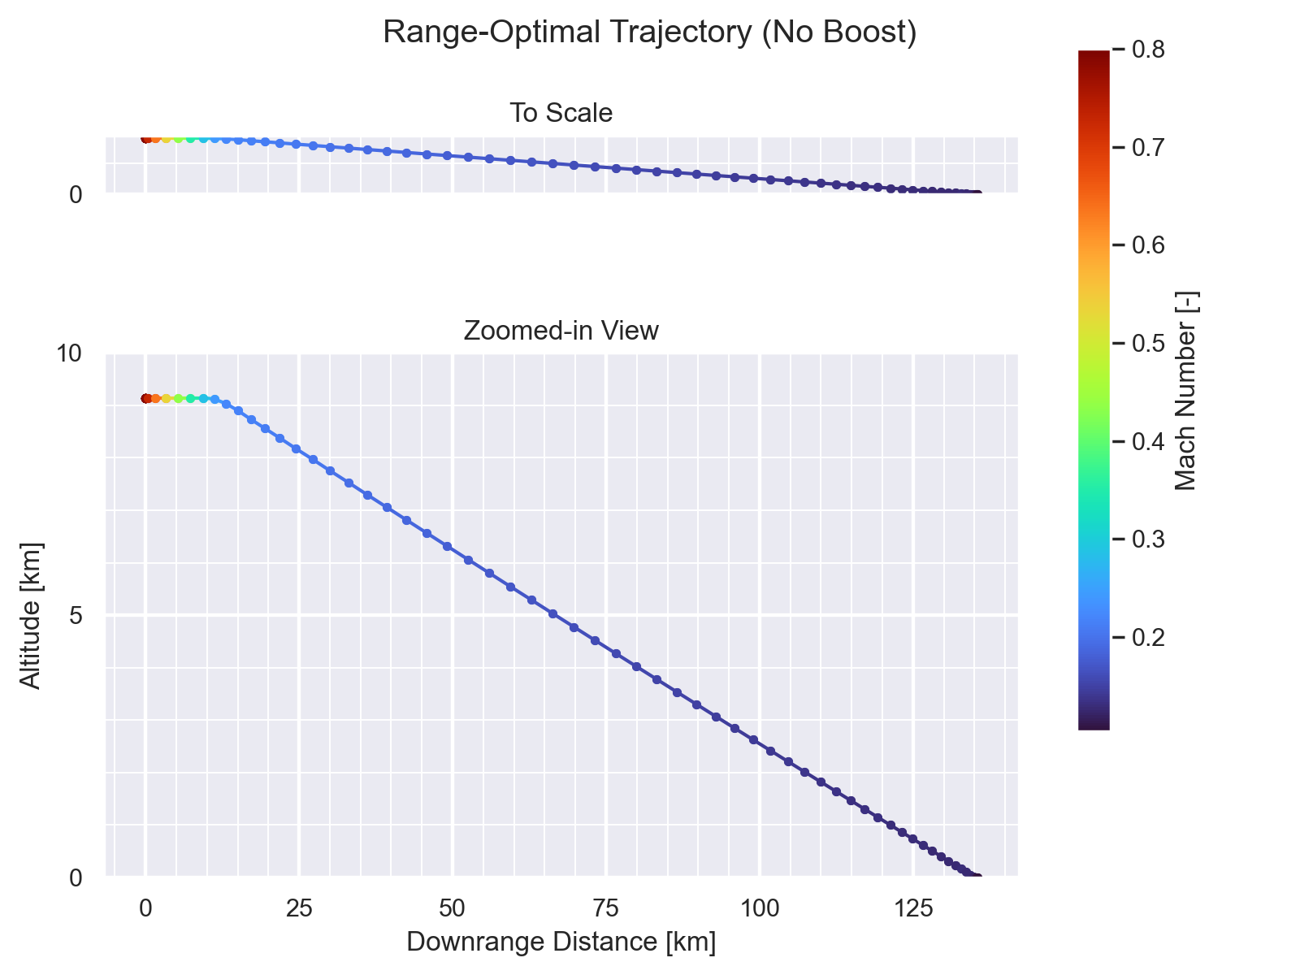
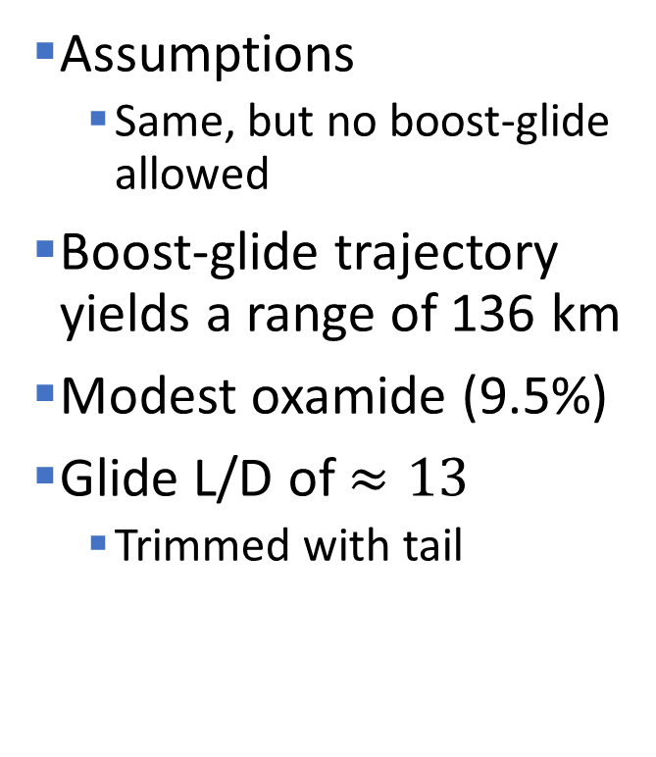
A Re-Optimized Firefly (No Boost)
Assumptions
Same, but no boost-glide allowed
Boost-glide trajectory yields a range of 136 km
Modest oxamide (9.5%)
Glide L/D of $≈13$
Trimmed with tail

Slide 13
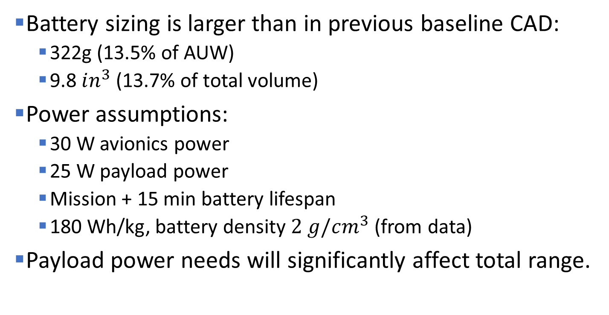
Battery Sizing and Payload Power
Battery sizing is larger than in previous baseline CAD:
322g (13.5% of AUW)
9.8 $in^{3}$ (13.7% of total volume)
Power assumptions:
30 W avionics power
25 W payload power
Mission + 15 min battery lifespan
180 Wh/kg, battery density $2 g/cm^{3}$ (from data)
Payload power needs will significantly affect total range.

