Slide 1
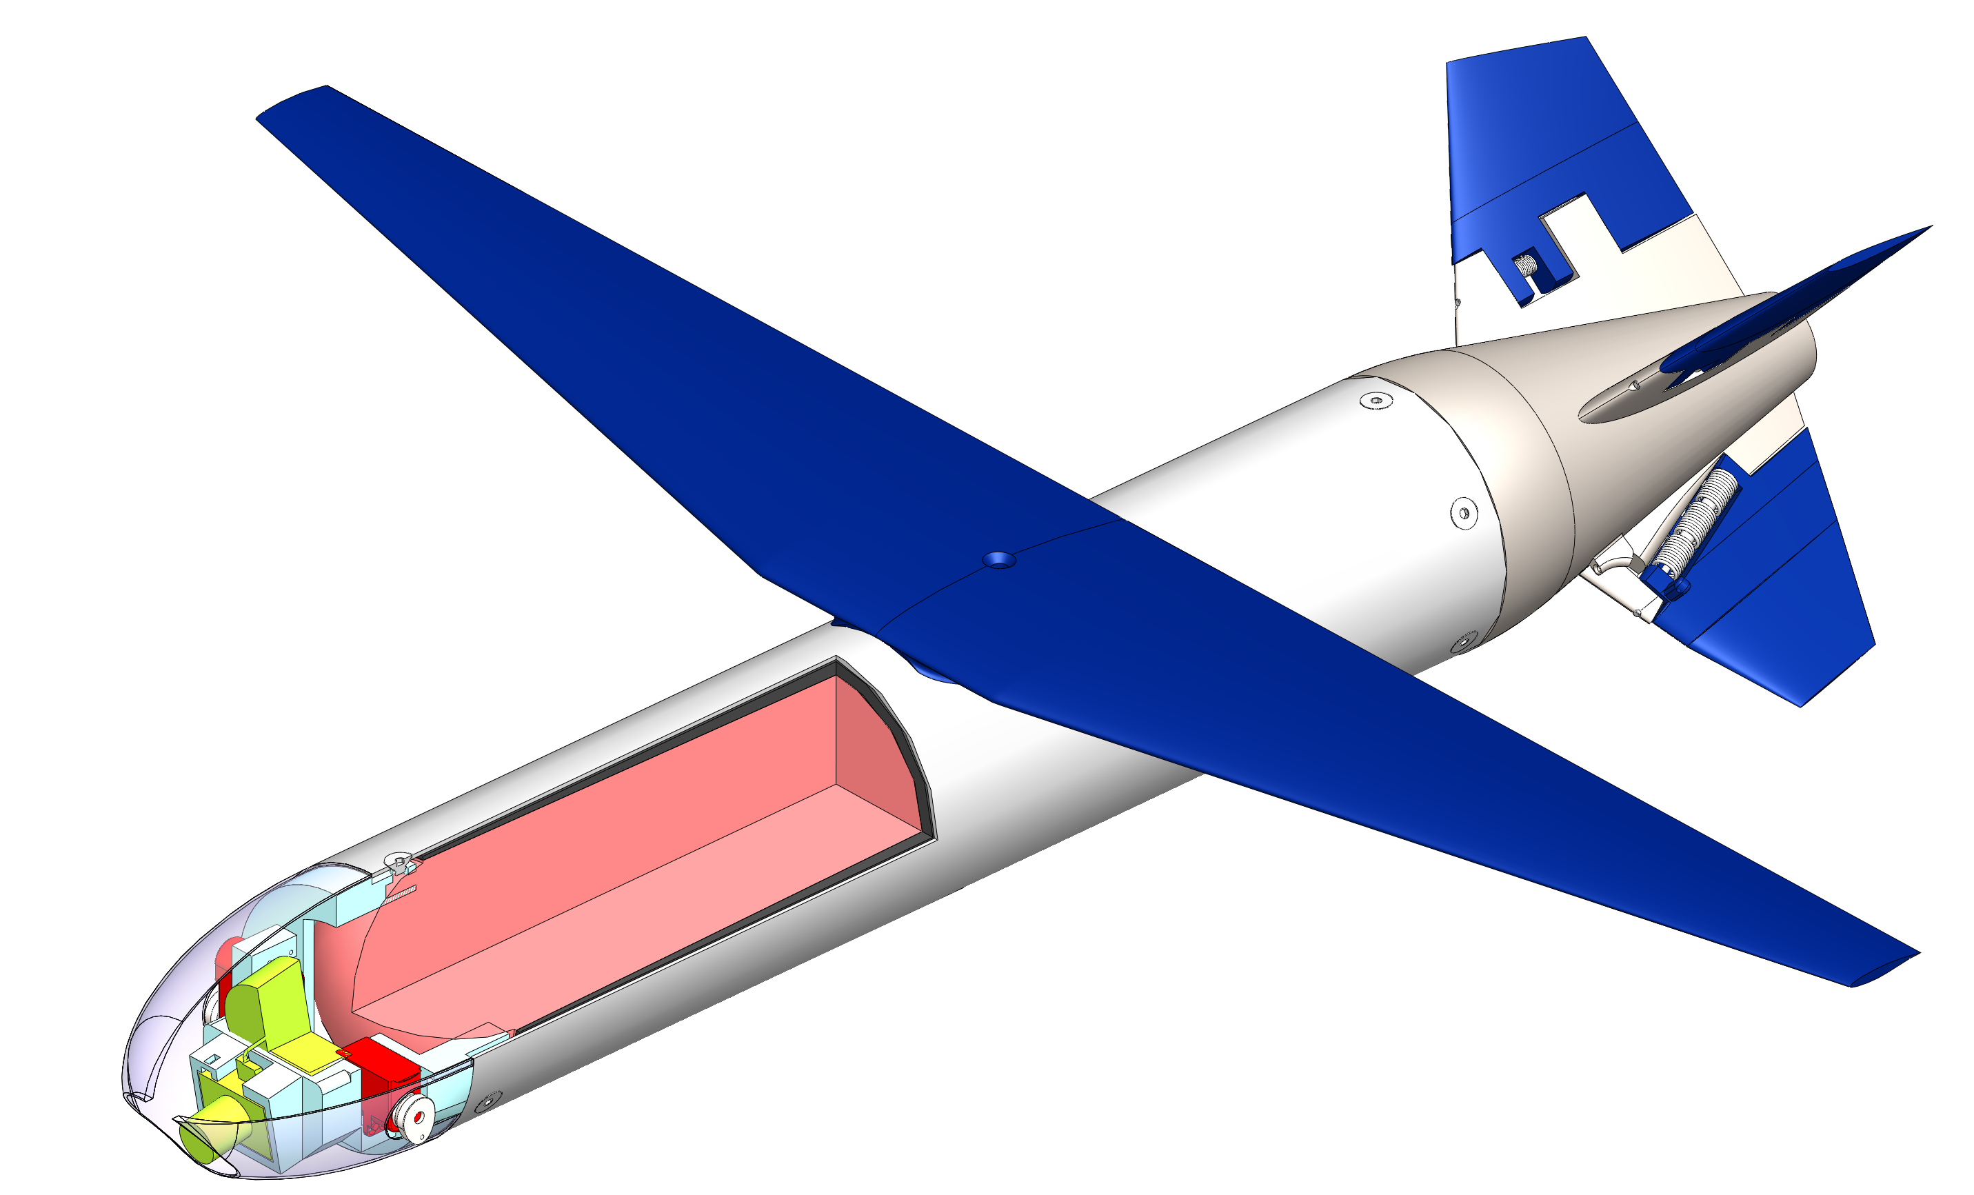
Actuated Tail Control Surfaces
Folding Wing
Motor case (Ti alloy)
Payload
Propellant
Ablative liner
Servos

