Slide 1
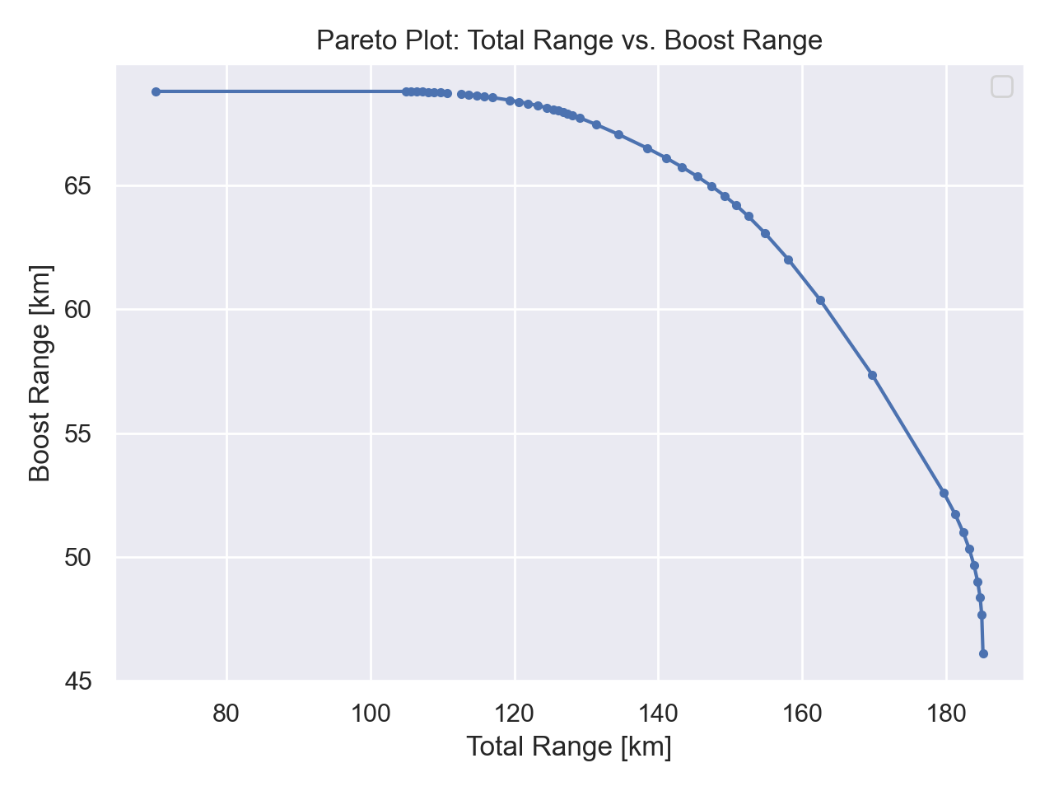
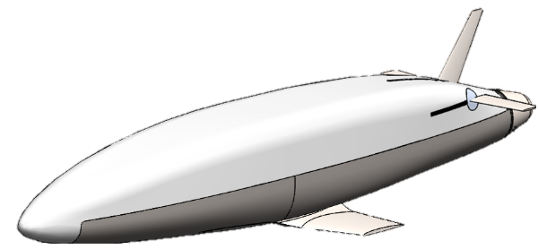
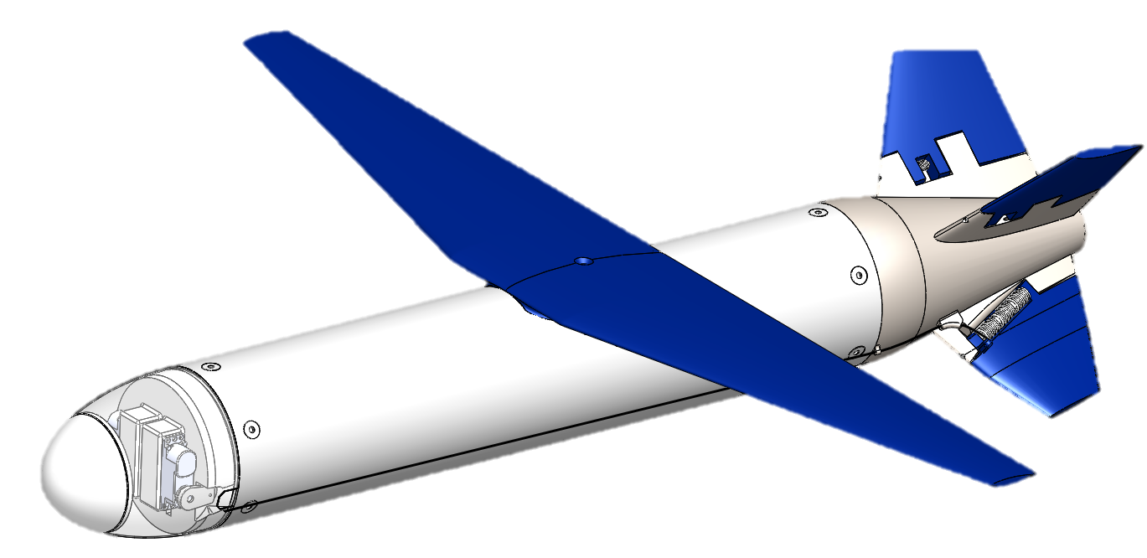
Missile-like design (original “mental model”)
High-speed glider design (result of AeroSandbox)
*Note: figure is based on an early model version, so range estimates are out-of-date – for qualitative illustration only

