Slide 1
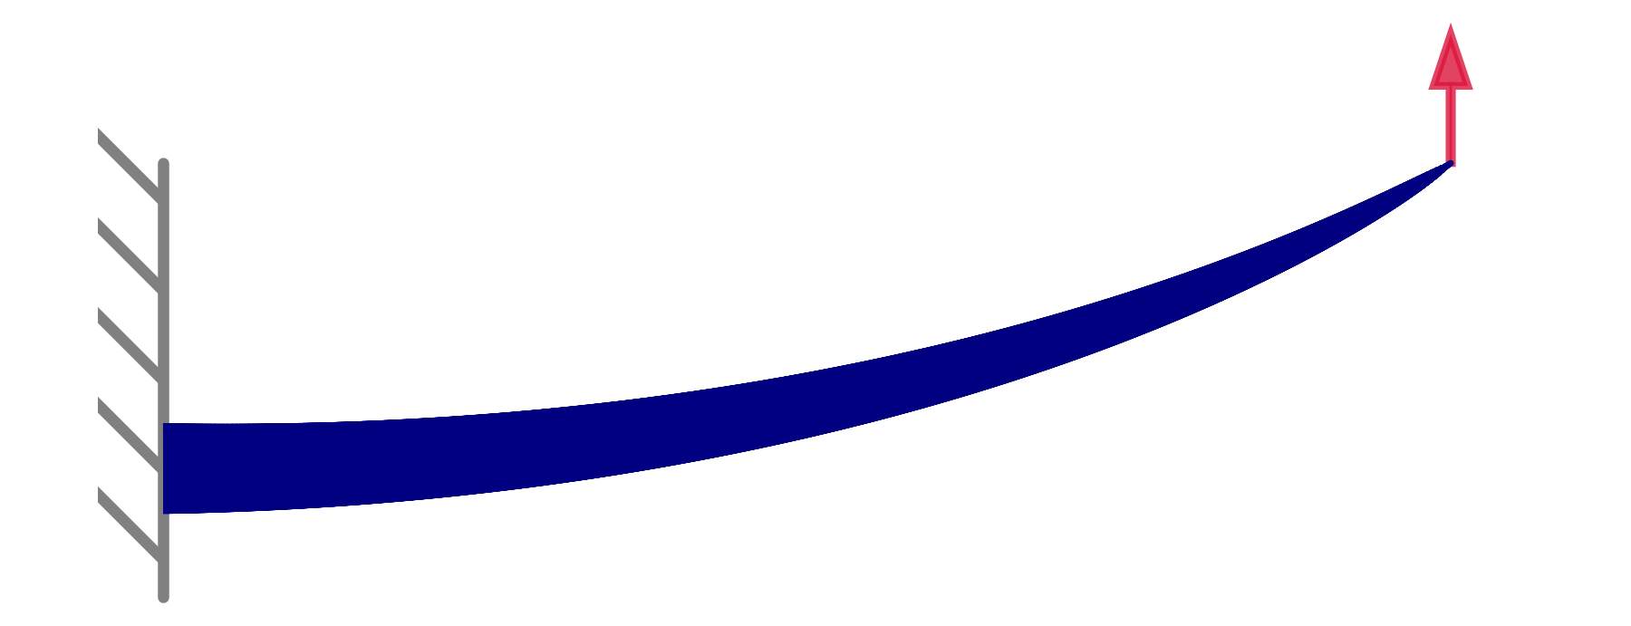


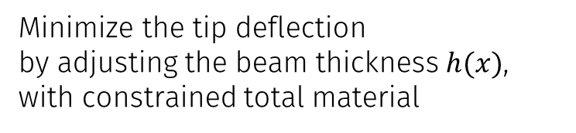
Minimize the tip deflection
by adjusting the beam thickness $h(x)$,
with constrained total material
$$x$$
Discretize along the length with $N$ nodes

