Slide 1
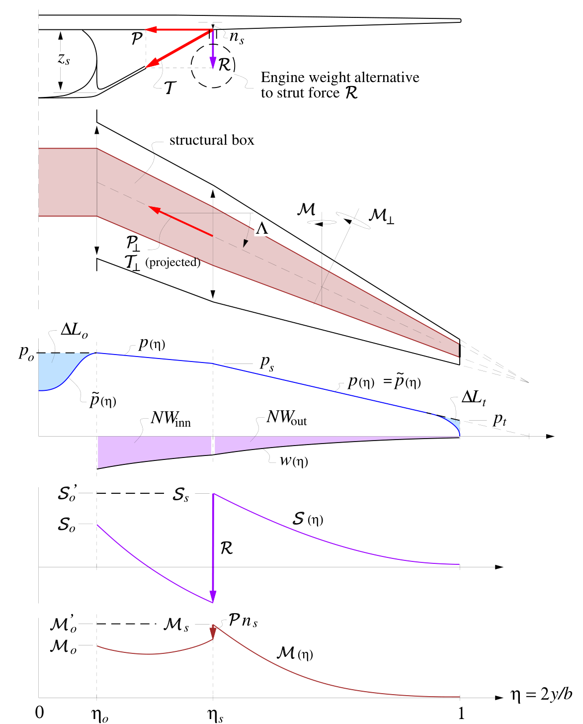

Slide 2
input_vector = [114115.099, 37.533, 10.697, ..., 2700.0, 817.0]

Slide 3
contaminated_input_vectors = [
[ NaN, 37.533, 10.697, ..., 2700.0, 817.0],
[114115.099, NaN, 10.697, ..., 2700.0, 817.0],
[114115.099, 37.533, NaN, ..., 2700.0, 817.0],
...,
[114115.099, 37.533, 10.697, ..., NaN, 817.0],
[114115.099, 37.533, 10.697, ..., 2700.0, NaN],
]

Slide 4
contaminated_outputs[18] = [NaN, 3475012.2, NaN, ..., 170545.5, NaN]

Slide 5
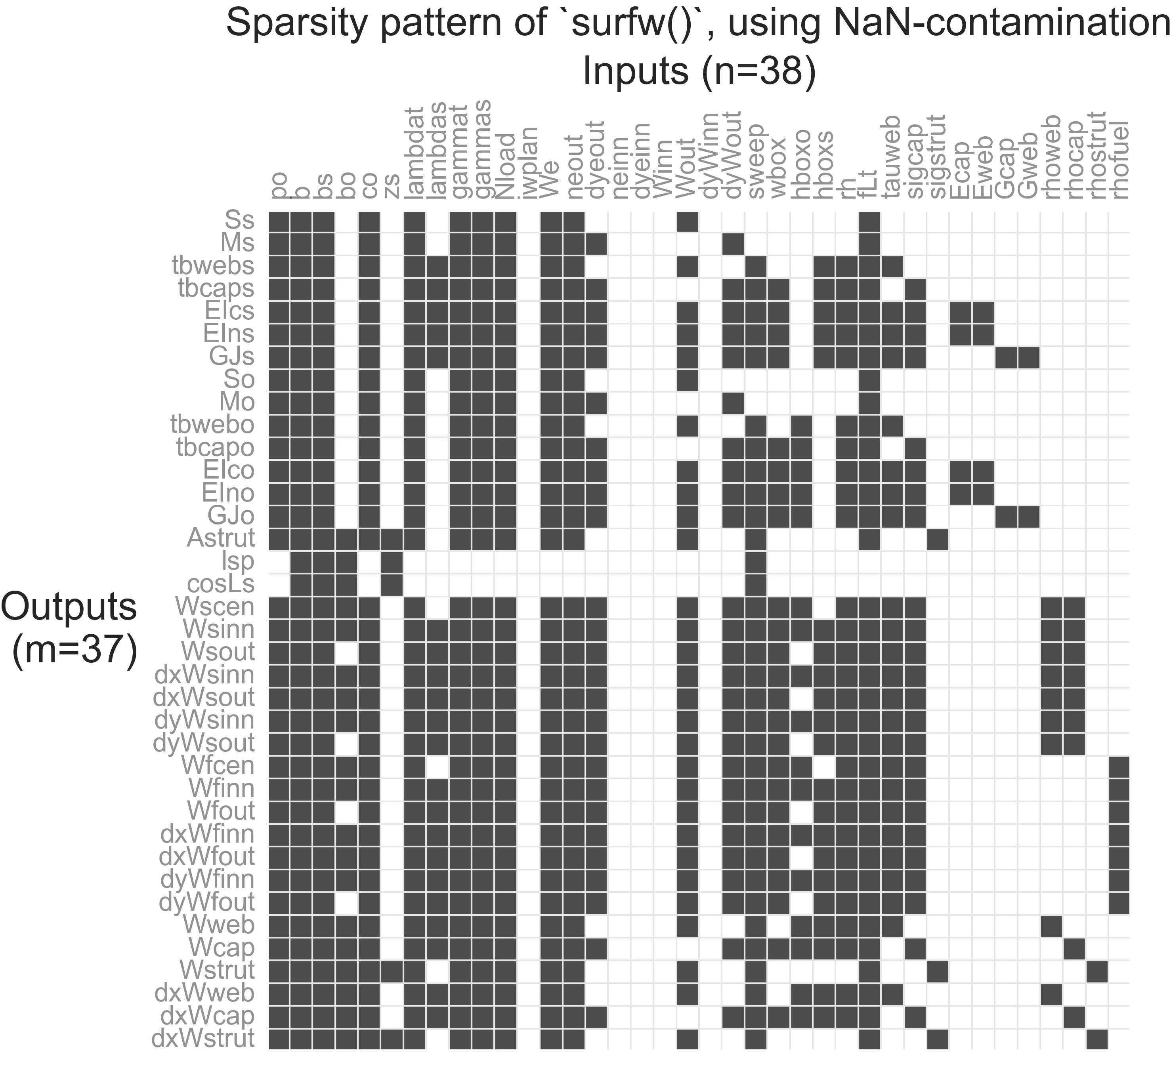

Slide 6
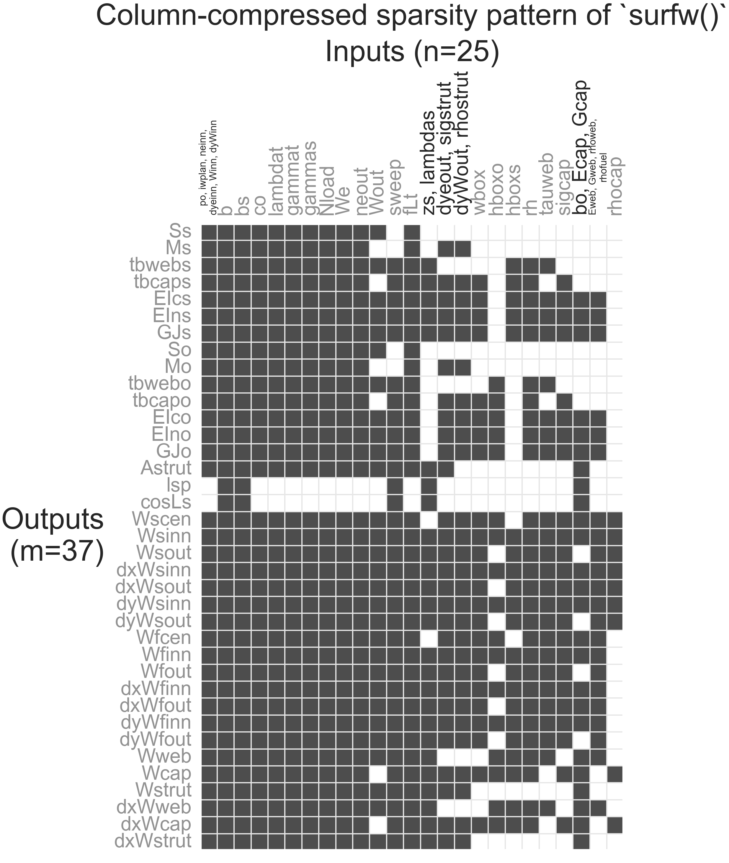

Slide 7
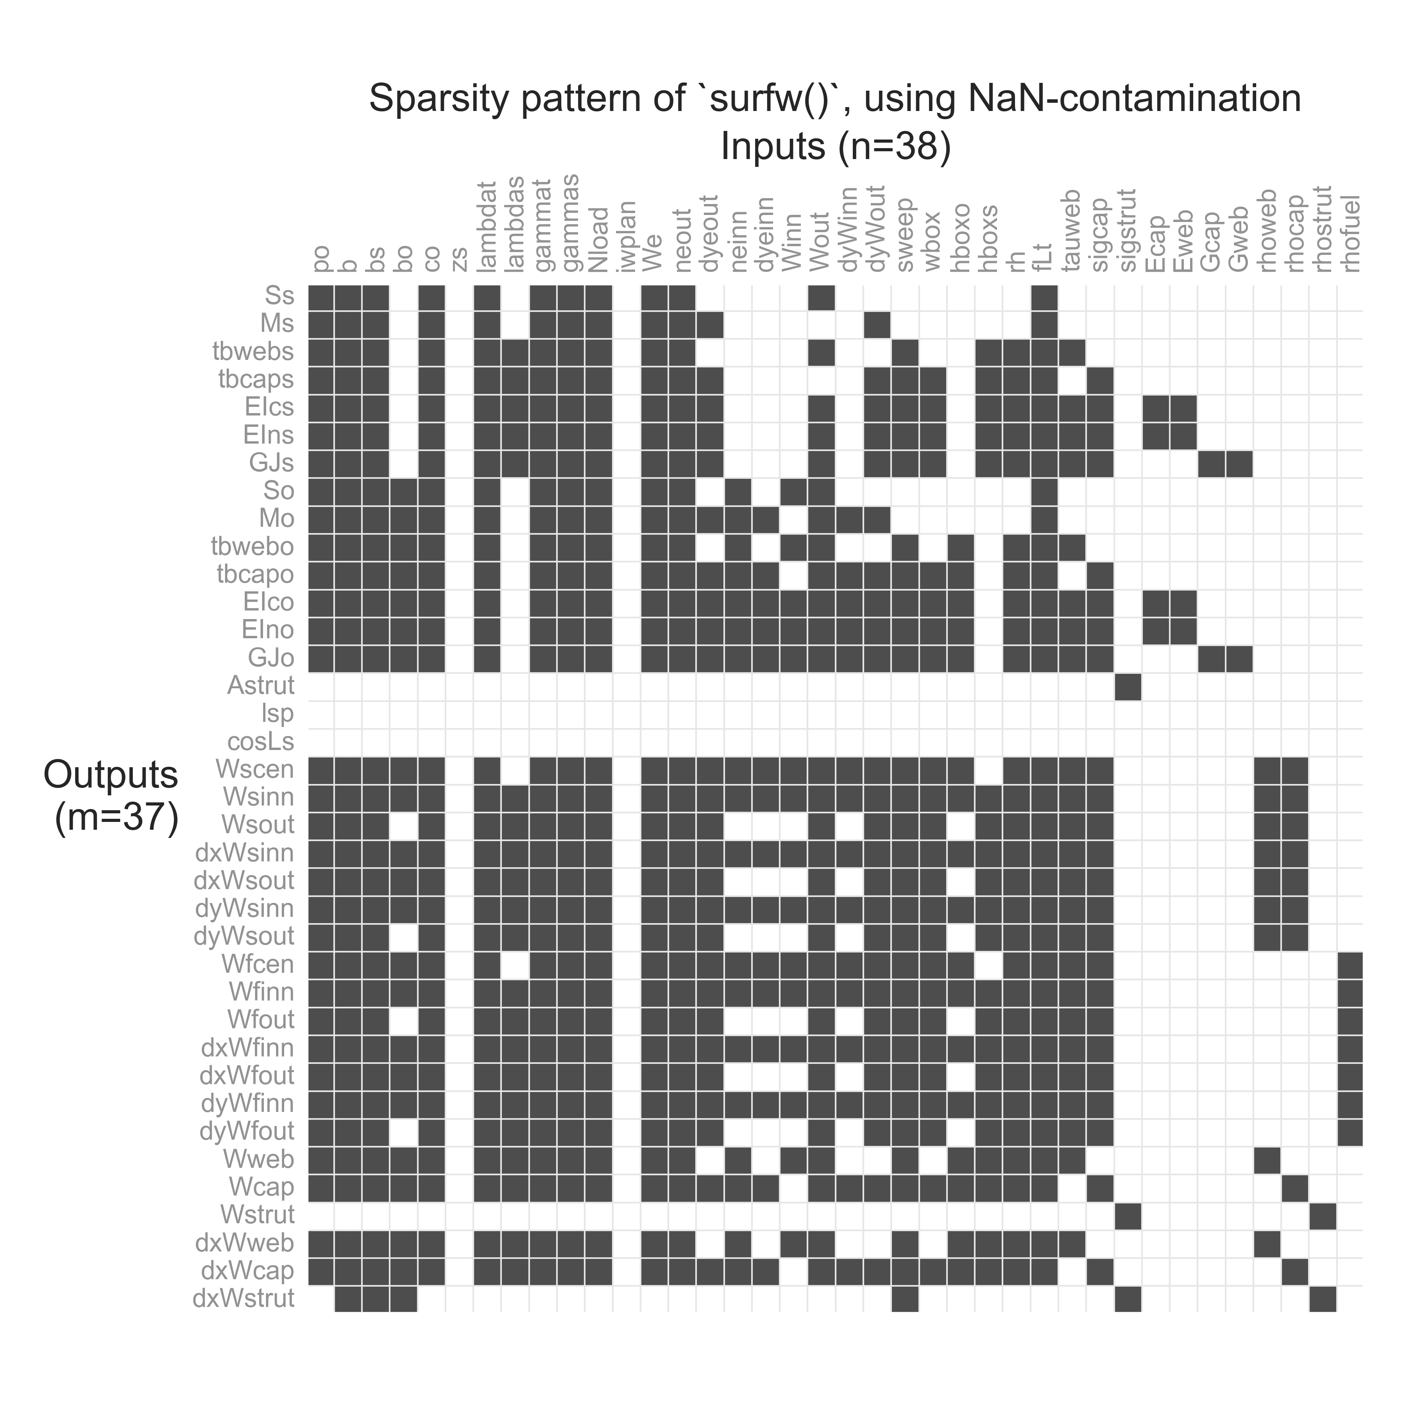

Slide 8
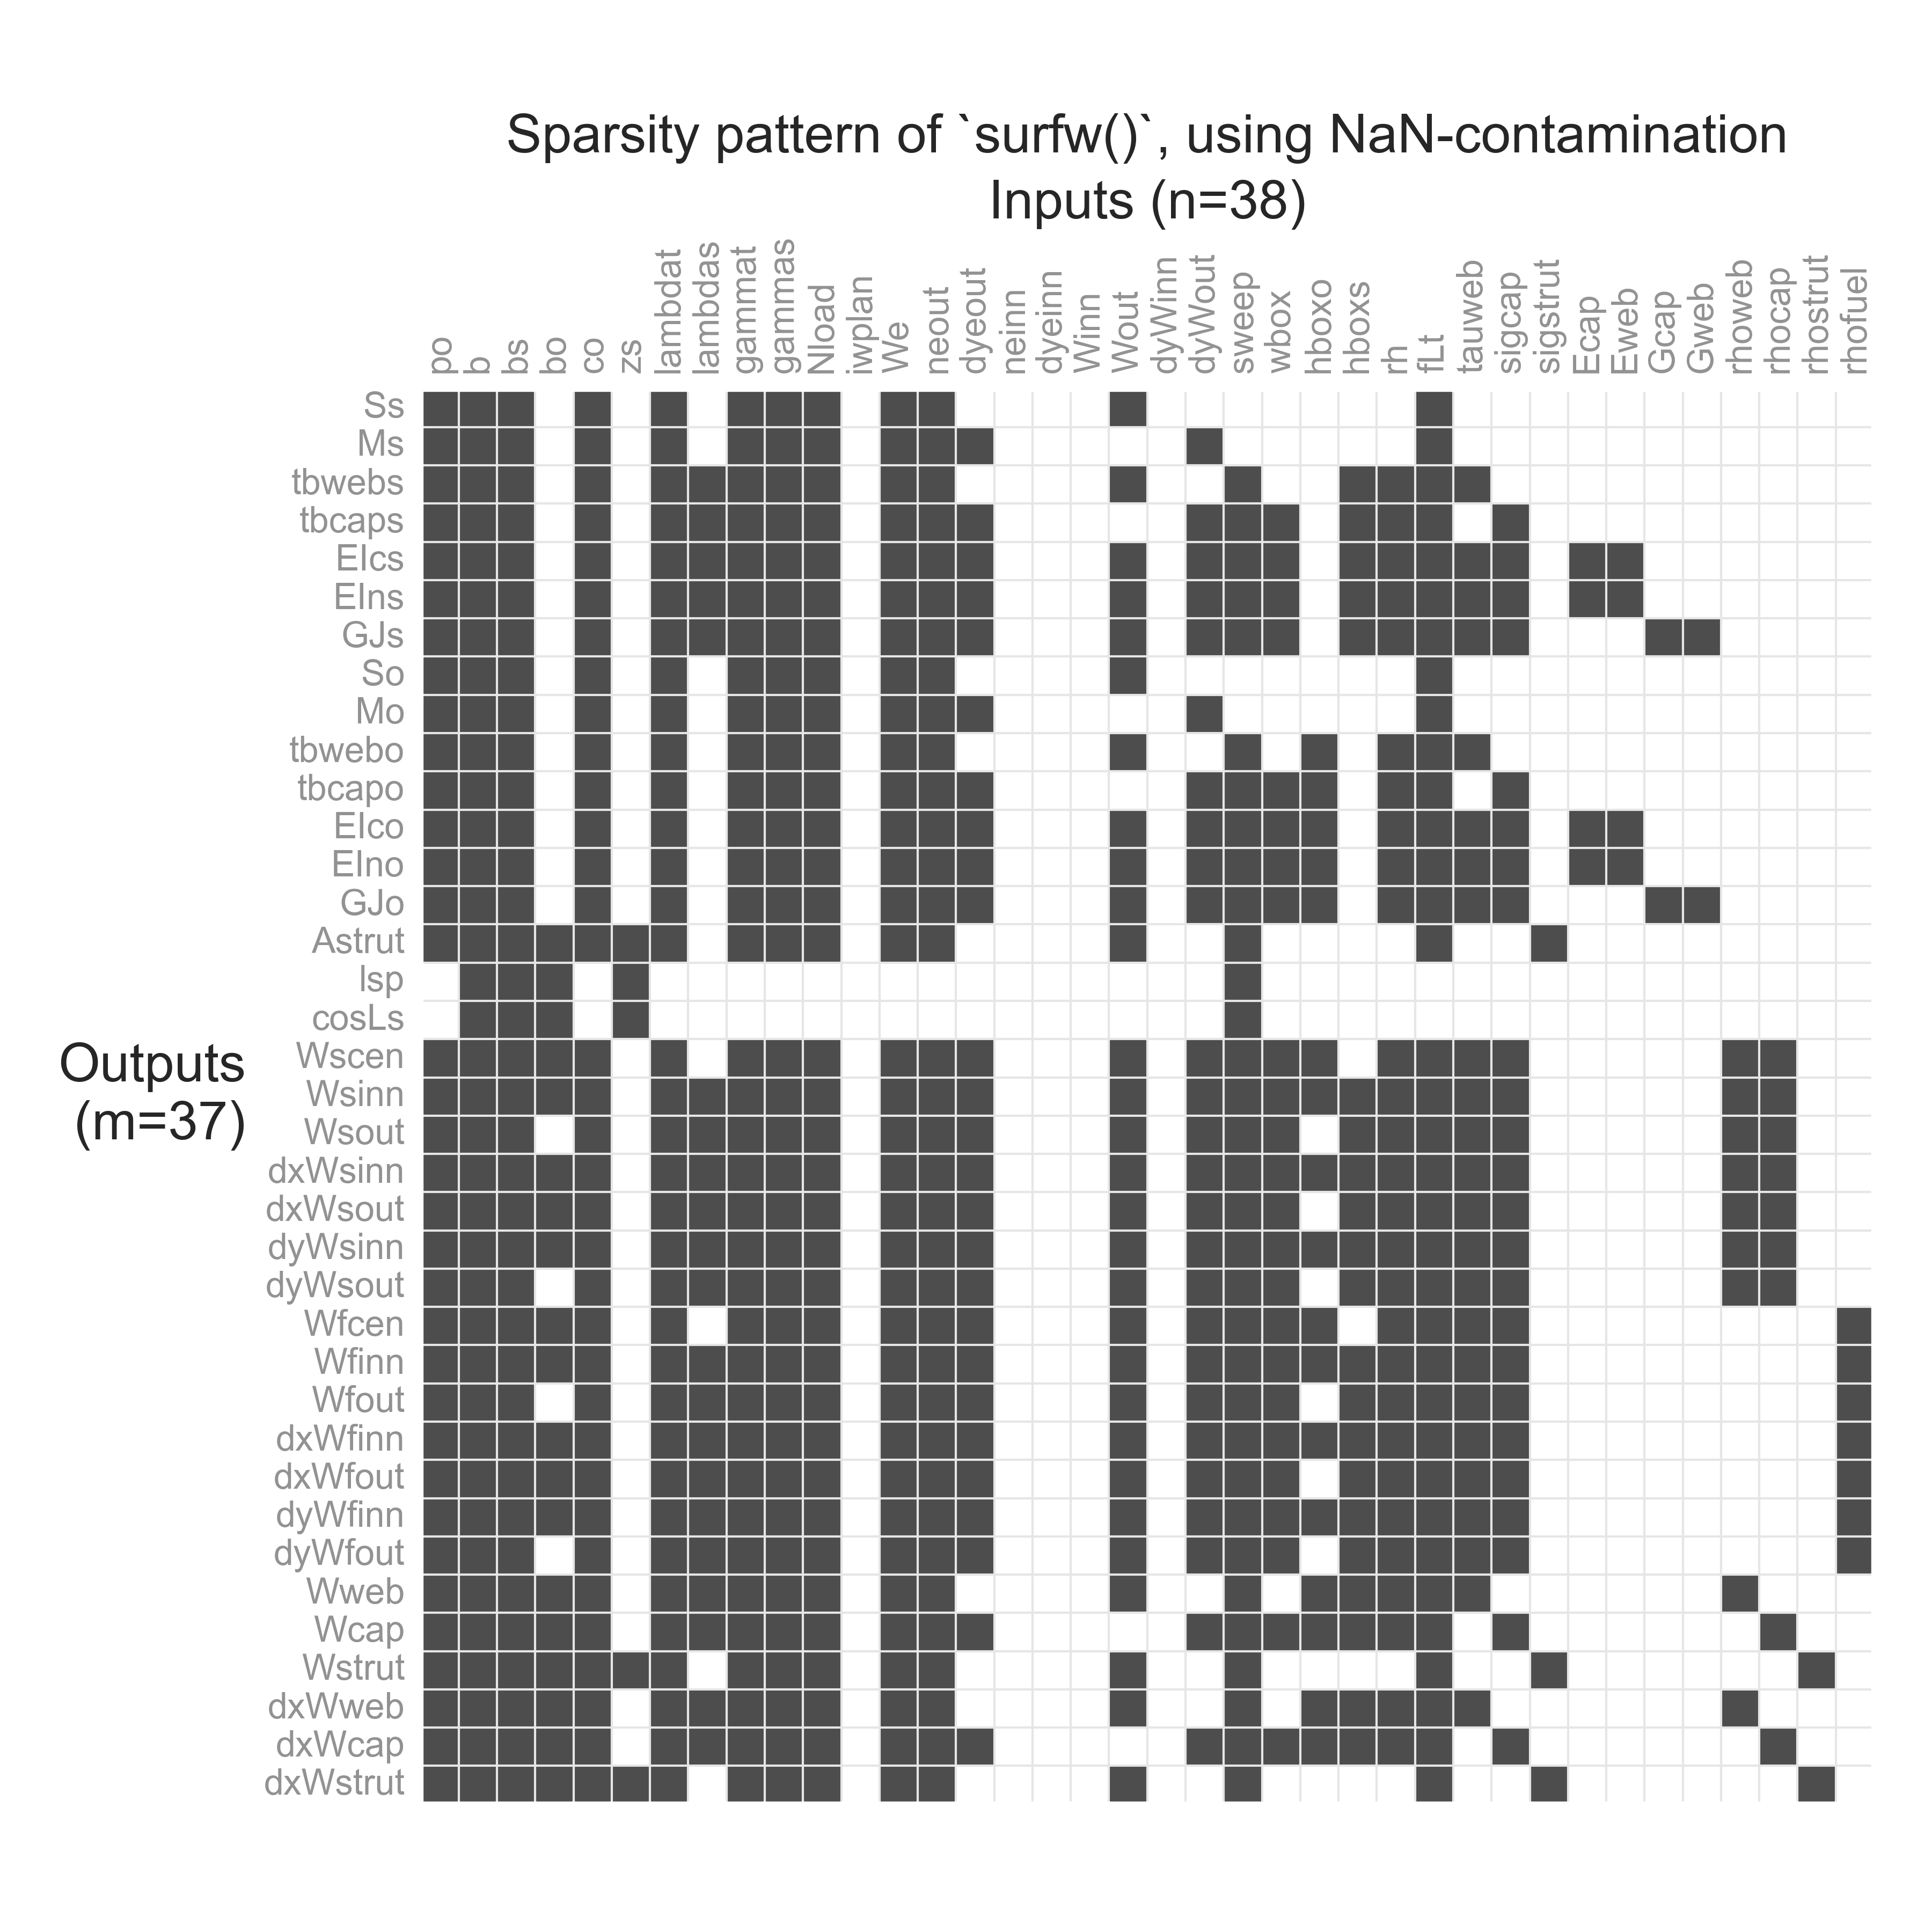

Slide 9
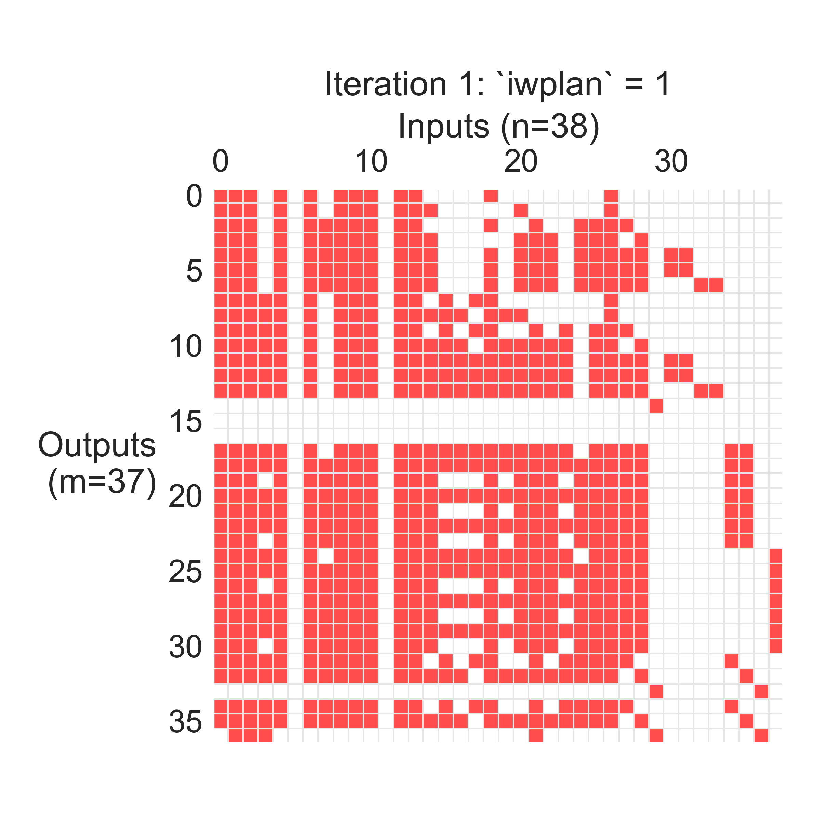
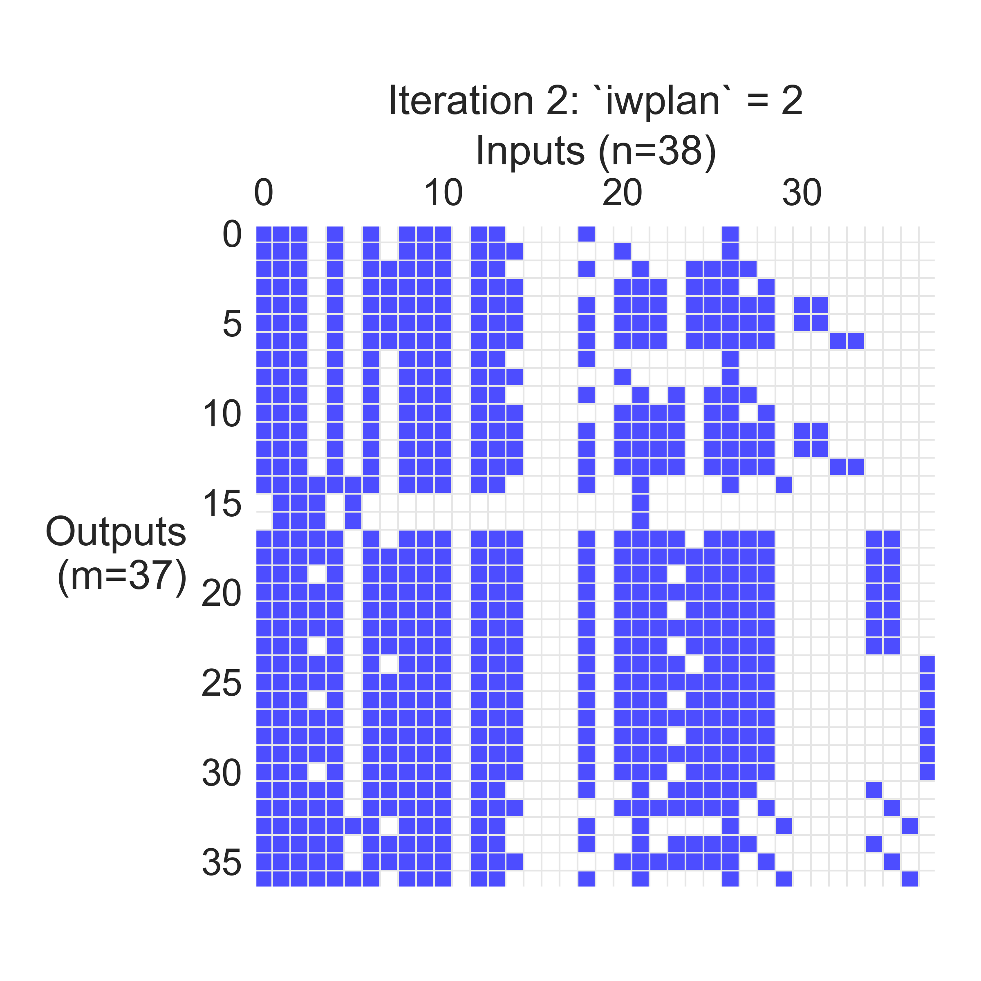
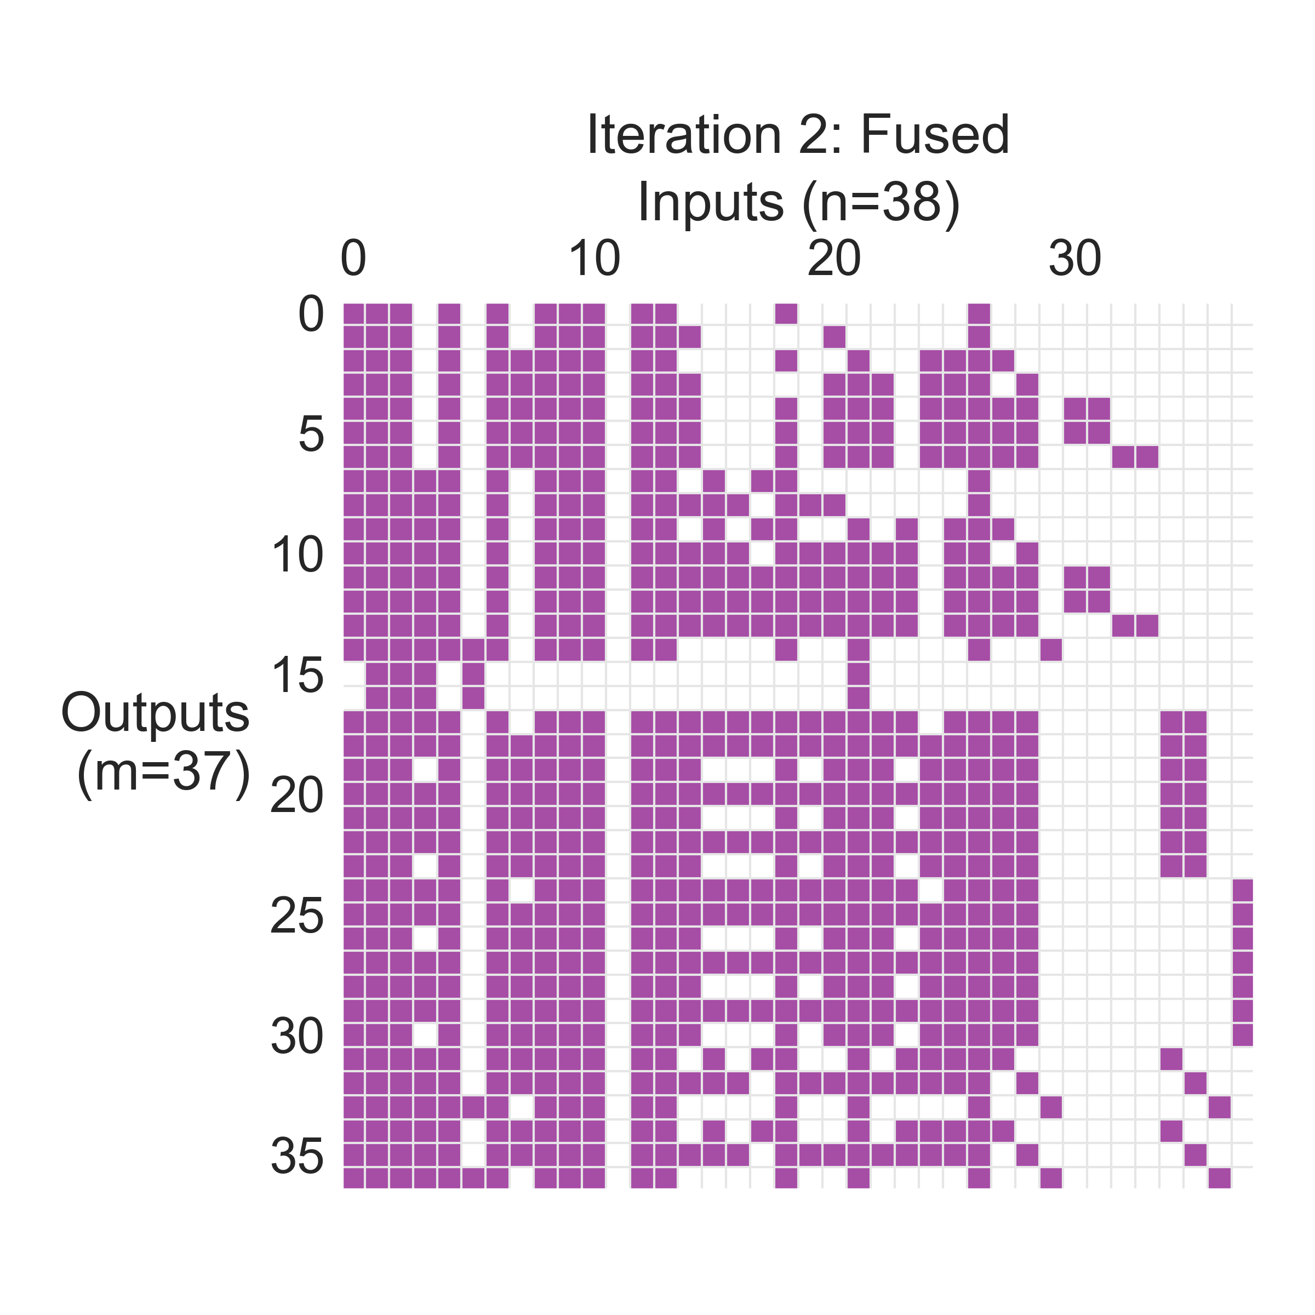
Step 1:
Trace sparsity with NaN-propagation
Compute gradient, take optimization step, etc.
Step 2:
At next iteration, if any new values for discrete variables are seen, redo the sparsity trace
Step 3:
Take the union of the new sparsity and the previous one, and use that going forward
+
=

Slide 10
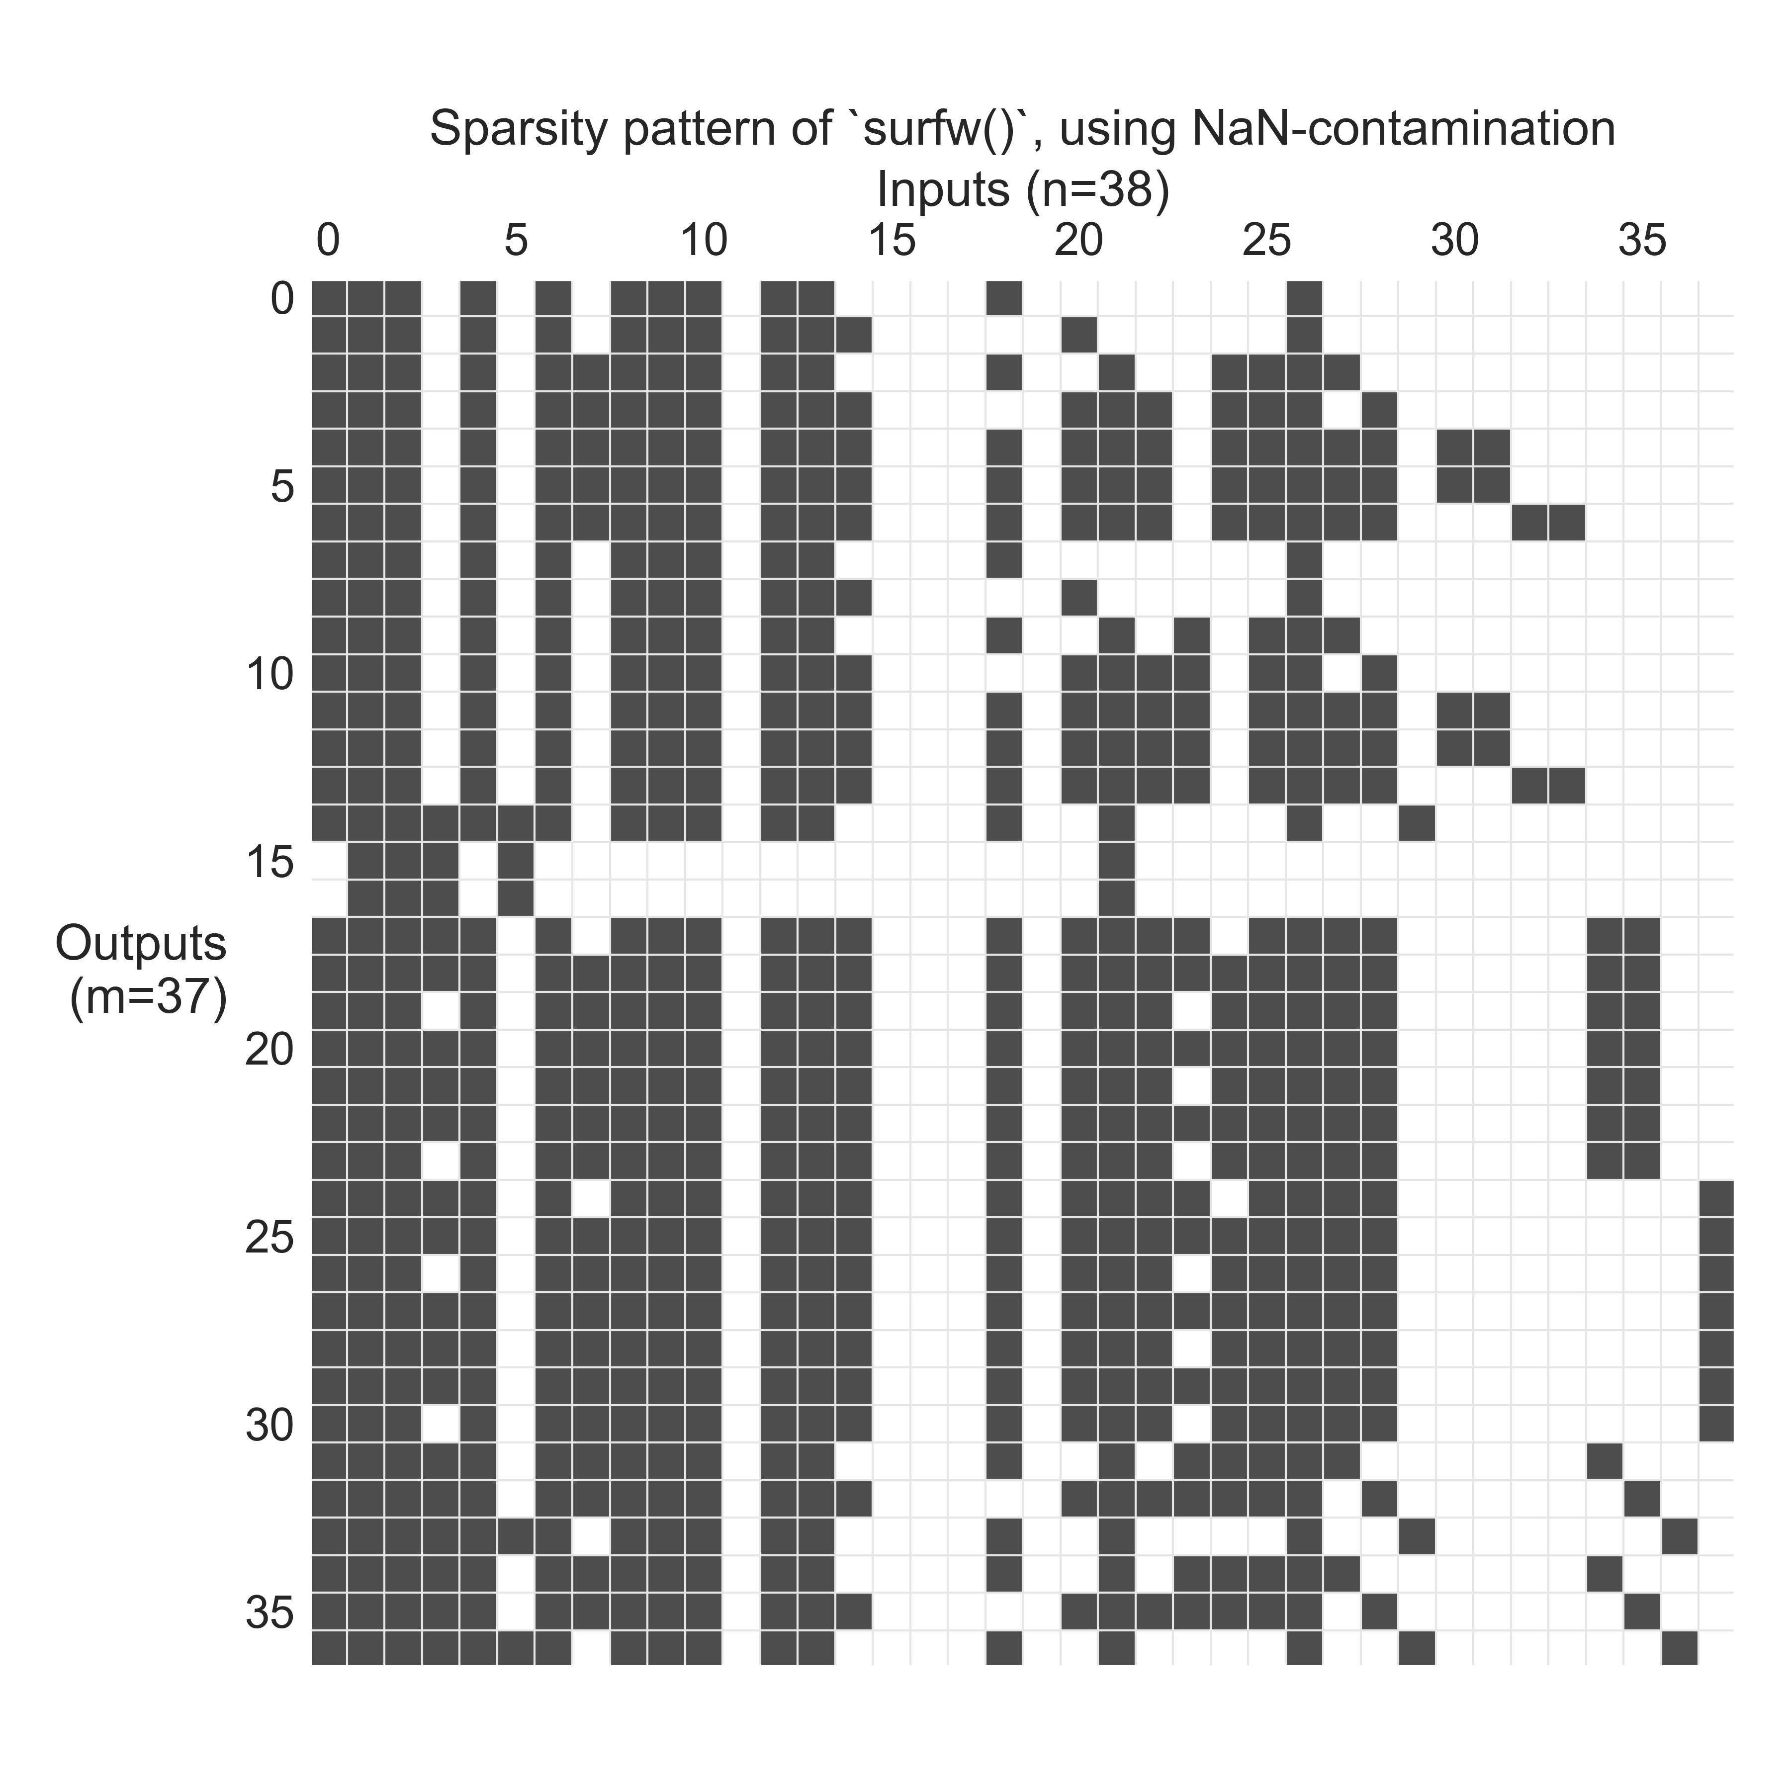

Slide 11
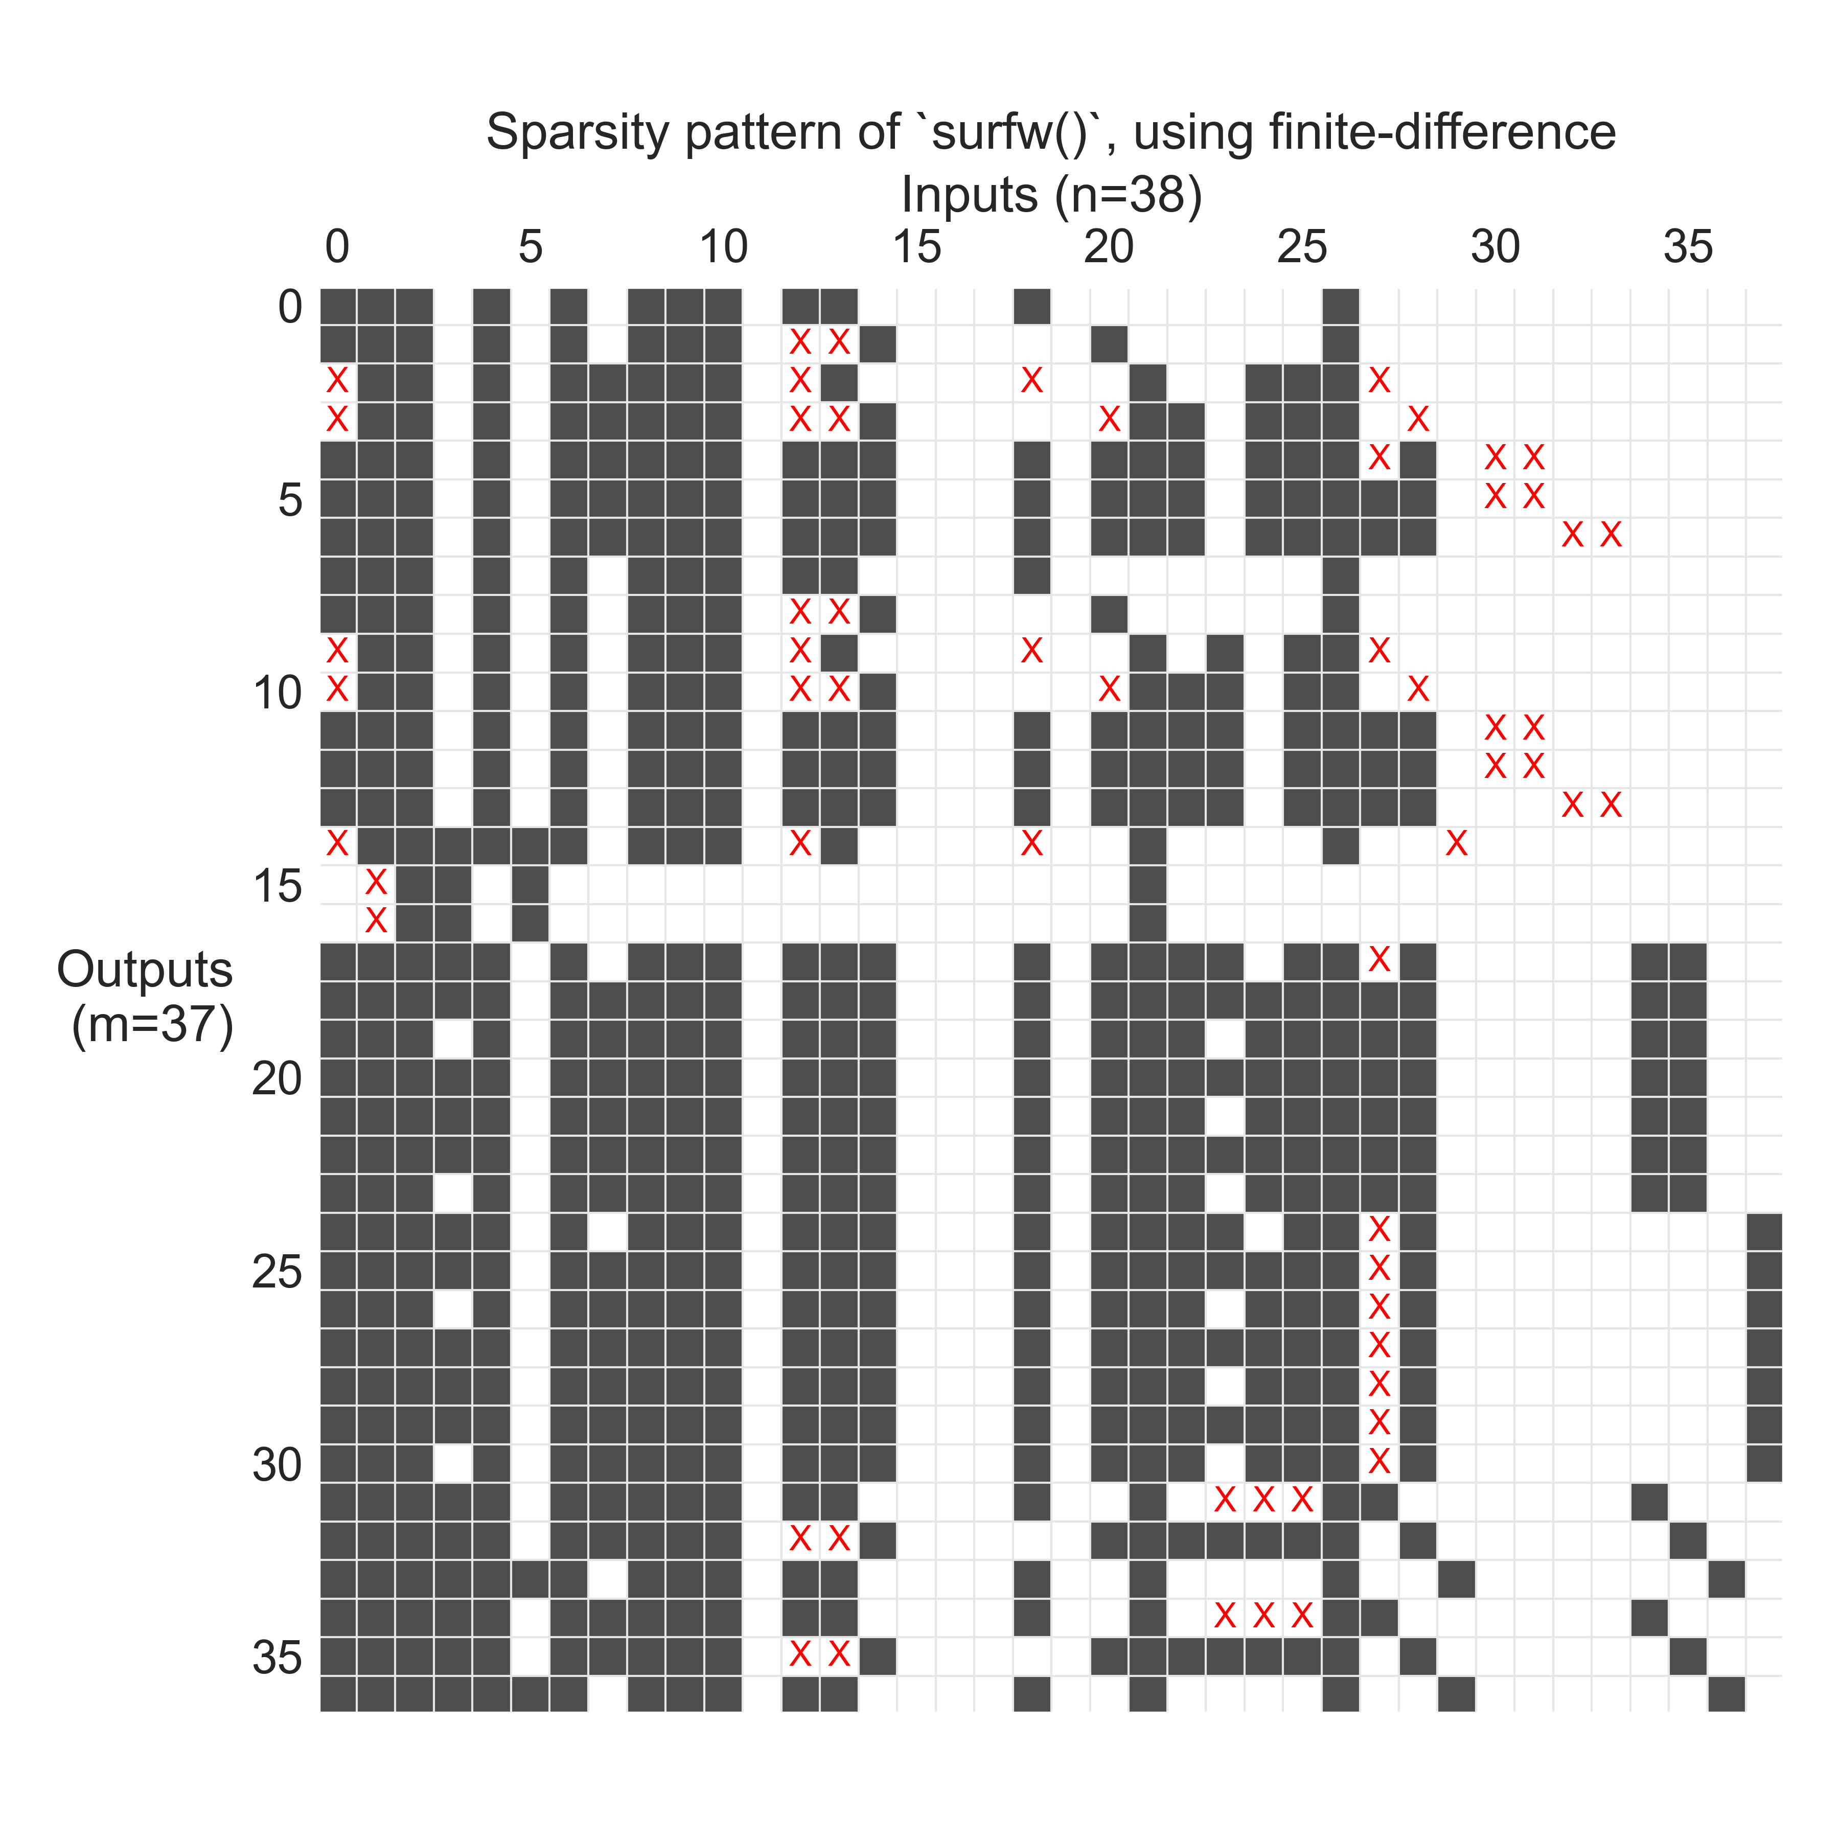
X = false negatives!

Slide 12
GJ = G * J
Output
Inputs

