Slide 1

e2e testing with Cypress
Mei 2019
Peter Eijgermans
peter.eijgermans@ordina.nl

Slide 2
What is Cypress?
Why it is so good?
Agenda

Slide 3
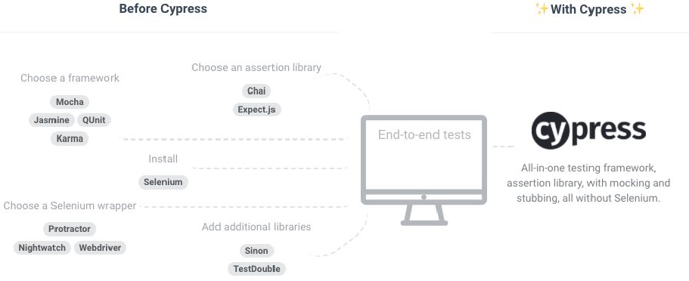
Cypress is all in one

Slide 4
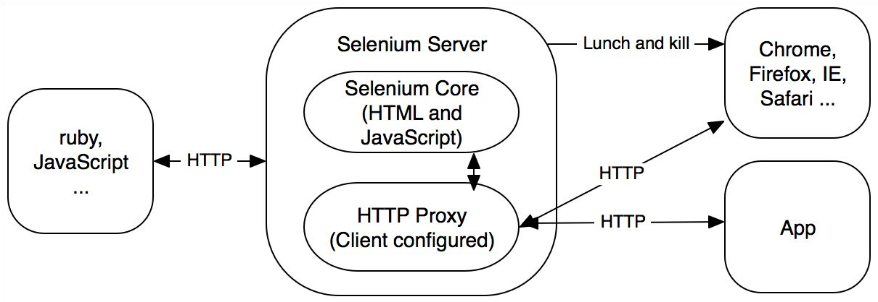
Cypress does not use Selenium

Slide 5
Cypress has native access to everything
Cypress is a Node.js server process
This makes performing tasks such as taking screenshots, recording videos, general file system operations and network operations possible.
Cypress tests run inside of the browser
You have real, native access to everything in your application under test.

Slide 6
Trade-offs
Cypress is not a general purpose automation tool
Cypress commands run inside of a browser
There will never be support for multiple browser tabs
You cannot use Cypress to drive two browsers at the same time
Each test is bound to a single origin

Slide 7
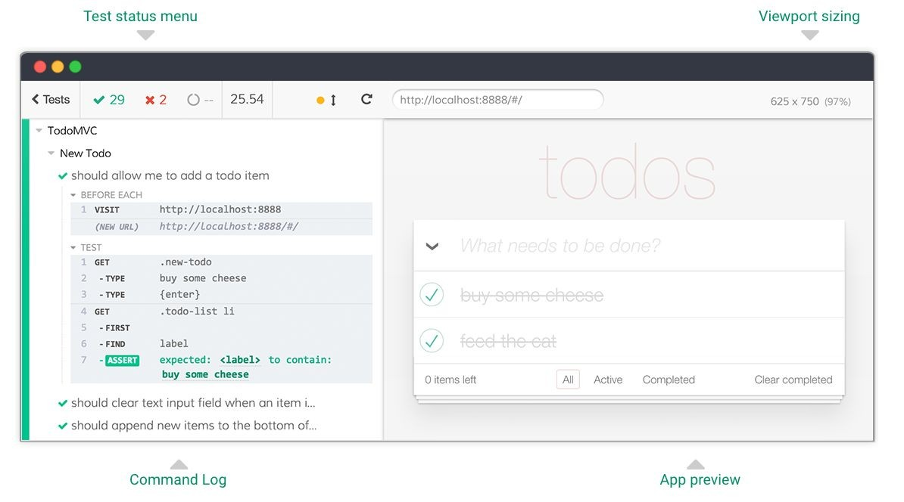
A test runner built for humans

Slide 8
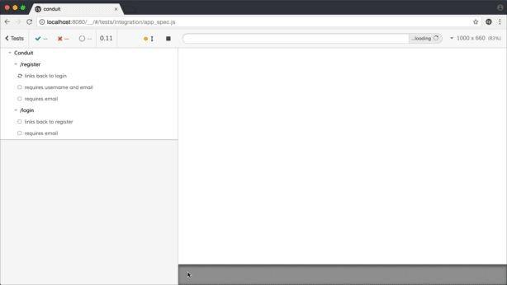
Cypress runs much, much faster

Slide 9
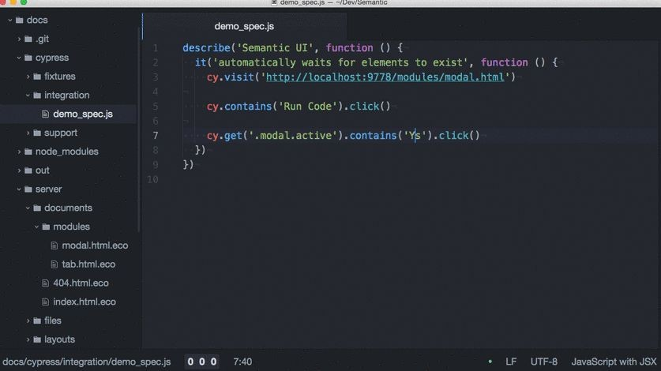
Debugging

Slide 10
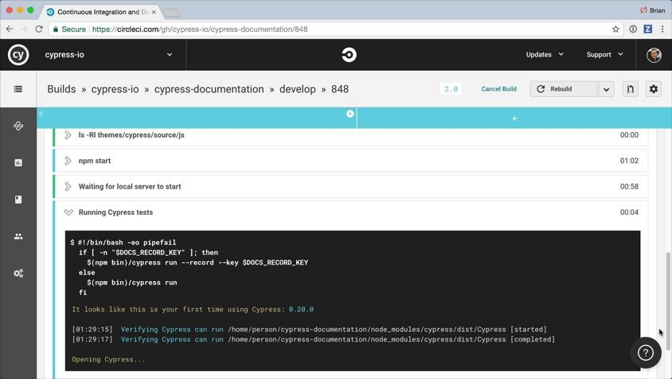
CI + Dashboard

Slide 11
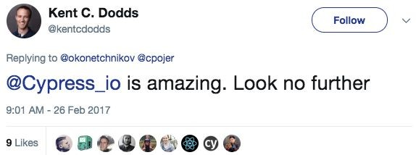
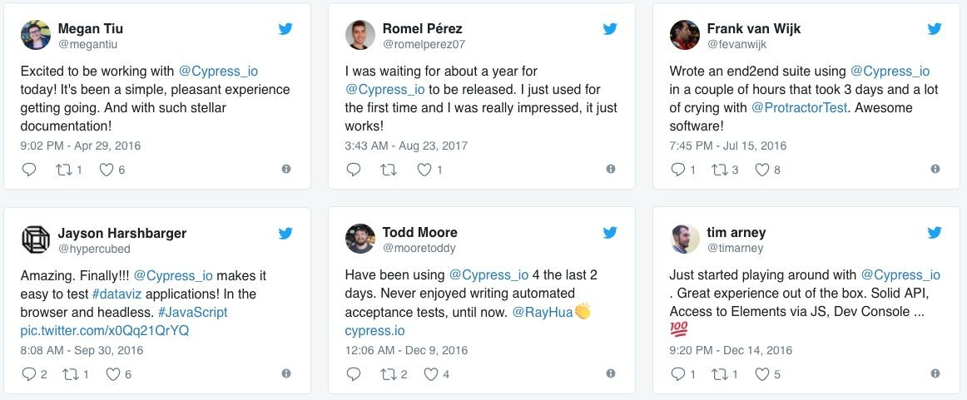

Who is using it?

Slide 12
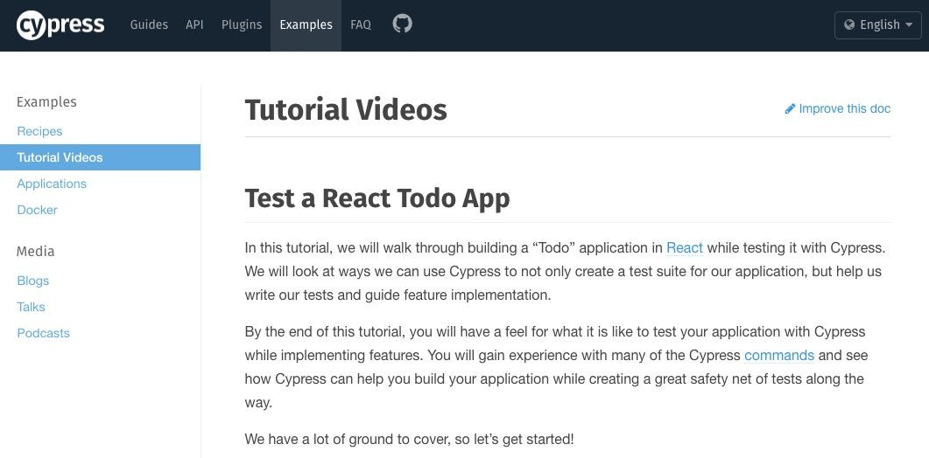

Slide 13
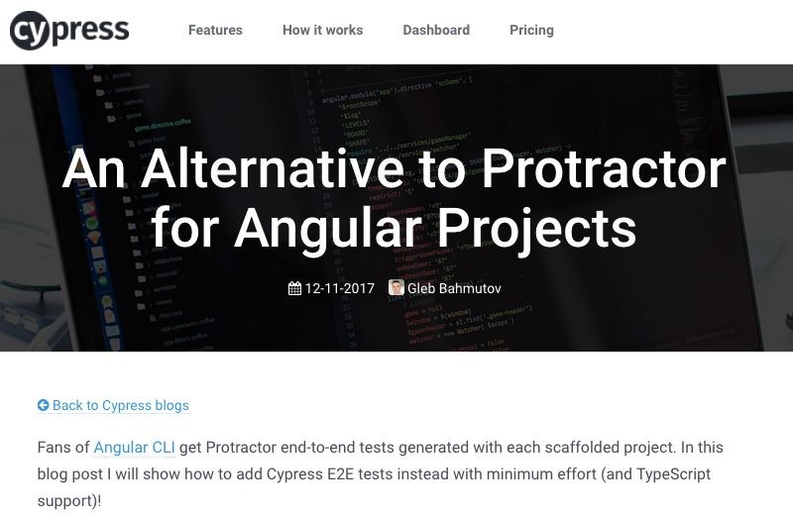

Slide 14
Exercise 1
https://docs.cypress.io/guides/getting-started/writing-your-first-test.html#Step-1-Visit-a-page

Slide 15
Exercise 2
E2E testing of the Rabobank site
see: app_spec.js in accelerator-programma/writing-your-first-test.html#Step-1-Visit-a-page

Slide 16
Thank you!

