Slide 1
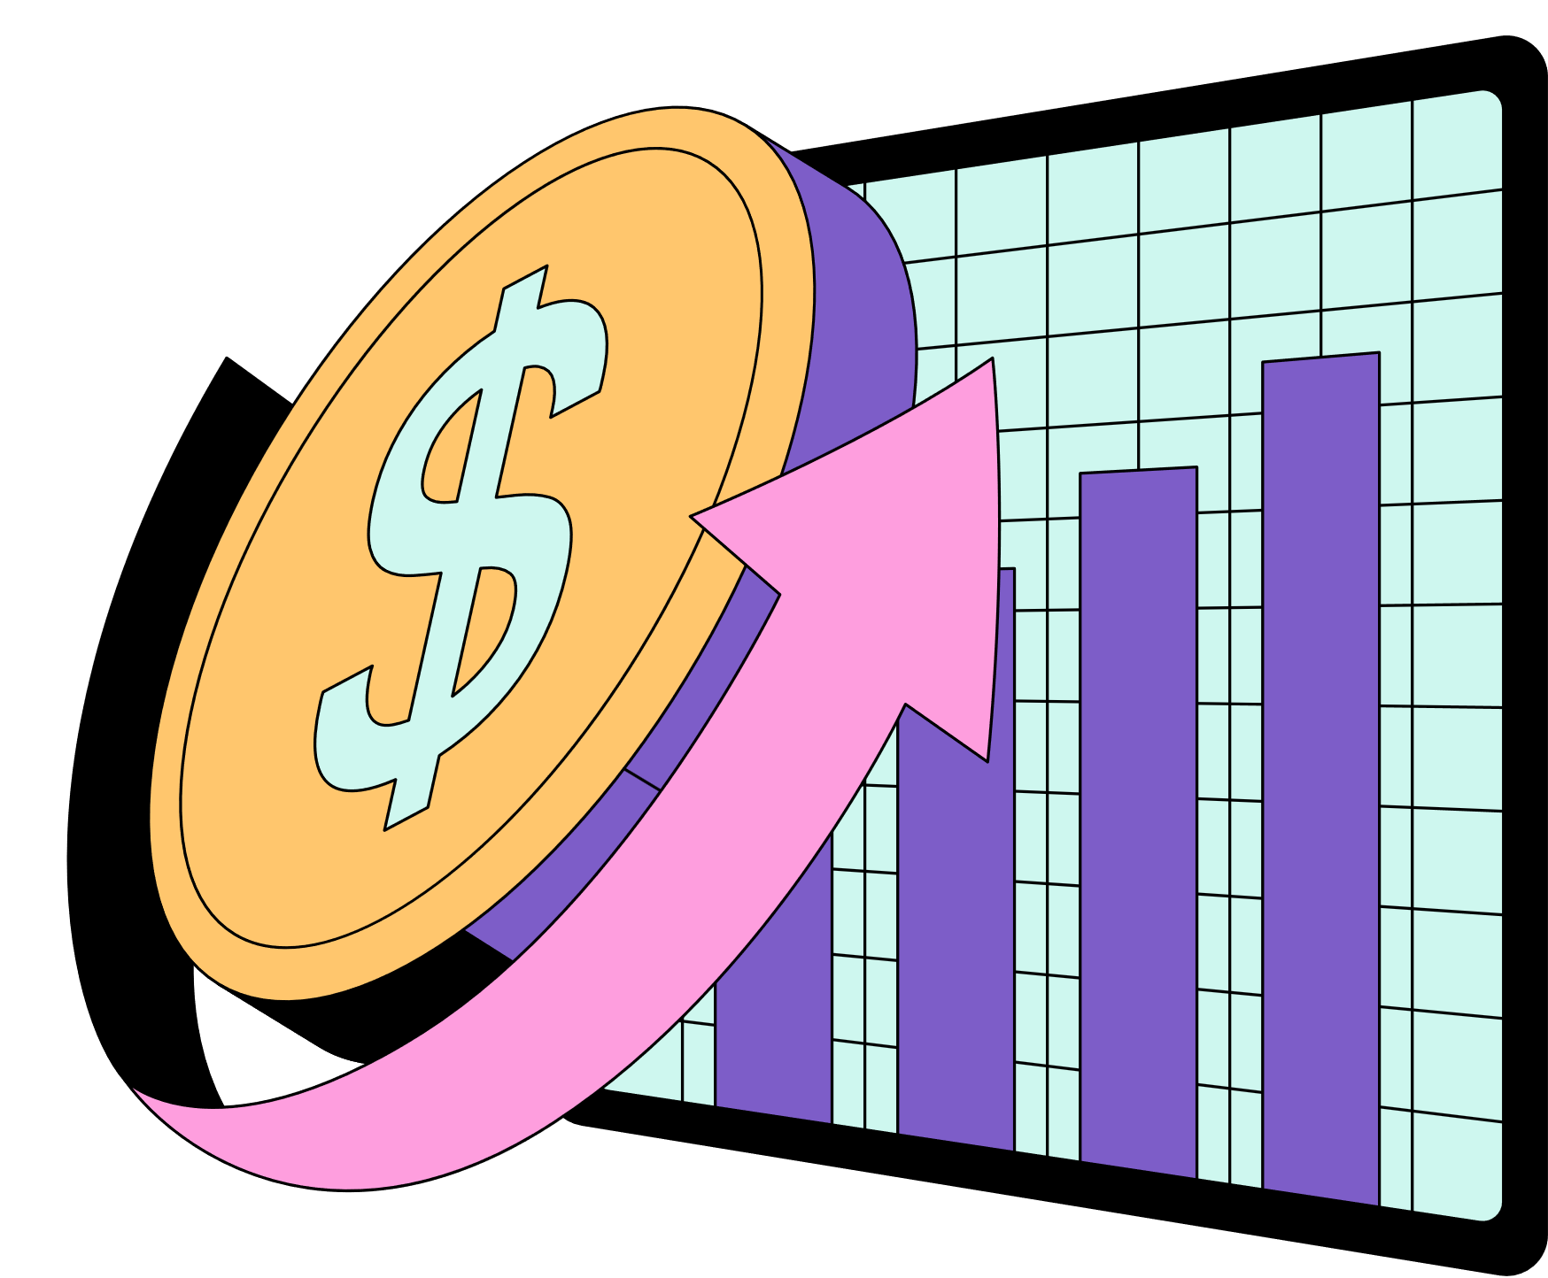
HOME
ABOUT
CONTENT
OTHERS
Final Project Proposal - Data Engineering
IPO Success
Prediction and Analysis Platform
Presented by Peter El Bikai

Slide 2


HOME
ABOUT
CONTENT
OTHERS
Stock Market and IPO
The stock market is a marketplace where buyers and sellers trade shares (small ownership stakes) of publicly listed companies. When you buy a stock, you own a tiny piece of that company and can profit if its value rises.
An IPO is the process by which a private company goes public — offering its shares to the general public for the first time.

Slide 3

HOME
ABOUT
CONTENT
OTHERS
What Problem Are We Solving?
THE PROBLEM
IPO investing is high-risk and data-heavy. Retail investors and analysts lack a unified, data-driven tool to assess whether an IPO will succeed in the short-to-medium term.
OUR SOLUTION
An end-to-end Palantir Foundry pipeline that ingests IPO & market data, trains an ML model to predict IPO success, and surfaces insights through 4 interactive Workshop dashboards.

Slide 4
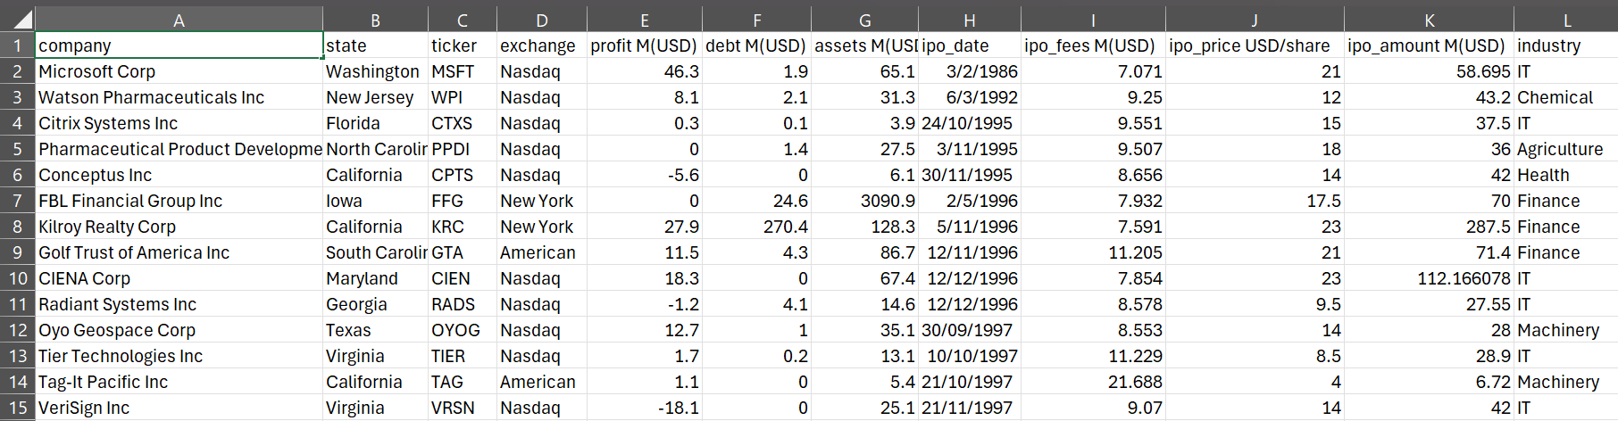
HOME
ABOUT
CONTENT
OTHERS
Datasets
US_IPO_DATA_1986_2021.CSV
CORE TRAINING DATASET — HISTORICAL IPO OUTCOMES
FIELDS: OFFER PRICE, SECTOR, EXCHANGE, TICKER (PK)

Slide 5
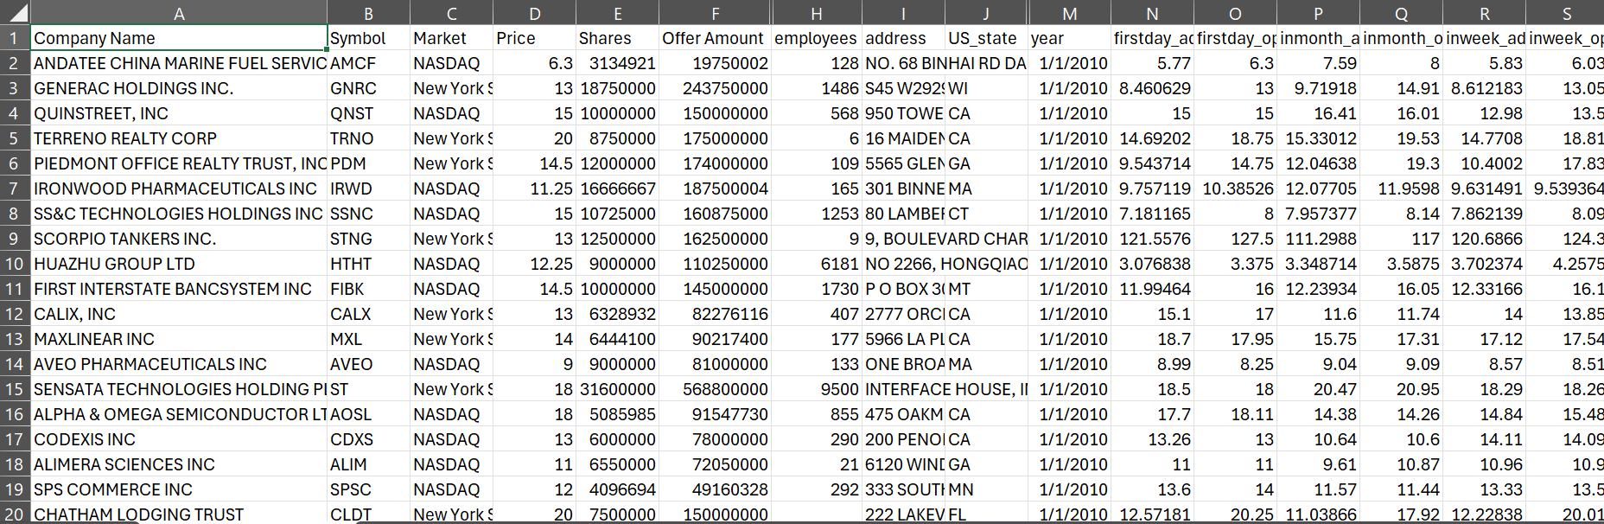
HOME
ABOUT
CONTENT
OTHERS
Datasets
IPO_STOCK_2010_2018_V2.CSV
FIELDS: FIRST DAY/MONTH/YEAR OPEN/CLOSE, SECTOR, EMPLOYEES, CEOPAY

Slide 6
HOME
ABOUT
CONTENT
OTHERS
Datasets
IPO_FULL_ML.CSV
DATASET FOR MACHINE LEARNING
FIELDS: OFFER PRICE, SECTOR, EXCHANGE, TICKER (PK), DAYSBETTERTHANSP
DAYSPROFIT, DAYSPROFITGROUPED, EXACTDIFFERNCE, YEAR, MONTH, DAY, LASTSALE, MARKETCAP, ADR TSO, SECTOR, INDUSTRY, SUMMARY QUOTE
IPODATE, CEOTAKEOVER, CEOAGE, CEONAME, CEOGENDER, CEOINCHARGEDURINGIPO, PRESIDENTTAKEOVER, PRESIDENTAGE, PRESIDENTNAME, PRESIDENTGENDER, PRESIDENTINCHARGEDURINGIPO, CITY,
STATECOUNTRY, FISCALDATEEND, REVENUE, NETINCOME, LASTFISCALYEARGROWTH, EMPLOYEES

Slide 7
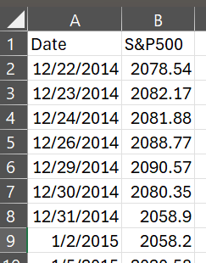
HOME
ABOUT
CONTENT
OTHERS
Datasets
Sp500_index.csv
FIELDS: date/ s&p 500 index

Slide 8
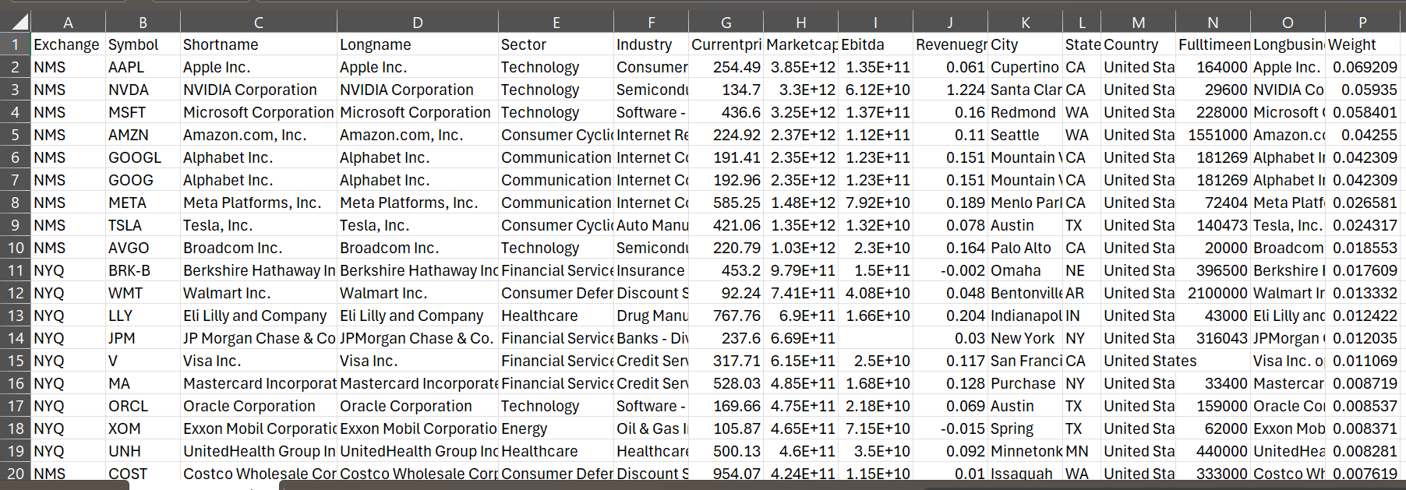
HOME
ABOUT
CONTENT
OTHERS
Datasets
Sp500_companies.csv
FIELDS: exchange, symbol, name, sector/indsutry,, price, marketcap,
earning before interest taxes depreciation amortization, revenue, city, state, country, employees, weight
Notes:
EBITDA stands for Earnings Before Interest, Taxes, Depreciation, and Amortization

Slide 9
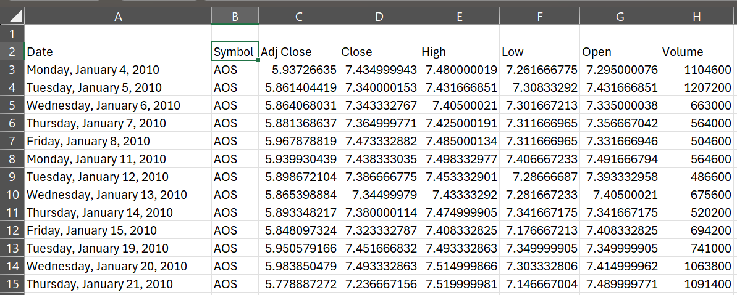
HOME
ABOUT
CONTENT
OTHERS
Datasets
Sp500_stocks.csv
FIELDS: date, symbol, adjusted close, close, high, low, open, volume
Notes:
EBITDA stands for Earnings Before Interest, Taxes, Depreciation, and Amortization

Slide 10
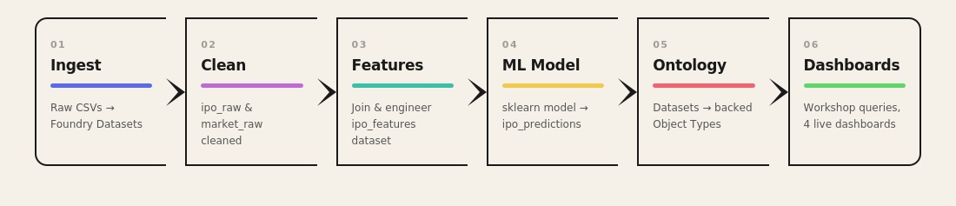
HOME
ABOUT
CONTENT
OTHERS
Foundry Pipeline

Slide 11


HOME
ABOUT
CONTENT
OTHERS
Object Types
IPO Object
company_name, ticker, sector, exchange, offer_price, listing_date,
first_day_return
ML Objective
ipo_id, predicted_outcome,
confidence_score, model_version,
prediction_date
PipelineHealthLog
dataset_name, check_type,
status, null_rate, alert_flag

Slide 12
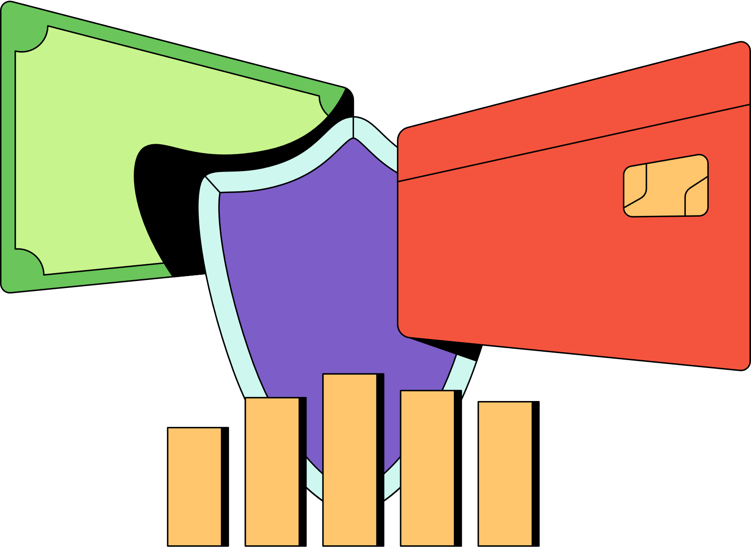
HOME
ABOUT
CONTENT
OTHERS
01 - Market Overview & Historical Analysis
IPO trends by year, sector, and exchange for analysts
02 - ML Prediction Center
Model predictions, confidence scores, and feature importance for data scientists
03 - IPO Deep Dive Explorer
Single-IPO detail view with PDF export for analysts
04 - Pipeline Health Monitor
Health check alerts, null rates, and run history for data engineers
Workshop Dashboards (Ontology)

Slide 13
HOME
ABOUT
CONTENT
OTHERS
Pipeline Schedule
Weekly refresh every Monday (full pipeline rebuild)
Monthly ML model retraining
Health Checks
Null check: flag datasets with null rate above threshold
Row count threshold: alert if output drops unexpectedly
Date freshness: verify latest data is within expected range
Model drift detection: monitor prediction distribution shifts
Scheduling & Health Checks

Slide 14

HOME
ABOUT
CONTENT
OTHERS
Thank You

