Slide 1
IPO Success Prediction
& Analysis Platform
Data Engineering Final Project | Palantir Foundry
Peter El Bikai
inmind.academy | March 26, 2026

Slide 2
Problem & Objective
The Problem
Our Objective
IPO investments are high-risk decisions where retail and institutional investors lack reliable, data-driven tools. Current analysis relies on manual due diligence, subjective judgment, and fragmented data sources that don't scale across hundreds of annual IPOs.
Build an end-to-end IPO Success Prediction Platform on Palantir Foundry that ingests historical IPO and market data, trains binary classifiers to predict post-listing performance, and delivers interactive dashboards for analysts, data scientists, and engineers.
7 Datasets
3 Pipelines
2 ML Models
8 Ontology Objects
4 Dashboards
Kaggle
Scheduled
Pre & Post IPO
Linked
Workshop
Peter El Bikai | inmind.academy | March 26, 2026
2 / 18

Slide 3
Data Sources
IPO Performance Dataset
Historical IPO fundamentals: offer price, market cap, revenue, profit, sector, CEO details
Historical IPO Explorer
US_IPO_Data_1986_2021_enriched
ipo_stock_2010_2018_v2_enriched
S&P 500 Stock Data
Index price of the S&P500, OHLCV price data, company profile data.
Market Analysis
sp500_index
sp500_companies
Sp500_stocks
Machine Learning Dataset
Daily OHLCV price data for IPO, rich data for ML
Prediction Center
IPO_full_ml_worthy
Upcoming IPOs
Company profiles: sector, industry, employees, market cap, revenue growth
Prediction Center
future_ipo_raw
Peter El Bikai | inmind.academy | March 26, 2026
4 / 18

Slide 4
Pipeline Architecture
Ingest
Preprocess
Transform
Cleaned
ML Models
Ontology &
Dashboards
▶
▶
▶
▶
▶
Data ingestion into
raw folder
Type casting
Null handling
Deduplication
Cross-dataset joins
Derived columns Business Logic
Feature Engineering
Model training
Run Inference
8 object types
4 dashboards
114 Variables
Three Parallel Pipelines
IPO Data Ingestion
US_IPO_Data_enriched + ipo_v2_enriched → preprocessed → transformed → cleaned → IPO Object
S&P 500 Pipeline
sp500_stock + companies + index → preprocessed → StockDailyPrice Object +Index Object +Company Object
ML Pipeline
IPO_Full_ML_worthy → training/testing → 2 models → predictions + metrics + feature importance
Peter El Bikai | inmind.academy | March 26, 2026
5 / 18

Slide 5
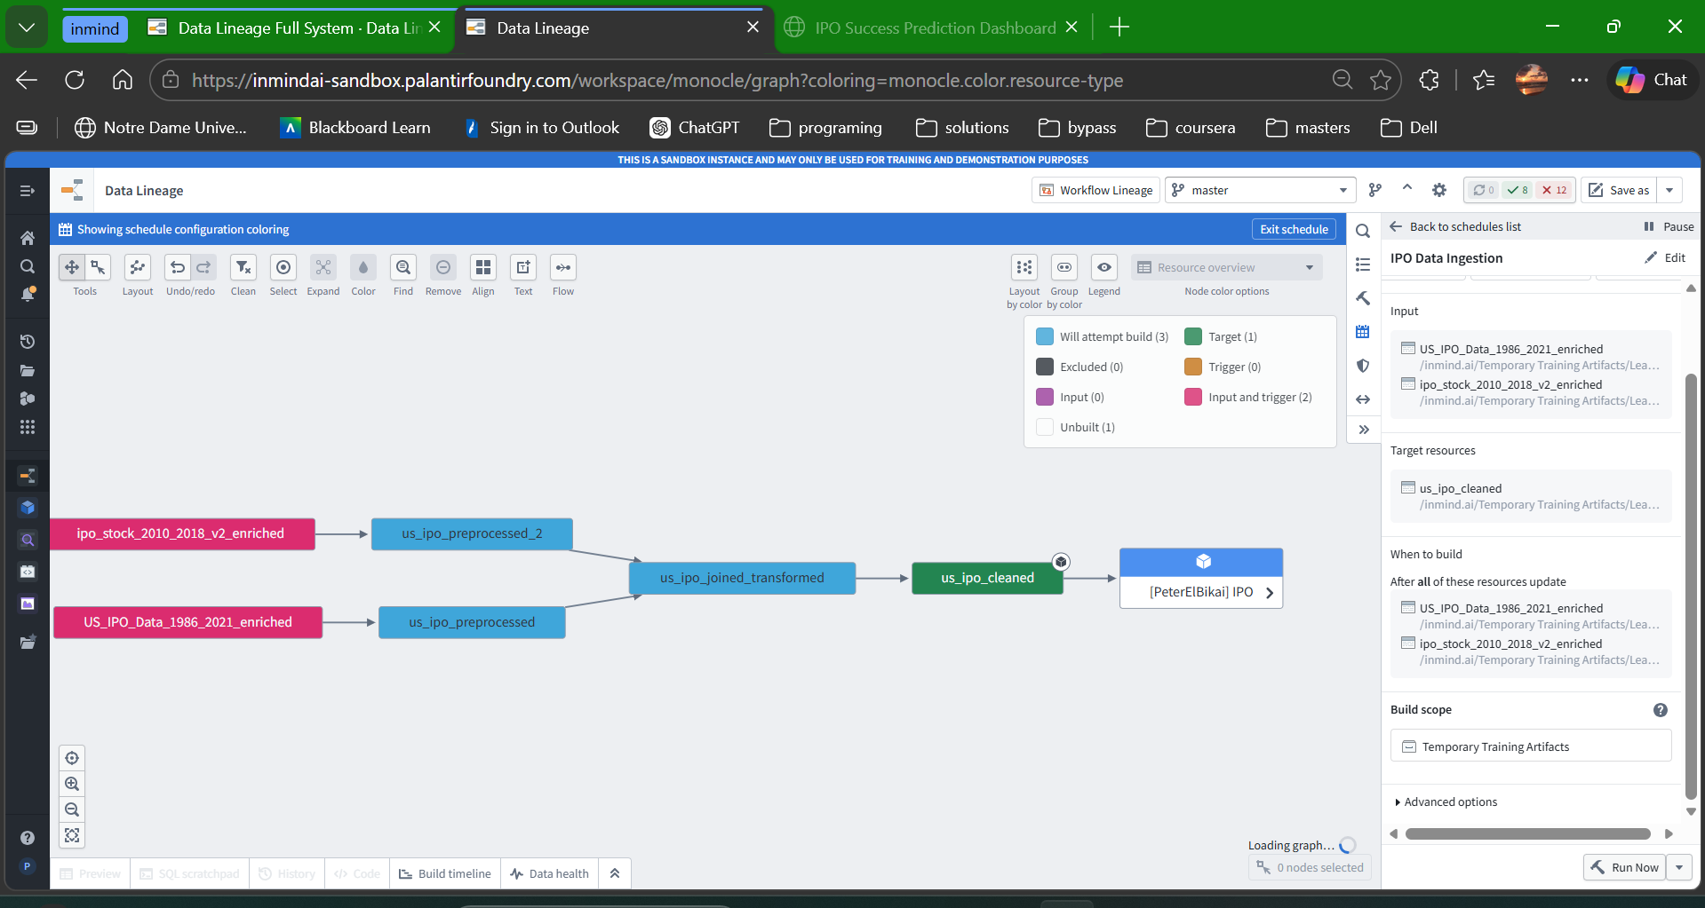
IPO Data Pipeline
🎬 DEMO
Show the IPO Data Ingestion schedule in Data Lineage view
Walk through: ingest → preprocess → join → clean → Ontology object
Key points: 2 input datasets, cross-dataset join on ticker, business validation rules
Peter El Bikai | inmind.academy | March 26, 2026
6 / 18
Notes:
Connecting build because I wanted all datasets in between to build. No weekly schedule because the datasets are static, so updating weekly would waste resources in this case.
Updates when both datasets updates Health Checks: - On schedule: -Schedule duration: Total time a schedule takes to complete
- Schedule status: status of most recent run(no fails)
On input datasets (not included in build of schedule): - Time since last updated
Schema check
Row count
Null percentage on Symbol

Slide 6
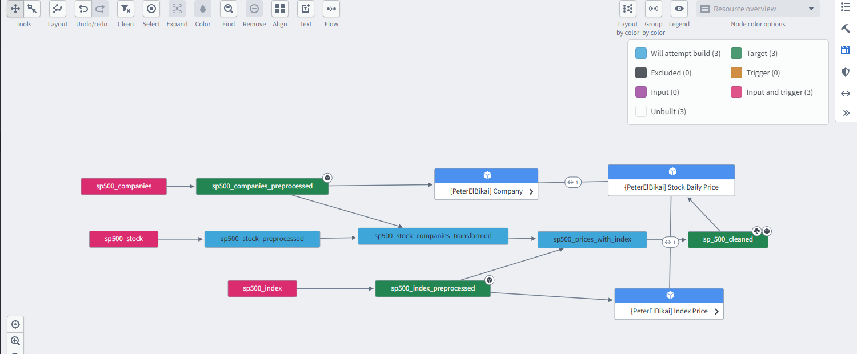
S&P 500 Pipeline
🎬 DEMO
Show the S&P500 Schedule in Data Lineage view
Walk through: 3 inputs → preprocess → join with index → enriched → cleaned
Key points: 3 source datasets, daily_return via Window function, 400K rows / 161 tickers
Peter El Bikai | inmind.academy | March 26, 2026
7 / 18
Notes:
Connecting build because I wanted all datasets in between to build. No weekly schedule because the datasets are static, so updating weekly would waste resources in this case. Updates when all three datasets update Health Checks: - On schedule: -Schedule duration: Total time a schedule takes to complete
- Schedule status: status of most recent run(no fails)
On input datasets (not included in build of schedule): - Time since last updated
Schema check
Row count
Null percentage on Symbol

Slide 7
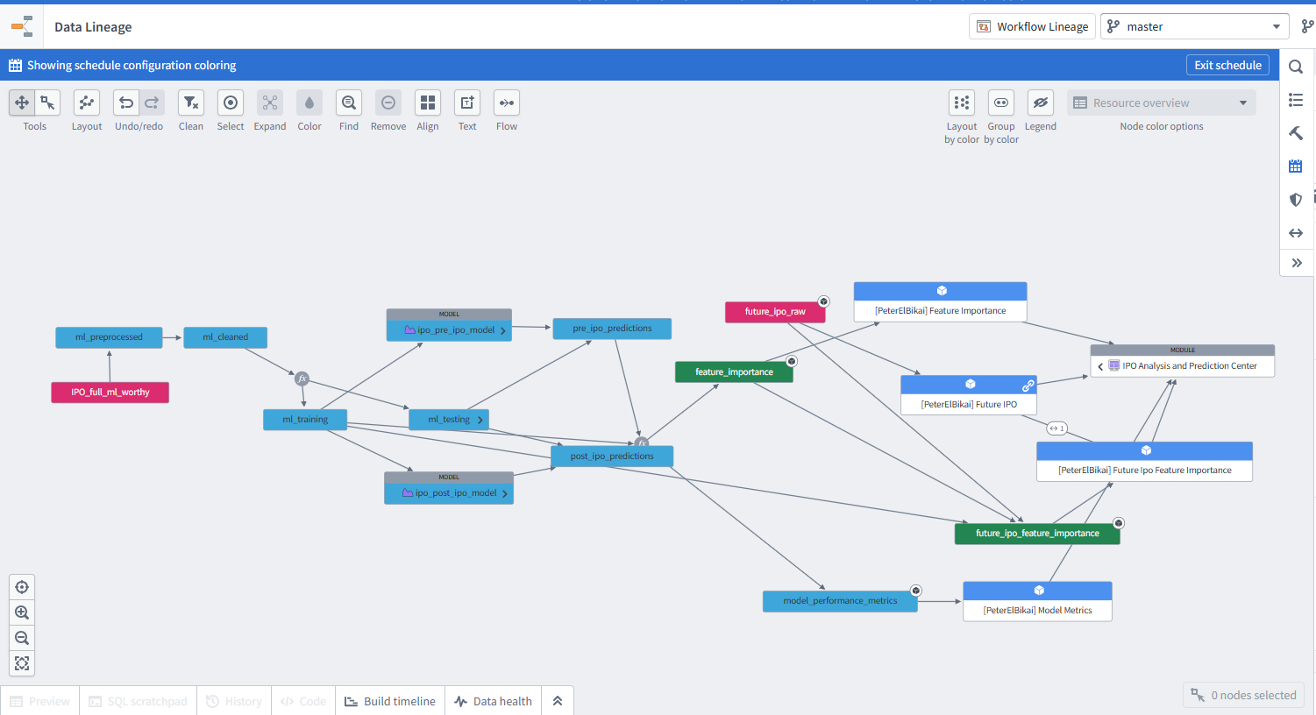
ML Pipeline & Training
🎬 DEMO
Show the ML Pipeline Schedule in Data Lineage
Walk through: IPO_Full_ML_worthy → preprocessed → cleaned → training/testing split
→ pre_ipo_model + post_ipo_model → predictions + metrics + feature importance
Also show: IPO Predictions Modeling Objective with 2 model submissions + Evaluation Dashboard
Peter El Bikai | inmind.academy | March 26, 2026
9 / 18
Notes:
Connecting build because I wanted all datasets in between to build. No weekly schedule because the datasets are static, so updating weekly would waste resources in this case. Updates when one of the two datasets update because if future ipo got added needs to update the object for dashboard
Health Checks: - On schedule: -Schedule duration: Total time a schedule takes to complete
- Schedule status: status of most recent run(no fails)
On input datasets (not included in build of schedule): - Time since last updated
Schema check
Row count
Null percentage on Symbol

Slide 8
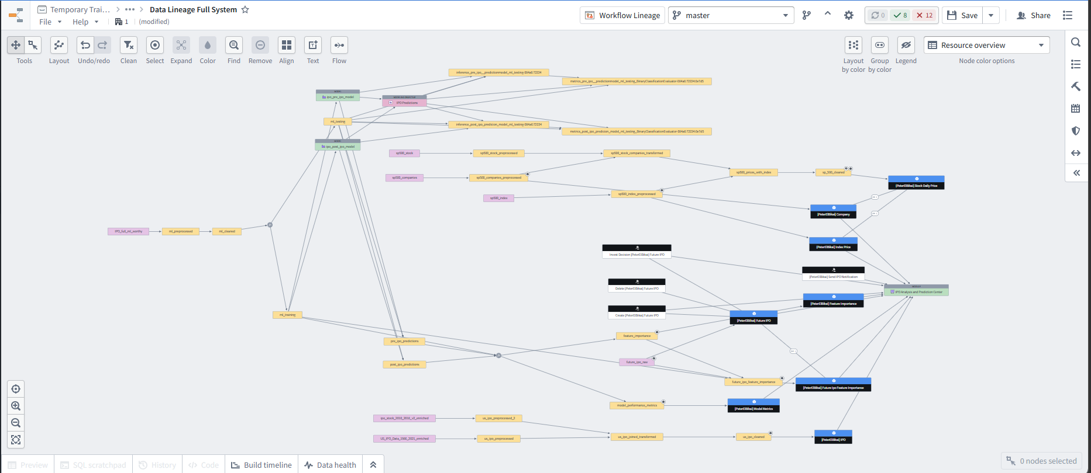
Full Data Lineage
🎬 DEMO
Show the ML Pipeline Schedule in Data Lineage
Walk through: IPO_Full_ML_worthy → preprocessed → cleaned → training/testing split
→ pre_ipo_model + post_ipo_model → predictions + metrics + feature importance
Also show: IPO Predictions Modeling Objective with 2 model submissions + Evaluation Dashboard
Peter El Bikai | inmind.academy | March 26, 2026
9 / 18

Slide 9
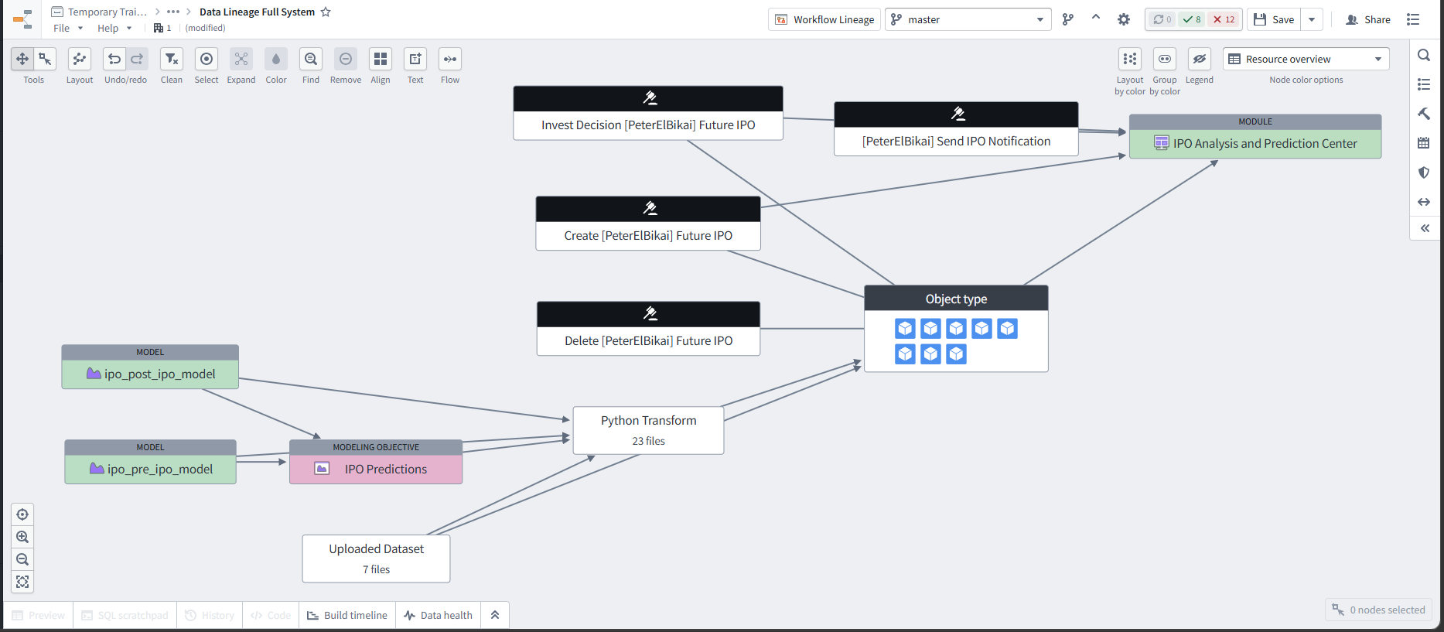
Full Data Lineage
🎬 DEMO
Show the ML Pipeline Schedule in Data Lineage
Walk through: IPO_Full_ML_worthy → preprocessed → cleaned → training/testing split
→ pre_ipo_model + post_ipo_model → predictions + metrics + feature importance
Also show: IPO Predictions Modeling Objective with 2 model submissions + Evaluation Dashboard
Peter El Bikai | inmind.academy | March 26, 2026
9 / 18

Slide 10
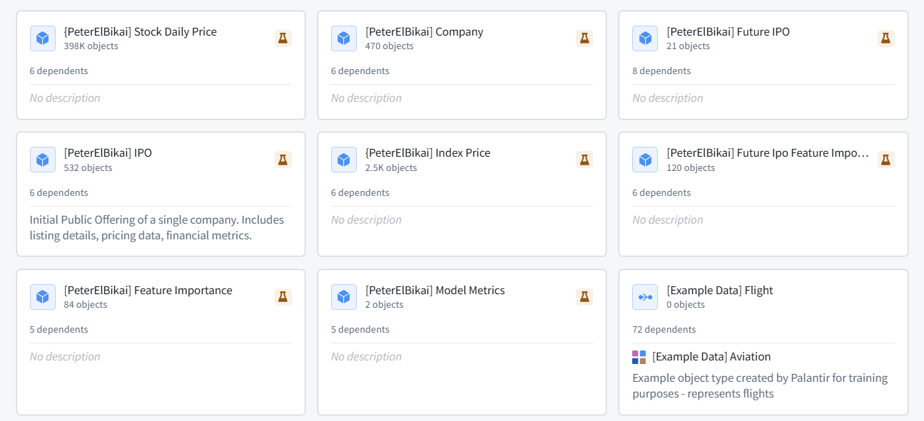
Ontology Objects
Peter El Bikai | inmind.academy | March 26, 2026
12 / 18

Slide 11
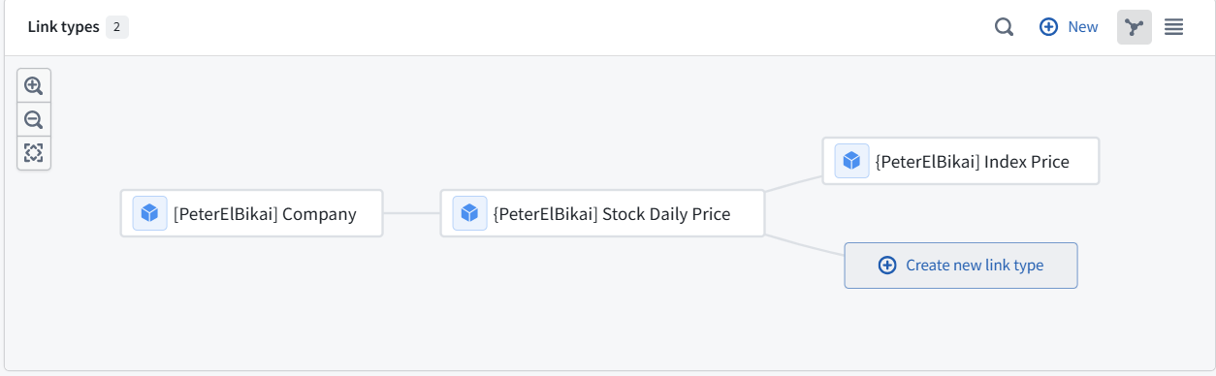
Link types
Company and Stock Daily Price
Stock Daily Price and Index Price
Linked on ticker
Linked on date
Peter El Bikai | inmind.academy | March 26, 2026
12 / 18

Slide 12
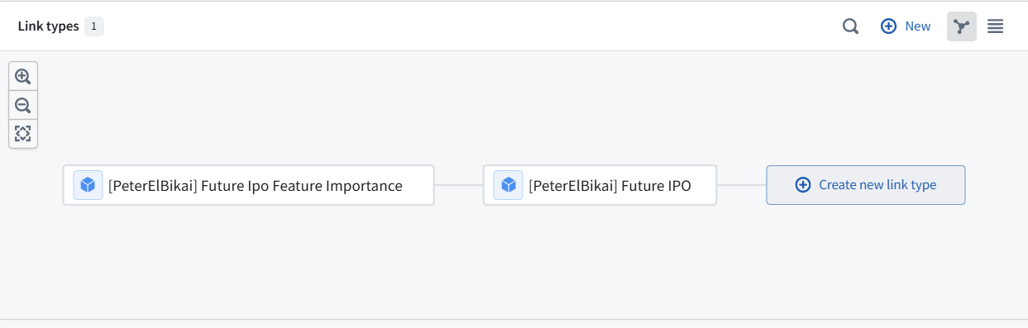
Link types
Future IPO and Future IPO Feature Importance
Linked on ticker
Peter El Bikai | inmind.academy | March 26, 2026
12 / 18

Slide 13




Actions
Peter El Bikai | inmind.academy | March 26, 2026
12 / 18

Slide 14
Dashboard
🎬 DEMO
Peter El Bikai | inmind.academy | March 26, 2026
13 / 18

Slide 15
Thank You
Questions?
Peter El Bikai | inmind.academy | March 26, 2026

