Slide 1
Hello, World!
– Porting GO to ucore.
计83班 陈睿
计83班 方宇剑

Slide 2
Original Schedule
Week 4~5: Get familiar with the experiment environment;
Week 6: Implement the simplest “hello world”;
Week 7: Research on thread scheduling;
Week 8: Flexible;

Slide 3
Exact Progress
Week 4~5: Get familiar with the experiment environment; [on time]
Week 6: Implement the simplest “hello world”; [postponed]
Week 7: Research on thread scheduling; [combined]
Week 8: Flexible; [hello world done]

Slide 4
Maximum Requirements
Linker: copy the one of linux (ELF32);
Package “runtime”:
    Memory allocation
    Local storage segment
    Printing
    Exit
    …
Package “syscall”, “os”...
More OS-specific support;

Slide 5
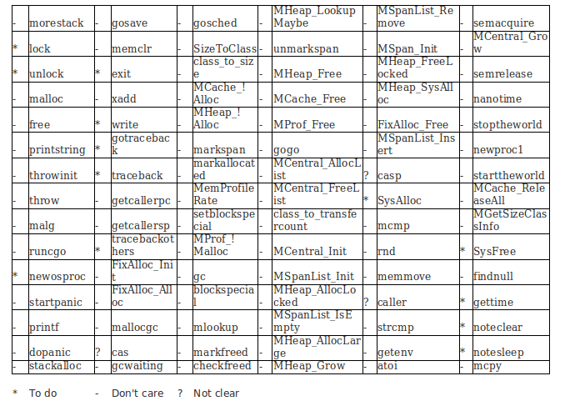
Step1: “hello world” analysis

Slide 6
Step2: maximum working set
.
├── cmd
│ ├── 8l
│ │ ├── asm.c
│ │ ├── doc.go
│ │ ├── obj.c
│ │ └── pass.c
│ ├── cov
│ │ └── Makefile
│ ├── ld
│ │ └── lib.h
│ └── prof
│ └── Makefile
├── Make.inc
└── pkg
├── crypto
│ └── rand
│ └── Makefile
├── debug
│ └── proc
│ ├── proc_ucore.go
│ └── regs_ucore_386.go
├── exec
│ └── Makefile
├── net
│ ├── fd_ucore.go
│ └── Makefile
├── os
│ ├── dir_ucore.go
│ ├── inotify
│ │ ├── inotify_ucore.go
│ │ ├── inotify_ucore_test.go
│ │ └── Makefile
│ ├── Makefile
│ ├── stat_ucore.go
│ └── sys_ucore.go
├── path
│ └── filepath
│ └── Makefile
├── runtime
│ ├── cgo
│ │ └── ucore_386.c
│ └── ucore
│ ├── 386
│ │ ├── defs.h
│ │ ├── rt0.s
│ │ ├── signal.c
│ │ └── sys.s
│ ├── defs1.c
│ ├── defs2.c
│ ├── defs_arm.c
│ ├── defs.c
│ ├── mem.c
│ ├── os.h
│ ├── signals.h
│ └── thread.c
├── syscall
│ ├── asm_ucore_386.s
│ ├── Makefile
│ ├── syscall_ucore_386.go
│ ├── syscall_ucore.go
│ ├── zerrors_ucore_386.go
│ ├── zsyscall_ucore_386.go
│ ├── zsysnum_ucore_386.go
│ └── ztypes_ucore_386.go
└── time
└── Makefile

Slide 7
Step3: cross-compile
Analysis of the GO makefiles' structure;
Strip the OS-dependent sources and package the ucore resources as an independent patch outside the original GO source;
Here ucore resources are simply a carbon copy of the linux implementation;

Slide 8
Step4: minimize working set
Minimize the current working set according to the requirements of the simplest “hello world”;
Focus mainly on package “runtime”, which is the bottom package that could rely on nothing;

Slide 9
Step4: minimize working set
.
├── cmd
│ ├── 8l
│ │ ├── asm.c
│ │ ├── doc.go
│ │ ├── obj.c
│ │ └── pass.c
│ ├── cov
│ │ └── Makefile
│ ├── ld
│ │ └── lib.h
│ └── prof
│ └── Makefile
├── Make.inc
└── pkg
├── crypto
│ └── rand
│ └── Makefile
├── debug
│ └── proc
│ ├── proc_ucore.go
│ └── regs_ucore_386.go
├── exec
│ └── Makefile
├── net
│ ├── fd_ucore.go
│ └── Makefile
├── os
│ ├── dir_ucore.go
│ ├── inotify
│ │ ├── inotify_ucore.go
│ │ ├── inotify_ucore_test.go
│ │ └── Makefile
│ ├── Makefile
│ ├── stat_ucore.go
│ └── sys_ucore.go
├── path
│ └── filepath
│ └── Makefile
├── runtime
│ ├── cgo
│ │ └── ucore_386.c
│ └── ucore
│ ├── 386
│ │ ├── defs.h
│ │ ├── rt0.s
│ │ ├── signal.c
│ │ └── sys.s
│ ├── defs1.c
│ ├── defs2.c
│ ├── defs_arm.c
│ ├── defs.c
│ ├── mem.c
│ ├── os.h
│ ├── signals.h
│ └── thread.c
├── syscall
│ ├── asm_ucore_386.s
│ ├── Makefile
│ ├── syscall_ucore_386.go
│ ├── syscall_ucore.go
│ ├── zerrors_ucore_386.go
│ ├── zsyscall_ucore_386.go
│ ├── zsysnum_ucore_386.go
│ └── ztypes_ucore_386.go
└── time
└── Makefile

Slide 10
Step5: Setting fake LDT
runtime·setldt: spare a new GDTe for GO;
In tiny mode, a GDTe is used as a LDTe, and we decided to do the same thing for the moment;

Slide 11
Step6: Something relatively simple
runtime·exit
runtime·write (two revisions), setting stderr to stdout: now we can throw runtime error info and exit;
runtime·rt_sigaction

Slide 12
Step7: Memory map
Three kinds of mapping:
    runtime·SysAlloc: anywhere;
    runtime·SysReserve: right after text & data segment, 768MB reserved;
    runtime·SysMap: map area that has been reserved in runtime·SysReserve;
Zeroize;
COW: fixed during zeroization;

Slide 13
Problem1: TLS offset
Thread local storage requires that 0(GS) and 4(GS) actually referring to -8(GS) and -4(GS);
In GO, tls_offset should be set correctly for a specific OS;

Slide 14
Problem2: set_ldt
Solved for the moment using a fake LDTe;

Slide 15
Problem3: cross-compiling
GO uses the environment constant GOOS to decide the compiling target and the compiler compiling target.
First try: full OS-dependent source;
    Compiler compiling fail;
    Impossible to make modifications;

Slide 16
Problem3: cross-compiling
Solved using part-compiling;
Part-compiling: compile with GOOS unset (default to the current OS), and part-recompile the OS-dependent package;

Slide 17
Problem4: the so-called “hint”
sys_mmap's requested address is usually regarded as a “hint”;
runtime·SysReserve: the 768MB reserved area is a LITTLE coincident with the data segment;
    Killed by the original ucore;

Slide 18
Problem4: the so-called “hint”
second chance: find it with the hint;
get_unmapped_area_with_hint(): looks for the suitable place forwards instead of backwards, starting from the requested address;
Even linux would not always care about the hint... Time for us to cry.

Slide 19
Problem5: reserving mapping
Difference between runtime·SysReserve and runtime·SysAlloc;
    Fault in original ucore;
Temporary solution: direct return when runtime·SysAlloc is called;

Slide 20
Problem6: argc, argv...
Process arguments;
    Unix-like: followed by all the envirment constants ended with a null,
Manually disable probing environment constants for GO (ucore);

Slide 21
What's next?
Current implementation is not that elegant, for example,
    Direct return of runtime·SysMap;
    Multiple LDTe...
    Frequent call to putc;
    mmap flag ignored;
An advanced “hello world”
    Package “fmt”;
        Package “syscall”;
        Package “os”;
        ...

Slide 22
What's next?
More is to be implemented based on thread scheduling, such as futex (mutex in ucore), lock & unlock mechanism, clone (for creating a new thread) etc.;

Slide 23
What can be tough?
Go: Some signal handlers replaced;
    Request for more stack at the stack overflow time;
    …
    We may need to implement signal;
We have not found TLS in ucore, but it is likely to be a must for GO;

Slide 24
What can be tough?
We have not compared ucore mutex with the futex GO will be using; the same situation goes for lock & unlock;
Clone;
Dynamic or not?
    runtime·iscgo

Slide 25

Thanks!

