Slide 1
Hello, Hello,
World! World!
– Porting GO to ucore.
计83班 陈睿
计83班 方宇剑

Slide 2
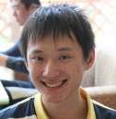
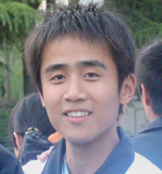
陈睿
方宇剑
Analysis of the program “Hello world”;
Set up GDB debugging environment;
Get to know the basic porting requirements;

Slide 3
陈睿
方宇剑
Research on syscalls to be implemented;
Confirm the maximum working set;
Set up experiment environment and succeed in cross-compiling. Extract the os-dependent package;

Slide 4
陈睿
方宇剑
Tool chain: a python script;
runtime·exit1: exit the current os thread;
Minimize working set;
Tool chain: a shell script;
runtime·setldt: fake ldt entries;

Slide 5
陈睿
方宇剑
Fix some bug in runtime·write: stderr, etc;
runtime·
rt_sigaction: set to a direct return;
runtime·write: repeated calls to putc();

Slide 6
陈睿
方宇剑
runtime·mmap implementation;
Disable environment constants and starting-up arguments;
runtime·mmap implementation: the “with hint” version;

Slide 7
陈睿
方宇剑
“Hello, world!”
“Hello, world!”

Slide 8
陈睿
方宇剑
Read through Go specifications;
Advanced hello world: using “fmt” package. “fmt” is os-independent -> “syscall” package;
Read through Go specifications;
peter.go: a program used for thread test;

Slide 9
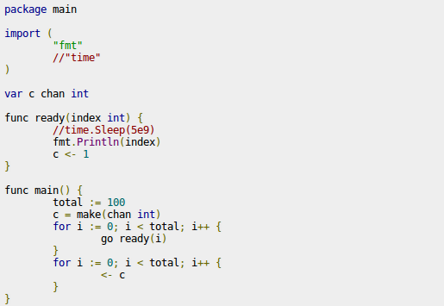
peter.go

Slide 10
陈睿
方宇剑
Clone: return pid as tid;
Research on goroutines in Linux;
Clone: return pid as tid;

Slide 11
陈睿
方宇剑
Attempts on semaphore: cause ucore to “reboot”;
Updated version of the shell script: originates from the one used for a demo.

Slide 12
demo.sh
-ng: disables the entire compiling of the Go compiler;
-nre: disables the part-recompile of our packages (those lie in patch);
-ntest: disables the compiling of the whole testsuit;
Recursively compile all test cases;
Automatically detect Makefile;
Automatically generate testall.sh under each folder, which will be used in ucore;

Slide 13
陈睿
方宇剑
Semaphore again: the nextm problem;
Semaphore again: we are pretty sure the semaphore is set correctly, but still not working;

Slide 14
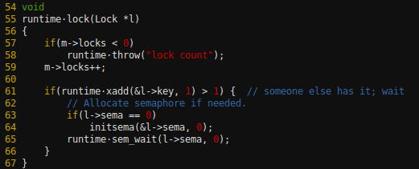
Lock/Unlock in Go
The user-mode lock/unlock:

Slide 15
陈睿
方宇剑
Stuck in gcc 4.6 bootblock size;
sleep: replace the former one using select;
A user-leveled simulator: semtest5.c

Slide 16
陈睿
方宇剑
The Println problem: it's not.
Finally focus on the gs: ucore would not store/restore fs/gs! This would cause an unexpected running stream;
Add fs/gs swap, problem solved;
The Println problem: it's not.

Slide 17
陈睿
方宇剑
Succeed in compiling ucore bootblock with gcc 4.6
exit_group: exit all threads attached with the current os thread. Two attempts;

Slide 18
陈睿
方宇剑
Testsuit;
Testsuit;
Environment constant: now contains “GOARCH=386”, which is used for env.go;

Slide 19
Testsuit categories
Compiler test: expected compiling error, tested and excluded;
Linked test: provided for other test cases, normally requires Makefile;
Generator test: used to generate another go file. Replaced;
The rest: listed in testall.sh, should be tested in ucore. Panic on error (except for the panic test, see wiki);

Slide 20
To be done
Signal!
We have looked through the whole runtime package, which is the base of the GO world, and signal is the only one that has not been implemented;

Slide 21
Thanks!

