Slide 1

We are Chewbacca
Peter, Fede & Anja
Our Analysis Process

Slide 2
Start Group Work
Friday
Create a Repo in Github
Fork and clone that
Put the files and the instruction in it

Slide 3
Monday
Start our group work
What we want show-> An overview about 3 cities
Decision about where the most Data Specialists work
Our Hypothesis: In Seattle work less Specialist than in New York or San Francisco.
For our work:
we share the jupyter notebook on Zoom

Slide 4
Start Group Work
Look into the file
Columns
Name of the columns ok
Rows
Columns Location and Position are important
Filtered by position
Data Scientist
Data Analyst
Create new subsets
For example
file_scientist=file_all[file_all['position'].
str.contains('Scient')==True]
Add a new column jobname with the value "Data Scientist"
file_scientist"jobname"]="Data Scientist"
Same again for the Data Analyst

Slide 5
Start Group Work
Rows
Filtered by location
New York
San Francisco
Seattle
Create new subsets for each city
For excample
file_scientist_NY=file_scientist[file_scientist['location'].str.contains('New')==True]
Add a new column city with the value "New York"
file_scientist_NY["city"]="New York"
The same for the cities San Fancisco and Seattle and for the Data Analyst Subset too

Slide 6
Start Group Work
All subsets merged to one finale file
finale file
final = pd.concat([file_scientist_NY,file_scientist_SF, file_scientist_SEA, file_analyst_NY, file_analyst_SF, file_analyst_SEA], axis=0)

Slide 7
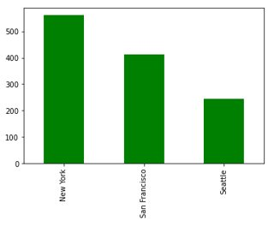
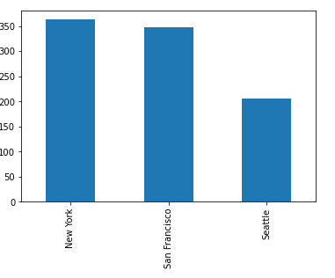
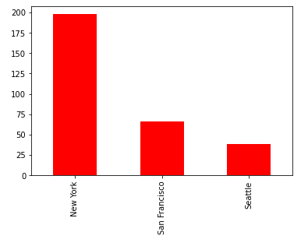



Our Results
Data Scientist and Data Analyst together in the cities
Data Scientist and Data Analyst (separate) in the cities
Data Scientist
Data Analyst

