Slide 1
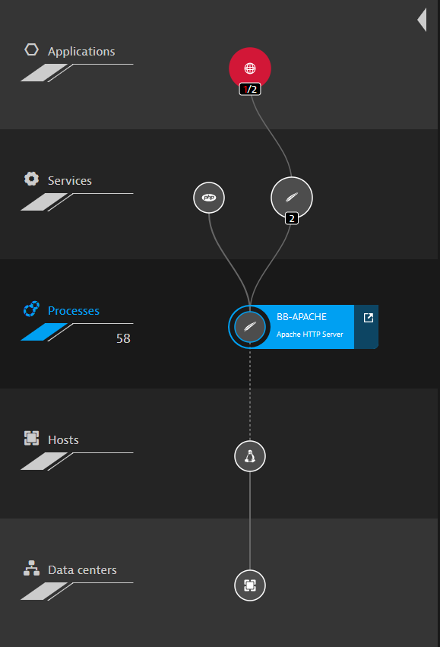
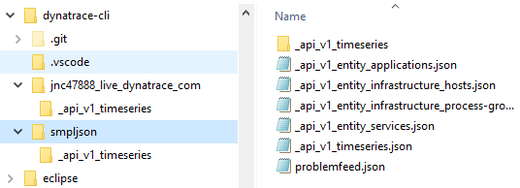
1
Read configuration from dtconfig.json
2
If using cache and current data is in cache read it from there
3
Use Dynatrace API to query data from LIVE environment
4
Persist latest query in cache
5
Perform CLI logic on data and return result to user
py dtcli.py ent app www.easytravel.com
5
3
1
2
4
dtconfig.json
apitoken
tenanturl
cacheupdate

Slide 2
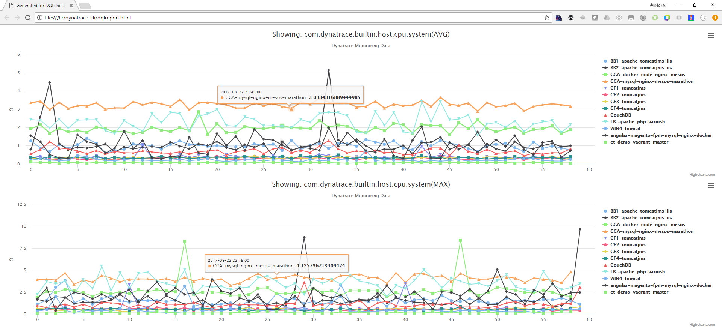
> py dtcli.py dqlr host tags/AWS:Name=et-demo.* host.cpu.system[max%hour],host.cpu.system[avg%hour]

Slide 3
> py dtcli.py dqlr srv tags/build=tmp57 responseTime[avg%hour],service.cpu[avg%hour]

