Slide 1

7 STL Vector: Mutiset
Peter H. Chen

Slide 2
7 STL Vector: Mutiset
https://www.youtube.com/watch?v=xxA2QjKj73w&list=PLk6CEY9XxSIA-xo3HRYC3M0Aitzdut7AA&index=7
STL Vector: Multiset
We can have duplicate objects in set.
1. List: different order are not equal
(list 1 2 3 2) != (list 2 1 3 2)
2. Multiset: different order are equal
(multiset 1 2 2 3) == (multiset 2 1 3 2)

Slide 3
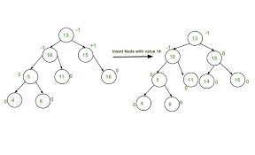
7 STL Vector: Mutiset
AVL (Adelson-Velskii and Landis) Tree:
A tree an AVL tree is a self-balancing Binary Search tree (BST).
If each node of the tree possesses one of the following properties:
A node is called left heavy if the longest path in its left subtree is one longer than the longest path of its right subtree.
https://www.youtube.com/watch?v=xxA2QjKj73w&list=PLk6CEY9XxSIA-xo3HRYC3M0Aitzdut7AA&index=7
STL Vector: Multiset
AVL Tree will be Self-Balance

Slide 4
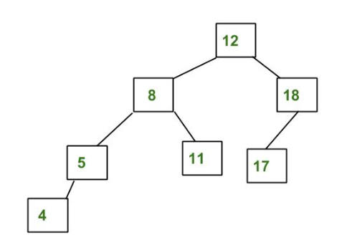
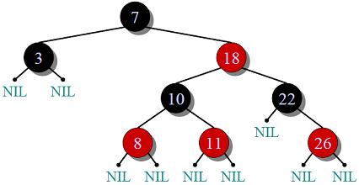
7 STL Vector: Mutiset
https://www.youtube.com/watch?v=xxA2QjKj73w&list=PLk6CEY9XxSIA-xo3HRYC3M0Aitzdut7AA&index=7
STL Vector: Multiset
a red–black tree is a less self-balancing binary search tree. Each node stores an extra bit representing "color" ("red" or "black")
AVL Tree is a more restricted Self-Balance Tree.

Slide 5
7 STL Vector: Mutiset
https://www.youtube.com/watch?v=xxA2QjKj73w&list=PLk6CEY9XxSIA-xo3HRYC3M0Aitzdut7AA&index=7
STL Vector: Multiset
When you insert a element into red-block tree, you have to compare one object to another object.
Insert object Person:
Age
Name
BST: Binary Search Tree

Slide 6
7 STL Vector: Mutiset
https://www.youtube.com/watch?v=xxA2QjKj73w&list=PLk6CEY9XxSIA-xo3HRYC3M0Aitzdut7AA&index=7
STL Vector: Multiset
Insert one object: one by one
When we print out, the order are sorted.

Slide 7
7 STL Vector: Mutiset
https://www.youtube.com/watch?v=xxA2QjKj73w&list=PLk6CEY9XxSIA-xo3HRYC3M0Aitzdut7AA&index=7
STL Vector: Multiset
When we print out, the order are sorted.
Insert one object: one by one

Slide 8
7 STL Vector: Mutiset
https://www.youtube.com/watch?v=xxA2QjKj73w&list=PLk6CEY9XxSIA-xo3HRYC3M0Aitzdut7AA&index=7
STL Vector: Multiset
Insert one object: default
Insert one object: less
Insert one object: greater

Slide 9
7 STL Vector: Mutiset
https://www.youtube.com/watch?v=xxA2QjKj73w&list=PLk6CEY9XxSIA-xo3HRYC3M0Aitzdut7AA&index=7
STL Vector: Multiset
Define Data Structure.
Note:
1. Insert Descending (greater) object.
Multiset internally loop through the existing database.
2. We need to provide the “bool operator > (passing in data structure) { return comparison criteria for object}”
Traverse to print out.

Slide 10
End

