Slide 1

31 STL: Iterator
Peter H. Chen

Slide 2
31 STL: Iterator
https://www.youtube.com/watch?v=EgVWWVZ6AEY
Iterator
Iterators are used to point at the memory address of STL containers.
Iterators are primarily used in the sequence of number, characters, and etc.
Iterators reduce the complexity and execution time of a program.

Slide 3
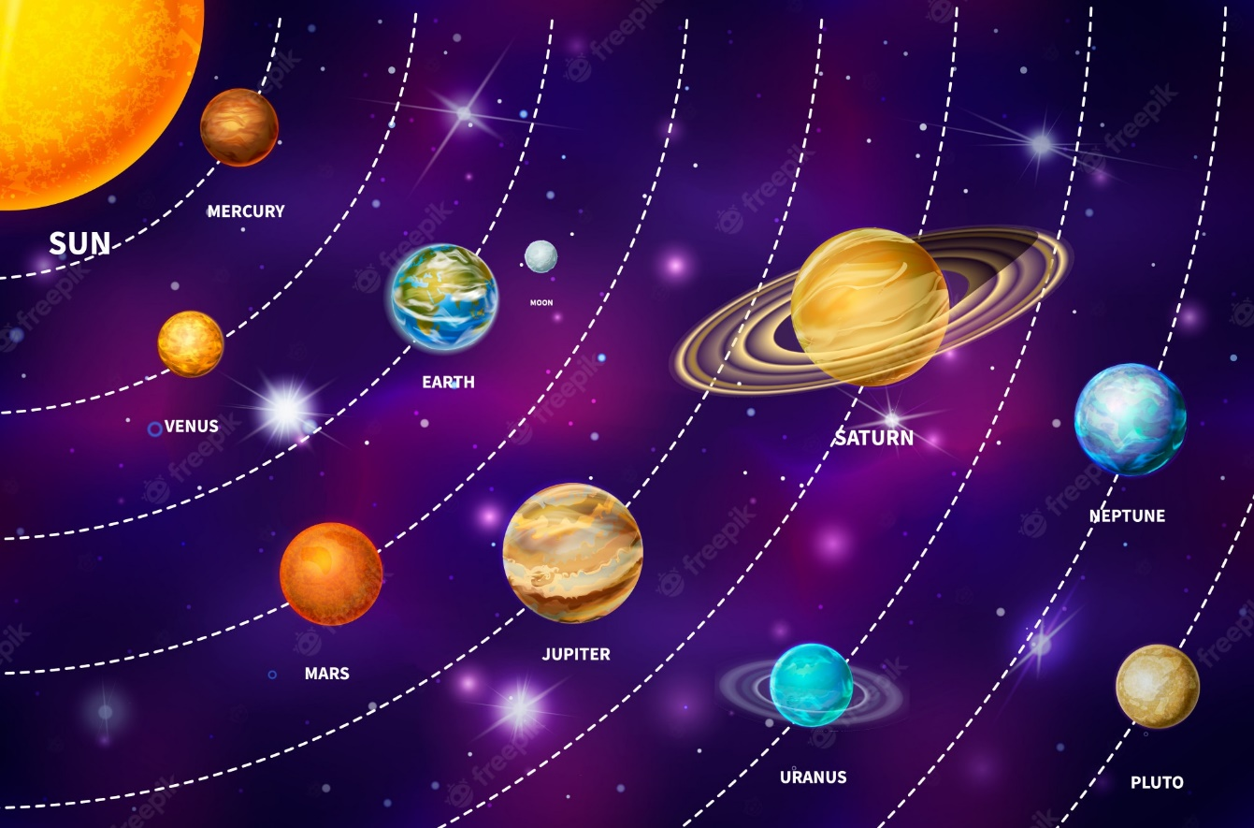
31 STL: Iterator
https://www.youtube.com/watch?v=EgVWWVZ6AEY
Iterator
Create vector planets.
Loop through the vector Planets.

Slide 4
31 STL: Iterator
https://www.youtube.com/watch?v=EgVWWVZ6AEY
Iterator
1. Index Looping
2. Range-based Looping
3. Iterator Looping
1
2
3

Slide 5
31 STL: Iterator
https://www.youtube.com/watch?v=EgVWWVZ6AEY
Iterator Result

Slide 6
End

