Slide 1

022_01 Bubble Sort: C
Peter H. Chen

Slide 2
022_01 Bubble Sort: C
https://www.tutorialspoint.com/data_structures_algorithms/bubble_sort_algorithm.htm
Hash Table: C
Bubble sort is a simple sorting algorithm.
This sorting algorithm is comparison-based algorithm in which each pair of adjacent elements is compared, and the elements are swapped if they are not in order.
This algorithm is not suitable for large data sets as its average and worst-case complexity are of Ο(n²) where n is the number of items.

Slide 3
022_01.1 How Bubble Sort Works?

Slide 4


022_01.1 How Bubble Sort Works?
https://www.tutorialspoint.com/data_structures_algorithms/bubble_sort_algorithm.htm
How Bubble Sort Work?
We take an unsorted array for our example.
Bubble sort takes Ο(n²) time so we're keeping it short and precise.
Bubble sort starts with very first two elements, comparing them to check which one is greater.

Slide 5


022_01.1 How Bubble Sort Works?
https://www.tutorialspoint.com/data_structures_algorithms/bubble_sort_algorithm.htm
How Bubble Sort Work?
In this case, value 33 is greater than 14, so it is already in sorted locations.
Next, we compare 33 with 27.
We find that 27 is smaller than 33 and these two values must be swapped.

Slide 6


022_01.1 How Bubble Sort Works?
https://www.tutorialspoint.com/data_structures_algorithms/bubble_sort_algorithm.htm
How Bubble Sort Work?
The new array should look like this
Next, we compare 33 and 35. We find that both are in already sorted positions.

Slide 7


022_01.1 How Bubble Sort Works?
https://www.tutorialspoint.com/data_structures_algorithms/bubble_sort_algorithm.htm
How Bubble Sort Work?
Then we move to the next two values, 35 and 10.
We know then that 10 is smaller 35.
Hence, they are not sorted.

Slide 8


022_01.1 How Bubble Sort Works?
https://www.tutorialspoint.com/data_structures_algorithms/bubble_sort_algorithm.htm
How Bubble Sort Work?
We swap these values.
We find that we have reached the end of the array.
After one iteration, the array should look like this
To be precise, we are now showing how an array should look like after each iteration.
After the second iteration, it should look like this.

Slide 9


022_01.1 How Bubble Sort Works?
https://www.tutorialspoint.com/data_structures_algorithms/bubble_sort_algorithm.htm
How Bubble Sort Work?
Notice that after each iteration, at least one value moves at the end.
And when there's no swap required, bubble sorts learns that an array is completely sorted.
Now, we should look into some practical aspects of bubble sort.

Slide 10
022_01.2 Bubble Sort Pseudo Code

Slide 11
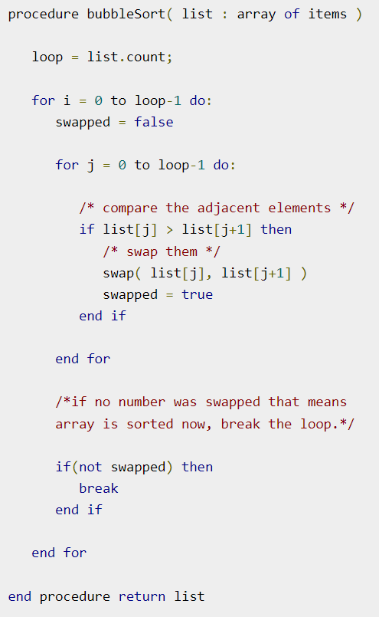
022_01.2 Bubble Sort Pseudo Code
https://www.tutorialspoint.com/data_structures_algorithms/bubble_sort_algorithm.htm
Bubble Sort Pseudo Code

Slide 12
022_01.3 Bubble Sort: C Code

Slide 13
022_01.3 Bubble Sort: C Code
https://www.tutorialspoint.com/data_structures_algorithms/bubble_sort_program_in_c.htm
Bubble Sort: C Code
One more issue we did not address in our original algorithm and its improvised pseudocode, is that, after every iteration the highest values settles down at the end of the array.
Note: j iterate from 0 to (Max - j – i) // each time i = 0, 1, 2, …
Hence, the next iteration need not include already sorted elements.
For this purpose, in our implementation, we restrict the inner loop to avoid already sorted values.

Slide 14
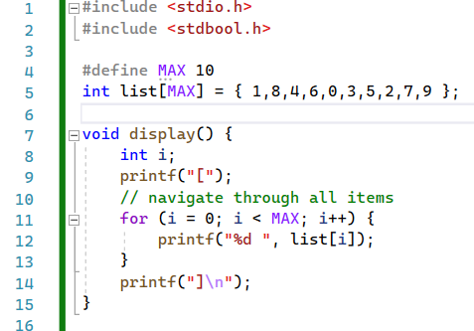
022_01.3 Bubble Sort: C Code
https://www.tutorialspoint.com/data_structures_algorithms/bubble_sort_program_in_c.htm
Bubble Sort: C Code
Define and display()

Slide 15
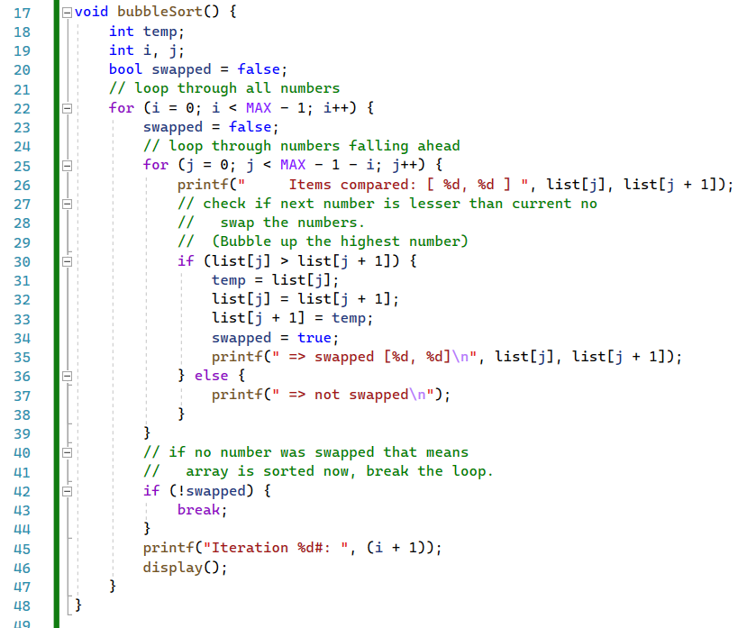
022_01.3 Bubble Sort: C Code
https://www.tutorialspoint.com/data_structures_algorithms/bubble_sort_program_in_c.htm
Bubble Sort: C Code
bubble_sort ()

Slide 16
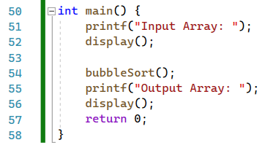
022_01.3 Bubble Sort: C Code
https://www.tutorialspoint.com/data_structures_algorithms/bubble_sort_program_in_c.htm
Bubble Sort: C Code
main ()

Slide 17
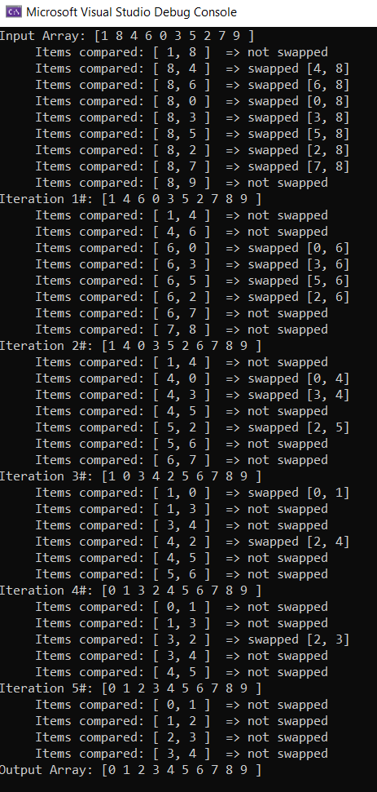
022_01.3 Bubble Sort: C Code
https://www.tutorialspoint.com/data_structures_algorithms/bubble_sort_program_in_c.htm
Bubble Sort: C Code
Note: j iterate from 0 to (Max - j – i) // each time i = 0, 1, 2, …

Slide 18
End

