Slide 1

022_02 Bubble Sort: STL
Peter H. Chen

Slide 2
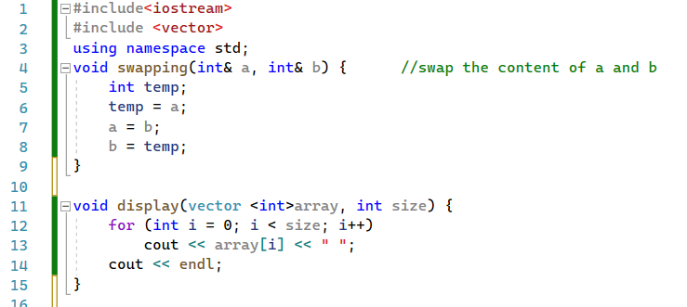
022_02 Bubble Sort: STL
https://www.tutorialspoint.com/cplusplus-program-to-implement-bubble-sort
Bubble Sort: STL
swapping() and display()

Slide 3
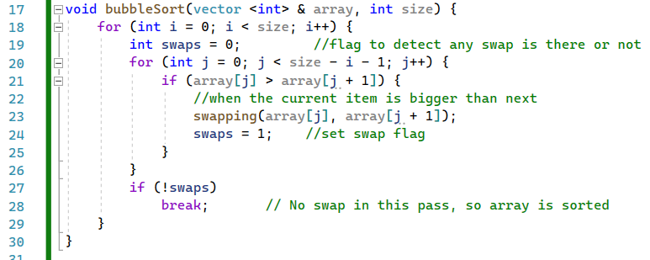
022_02 Bubble Sort: STL
https://www.tutorialspoint.com/cplusplus-program-to-implement-bubble-sort
Bubble Sort: STL
bubbleSort()

Slide 4
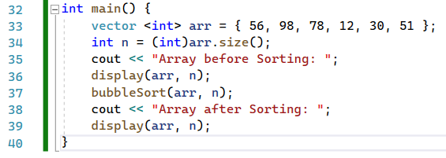
022_02 Bubble Sort: STL
https://www.tutorialspoint.com/cplusplus-program-to-implement-bubble-sort
Bubble Sort: STL
main()

Slide 5

022_02 Bubble Sort: STL
https://www.tutorialspoint.com/cplusplus-program-to-implement-bubble-sort
Bubble Sort: STL
Result

Slide 6
End

