Slide 1

035_03 Spanning Tree: STL
Peter H. Chen

Slide 2
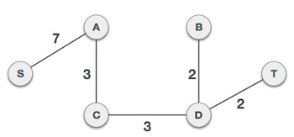
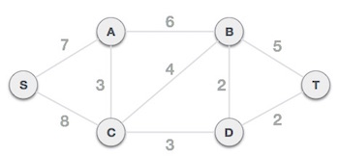
035_03 Prim’s Algorithm
https://www.geeksforgeeks.org/prims-minimum-spanning-tree-mst-greedy-algo-5/
Prim’s Algorithm
Like Kruskal’s algorithm, Prim’s algorithm is also a Greedy algorithm.
Prim’s algorithm always starts with a single node, and it moves through several adjacent nodes, in order to explore all the connected edges along the way.
(Minimum Spanning Tree)

Slide 3
035_03 Prim’s Algorithm
https://www.geeksforgeeks.org/prims-minimum-spanning-tree-mst-greedy-algo-5/
Prim’s Algorithm
Prim’s starts with an empty spanning tree.
The idea is to maintain two sets of vertices.
The first set contains the vertices already included in the MST; the other set contains the vertices not yet included.
At every step, it considers all the edges that connect the two sets and picks the minimum weight edge from these edges.
After picking the edge, it moves the other endpoint of the edge to the set containing MST.
(Minimum Spanning Tree)

Slide 4
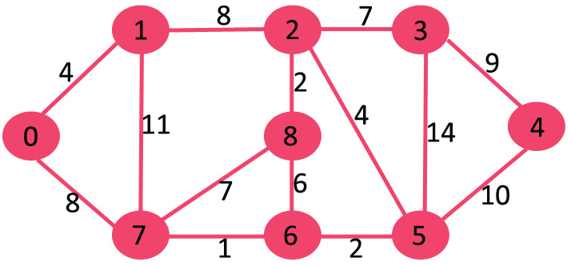
035_03 Prim’s Algorithm
https://www.geeksforgeeks.org/prims-minimum-spanning-tree-mst-greedy-algo-5/
Prim’s Algorithm
Input graph:

Slide 5

035_03 Prim’s Algorithm
https://www.geeksforgeeks.org/prims-minimum-spanning-tree-mst-greedy-algo-5/
Prim’s Algorithm
Step 1:
The set mstSet is initially empty and keys assigned to vertices are {0, INF, INF, INF, INF, INF, INF, INF} where INF indicates infinite.
Now pick the vertex with the minimum key value.
The vertex 0 is picked, include it in mstSet.
So mstSet becomes {0}.
After including it to mstSet, update key values of adjacent vertices.
Adjacent vertices of 0 are 1 and 7.
The key values of 1 and 7 are updated as 4 and 8.
Following subgraph shows vertices and their key values, only the vertices with finite key values are shown.
The vertices included in MST are shown in green color.

Slide 6
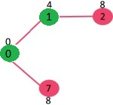
035_03 Prim’s Algorithm
https://www.geeksforgeeks.org/prims-minimum-spanning-tree-mst-greedy-algo-5/
Prim’s Algorithm
Step 2:
Pick the vertex with minimum key value and which is not already included in the MST (not in mstSet).
The vertex 1 is picked and added to mstSet.
So mstSet now becomes {0, 1}.
Update the key values of adjacent vertices of 1.
The key value of vertex 2 becomes 8.

Slide 7
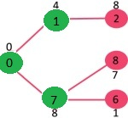
035_03 Prim’s Algorithm
https://www.geeksforgeeks.org/prims-minimum-spanning-tree-mst-greedy-algo-5/
Prim’s Algorithm
Step 3:
Pick the vertex with minimum key value and which is not already included in the MST (not in mstSet).
We can either pick vertex 7 or vertex 2, let vertex 7 is picked.
So mstSet now becomes {0, 1, 7}.
Update the key values of adjacent vertices of 7.
The key value of vertex 6 and 8 becomes finite (1 and 7 respectively).

Slide 8
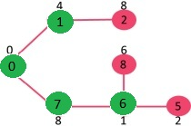
035_03 Prim’s Algorithm
https://www.geeksforgeeks.org/prims-minimum-spanning-tree-mst-greedy-algo-5/
Prim’s Algorithm
Step 4:
Pick the vertex with minimum key value and not already included in MST (not in mstSet).
Vertex 6 is picked. So mstSet now becomes {0, 1, 7, 6}.
Update the key values of adjacent vertices of 6.
The key value of vertex 5 and 8 are updated.

Slide 9
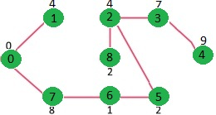
035_03 Prim’s Algorithm
https://www.geeksforgeeks.org/prims-minimum-spanning-tree-mst-greedy-algo-5/
Prim’s Algorithm
Step 5:
Repeat the above steps until mstSet includes all vertices of given graph.
Finally, we get the following graph.

Slide 10
035_03.1 Prim’s Algorithm: STL Code

Slide 11
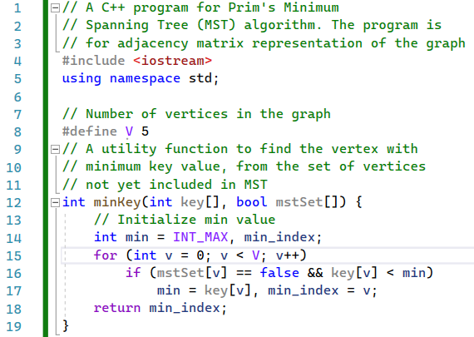
035_03 Prim’s Algorithm
https://www.geeksforgeeks.org/prims-minimum-spanning-tree-mst-greedy-algo-5/
Prim’s STL Code
minKey(): Find the vertex of minimum key value.

Slide 12
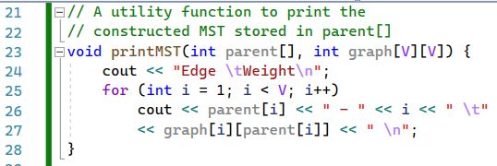
035_03 Prim’s Algorithm
https://www.geeksforgeeks.org/prims-minimum-spanning-tree-mst-greedy-algo-5/
Prim’s STL Code
printMST(): Print the MST.

Slide 13
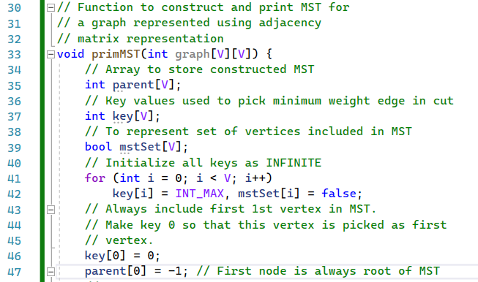
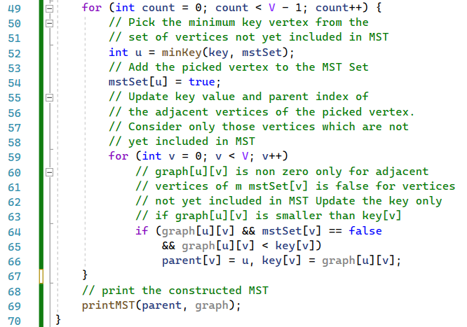
035_03 Prim’s Algorithm
https://www.geeksforgeeks.org/prims-minimum-spanning-tree-mst-greedy-algo-5/
Prim’s STL Code
primMST(): Construct MST

Slide 14
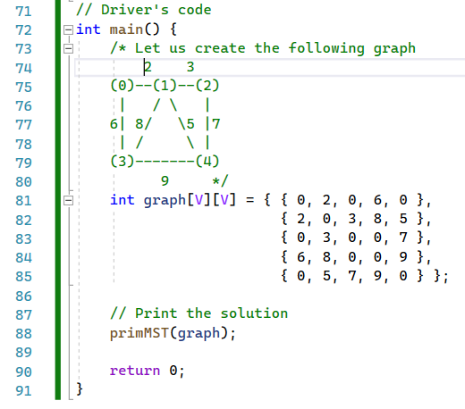
035_03 Prim’s Algorithm
https://www.geeksforgeeks.org/prims-minimum-spanning-tree-mst-greedy-algo-5/
Prim’s STL Code
main():
graph[0][0] = 0, graph[0][1] = 2, graph[0][3] = 6,
graph[1][0] = 2, graph[1][2] = 3,
graph[1][3] = 8,
graph[1][4] = 5,
….

Slide 15
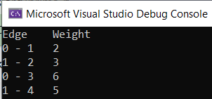
035_03 Prim’s Algorithm
https://www.geeksforgeeks.org/prims-minimum-spanning-tree-mst-greedy-algo-5/
Prim’s STL Code
Result

Slide 16
End

