Slide 1

033_01 Binary Search Tree: C
Peter H. Chen

Slide 2
033_01 Binary Search Tree: C
https://www.tutorialspoint.com/data_structures_algorithms/binary_search_tree.htm
Binary Search Tree: C
A Binary Search Tree (BST) is a tree in which all the nodes follow the below-mentioned properties −
The value of the key to the left sub-tree is less than the value of its parent (root) node's key.
The value of the key to the right sub-tree is greater than or equal to the value of its parent (root) node's key
Thus, BST divides all its sub-trees into two segments; the left sub-tree and the right sub-tree and can be defined as −

Slide 3
033_01.1 Representation

Slide 4
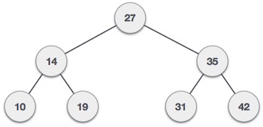
033_01.1 Representation
https://www.tutorialspoint.com/data_structures_algorithms/binary_search_tree.htm
Representation
BST is a collection of nodes arranged in a way where they maintain BST properties.
Each node has a key and an associated value.
While searching, the desired key is compared to the keys in BST and if found, the associated value is retrieved.
Following diagram is a representation of BST.
We observe that the root node key (27) has all less-valued keys on the left sub-tree and the higher valued keys on the right sub-tree.

Slide 5
033_01.2 Basic Operation

Slide 6
033_01.2 Basic Operation
https://www.tutorialspoint.com/data_structures_algorithms/binary_search_tree.htm
Basic Operation
The Following are the basic operations of a tree −
Search − Searches an element in a tree.
Insert − Inserts an element in a tree.
Pre-order Traversal − Traverses a tree in a pre-order manner.
In-order Traversal − Traverses a tree in an in-order manner.
Post-order Traversal − Traverses a tree in a post-order manner.

Slide 7
033_01.3 Node

Slide 8
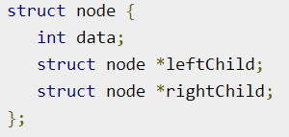
033_01.3 Node
https://www.tutorialspoint.com/data_structures_algorithms/binary_search_tree.htm
Node
Define a node having some data, references to its left and right child nodes.

Slide 9
033_01.4 Search Operation

Slide 10
033_01.4 Search Operation
https://www.tutorialspoint.com/data_structures_algorithms/binary_search_tree.htm
Search Operation
Whenever an element is to be searched, start searching from the root node.
Then if the data is less than the key value, search for the element in the left subtree.
Otherwise, search for the element in the right subtree.

Slide 11
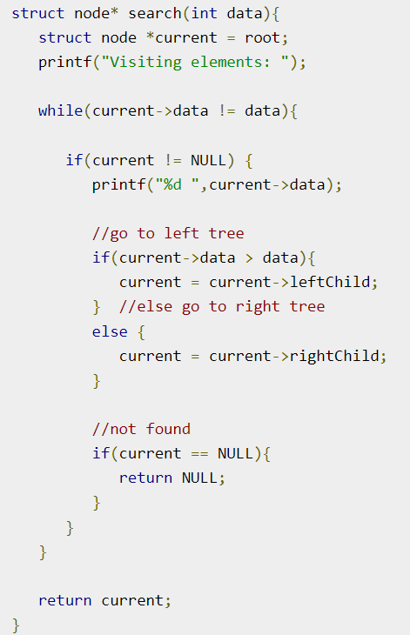
033_01.4 Search Operation
https://www.tutorialspoint.com/data_structures_algorithms/binary_search_tree.htm
Algorithm
Follow the same algorithm for each node.

Slide 12
033_01.5 Insert Operation

Slide 13
033_01.5 Insert Operation
https://www.tutorialspoint.com/data_structures_algorithms/binary_search_tree.htm
Insert Operation
Whenever an element is to be inserted, first locate its proper location.
Start searching from the root node, then if the data is less than the key value, search for the empty location in the left subtree and insert the data.
Otherwise, search for the empty location in the right subtree and insert the data.

Slide 14
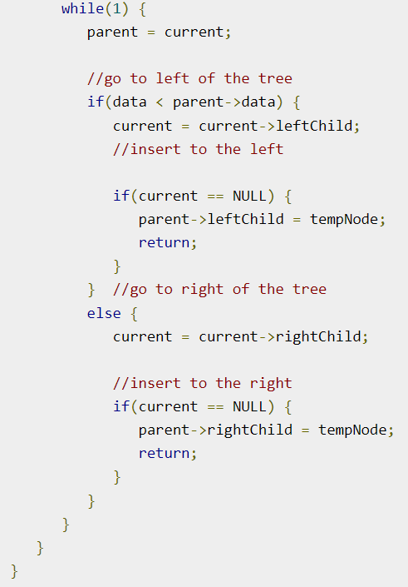
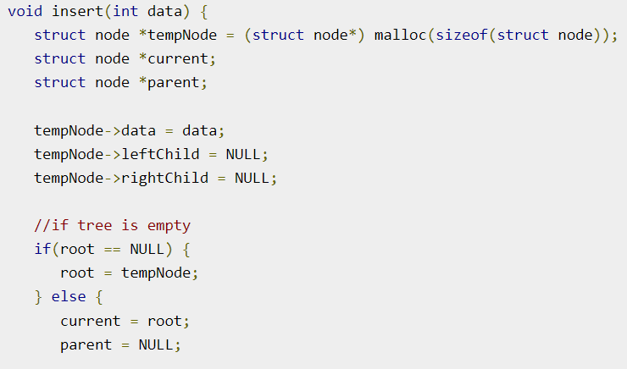
033_01.5 Insert Operation
https://www.tutorialspoint.com/data_structures_algorithms/binary_search_tree.htm
Algorithm

Slide 15
033_01.6 Binary Search Tree: C Code

Slide 16
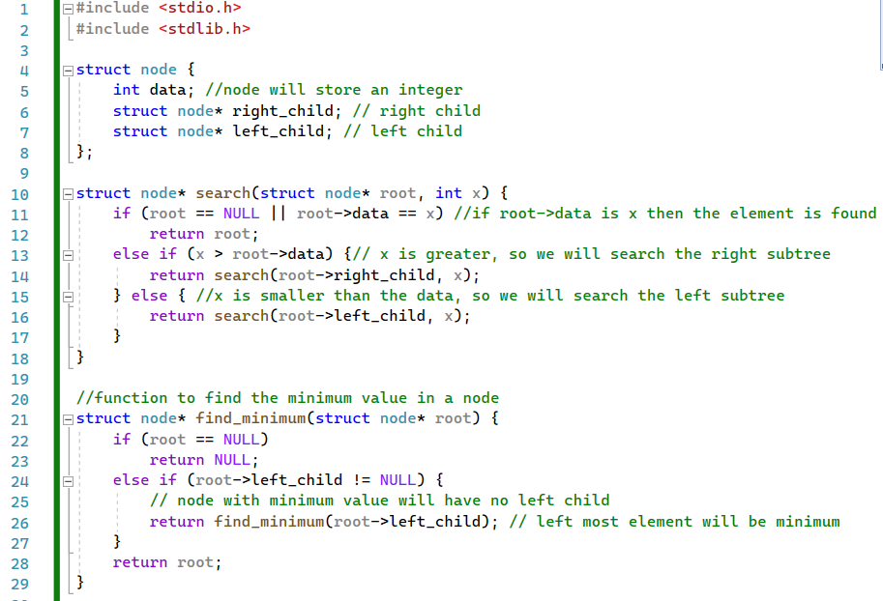
033_01.6 Binary Search Tree: C Code
https://www.codesdope.com/blog/article/binary-search-tree-in-c/
Binary Search Tree: C Code
Define node, search(), find_minimum().

Slide 17
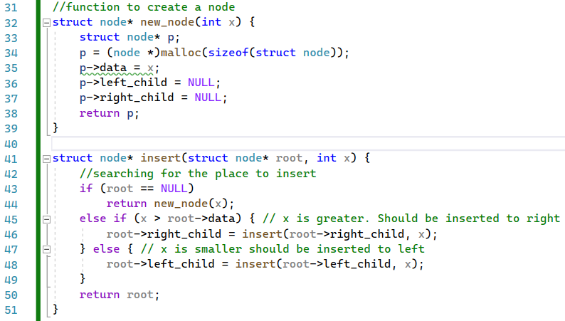
033_01.6 Binary Search Tree: C Code
https://www.codesdope.com/blog/article/binary-search-tree-in-c/
Binary Search Tree: C Code
new_node(), insert()

Slide 18
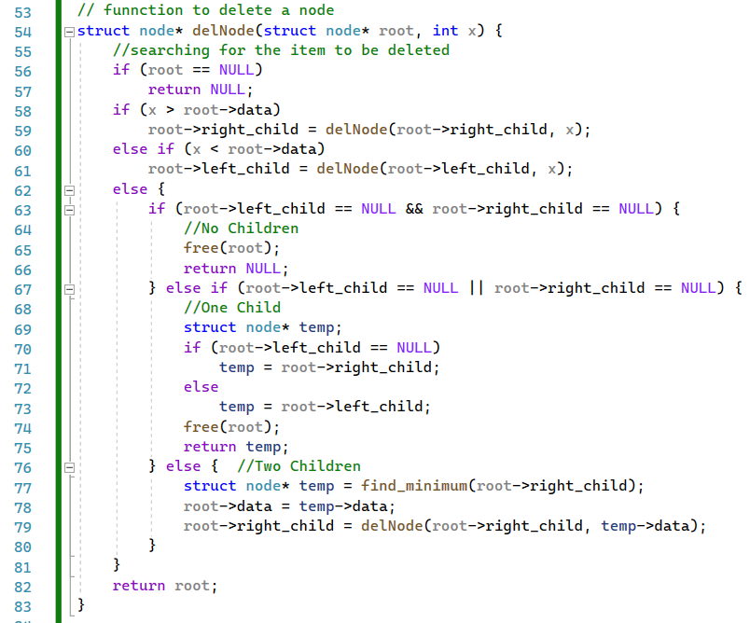
033_01.6 Binary Search Tree: C Code
https://www.codesdope.com/blog/article/binary-search-tree-in-c/
Binary Search Tree: C Code
delNode()

Slide 19
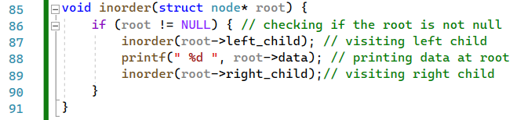
033_01.6 Binary Search Tree: C Code
https://www.codesdope.com/blog/article/binary-search-tree-in-c/
Binary Search Tree: C Code
inorder()

Slide 20
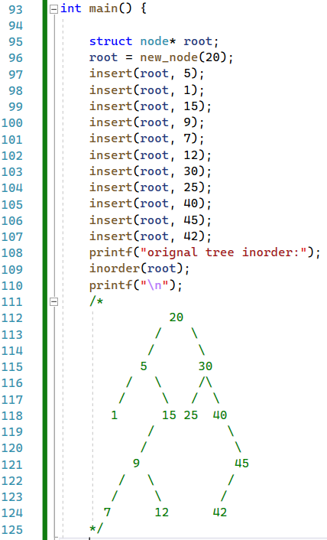
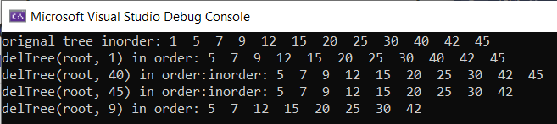
033_01.6 Binary Search Tree: C Code
https://www.codesdope.com/blog/article/binary-search-tree-in-c/
Binary Search Tree: C Code
Create Tree inorder:
(5) 20 (30) => (1, 5, (15)) 20 (25, 30, (40))
=> 1, 5, ((9), 15), 20, 25, 30, 42, 45
=> 1, 5, 7, 9, 12, 15, 20, 25, 30, 40, 42, 45
20
5
30
1
15
25
40
9
45
7
12
42

Slide 21
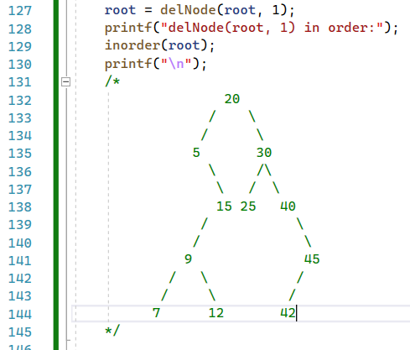
033_01.6 Binary Search Tree: C Code
https://www.codesdope.com/blog/article/binary-search-tree-in-c/
Binary Search Tree: C Code
Delete Node 1

Slide 22
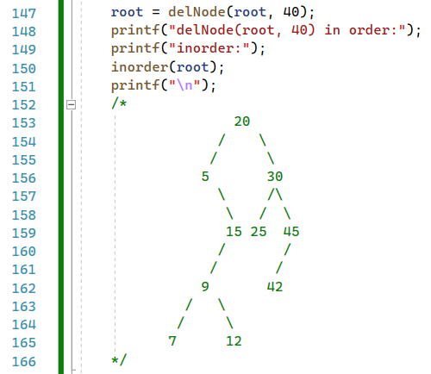
033_01.6 Binary Search Tree: C Code
https://www.codesdope.com/blog/article/binary-search-tree-in-c/
Binary Search Tree: C Code
Delete Node 1

Slide 23
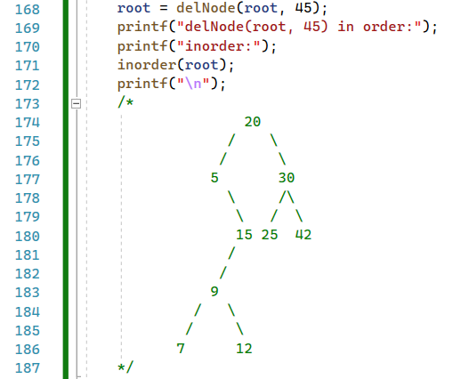
033_01.6 Binary Search Tree: C Code
https://www.codesdope.com/blog/article/binary-search-tree-in-c/
Binary Search Tree: C Code
Delete Node 1

Slide 24
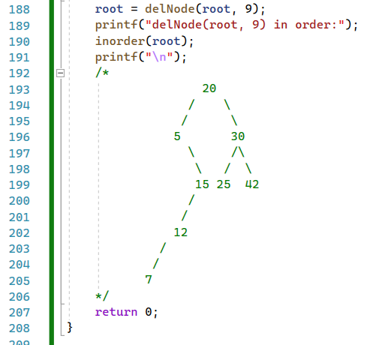
033_01.6 Binary Search Tree: C Code
https://www.codesdope.com/blog/article/binary-search-tree-in-c/
Binary Search Tree: C Code
Delete Node 1

Slide 25
033_01.6 Binary Search Tree: C Code
https://www.codesdope.com/blog/article/binary-search-tree-in-c/
Binary Search Tree: C Code

Slide 26
End

