Slide 1

034_01 AVL Tree: C
Peter H. Chen

Slide 2
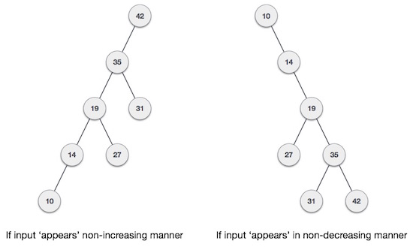
034_01 AVL Tree: C
https://www.tutorialspoint.com/data_structures_algorithms/avl_tree_algorithm.htm
AVL Tree: C
What if the input to binary search tree comes in a sorted (ascending or descending) manner?
It will then look like this.

Slide 3
034_01 AVL Tree: C
https://www.tutorialspoint.com/data_structures_algorithms/avl_tree_algorithm.htm
AVL Tree: C
It is observed that BST's worst-case performance is closest to linear search algorithms, that is Ο(n).
In real-time data, we cannot predict data pattern and their frequencies.
So, a need arises to balance out the existing BST.
The AVL Tree is named after their inventor Adelson, Velski, Landis.
AVL trees are height balancing binary search tree.
AVL tree checks the height of the left and the right sub-trees and assures that the difference is not more than 1.
This difference is called the Balance Factor.

Slide 4
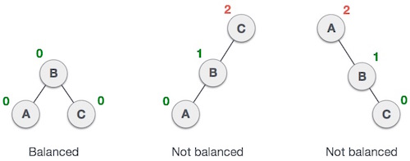
034_01 AVL Tree: C
https://www.tutorialspoint.com/data_structures_algorithms/avl_tree_algorithm.htm
AVL Tree: C
Here, we see that the first tree is balanced, and the next two trees are not balanced.
In the second tree, the left subtree of C has height 2 and the right subtree has height 0, so the difference is 2.
In the third tree, the right subtree of A has height 2 and the left is missing, so it is 0, and the difference is 2 again.
AVL tree permits difference (balance factor) to be only 1.

Slide 5
034_01 AVL Tree: C
https://www.tutorialspoint.com/data_structures_algorithms/avl_tree_algorithm.htm
AVL Tree: C
If the difference in the height of left and right sub-trees is more than 1, the tree is balanced using some rotation techniques.

Slide 6
034_01.1 AVL Rotation

Slide 7
034_01.1 AVL Rotation
https://www.tutorialspoint.com/data_structures_algorithms/avl_tree_algorithm.htm
AVL Rotation
To balance itself, an AVL tree may perform the following four kinds of rotations −
Left rotation
Right rotation
Left-Right rotation
Right-Left rotation
The first two rotations are single rotations, and the next two rotations are double rotations.
To have an unbalanced tree, we at least need a tree of height 2.
With this simple tree, let's understand them one by one.

Slide 8
034_01.2 Left Rotation

Slide 9
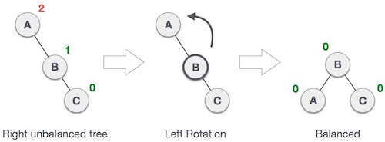
034_01.2 Left Rotation
https://www.tutorialspoint.com/data_structures_algorithms/avl_tree_algorithm.htm
Left Rotation
If a tree becomes unbalanced, when a node is inserted into the right subtree of the right subtree, then we perform a single left rotation
In the below example, node A has become unbalanced as a node is inserted in the right subtree of A's right subtree.
We perform the left rotation by making A the left-subtree of B.

Slide 10
034_01.3 Right Rotation

Slide 11
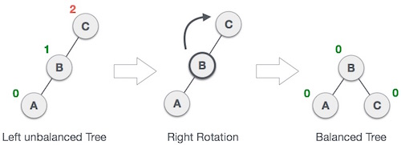
034_01.3 Right Rotation
https://www.tutorialspoint.com/data_structures_algorithms/avl_tree_algorithm.htm
Right Rotation
AVL tree may become unbalanced, if a node is inserted in the left subtree of the left subtree.
The tree then needs a right rotation.
In the below example, the unbalanced node becomes the right child of its left child by performing a right rotation.

Slide 12
034_01.4 Left-Right Rotation

Slide 13
034_01.4 Left-Right Rotation
https://www.tutorialspoint.com/data_structures_algorithms/avl_tree_algorithm.htm
Left-Right Rotation
Double rotations are slightly complex version of already explained versions of rotations.
To understand them better, we should take note of each action performed while rotation.
Let's first check how to perform Left-Right rotation.
A left-right rotation is a combination of left rotation followed by right rotation.

Slide 14

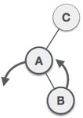
034_01.4 Left-Right Rotation
https://www.tutorialspoint.com/data_structures_algorithms/avl_tree_algorithm.htm
Left-Right Rotation
State | Action
 | A node has been inserted into the right subtree of the left subtree. This makes C an unbalanced node. These scenarios cause AVL tree to perform left-right rotation.
 | We first perform the left rotation on the left subtree of C. This makes A, the left subtree of B.

Slide 15
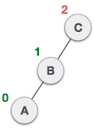
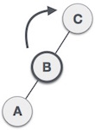
034_01.4 Left-Right Rotation
https://www.tutorialspoint.com/data_structures_algorithms/avl_tree_algorithm.htm
Left-Right Rotation
State | Action
 | Node C is still unbalanced, however now, it is because of the left-subtree of the left-subtree.
 | We shall now right-rotate the tree, making B the new root node of this subtree. C now becomes the right subtree of its own left subtree.

Slide 16
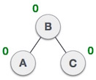
034_01.4 Left-Right Rotation
https://www.tutorialspoint.com/data_structures_algorithms/avl_tree_algorithm.htm
Left-Right Rotation
State | Action
 | The tree is now balanced.

Slide 17
034_01.5 Right-Left Rotation

Slide 18
034_01.5 Right-Left Rotation
https://www.tutorialspoint.com/data_structures_algorithms/avl_tree_algorithm.htm
Right-Left Rotation
The second type of double rotation is Right-Left Rotation.
It is a combination of right rotation followed by left rotation.

Slide 19

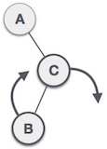
034_01.5 Right-Left Rotation
https://www.tutorialspoint.com/data_structures_algorithms/avl_tree_algorithm.htm
Left-Right Rotation
State | Action
 | A node has been inserted into the left subtree of the right subtree. This makes A, an unbalanced node with balance factor 2.
 | First, we perform the right rotation along C node, making C the right subtree of its own left subtree B. Now, B becomes the right subtree of A.

Slide 20
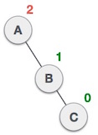
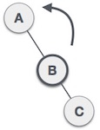
034_01.5 Right-Left Rotation
https://www.tutorialspoint.com/data_structures_algorithms/avl_tree_algorithm.htm
Left-Right Rotation
State | Action
 | Node A is still unbalanced because of the right subtree of its right subtree and requires a left rotation.
 | A left rotation is performed by making B the new root node of the subtree. A becomes the left subtree of its right subtree B.

Slide 21
034_01.5 Right-Left Rotation
https://www.tutorialspoint.com/data_structures_algorithms/avl_tree_algorithm.htm
Left-Right Rotation
State | Action
 | The tree is now balanced.

Slide 22
034_01.6 AVL Tree: C Code

Slide 23
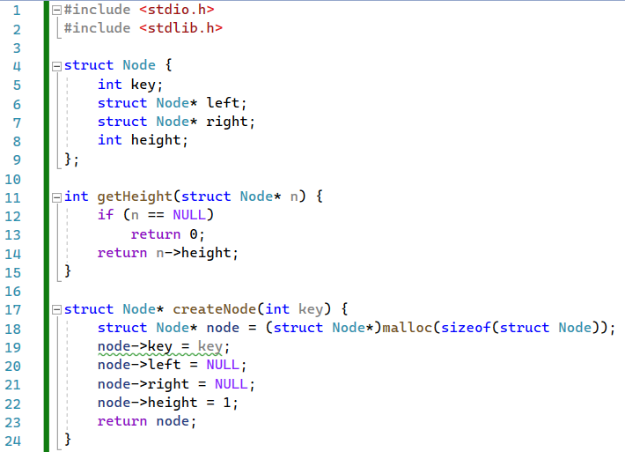
034_01.6 AVL Tree: C Code
https://www.codewithharry.com/videos/data-structures-and-algorithms-in-hindi-82/
AVL Tree: C Code
Node, getHeight(), createNode()

Slide 24
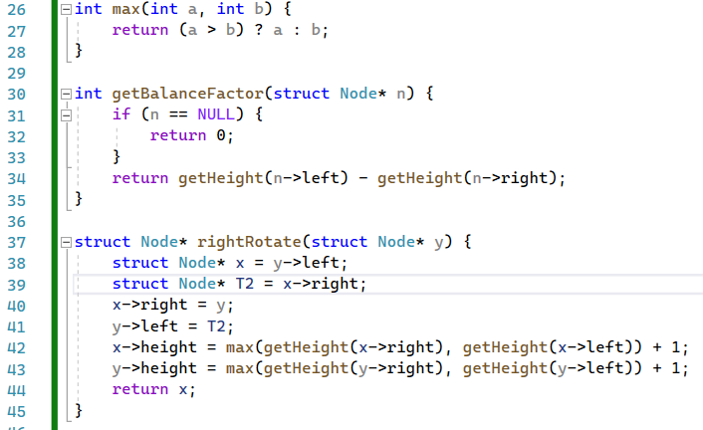
034_01.6 AVL Tree: C Code
https://www.codewithharry.com/videos/data-structures-and-algorithms-in-hindi-82/
AVL Tree: C Code
max(), getBalanceFactor(), rightRotate()

Slide 25
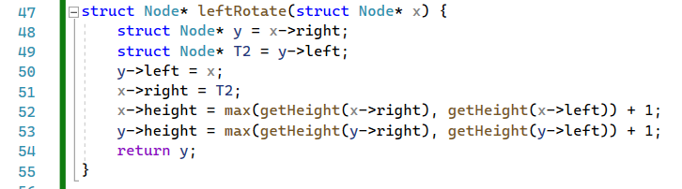
034_01.6 AVL Tree: C Code
https://www.codewithharry.com/videos/data-structures-and-algorithms-in-hindi-82/
AVL Tree: C Code
leftRotate()

Slide 26
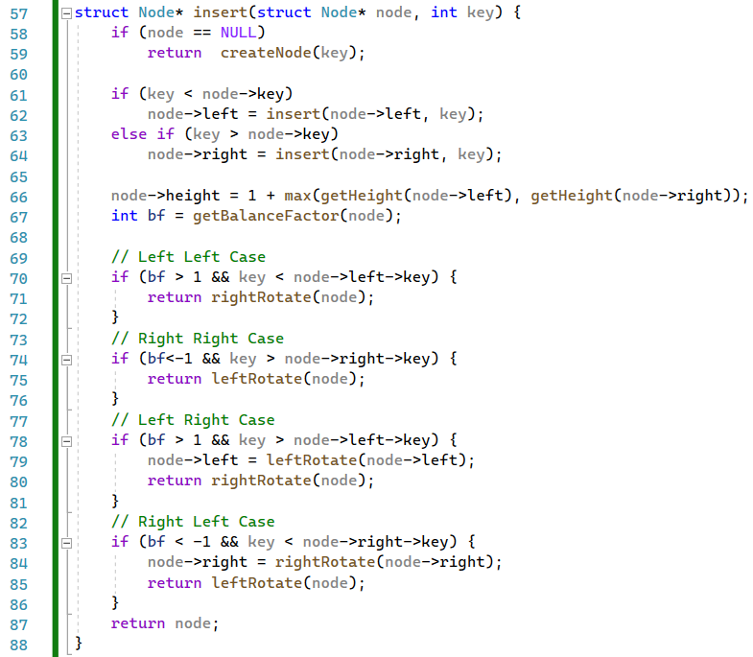
034_01.6 AVL Tree: C Code
https://www.codewithharry.com/videos/data-structures-and-algorithms-in-hindi-82/
AVL Tree: C Code
insert()

Slide 27
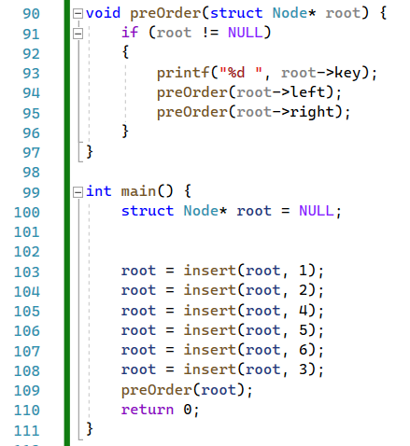
034_01.6 AVL Tree: C Code
https://www.codewithharry.com/videos/data-structures-and-algorithms-in-hindi-82/
AVL Tree: C Code
preOrder(), main()

Slide 28

034_01.6 AVL Tree: C Code
https://www.codewithharry.com/videos/data-structures-and-algorithms-in-hindi-82/
AVL Tree: C Code

Slide 29
End

