Slide 1

034_02 AVL Tree: CPP
Peter H. Chen

Slide 2
034_02 AVL Tree: CPP
https://www.tutorialspoint.com/cplusplus-program-to-implement-avl-tree
AVL Tree: CPP
AVL tree is a self-balancing Binary Search Tree where the difference between heights of left and right subtrees cannot be more than one for all nodes.
Tree rotation is an operation that changes the structure without interfering with the order of the elements on an AVL tree.
It moves one node up in the tree and one node down.
It is used to change the shape of the tree, and to decrease its height by moving smaller subtrees down and larger subtrees up, resulting in improved performance of many tree operations.
The direction of a rotation depends on the side which the tree nodes are shifted upon whilst others say that it depends on which child takes the root’s place.
This is a C++ Program to Implement AVL Tree.

Slide 3
034_02.1 Function Description

Slide 4
034_02.1 Function Description
https://www.tutorialspoint.com/cplusplus-program-to-implement-avl-tree
Function Descriptions:
Height (avl *) : It calculate the height of the given AVL tree.
difference (avl *): It calculate the difference between height of sub trees of given tree
avl * rr_rota t(avl *): A right-right rotation is a combination of right rotation followed by right rotation.
avl * ll_rotat (avl *): A left-left rotation is a combination of left rotation followed by left rotation.

Slide 5
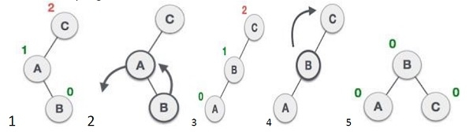
034_02.1 Function Description
https://www.tutorialspoint.com/cplusplus-program-to-implement-avl-tree
Function Descriptions:
avl * lr_rotat (avl*): A left-right rotation is a combination of left rotation followed by right rotation.
Left
Right

Slide 6
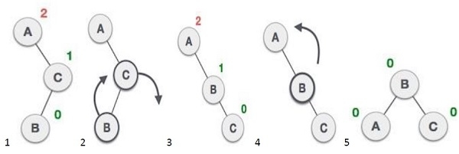
034_02.1 Function Description
https://www.tutorialspoint.com/cplusplus-program-to-implement-avl-tree
Function Descriptions:
avl *rl_rotat (avl *): It is a combination of right rotation followed by left rotation.
Right
Left

Slide 7
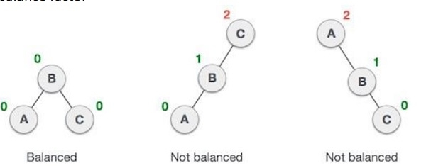
034_02.1 Function Description
https://www.tutorialspoint.com/cplusplus-program-to-implement-avl-tree
Function Descriptions:
avl * balance (avl *): It perform balance operation to the tree by getting balance factor

Slide 8
034_02.1 Function Description
https://www.tutorialspoint.com/cplusplus-program-to-implement-avl-tree
Function Descriptions:
avl * insert (avl*, int): It perform insert operation. Insert values in the tree using this function.
show (avl*, int): It display the values of the tree.
inorder (avl *): Traverses a tree in an in-order manner.
preorder (avl *): Traverses a tree in a pre-order manner.
postorder (avl*): Traverses a tree in a post-order manner

Slide 9
034_02.2 AVL Tree: CPP Code

Slide 10
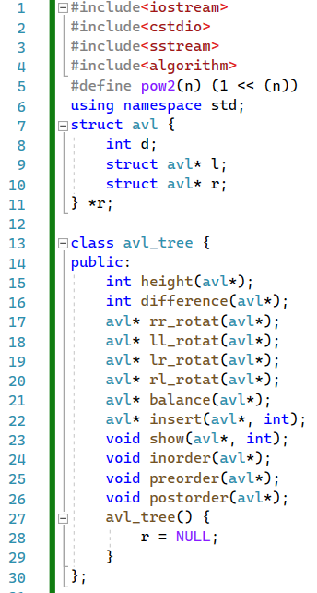
034_02.2 AVL Tree: CPP Code
https://www.tutorialspoint.com/cplusplus-program-to-implement-avl-tree
AVL Tree: CPP Code
Define struct and class avl_tree {}

Slide 11
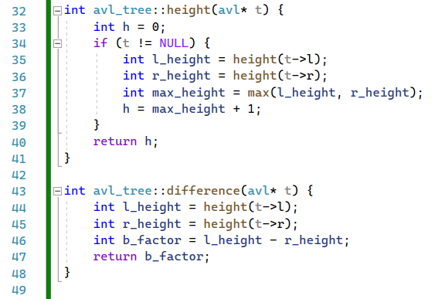
034_02.2 AVL Tree: CPP Code
https://www.tutorialspoint.com/cplusplus-program-to-implement-avl-tree
AVL Tree: CPP Code
height() and difference()

Slide 12
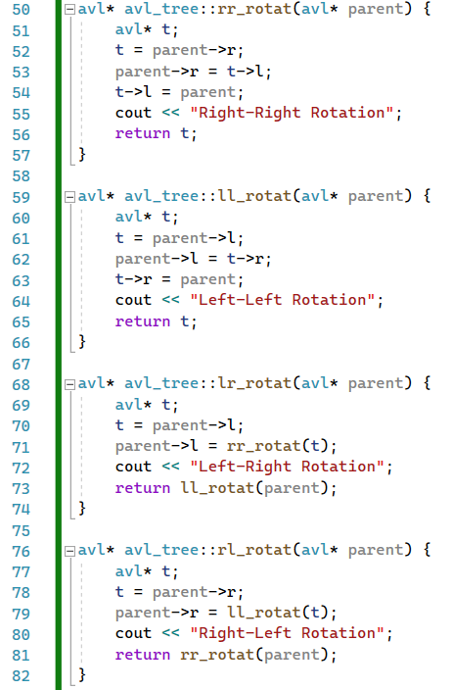
034_02.2 AVL Tree: CPP Code
https://www.tutorialspoint.com/cplusplus-program-to-implement-avl-tree
AVL Tree: CPP Code
rr_rotat(), ll_rotat(), lr_rotat(), rl_rotat()
Left
Right
Right
Left

Slide 13
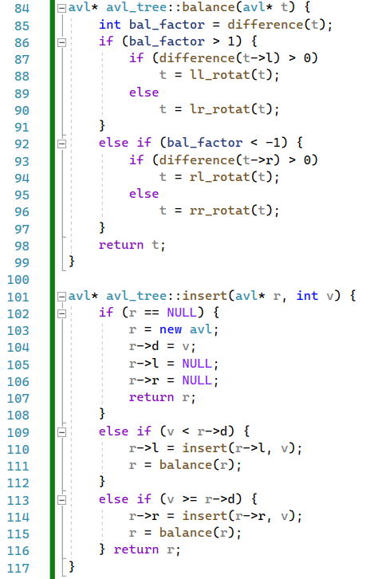
034_02.2 AVL Tree: CPP Code
https://www.tutorialspoint.com/cplusplus-program-to-implement-avl-tree
AVL Tree: CPP Code
balance(), insert()

Slide 14
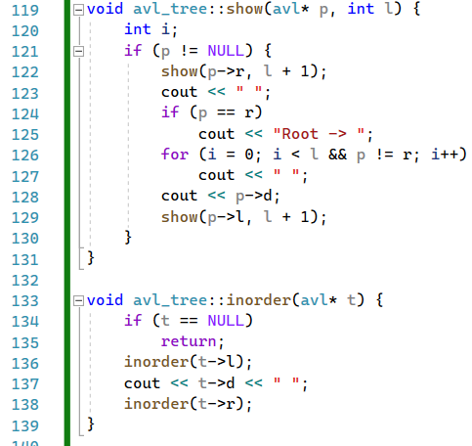
034_02.2 AVL Tree: CPP Code
https://www.tutorialspoint.com/cplusplus-program-to-implement-avl-tree
AVL Tree: CPP Code
show(), inorder()

Slide 15
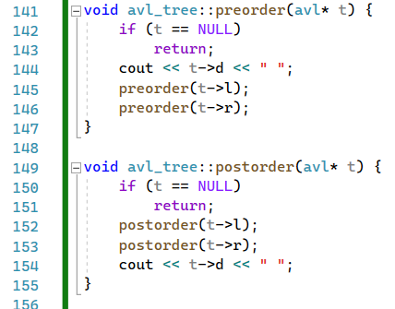
034_02.2 AVL Tree: CPP Code
https://www.tutorialspoint.com/cplusplus-program-to-implement-avl-tree
AVL Tree: CPP Code
preorder(), postorder()

Slide 16
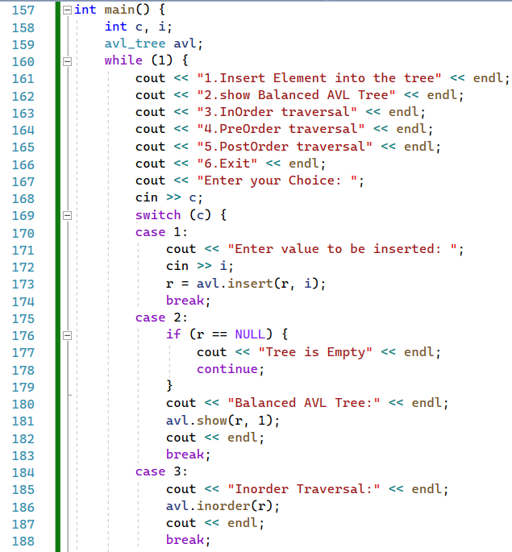
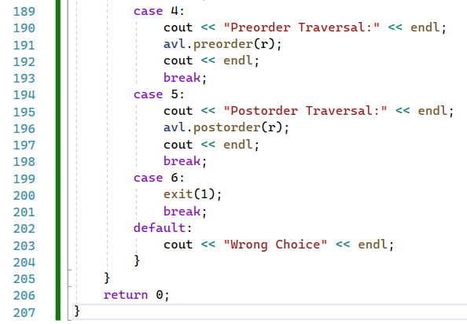
034_02.2 AVL Tree: CPP Code
https://www.tutorialspoint.com/cplusplus-program-to-implement-avl-tree
AVL Tree: CPP Code
main()

Slide 17
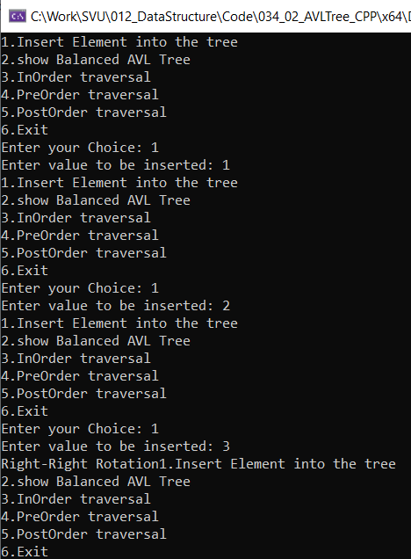
034_02.2 AVL Tree: CPP Code
https://www.tutorialspoint.com/cplusplus-program-to-implement-avl-tree
AVL Tree: CPP Code
Result

Slide 18
End

