Slide 1

017_01 Linear Search: C
Peter H. Chen

Slide 2
017_01 Linear Search: C
https://www.tutorialspoint.com/data_structures_algorithms/linear_search_algorithm.htm
Linear Search: C
Linear search is a very simple search algorithm.
In this type of search, a sequential search is made over all items one by one.
Every item is checked and if a match is found then that particular item is returned, otherwise, the search continues till the end of the data collection.

Slide 3
017_01.1 Linear Search: C Code

Slide 4
017_01.1 Linear Search: C Code
https://www.tutorialspoint.com/data_structures_algorithms/linear_search_algorithm.htm
Linear Search: C Code
int linear_search (list, value) {
int index = 0;
for (auto item: list) {
if (item == value)
return index;
}
index++;
}
return -1;
}

Slide 5
017_01.2 Linear Search in C

Slide 6
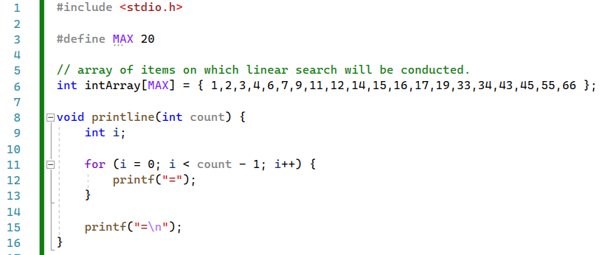
017_01.2 Linear Search in C
https://www.tutorialspoint.com/data_structures_algorithms/linear_search_program_in_c.htm
Linear Search Example in C Code
printline (): print ==============

Slide 7
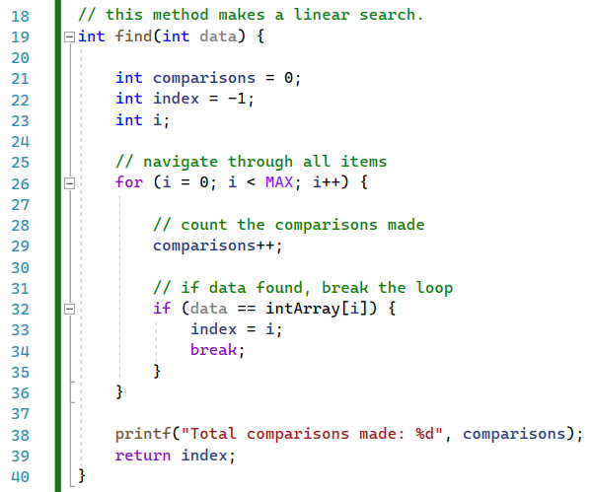
017_01.2 Linear Search in C
https://www.tutorialspoint.com/data_structures_algorithms/linear_search_program_in_c.htm
Linear Search Example in C Code
find()

Slide 8
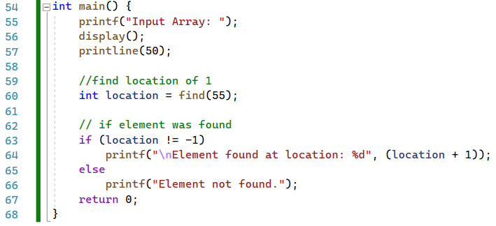
017_01.2 Linear Search in C
https://www.tutorialspoint.com/data_structures_algorithms/linear_search_program_in_c.htm
Linear Search Example in C Code
main()

Slide 9
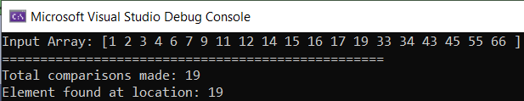
017_01.2 Linear Search in C
https://www.tutorialspoint.com/data_structures_algorithms/linear_search_program_in_c.htm
Linear Search Example in C Code
Result

Slide 10
End

