Slide 1

018_02 Binary Search: STL
Peter H. Chen

Slide 2
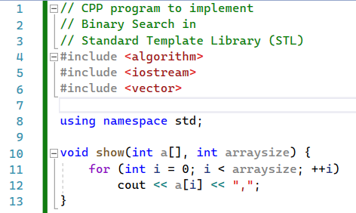
018_02 Binary Search: STL
https://www.geeksforgeeks.org/binary-search-functions-in-c-stl-binary_search-lower_bound-and-upper_bound/
Binary Search: STL
show()

Slide 3
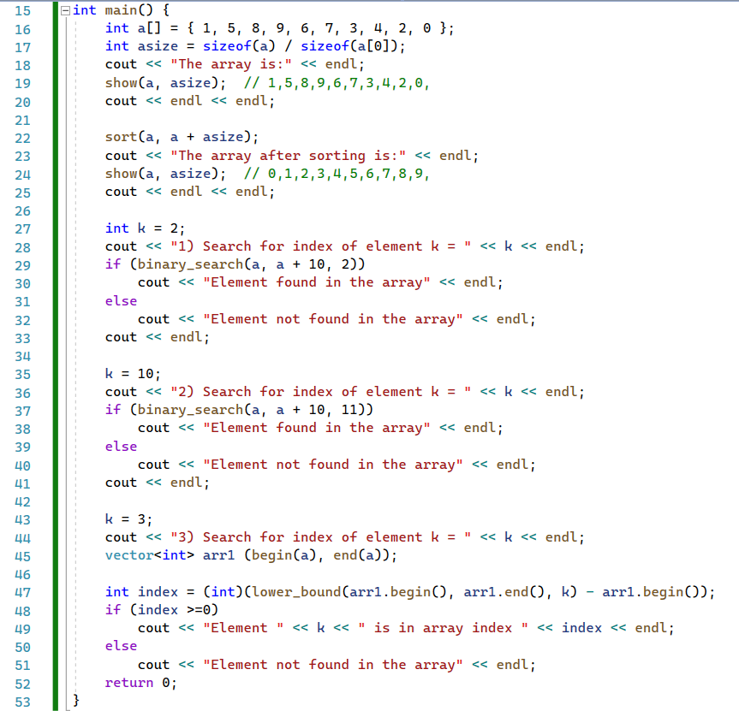
018_02 Binary Search: STL
https://www.geeksforgeeks.org/binary-search-functions-in-c-stl-binary_search-lower_bound-and-upper_bound/
Binary Search: STL
main()

Slide 4
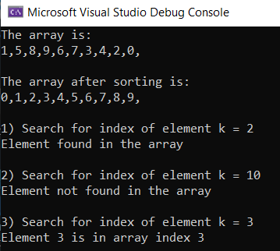
018_02 Binary Search: STL
https://www.geeksforgeeks.org/binary-search-functions-in-c-stl-binary_search-lower_bound-and-upper_bound/
Binary Search: STL
Result

Slide 5
End

