Slide 1

023_02 Insertion Sort: STL
Peter H. Chen

Slide 2
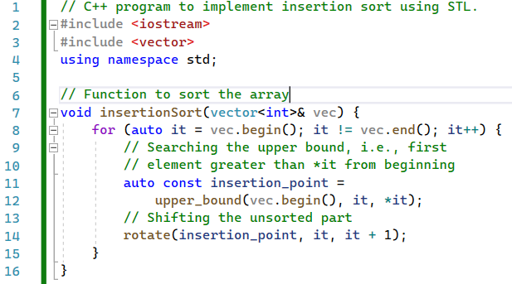
023_02 Insertion Sort: STL
https://www.geeksforgeeks.org/insertion-sort-using-c-stl/
Insertion Sort: STL
insertioSort(): Sorted in each sub-list by using upper_bound() function.

Slide 3
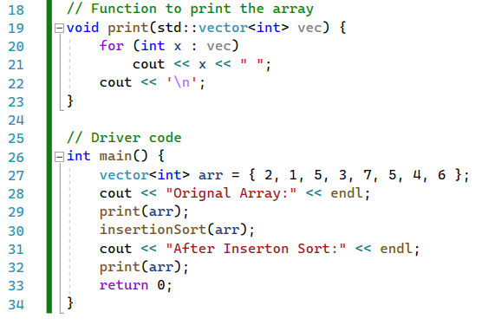
023_02 Insertion Sort: STL
https://www.geeksforgeeks.org/insertion-sort-using-c-stl/
Insertion Sort: STL
print() and main()

Slide 4
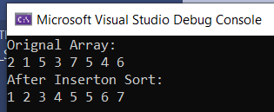
023_02 Insertion Sort: STL
https://www.geeksforgeeks.org/insertion-sort-using-c-stl/
Insertion Sort: STL
Result

Slide 5
End

