Slide 1

026_01 Shell Sort: C
Peter H. Chen

Slide 2
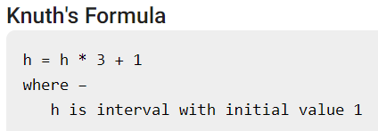
026_01 Shell Sort: C
https://www.tutorialspoint.com/data_structures_algorithms/shell_sort_algorithm.htm
Shell Sort: C
Shell sort is a highly efficient sorting algorithm and is based on insertion sort algorithm.
This algorithm avoids large shifts as in case of insertion sort, if the smaller value is to the far right and has to be moved to the far left.
This algorithm uses insertion sort on a widely spread elements, first to sort them and then sorts the less widely spaced elements.
This spacing is termed as interval.
This interval is calculated based on Knuth's formula as:

Slide 3
026_01 Shell Sort: C
https://www.tutorialspoint.com/data_structures_algorithms/shell_sort_algorithm.htm
Shell Sort: C
This algorithm is quite efficient for medium-sized data sets as its average and worst-case complexity of this algorithm depends on the gap sequence the best known is Ο(n), where n is the number of items.
And the worst-case space complexity is O(n).

Slide 4
026_01.1 How Shell Sort Works?

Slide 5
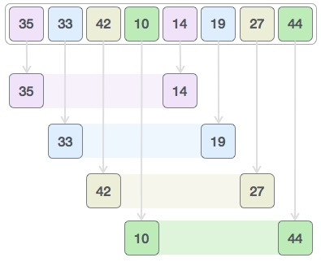
026_01.1 How Shell Sort Works?
https://www.tutorialspoint.com/data_structures_algorithms/shell_sort_algorithm.htm
How Shell Sort Work?
Let us consider the following example to have an idea of how shell sort works.
We take the same array we have used in our previous examples.
For our example and ease of understanding, we take the interval of 4.
Make a virtual sub-list of all values located at the interval of 4 positions.
Here these values are {35, 14}, {33, 19}, {42, 27} and {10, 44}

Slide 6

026_01.1 How Shell Sort Works?
https://www.tutorialspoint.com/data_structures_algorithms/shell_sort_algorithm.htm
How Shell Sort Work?
We compare values in each sub-list and swap them (if necessary) in the original array.
After this step, the new array should look like this

Slide 7
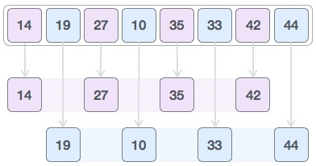
026_01.1 How Shell Sort Works?
https://www.tutorialspoint.com/data_structures_algorithms/shell_sort_algorithm.htm
How Shell Sort Work?
Then, we take interval of 1 and this gap generates two sub-lists - {14, 27, 35, 42}, {19, 10, 33, 44}

Slide 8

026_01.1 How Shell Sort Works?
https://www.tutorialspoint.com/data_structures_algorithms/shell_sort_algorithm.htm
How Shell Sort Work?
We compare and swap the values, if required, in the original array.
After this step, the array should look like this

Slide 9
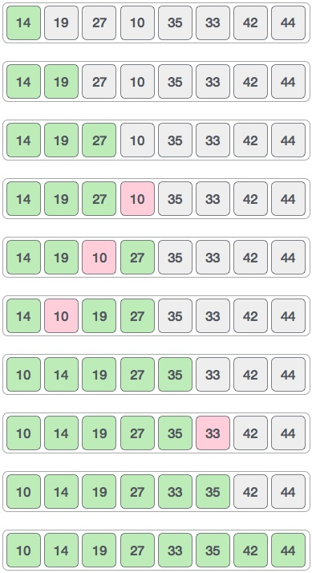
026_01.1 How Shell Sort Works?
https://www.tutorialspoint.com/data_structures_algorithms/shell_sort_algorithm.htm
How Shell Sort Work?
Finally, we sort the rest of the array using interval of value 1. Shell sort uses insertion sort to sort the array.
Following is the step-by-step depiction.
We see that it required only four swaps to sort the rest of the array.

Slide 10
026_01.2 Pseudo Code

Slide 11
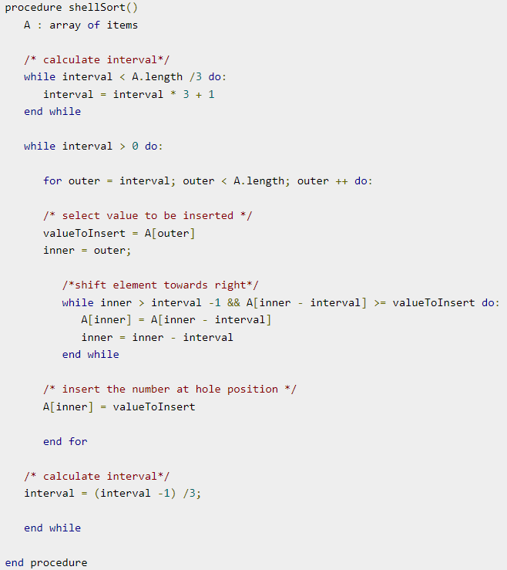
026_01.2 Pseudo Code
https://www.tutorialspoint.com/data_structures_algorithms/shell_sort_algorithm.htm
Pseudo Code

Slide 12
026_01.3 Shell Sort: C

Slide 13
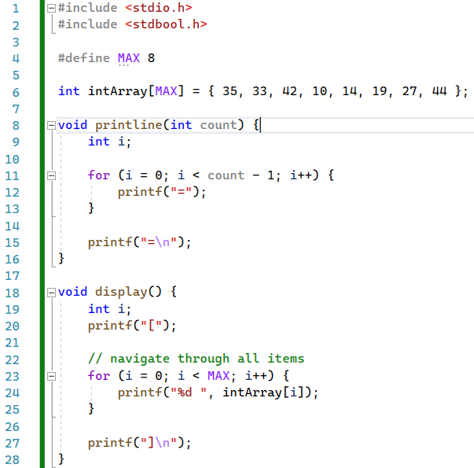
026_01.3 Shell Sort: C
https://www.tutorialspoint.com/data_structures_algorithms/shell_sort_program_in_c.htm
Shell Sort: C
Result

Slide 14
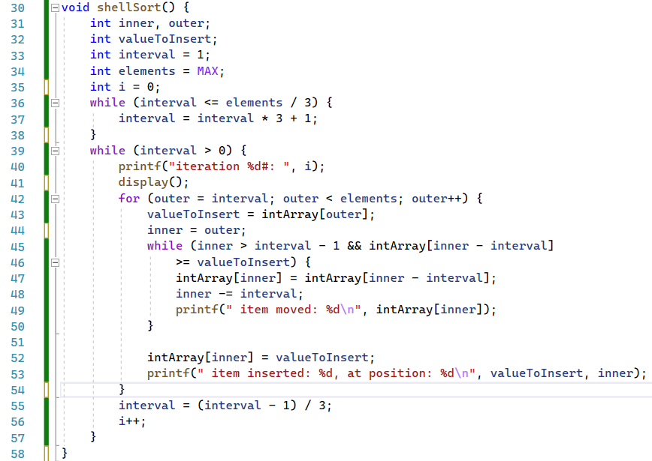
026_01.3 Shell Sort: C
https://www.tutorialspoint.com/data_structures_algorithms/shell_sort_program_in_c.htm
Shell Sort: C
shellSort()

Slide 15
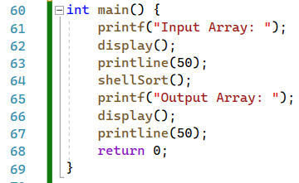
026_01.3 Shell Sort: C
https://www.tutorialspoint.com/data_structures_algorithms/shell_sort_program_in_c.htm
Shell Sort: C
main()

Slide 16
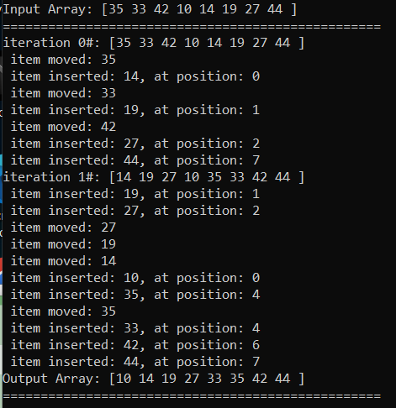
026_01.3 Shell Sort: C
https://www.tutorialspoint.com/data_structures_algorithms/shell_sort_program_in_c.htm
Shell Sort: C
Result

Slide 17
End

