Slide 1

026_02 Shell Sort: CPP
Peter H. Chen

Slide 2
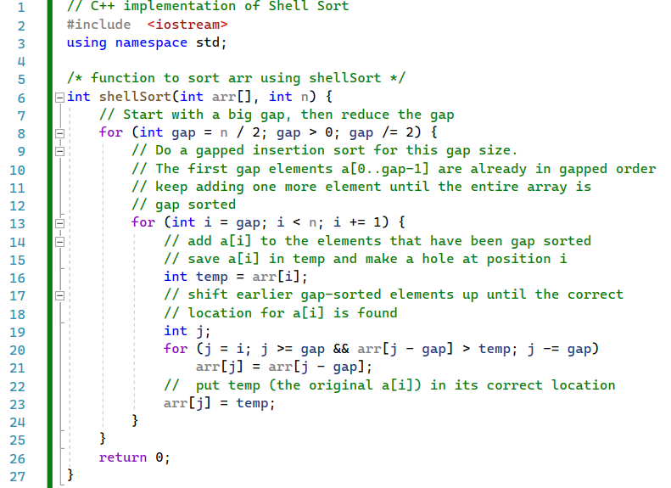
026_02 Shell Sort: CPP
https://www.geeksforgeeks.org/shellsort/
Shell Sort: CPP
shellSort()

Slide 3
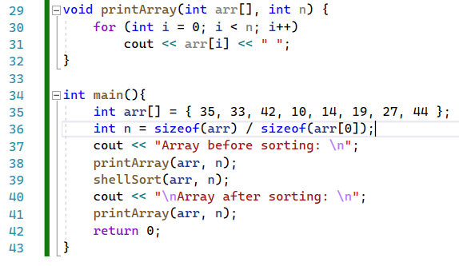
026_02 Shell Sort: CPP
https://www.geeksforgeeks.org/shellsort/
Shell Sort: CPP
printArray() and main()

Slide 4
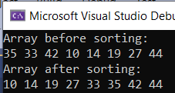
026_02 Shell Sort: CPP
https://www.geeksforgeeks.org/shellsort/
Shell Sort: CPP
Result

Slide 5
End

