Slide 1

025_01 Merge Sort: C
Peter H. Chen

Slide 2
025_01 Merge Sort: C
https://www.tutorialspoint.com/data_structures_algorithms/merge_sort_algorithm.htm
Merge Sort: C
Merge sort is a sorting technique based on divide and conquer technique.
With worst-case time complexity being Ο(n log n), it is one of the most respected algorithms.
Merge sort first divides the array into equal halves and then combines them in a sorted manner.

Slide 3
025_01.1 How Merge Sort Works?

Slide 4


025_01.1 How Merge Sort Works?
https://www.tutorialspoint.com/data_structures_algorithms/merge_sort_algorithm.htm
How Merge Sort Work?
To understand merge sort, we take an unsorted array as the following.
We know that merge sort first divides the whole array iteratively into equal halves unless the atomic values are achieved.
We see here that an array of 8 items is divided into two arrays of size 4.

Slide 5

025_01.1 How Merge Sort Works?
https://www.tutorialspoint.com/data_structures_algorithms/merge_sort_algorithm.htm
How Merge Sort Work?
This does not change the sequence of appearance of items in the original.
Now we divide these two arrays into halves.
We further divide these arrays, and we achieve atomic value which can no more be divided.

Slide 6

025_01.1 How Merge Sort Works?
https://www.tutorialspoint.com/data_structures_algorithms/merge_sort_algorithm.htm
How Merge Sort Work?
Now, we combine them in exactly the same manner as they were broken down.
Please note the color codes given to these lists.
We first compare the element for each list and then combine them into another list in a sorted manner. We see that 14 and 33 are in sorted positions.
We compare 27 and 10 and in the target list of 2 values we put 10 first, followed by 27.
We change the order of 19 and 35 whereas 42 and 44 are placed sequentially.

Slide 7

025_01.1 How Merge Sort Works?
https://www.tutorialspoint.com/data_structures_algorithms/merge_sort_algorithm.htm
How Merge Sort Work?
In the next iteration of the combining phase, we compare lists of two data values, and merge them into a list of found data values placing all in a sorted order.

Slide 8

025_01.1 How Merge Sort Works?
https://www.tutorialspoint.com/data_structures_algorithms/merge_sort_algorithm.htm
How Merge Sort Work?
After the final merging, the list should look like this
Now we will do the programming of merge sorting.

Slide 9
025_01.2 Pseudo Code

Slide 10
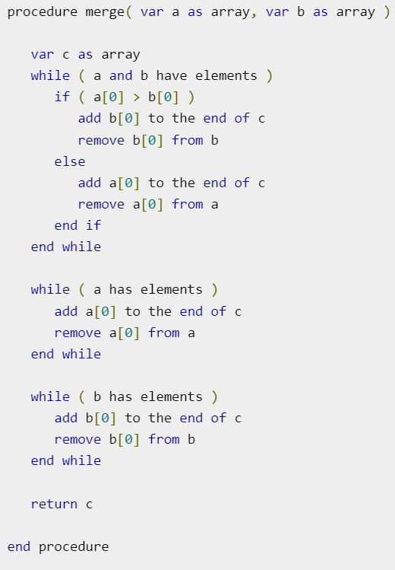
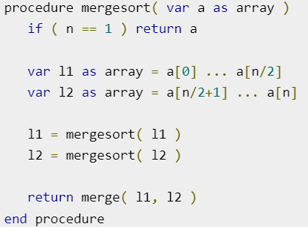
025_01.2 Pseudo Code
https://www.tutorialspoint.com/data_structures_algorithms/merge_sort_algorithm.htm
Pseudo Code
Recursive call itself
Merge l1 and l2 with order

Slide 11
025_01.3 Merge Sort: C Code

Slide 12
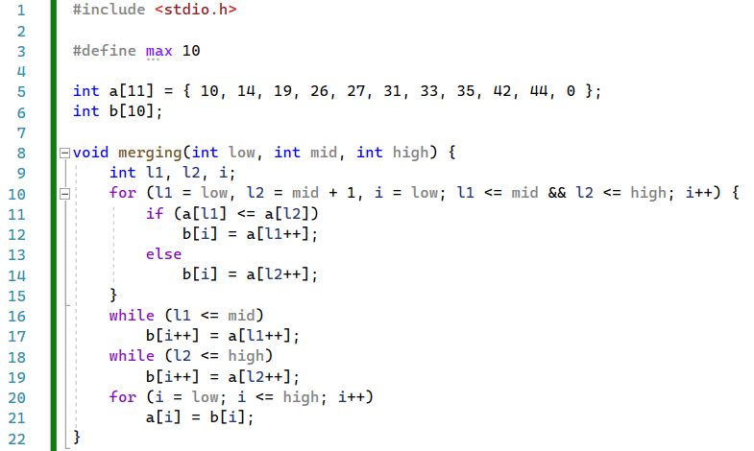
025_01.3 Merge Sort: C Code
https://www.tutorialspoint.com/data_structures_algorithms/merge_sort_algorithm.htm
Merge Sort: C Code

Slide 13
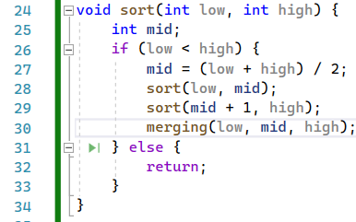
025_01.3 Merge Sort: C Code
https://www.tutorialspoint.com/data_structures_algorithms/merge_sort_algorithm.htm
Merge Sort: C Code
Sort lower
Sort upper
Merge lower and upper

Slide 14
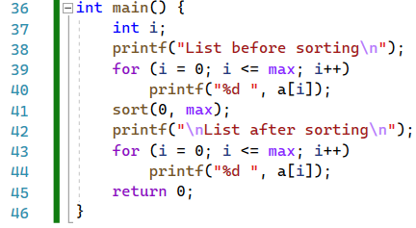
025_01.3 Merge Sort: C Code
https://www.tutorialspoint.com/data_structures_algorithms/merge_sort_algorithm.htm
Merge Sort: C Code

Slide 15
End

