Slide 1

025_02 Merge Sort: STL
Peter H. Chen

Slide 2
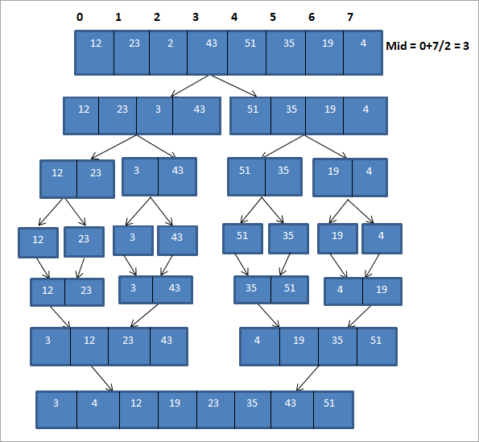
025_02 Merge Sort: STL
https://www.softwaretestinghelp.com/merge-sort/
Merge Sort: STL
Pass | Unsorted list | divide | Sorted list
1 | {12, 23,2,43,51,35,19,4 } | {12,23,2,43} {51,35,19,4} | {}
2 | {12,23,2,43} {51,35,19,4} | {12,23}{2,43} {51,35}{19,4} | {}
3 | {12,23}{2,43} {51,35}{19,4} | {12,23} {2,43} {35,51}{4,19} | {12,23} {2,43} {35,51}{4,19}
4 | {12,23} {2,43} {35,51}{4,19} | {2,12,23,43} {4,19,35,51} | {2,12,23,43} {4,19,35,51}
5 | {2,12,23,43} {4,19,35,51} | {2,4,12,19,23,35,43,51} | {2,4,12,19,23,35,43,51}
6 | {} | {} | {2,4,12,19,23,35,43,51}

Slide 3
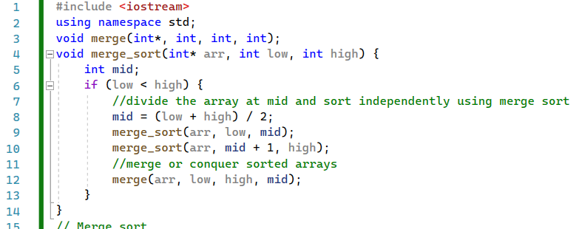
025_02 Merge Sort: STL
https://www.softwaretestinghelp.com/merge-sort/
Merge Sort: STL
merge_sort()

Slide 4
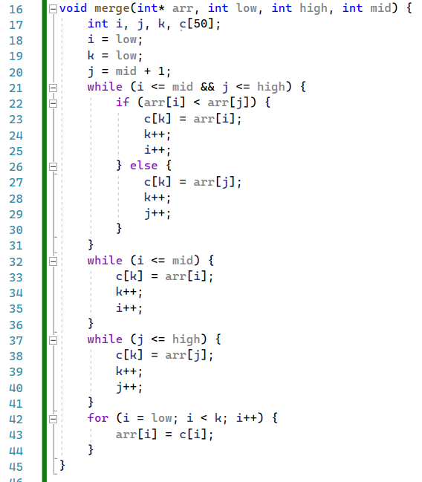
025_02 Merge Sort: STL
https://www.softwaretestinghelp.com/merge-sort/
Merge Sort: STL
merge()

Slide 5
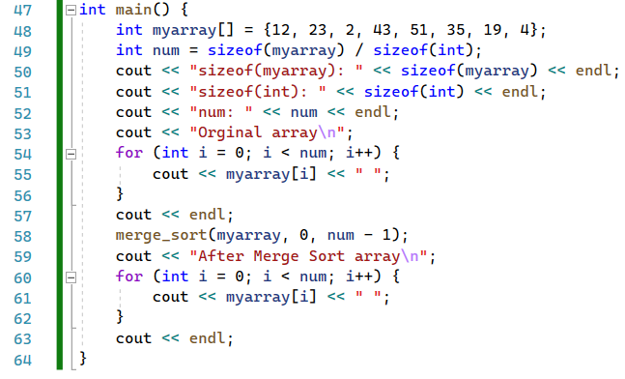
025_02 Merge Sort: STL
https://www.softwaretestinghelp.com/merge-sort/
Merge Sort: STL
main()

Slide 6
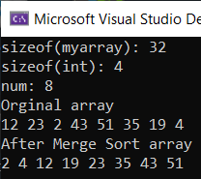
025_02 Merge Sort: STL
https://www.softwaretestinghelp.com/merge-sort/
Merge Sort: STL
Result

Slide 7
End

