Slide 1

027_01 Quick Sort: C
Peter H. Chen

Slide 2
027_01 Quick Sort: C
https://towardsdatascience.com/an-overview-of-quicksort-algorithm-b9144e314a72
Quick Sort: C
Quick sort is a highly efficient sorting algorithm and is based on partitioning of array of data into smaller arrays.
A large array is partitioned into two arrays one of which holds values smaller than the specified value, say pivot, based on which the partition is made, and another array holds values greater than the pivot value.
Quicksort partitions an array and then calls itself recursively twice to sort the two resulting subarrays.
This algorithm is quite efficient for large-sized data sets as its best, average, and worst-case complexity are O(n * log n) , O(n * log n) and O(n²), respectively.

Slide 3
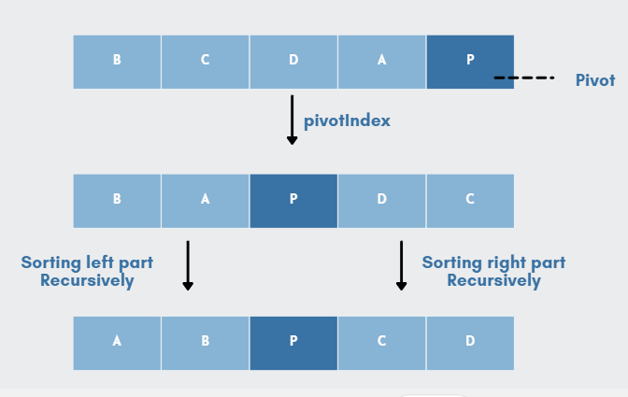
027_01 Quick Sort: C
https://towardsdatascience.com/an-overview-of-quicksort-algorithm-b9144e314a72
Quick Sort: C
Quick Sort is based on divide-and-conquer.

Slide 4
027_01.1 Partition in Quick Sort

Slide 5
027_01.1 Partition in Quick Sort
https://www.tutorialspoint.com/data_structures_algorithms/quick_sort_algorithm.htm
Partition in Quick Sort
Following animated representation explains how to find the pivot value in an array.
Given array = [ 35, 33, 42, 10, 14, 19, 27, 44, 26, 31]
Pivot = 31, low = 35, hi = 26.
35 is greater then pivot 31, move to right and 26 is less than pivot 31, move to left.
Move lo to right of 26 and hi left of 35. …

Slide 6
027_01.1 Partition in Quick Sort
https://www.tutorialspoint.com/data_structures_algorithms/quick_sort_algorithm.htm
Partition in Quick Sort
The pivot value divides the list into two parts.
And recursively, we find the pivot for each sub-lists until all lists contains only one element.

Slide 7
027_01.2 Pseudo Code of Quick Sort

Slide 8
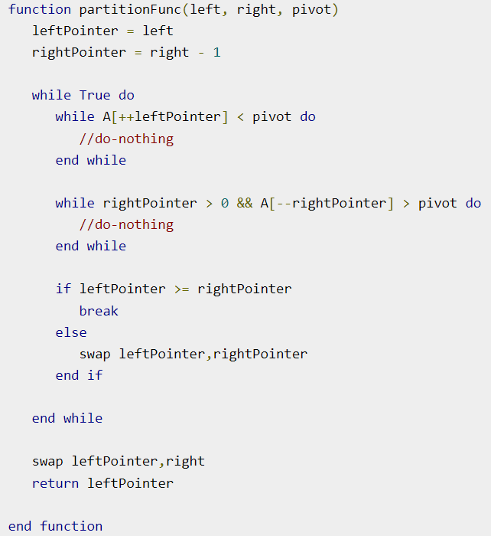
027_01.2 Pseudo Code of Quick Sort
https://www.tutorialspoint.com/data_structures_algorithms/quick_sort_algorithm.htm
Pseudo Code of Quick Sort

Slide 9
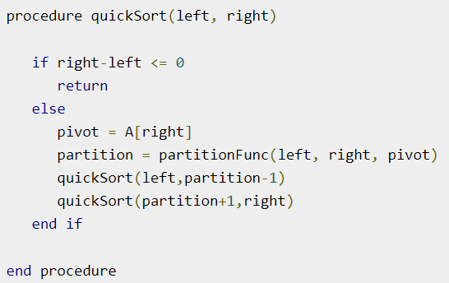
027_01.2 Pseudo Code of Quick Sort
https://www.tutorialspoint.com/data_structures_algorithms/quick_sort_algorithm.htm
Pseudo Code of Quick Sort

Slide 10
027_01.3 Quick Sort: C-Code

Slide 11
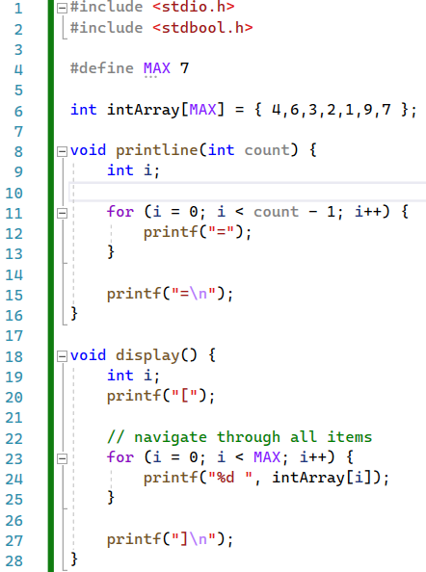
027_01.3 Quick Sort: C-Code
https://www.tutorialspoint.com/data_structures_algorithms/quick_sort_program_in_c.htm
Pseudo Code of Quick Sort

Slide 12
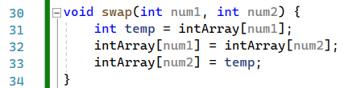
027_01.3 Quick Sort: C-Code
https://www.tutorialspoint.com/data_structures_algorithms/quick_sort_program_in_c.htm
Pseudo Code of Quick Sort

Slide 13
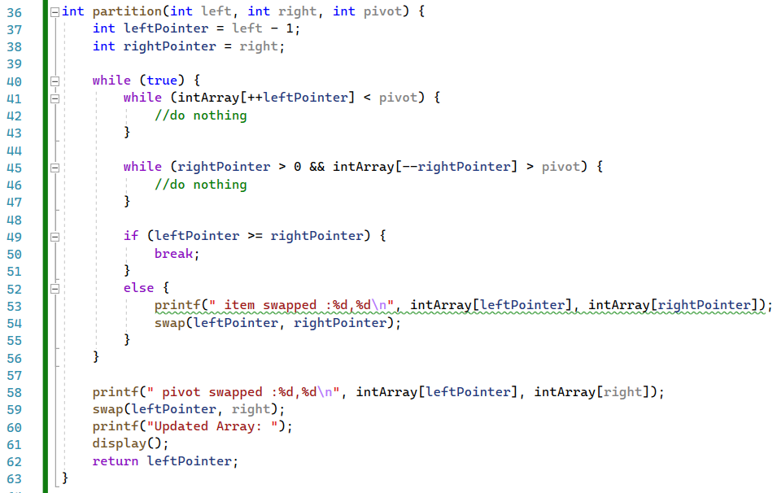
027_01.3 Quick Sort: C-Code
https://www.tutorialspoint.com/data_structures_algorithms/quick_sort_program_in_c.htm
Pseudo Code of Quick Sort

Slide 14
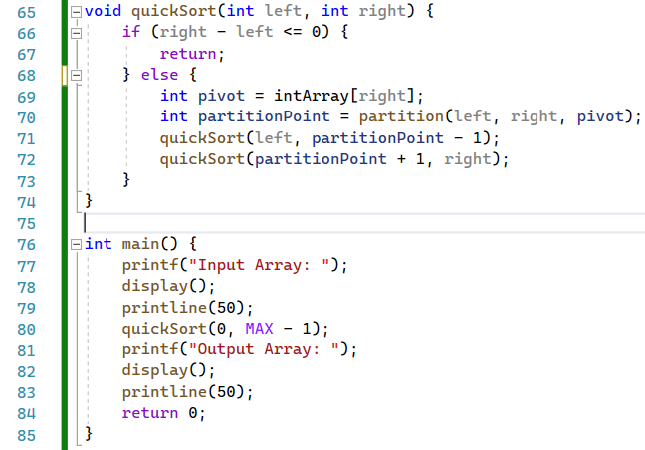
027_01.3 Quick Sort: C-Code
https://www.tutorialspoint.com/data_structures_algorithms/quick_sort_program_in_c.htm
Pseudo Code of Quick Sort

Slide 15
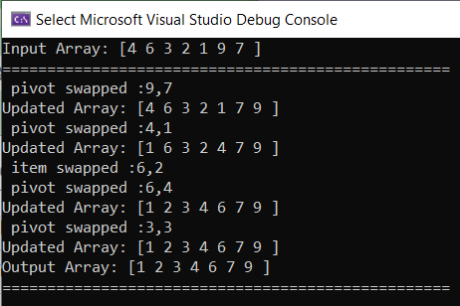
027_01.3 Quick Sort: C-Code
https://www.tutorialspoint.com/data_structures_algorithms/quick_sort_program_in_c.htm
Pseudo Code of Quick Sort

Slide 16
End

