Slide 1

027_02 Quick Sort: CPP
Peter H. Chen

Slide 2
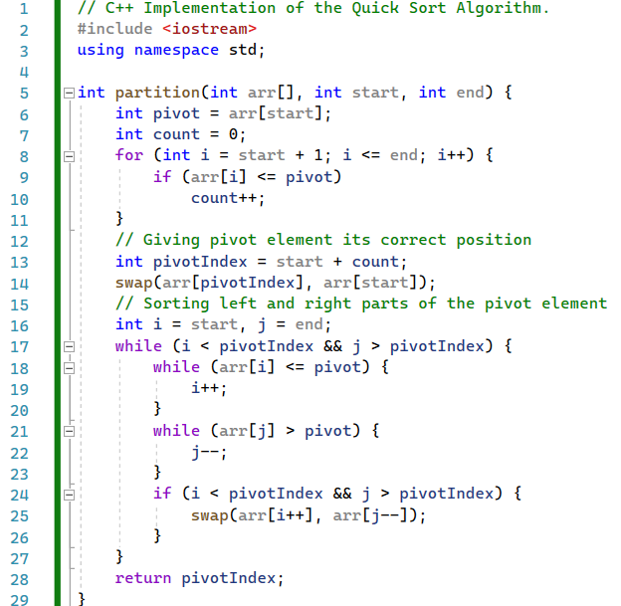
027_02 Quick Sort: CPP
https://www.geeksforgeeks.org/cpp-program-for-quicksort/
Quick Sort: CPP
partition()

Slide 3
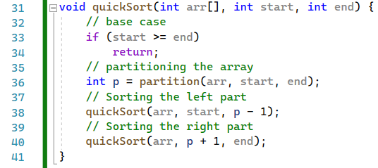
027_02 Quick Sort: CPP
https://www.geeksforgeeks.org/cpp-program-for-quicksort/
Quick Sort: CPP
quicksort()

Slide 4
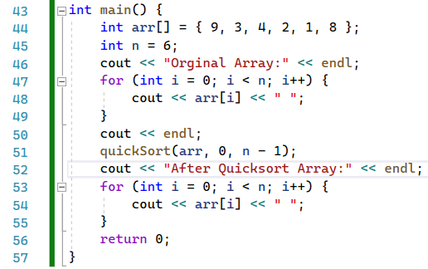
027_02 Quick Sort: CPP
https://www.geeksforgeeks.org/cpp-program-for-quicksort/
Quick Sort: CPP
main()

Slide 5
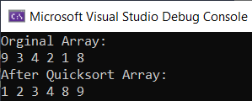
027_02 Quick Sort: CPP
https://www.geeksforgeeks.org/cpp-program-for-quicksort/
Quick Sort: CPP
Result

Slide 6
End

