Slide 1

027_03 Quick Sort: STL
Peter H. Chen

Slide 2
027_03 Quick Sort: STL
https://www.geeksforgeeks.org/c-qsort-vs-c-sort/
Comparison to qsort and sort()
1. Implementation details:
As the name suggests, qsort function uses QuickSort algorithm to sort the given array, although the C standard does not require it to implement quicksort.
C++ sort function uses introsort which is a hybrid algorithm. Different implementations use different algorithms.
The GNU Standard C++ library, for example, uses a 3-part hybrid sorting algorithm: introsort is performed first (introsort itself being a hybrid of quicksort and heap sort) followed by an insertion sort on the result.
2. Complexity :
The C standard doesn’t talk about its complexity of qsort.
The new C++11 standard requires that the complexity of sort to be O(N * log(N)) in the worst case.
Previous versions of C++ such as C++03 allow possible worst-case scenario of O(N^2).
Only average complexity was required to be O(N log N).

Slide 3
027_03 Quick Sort: STL
https://www.geeksforgeeks.org/c-qsort-vs-c-sort/
Comparison to qsort and sort()
3. Running time:
STL’s sort ran faster than C’s qsort, because C++’s templates generate optimized code for a particular data type and a particular comparison function.
STL’s sort runs 20% to 50% faster than the hand-coded quicksort and 250% to 1000% faster than the C qsort library function. C might be the fastest language but qsort is very slow.
When we tried to sort one million integers on C++14, Time taken by C qsort() was 0.247883 sec and time taken by C++ sort() was only 0.086125 sec

Slide 4
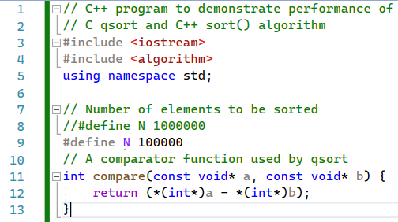
027_03 Quick Sort: STL
https://www.geeksforgeeks.org/c-qsort-vs-c-sort/
Comparison to qsort and sort()
Visual Studio Benchmark: qsort is faster than sort.

Slide 5
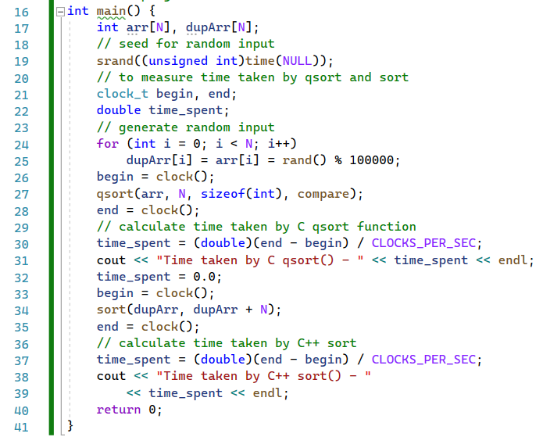
027_03 Quick Sort: STL
https://www.geeksforgeeks.org/c-qsort-vs-c-sort/
Comparison to qsort and sort()
Visual Studio Benchmark: qsort is faster than sort.

Slide 6

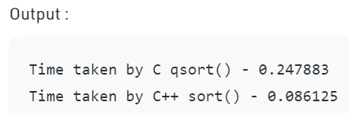
027_03 Quick Sort: STL
https://www.geeksforgeeks.org/c-qsort-vs-c-sort/
Comparison to qsort and sort()
Visual Studio Benchmark: qsort is faster than sort.

Slide 7
End

